Slide 1
Harmful Brain Activity Classification
Clayton Whitteberry

Slide 2
Overview
Multiclass Target (Brain Activity)
Seizure
Lateralized Periodic Discharge
Generalized Periodic Discharge
Lateralized Rhythmic Delta
Generalized Rhythmic Delta
Other
106.8k sub EEGs and sub spectrograms
Sub EEG Dimensions
10k rows by 20 columns
Sub Spectrogram Dimensions
300 rows by 401 columns

Slide 3
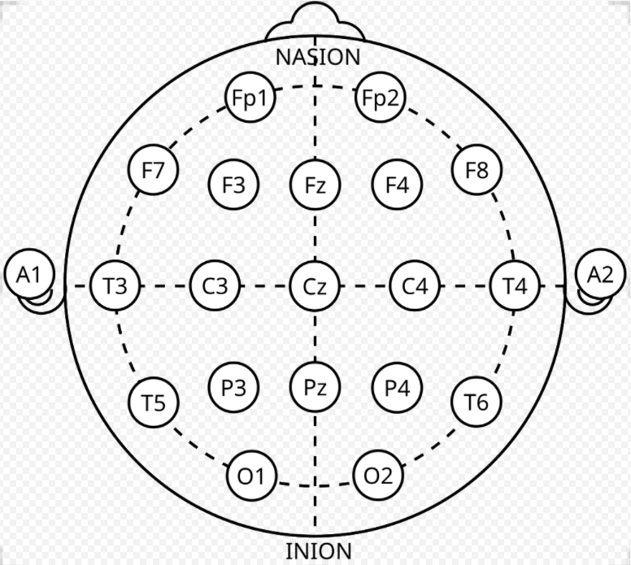
EEG Background
Key Advantage
Non-invasive measure of brain activity that is measured at the speed the brain activity is happening
Key Disadvantage
Electrodes highly sensitive
Pick up broad range of signals inside and outside the brain
Resulting EEG signals can have high amounts of noise

Slide 4
Objective: EEG Preprocessing
Denoising
Principal Component Analysis (PCA)
Independent Component Analysis (ICA)
Frequency Filtering
Dimensionality Reduction
Principal Component Analysis (PCA)
Grouping and Averaging Signals

Slide 5
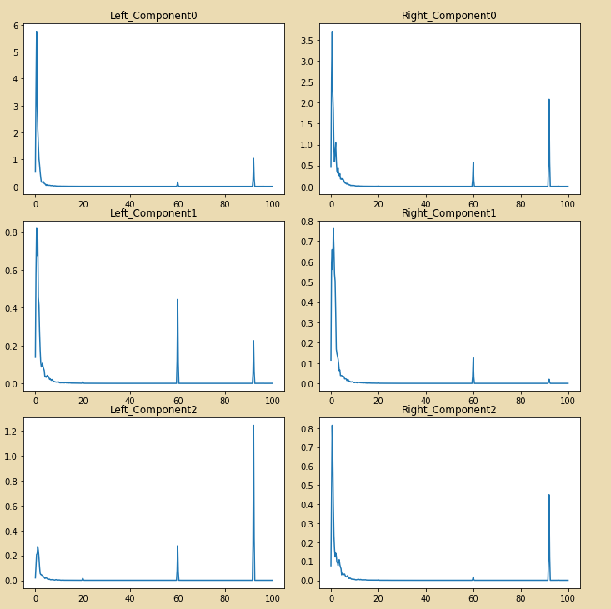
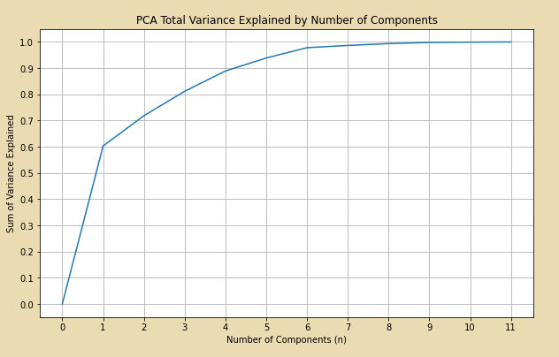
PCA Only (Left/Right Electrodes)
Principal Component Analysis (PCA)
Grouped scalp electrodes by left and right hemisphere
11 in each group
Reduced to 3 components
> 80% variance explained
PCA alone not sufficient to handle denoising
Power line noise (spikes at 60 Hz) still present

Slide 6
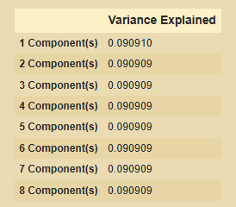
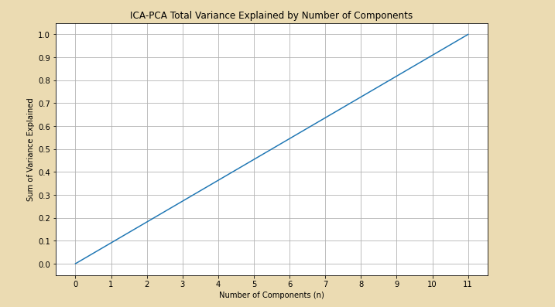
ICA-PCA
Independent Component Analysis (ICA)
ICA prior to PCA hurts PCA results
8 components required to explain more than 70% of variance

Slide 7
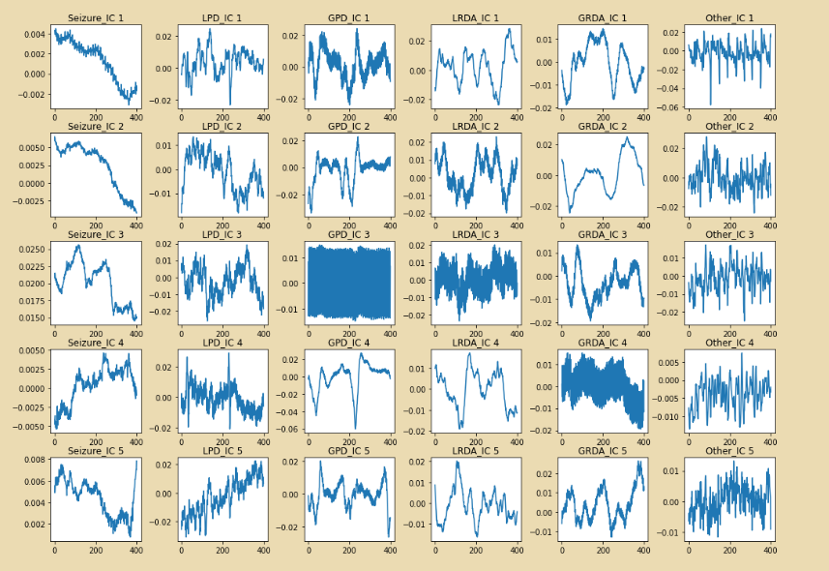
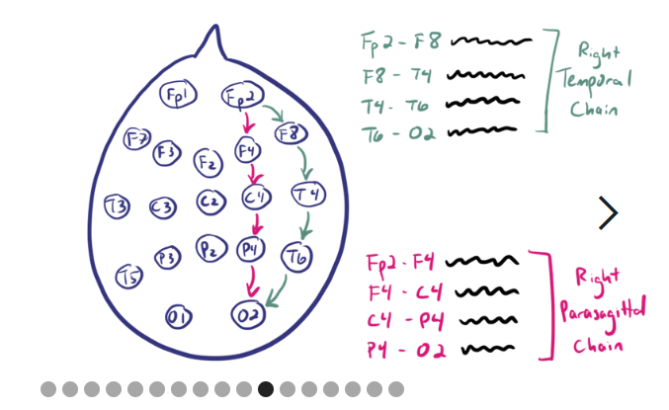
Averaging Signals for ICA
Grouped scalp electrodes according to spectrogram groupings
Right/Left Parasagittal
Right/Left Lateral
Central
Averaged Signals within Groups
Reduces 19 columns to 5
Advantages
Dimensions reduced before ICA
Approach similar to spectrogram generation

Slide 8
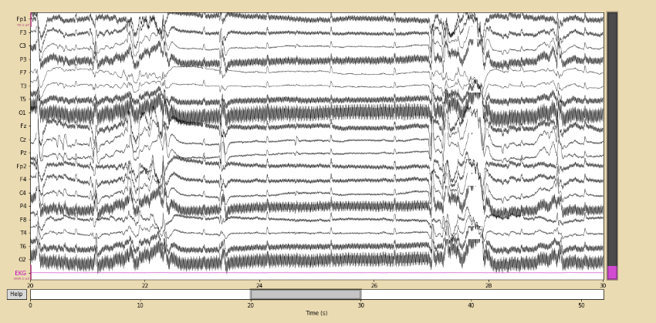
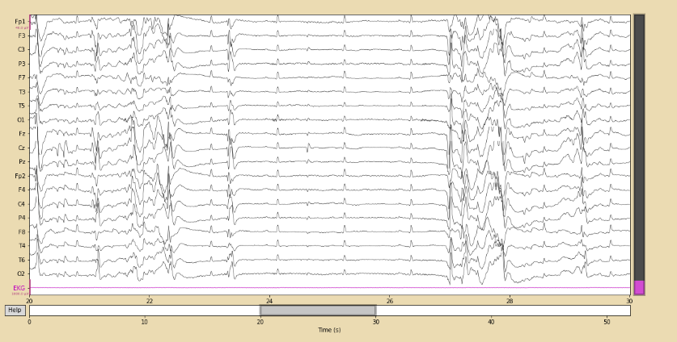
Filtering EEG Signals with MNE
Filters Applied
Low Frequency (1 Hz)
High Frequency (70 Hz)
Notch Filter (60 Hz)

Slide 9
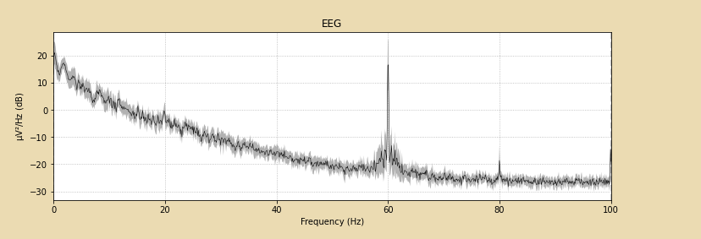
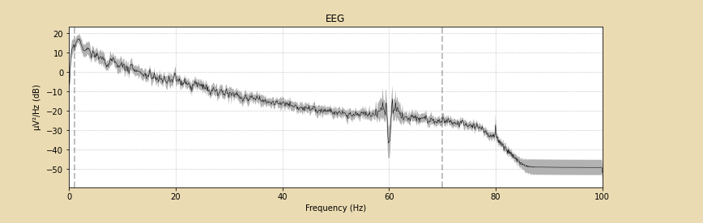
Effects of Filter on Power Spectrum
Notch filter seen clearest
Spike at 60 Hz removed

Slide 10
Capstone II
Finish EEG preprocessing
Evaluate/Improve Filtering Results
ICA artifact repair/removal
Feature Extraction
Time-Frequency Analysis
Non-Linear Analysis
Modeling
Ensemble approach

Slide 11
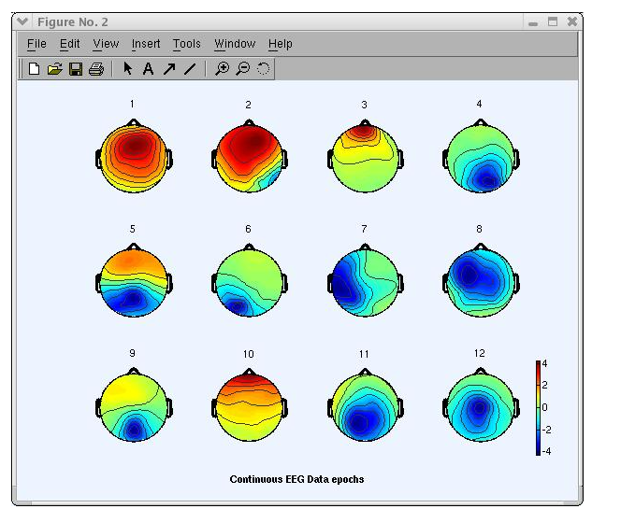
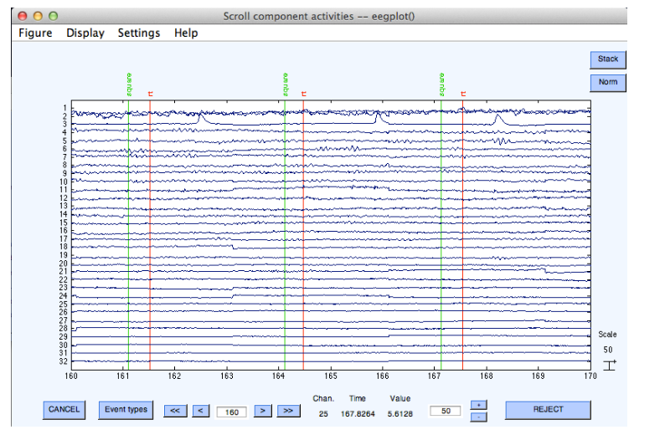
ICA Artifact Detection
Example
Blink Artifact Detection

Slide 12
Feature Extraction
Time-Frequency
Short-time Fourier Transform
Wavelet Transform
Frequency Band Power
Nonlinear
Higher Order Spectra
Approximate Entropy
Noise Immunity
Measure of Regularity

Slide 13
Modeling
Common Models
Random Forest
Alternative
XGBoost
Used for seizure specific tasks
SVM

