Slide 1
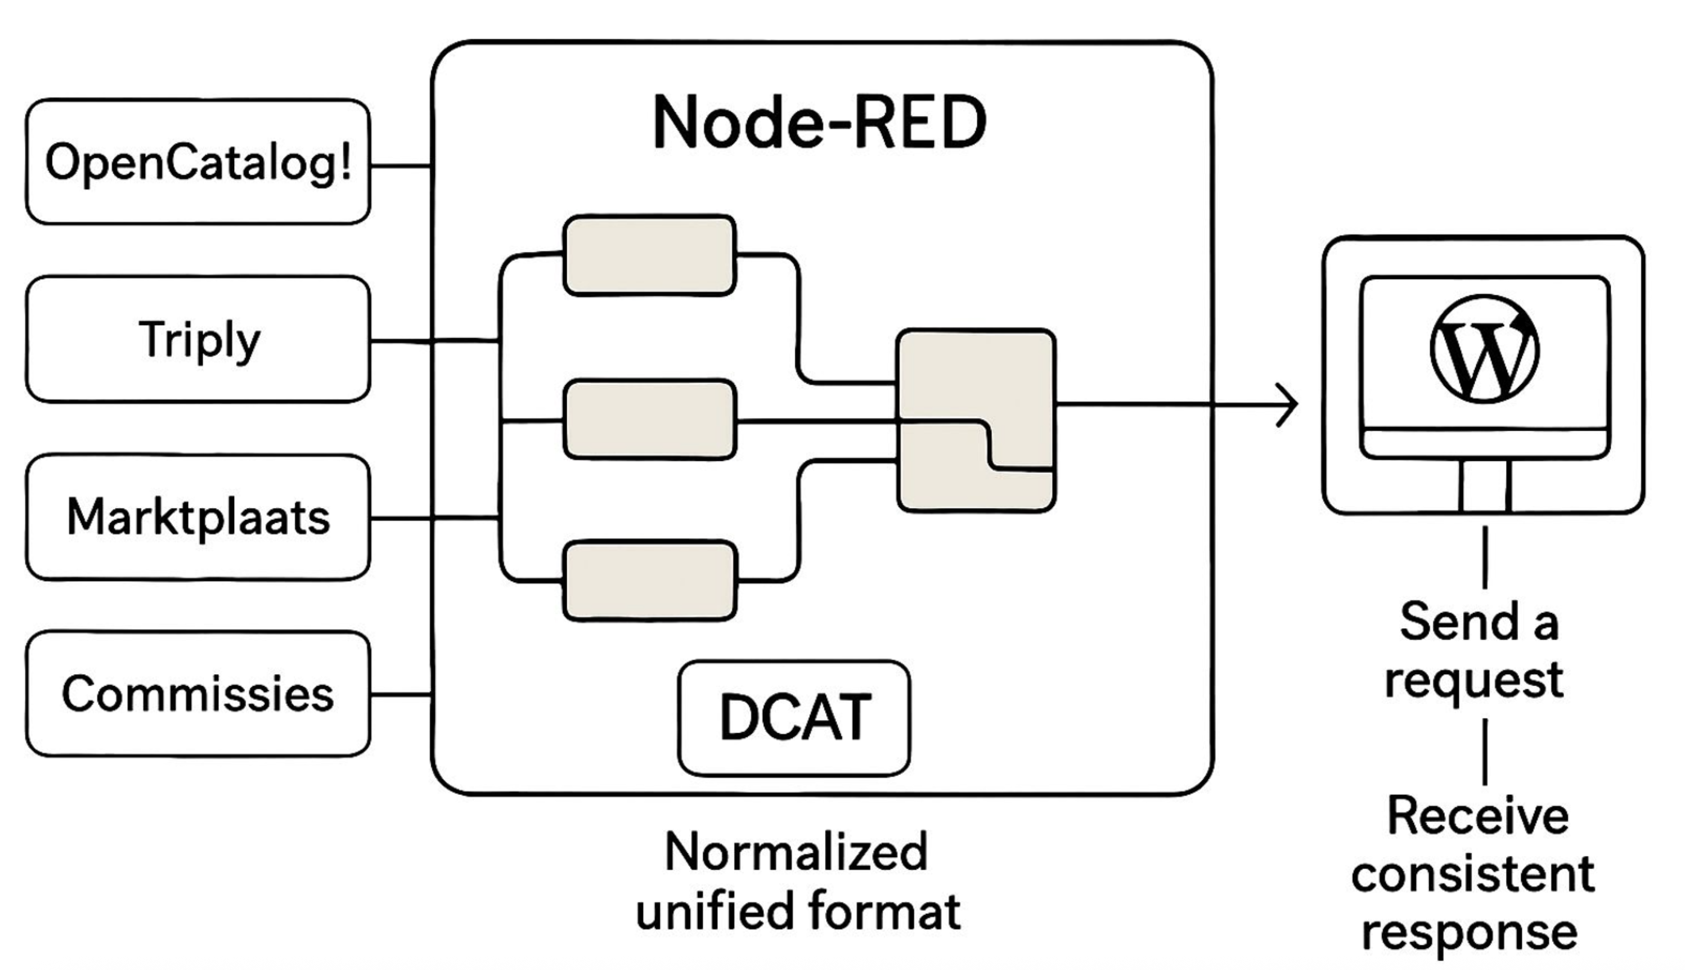

OpenCatalogi
Linked Data Platform (Triply)
Open Urban Platform
CKAN platforms

