Slide 1
Exploring Parallels:
A Comparative Analysis of Barbie's Careers and College-Aged Women's Major Choices
By Kate Amsterdam

Slide 2
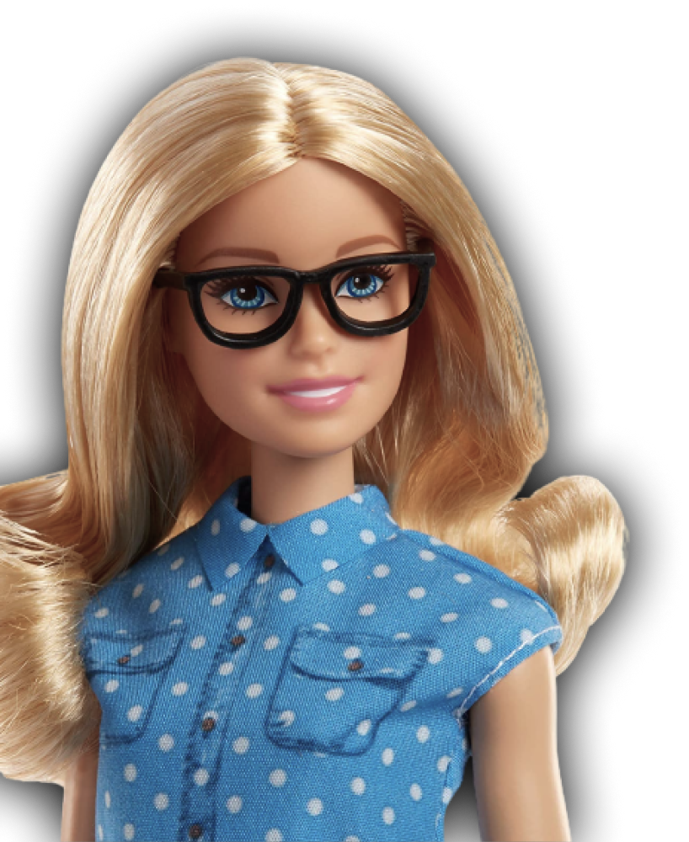
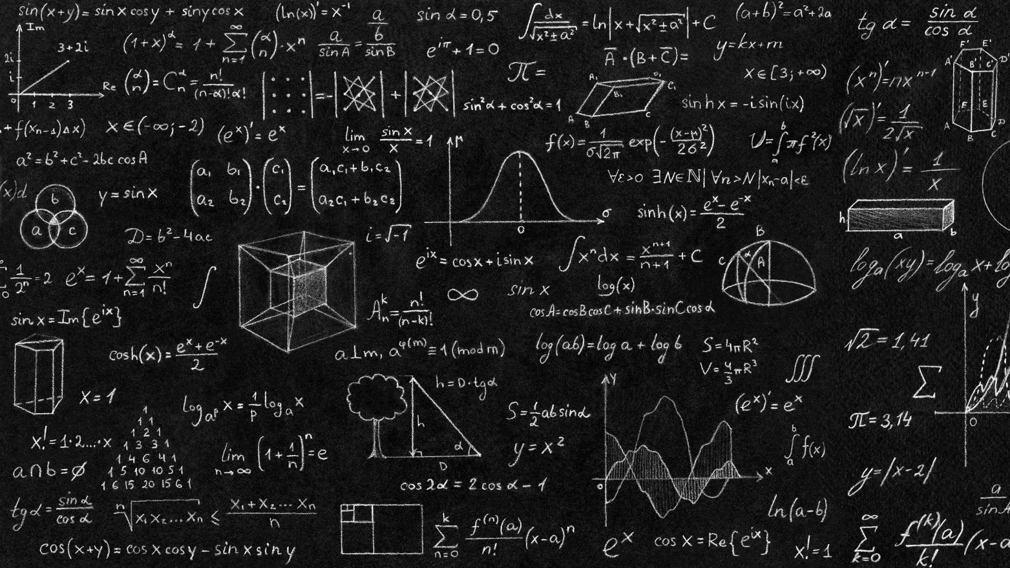
Initial Questions
How do Barbie's career choices align with the majors commonly chosen by college-aged women?
If we correlate Barbie’s careers to college majors, what is her most popular major, how does it correlate to the most popular major among women?
Conversely, which career is least popular among Barbie dolls, and how does it compare to the least commonly chosen major among women?

Slide 3
Collecting the Data
I gathered data on women’s majors spanning the years 2010 to 2022, utilizing a comprehensive provided by the Department of Education.
The information specific to women's majors was extracted from the following source: [link]The tables employed for this analysis include 'Degrees/Certificates by Gender and Field of Study' from the academic year 2010-11 through the academic year 2021-22.
I found a thorough compilation of Barbie's careers at [Link] to ensure accuracy, I meticulously cross-referenced the list by conducting targeted searches for each specific doll and its release date.

Slide 4
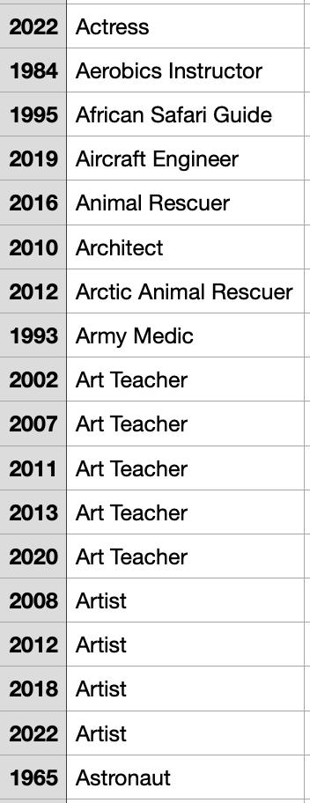
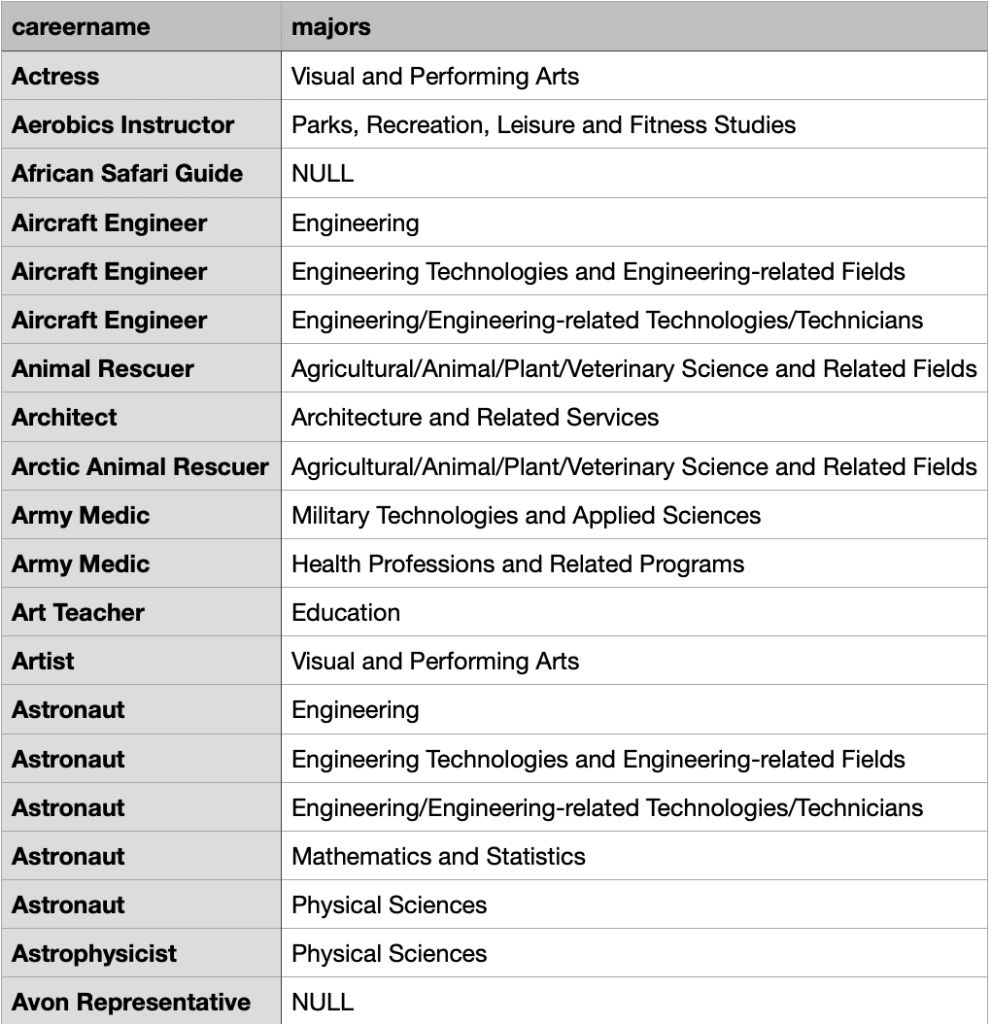
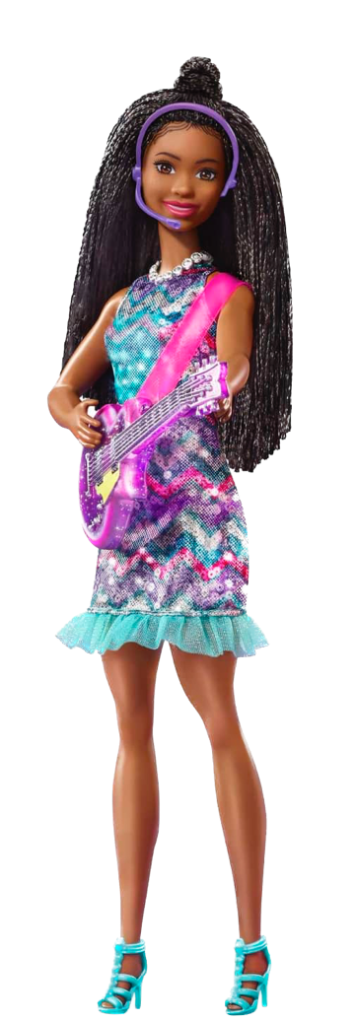
Matching Barbie’s Careers to college majors
I compiled an inventory detailing the corresponding majors for each Barbie career, drawing from the comprehensive dataset provided by the Department of Education. Notably, certain professions exhibited a diverse range of associated majors, while others, such as ice skater, Avon representative, and many more, did not necessitate a specific degree for job entry.

Slide 5
Findings
(summed 1959-2023)
Barbie’s top 3 degrees are :
Visual and Performing Arts (90 dolls)
2.Biological and Biomedical sciences (56 Dolls)
3. Health Professions and Related Programs (45 Dolls)
Least Popular Majors:
Transportation and Materials Moving
Public Administration and Social Service Professions
Construction Trades
218 working dolls do not have a matching major.

Slide 6
Women’s Top Majors
(summed 2011-2022)
Health Professions and Related Programs
Business, Management, Marketing, and Related Support Services
Liberal Arts and Sciences, General Studies and Humanities
Least Popular Majors
Military Technologies and Applied Science
Construction Trades
Science Technologies/ Technicians

Slide 7

Graph shows % difference in Barbie's vs. actual women's degrees. Positive values: Barbie underrepresented; Negative values: Barbie overrepresented. Highlights disparities in portrayal vs. actual prevalence

Slide 8
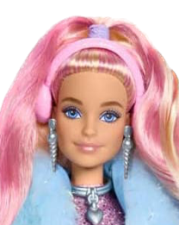

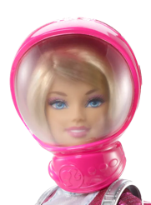
Barbie's predominant career is 'Fashion Model’ which requires no degree.
Barbie
Career
Stats
Barbie has been an astronaut 11x in her lifetime.

Slide 9


Barbie
CAN BE ANYTHING…
*but she’s yet to use these degrees
Degrees Barbie Has Not Used
Area, Ethnic, Cultural, Gender, and Group Studies
Family and Consumer Sciences/Human Sciences
Liberal Arts and Sciences, General Studies and Humanities
Library Science
Mechanic and Repair Technologies/Technicians
Multi/Interdisciplinary Studies
Philosophy and Religious Studies
Precision Production
Theology and Religious Vocations

