Slide 1
GITHUB PROJECT SHOWCASE / 2026
NETFLIX
Movies & TV Shows
Data Analysis
15 SQL Business Problems • PostgreSQL • Data Exploration
BY HARSH SONI | DATA ANALYST PORTFOLIO
github.com/data-analyst-harsh-soni/Netflix-SQL-Analysis

Slide 2
DATA-ANALYST-HARSH-SONI / NETFLIX-SQL-ANALYSIS
Project repository
Netflix-SQL-Analysis
Public repository • main branch • SQL project
▤ Business Problems Netflix.sql
Business questions / project brief
PROJECT AT A GLANCE
▤ README.md
Project documentation
15
Business questions
▤ Schemas.sql
Database table definition
1
PostgreSQL dataset
▤ Solutions of 15 business problems.sql
15 SQL solutions
12
Source columns
▤ logo.png
Project branding asset
5
Repository assets
02

Slide 3
DATA-ANALYST-HARSH-SONI / NETFLIX-SQL-ANALYSIS
Project overview
Turn a raw content catalogue into structured business insights.
ANALYSIS WORKFLOW
1
Dataset acquisition
This project uses PostgreSQL to explore Netflix Movies and TV Shows.
It answers 15 practical questions across content mix, ratings, geography, release trends, genres, people and descriptions.
The focus is query design, data exploration and business problem-solving.
2
Table creation & data loading
3
SQL exploration
4
Business questions & solutions
5
Insights and documentation
03

Slide 4
DATA-ANALYST-HARSH-SONI / NETFLIX-SQL-ANALYSIS
Objectives & dataset
ANALYSIS OBJECTIVES
DATASET SOURCE
• Compare Movies vs TV Shows
• Find common content ratings
• Explore release years and countries
• Analyze duration, seasons and genres
• Study Indian content and cast patterns
• Classify descriptions using keywords
Netflix Movies and TV Shows
Kaggle dataset by Shivam Bansal
12 columns
show_id • type • title • director • casts • country
date_added • release_year • rating • duration
listed_in • description
kaggle.com/datasets/shivamb/netflix-shows
04

Slide 5
DATA-ANALYST-HARSH-SONI / NETFLIX-SQL-ANALYSIS
PostgreSQL table schema
SQL QUERY · PostgreSQL
DROP TABLE IF EXISTS netflix;
CREATE TABLE netflix (
show_id VARCHAR(5),
type VARCHAR(10),
title VARCHAR(250),
director VARCHAR(550),
casts VARCHAR(1050),
country VARCHAR(550),
date_added VARCHAR(55),
release_year INT,
rating VARCHAR(15),
duration VARCHAR(15),
listed_in VARCHAR(250),
description VARCHAR(550)
);
SCHEMA NOTES
• Table: netflix
• 12 source columns
• Text fields stored as VARCHAR
• release_year stored as INT
• duration stored as text and parsed in queries
05

Slide 6
DATA-ANALYST-HARSH-SONI / NETFLIX-SQL-ANALYSIS
Business problem 01 / Count Movies vs TV Shows
How is the catalogue split by content type?
SQL QUERY · PostgreSQL
SELECT type, COUNT(*) AS total_content
FROM netflix
GROUP BY type;
SQL CONCEPT
GROUP BY + COUNT
BUSINESS PURPOSE
Summarizes the number of records in each content type.
POSTGRESQL • SQL BUSINESS ANALYSIS
06

Slide 7
DATA-ANALYST-HARSH-SONI / NETFLIX-SQL-ANALYSIS
Business problem 02 / Most common rating by content type
Which rating appears most frequently for Movies and TV Shows?
SQL QUERY · PostgreSQL
WITH RatingCounts AS (
SELECT type, rating, COUNT(*) AS rating_count
FROM netflix GROUP BY type, rating
),
RankedRatings AS (
SELECT type, rating, rating_count,
RANK() OVER (PARTITION BY type ORDER BY rating_count DESC) AS rank
FROM RatingCounts
)
SELECT type, rating AS most_frequent_rating
FROM RankedRatings WHERE rank = 1;
SQL CONCEPT
CTE + RANK()
BUSINESS PURPOSE
Ranks ratings separately within each content type; ties are retained.
POSTGRESQL • SQL BUSINESS ANALYSIS
07

Slide 8
DATA-ANALYST-HARSH-SONI / NETFLIX-SQL-ANALYSIS
Business problem 03 / Movies released in 2020
Which movies have a release year of 2020?
SQL QUERY · PostgreSQL
SELECT *
FROM netflix
WHERE type = 'Movie'
AND release_year = 2020;
SQL CONCEPT
WHERE filtering
BUSINESS PURPOSE
Filters the dataset to movie records from the selected year.
POSTGRESQL • SQL BUSINESS ANALYSIS
08

Slide 9
DATA-ANALYST-HARSH-SONI / NETFLIX-SQL-ANALYSIS
Business problem 04 / Top 5 countries by content
Which countries contribute the most Netflix titles?
SQL QUERY · PostgreSQL
SELECT * FROM (
SELECT UNNEST(STRING_TO_ARRAY(country, ',')) AS country,
COUNT(*) AS total_content
FROM netflix GROUP BY 1
) AS t1
WHERE country IS NOT NULL
ORDER BY total_content DESC
LIMIT 5;
SQL CONCEPT
STRING_TO_ARRAY + UNNEST
BUSINESS PURPOSE
Splits multi-country values into individual country rows, then ranks them.
POSTGRESQL • SQL BUSINESS ANALYSIS
09

Slide 10
DATA-ANALYST-HARSH-SONI / NETFLIX-SQL-ANALYSIS
Business problem 05 / Longest movie
Which movie has the greatest runtime?
SQL QUERY · PostgreSQL
SELECT *
FROM netflix
WHERE type = 'Movie'
ORDER BY SPLIT_PART(duration, ' ', 1)::INT DESC;
SQL CONCEPT
SPLIT_PART + CAST
BUSINESS PURPOSE
Extracts the numeric runtime from duration text and sorts descending.
POSTGRESQL • SQL BUSINESS ANALYSIS
10

Slide 11
DATA-ANALYST-HARSH-SONI / NETFLIX-SQL-ANALYSIS
Business problem 06 / Content added in last 5 years
Which titles were added within the last five years?
SQL QUERY · PostgreSQL
SELECT *
FROM netflix
WHERE TO_DATE(date_added, 'Month DD, YYYY')
>= CURRENT_DATE - INTERVAL '5 years';
SQL CONCEPT
TO_DATE + INTERVAL
BUSINESS PURPOSE
Converts date text and applies a rolling five-year filter.
POSTGRESQL • SQL BUSINESS ANALYSIS
11

Slide 12
DATA-ANALYST-HARSH-SONI / NETFLIX-SQL-ANALYSIS
Business problem 07 / Content by Rajiv Chilaka
Which titles list Rajiv Chilaka as a director?
SQL QUERY · PostgreSQL
SELECT * FROM (
SELECT *, UNNEST(STRING_TO_ARRAY(director, ',')) AS director_name
FROM netflix
) AS director_data
WHERE director_name = 'Rajiv Chilaka';
SQL CONCEPT
String splitting + UNNEST
BUSINESS PURPOSE
Expands director names stored as comma-separated text before filtering.
POSTGRESQL • SQL BUSINESS ANALYSIS
12

Slide 13
DATA-ANALYST-HARSH-SONI / NETFLIX-SQL-ANALYSIS
Business problem 08 / TV shows with more than 5 seasons
Which TV shows have over five seasons?
SQL QUERY · PostgreSQL
SELECT *
FROM netflix
WHERE type = 'TV Show'
AND SPLIT_PART(duration, ' ', 1)::INT > 5;
SQL CONCEPT
Text parsing + numeric filter
BUSINESS PURPOSE
Extracts season count and filters values greater than five.
POSTGRESQL • SQL BUSINESS ANALYSIS
13

Slide 14
DATA-ANALYST-HARSH-SONI / NETFLIX-SQL-ANALYSIS
Business problem 09 / Content count by genre
How many titles are listed in each genre?
SQL QUERY · PostgreSQL
SELECT UNNEST(STRING_TO_ARRAY(listed_in, ',')) AS genre,
COUNT(*) AS total_content
FROM netflix
GROUP BY 1;
SQL CONCEPT
UNNEST + aggregation
BUSINESS PURPOSE
Expands multi-genre values and counts titles per genre.
POSTGRESQL • SQL BUSINESS ANALYSIS
14

Slide 15
DATA-ANALYST-HARSH-SONI / NETFLIX-SQL-ANALYSIS
Business problem 10 / Indian content by release year
Which five release years have the highest share of Indian titles?
SQL QUERY · PostgreSQL
SELECT country, release_year, COUNT(show_id) AS total_release,
ROUND(COUNT(show_id)::NUMERIC /
(SELECT COUNT(show_id) FROM netflix WHERE country = 'India')::NUMERIC * 100, 2)
AS avg_release
FROM netflix WHERE country = 'India'
GROUP BY country, release_year
ORDER BY avg_release DESC LIMIT 5;
SQL CONCEPT
Subquery + percentage
BUSINESS PURPOSE
Calculates each year's share among records where country equals India.
POSTGRESQL • SQL BUSINESS ANALYSIS
15

Slide 16
DATA-ANALYST-HARSH-SONI / NETFLIX-SQL-ANALYSIS
Business problem 11 / Documentaries
Which titles are classified under Documentaries?
SQL QUERY · PostgreSQL
SELECT *
FROM netflix
WHERE listed_in LIKE '%Documentaries%';
SQL CONCEPT
LIKE pattern matching
BUSINESS PURPOSE
Finds records whose category text contains the Documentary keyword.
POSTGRESQL • SQL BUSINESS ANALYSIS
16

Slide 17
DATA-ANALYST-HARSH-SONI / NETFLIX-SQL-ANALYSIS
Business problem 12 / Titles without a director
Which records have no director value?
SQL QUERY · PostgreSQL
SELECT *
FROM netflix
WHERE director IS NULL;
SQL CONCEPT
NULL filtering
BUSINESS PURPOSE
Identifies missing director values for data-quality exploration.
POSTGRESQL • SQL BUSINESS ANALYSIS
17

Slide 18
DATA-ANALYST-HARSH-SONI / NETFLIX-SQL-ANALYSIS
Business problem 13 / Movies featuring Salman Khan
Which movies featuring Salman Khan were released in the last 10 years?
SQL QUERY · PostgreSQL
SELECT *
FROM netflix
WHERE type = 'Movie'
AND casts LIKE '%Salman Khan%'
AND release_year > EXTRACT(YEAR FROM CURRENT_DATE) - 10;
SQL CONCEPT
LIKE + EXTRACT
BUSINESS PURPOSE
Filters movie records by cast text and a rolling release-year threshold.
POSTGRESQL • SQL BUSINESS ANALYSIS
18

Slide 19
DATA-ANALYST-HARSH-SONI / NETFLIX-SQL-ANALYSIS
Business problem 14 / Top 10 actors in Indian content
Which actors appear most often in Indian-produced titles?
SQL QUERY · PostgreSQL
SELECT UNNEST(STRING_TO_ARRAY(casts, ',')) AS actor,
COUNT(*) AS total_appearances
FROM netflix
WHERE country = 'India'
GROUP BY 1
ORDER BY 2 DESC
LIMIT 10;
SQL CONCEPT
UNNEST + GROUP BY
BUSINESS PURPOSE
Splits cast lists and ranks actor appearances in records marked India.
POSTGRESQL • SQL BUSINESS ANALYSIS
19

Slide 20
DATA-ANALYST-HARSH-SONI / NETFLIX-SQL-ANALYSIS
Business problem 15 / Keyword-based content categories
How many titles contain 'kill' or 'violence' in descriptions, by type?
SQL QUERY · PostgreSQL
SELECT category, type, COUNT(*) AS content_count
FROM (
SELECT *, CASE
WHEN description ILIKE '%kill%' OR description ILIKE '%violence%'
THEN 'Keyword Match' ELSE 'No Keyword Match'
END AS category
FROM netflix
) AS categorized_content
GROUP BY category, type
ORDER BY type;
SQL CONCEPT
CASE WHEN + ILIKE
BUSINESS PURPOSE
Creates keyword-based labels using case-insensitive matching and counts by type.
POSTGRESQL • SQL BUSINESS ANALYSIS
20

Slide 21
DATA-ANALYST-HARSH-SONI / NETFLIX-SQL-ANALYSIS
What the analysis helps reveal
CONTENT MIX
AUDIENCE & RATINGS
GLOBAL FOOTPRINT
Compare the scale of Movies and TV Shows.
Understand rating patterns across content types.
Explore country contributions and genre distribution.
INDIAN CATALOGUE
CONTENT ATTRIBUTES
TEXT CLASSIFICATION
Study release-year shares and actor appearances.
Inspect runtime, seasons, directors and documentary labels.
Use description keywords to create simple categories.
Numeric findings should be populated from executed query outputs; this deck focuses on questions and query logic.
21

Slide 22
DATA-ANALYST-HARSH-SONI / NETFLIX-SQL-ANALYSIS
SQL skills demonstrated
✓ SELECT & WHERE
✓ GROUP BY & ORDER BY
✓ COUNT & aggregate functions
✓ CTEs and subqueries
✓ Window functions: RANK()
✓ String parsing: SPLIT_PART()
✓ Arrays: STRING_TO_ARRAY(), UNNEST()
✓ Date functions: TO_DATE(), EXTRACT()
✓ CASE WHEN and ILIKE
✓ Casting and numeric calculations
22

Slide 23
DATA-ANALYST-HARSH-SONI / NETFLIX-SQL-ANALYSIS
Validation notes & analytical considerations
Country matching
country = 'India' excludes multi-country strings such as 'India, United States'.
Whitespace in split values
TRIM() can be applied after splitting country, director, genre or cast values.
Question 10 metric
The query calculates percentage share by release year, not an arithmetic average.
Question 13 output
The query returns matching movie rows. Use COUNT(*) if a single count is required.
Question 15 labels
Keyword labels indicate selected words only; they do not judge content quality.
23

Slide 24
DATA-ANALYST-HARSH-SONI / NETFLIX-SQL-ANALYSIS
Conclusion
From raw records to structured questions and reusable SQL.
This project demonstrates practical PostgreSQL skills through 15 business-focused questions.
It combines filtering, aggregation, ranking, string processing, date handling and conditional logic.
The work provides a foundation for deeper analysis, dashboard development and data storytelling.
PROJECT SUMMARY
15
business questions
Next step: connect query results to charts or a dashboard for stronger data storytelling.
24

Slide 25
THANK YOU
Harsh Soni
Data Analyst • SQL Enthusiast • Aspiring Data Engineer
PROJECT REPOSITORY
github.com/data-analyst-harsh-soni/Netflix-SQL-Analysis
PORTFOLIO
https://datain.vercel.app/
Dataset credit: Shivam Bansal — Kaggle Netflix Movies and TV Shows dataset.

Slide 26
DATA-ANALYST-HARSH-SONI / NETFLIX-SQL-ANALYSIS
Executed SQL results / Key findings
CONTENT MIX
RATING & DATA QUALITY
12,262
Movies
Most frequent rating
TV-MA
5,352
TV Shows
for both Movies and TV Shows
Total records by type: 17,614
Missing director values
Movies represent approximately 69.6% of the two content types; TV Shows account for approximately 30.4%.
5,268
The missing-director query returned 5,268 records, highlighting a substantial metadata completeness issue.
26

Slide 27
DATA-ANALYST-HARSH-SONI / NETFLIX-SQL-ANALYSIS
Executed SQL results / Geography & Indian content
TOP COUNTRY COUNTS AS RETURNED
INDIA: TOP RELEASE YEARS BY SHARE
United States
6,422
2017
202
10.39%
India
2,016
2018
188
9.67%
United Kingdom
1,256
2019
174
8.95%
United States…
958
2020
150
7.72%
2016
146
7.51%
Canada
542
avg_release is a percentage share of Indian records, not an average.
Note: split values appear to contain a United States naming/format variant.
27

Slide 28
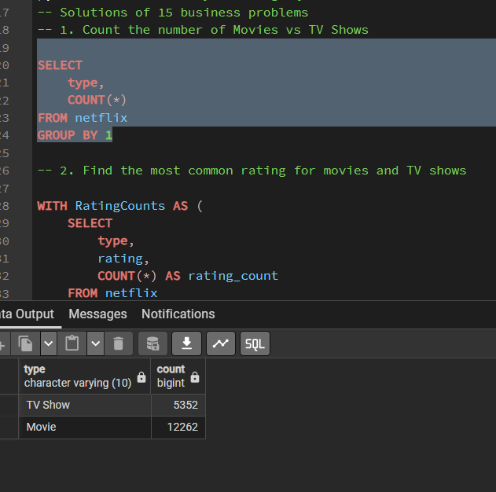
DATA-ANALYST-HARSH-SONI / NETFLIX-SQL-ANALYSIS
Execution evidence / Q1 — Movies vs TV Shows
12,262 Movies and 5,352 TV Shows were returned by the grouped count.
28

Slide 29
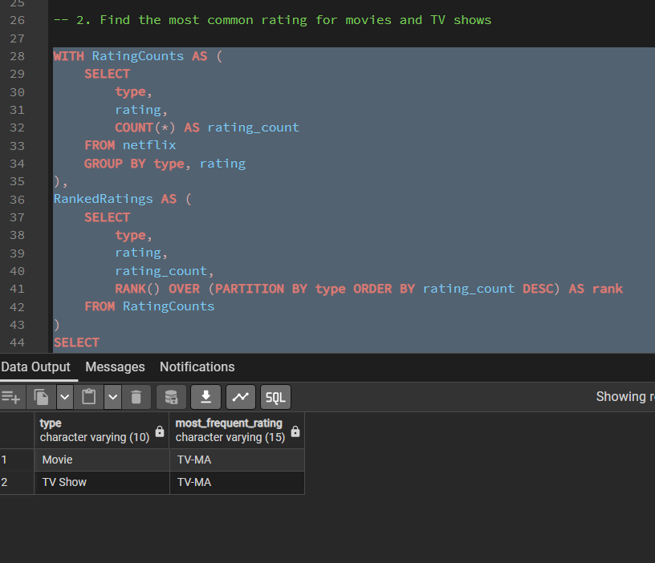
DATA-ANALYST-HARSH-SONI / NETFLIX-SQL-ANALYSIS
Execution evidence / Q2 — Most common ratings
TV-MA is the most frequent rating for both Movies and TV Shows.
29

Slide 30
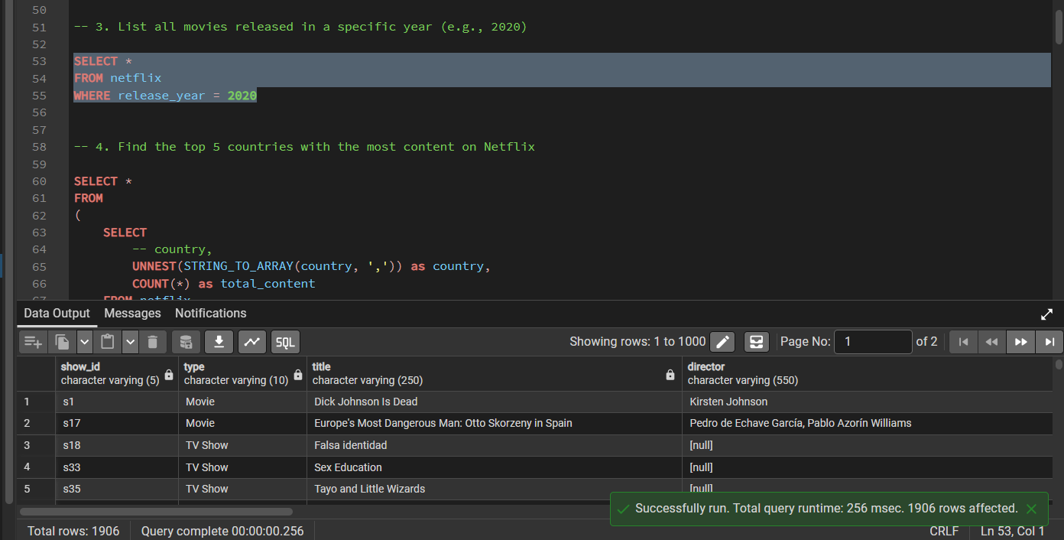
DATA-ANALYST-HARSH-SONI / NETFLIX-SQL-ANALYSIS
Execution evidence / Q3 — Titles released in 2020
The executed query returned 1,906 rows. The SQL shown filters release_year only, not type = 'Movie'.
30

Slide 31
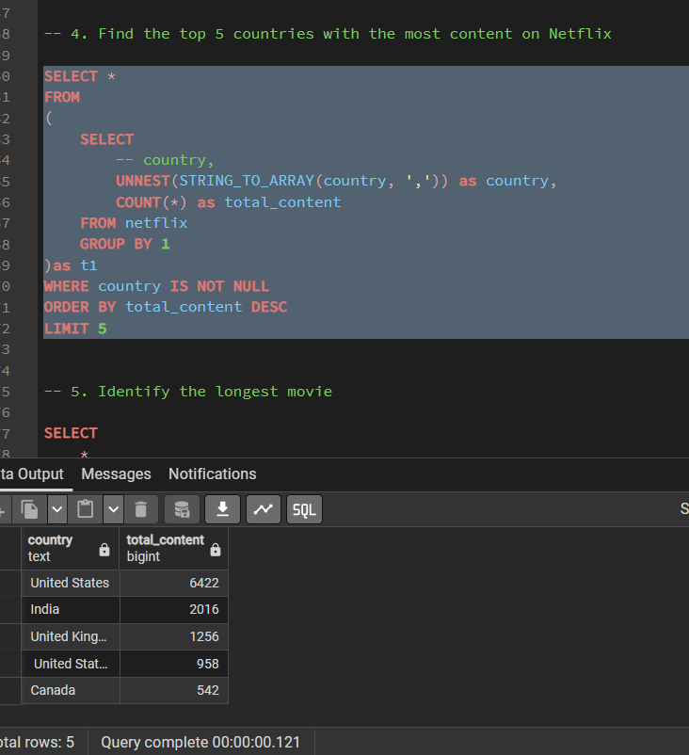
DATA-ANALYST-HARSH-SONI / NETFLIX-SQL-ANALYSIS
Execution evidence / Q4 — Top 5 countries
The returned counts show United States (6,422), India (2,016), United Kingdom (1,256), a United States variant (958), and Canada (542).
31

Slide 32
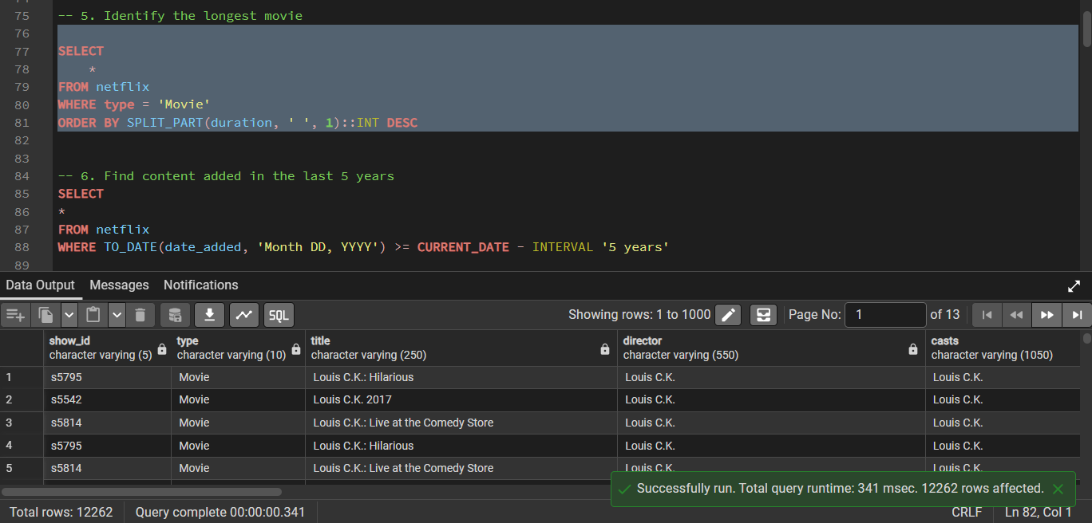
DATA-ANALYST-HARSH-SONI / NETFLIX-SQL-ANALYSIS
Execution evidence / Q5 — Longest movie
The query sorts all Movie rows by extracted duration. Add LIMIT 1 to return only the longest record.
32

Slide 33
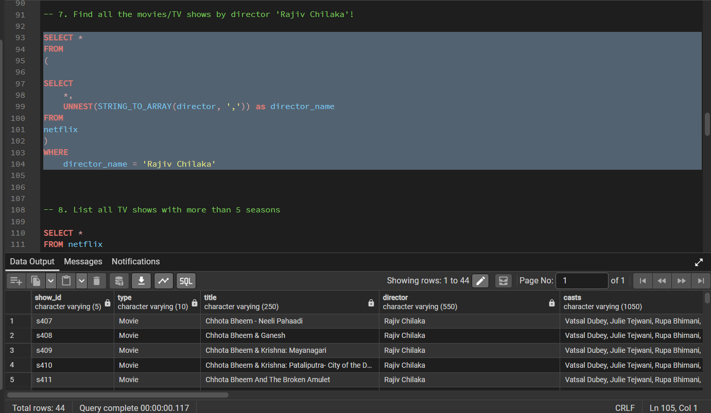
DATA-ANALYST-HARSH-SONI / NETFLIX-SQL-ANALYSIS
Execution evidence / Q7 — Content by Rajiv Chilaka
The director query returned 44 matching records.
33

Slide 34
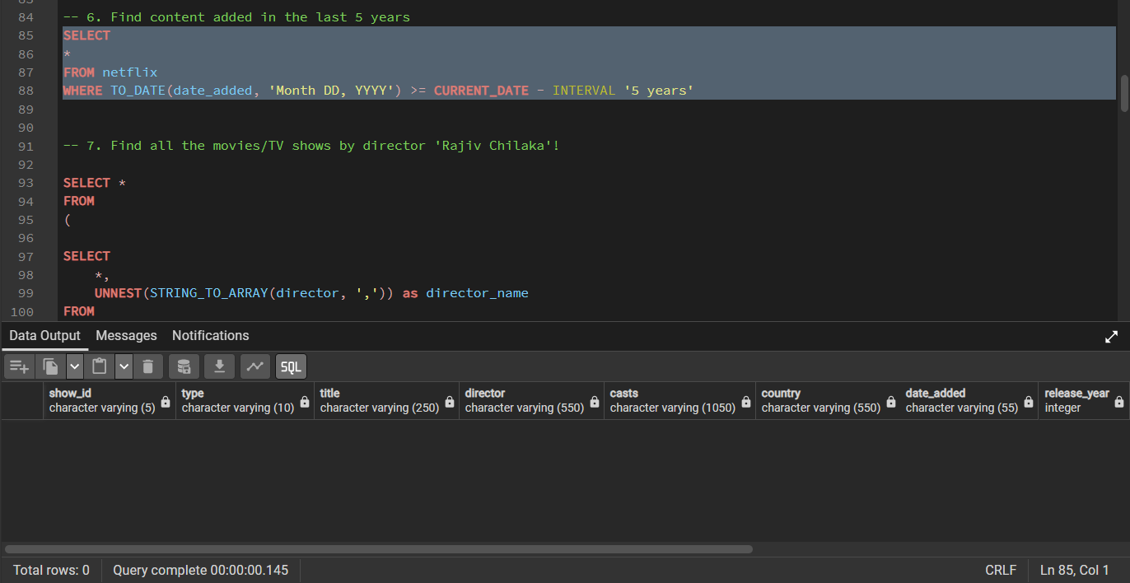
DATA-ANALYST-HARSH-SONI / NETFLIX-SQL-ANALYSIS
Execution evidence / Q6 — Content added in last 5 years
The displayed execution returned 0 rows; verify date_added parsing and source date values before drawing a conclusion.
34

Slide 35
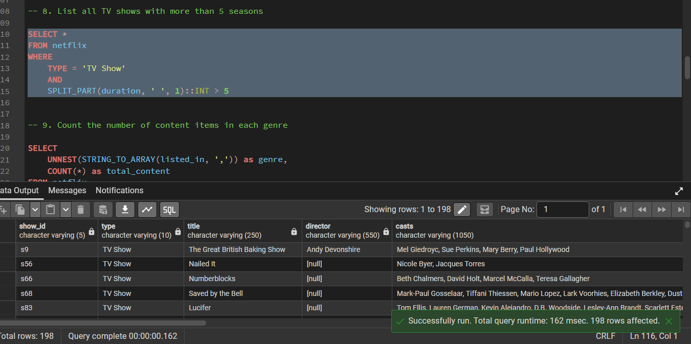
DATA-ANALYST-HARSH-SONI / NETFLIX-SQL-ANALYSIS
Execution evidence / Q8 — TV shows with more than 5 seasons
The executed query returned 198 TV Show records.
35

Slide 36
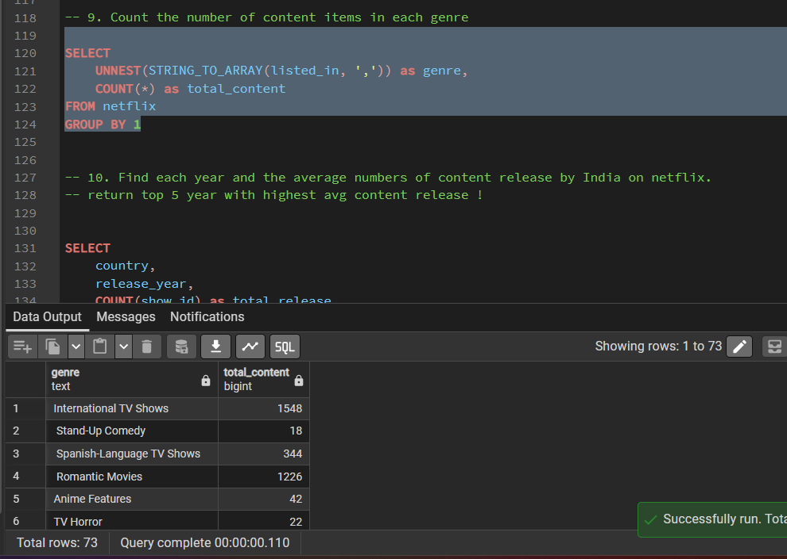
DATA-ANALYST-HARSH-SONI / NETFLIX-SQL-ANALYSIS
Execution evidence / Q9 — Content by genre
The query returned 73 genre groups. Examples visible include International TV Shows (1,548) and Spanish-Language TV Shows (344).
36

Slide 37
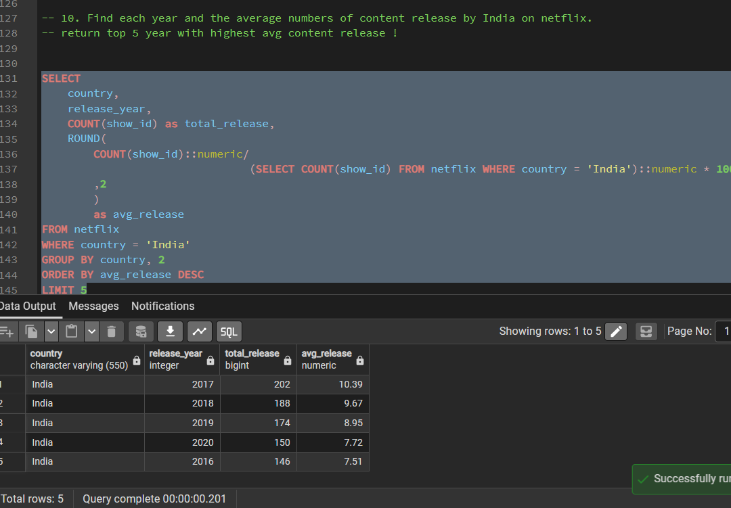
DATA-ANALYST-HARSH-SONI / NETFLIX-SQL-ANALYSIS
Execution evidence / Q10 — Indian content by release year
Top year by share is 2017: 202 releases (10.39%), followed by 2018: 188 (9.67%).
37

Slide 38
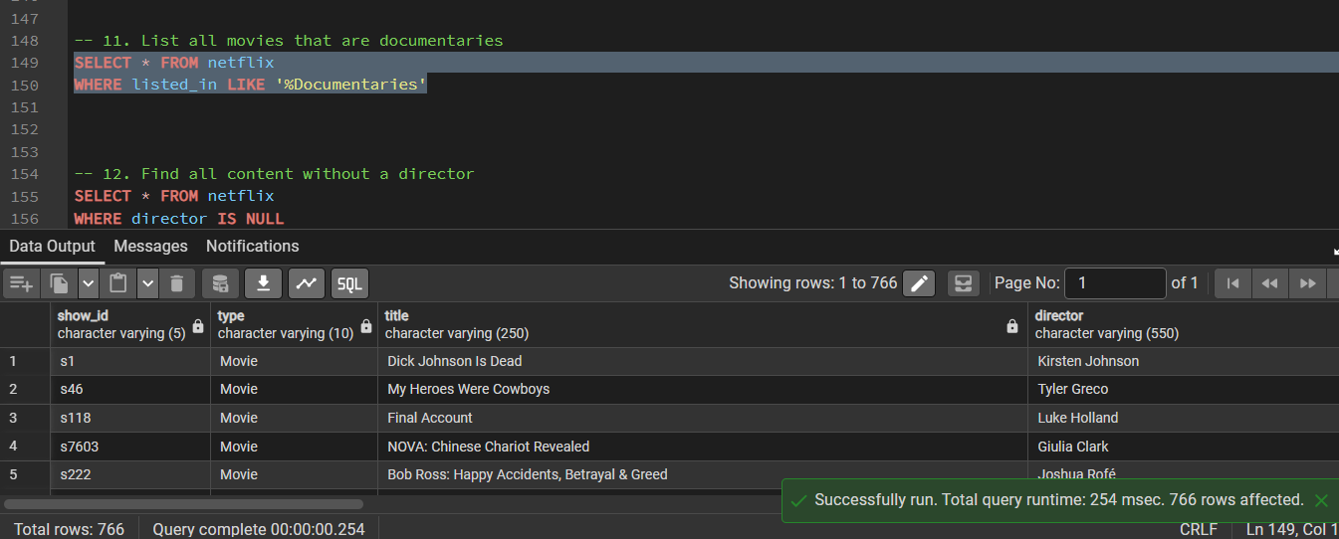
DATA-ANALYST-HARSH-SONI / NETFLIX-SQL-ANALYSIS
Execution evidence / Q11 — Documentaries
The documentary filter returned 766 records.
38

Slide 39
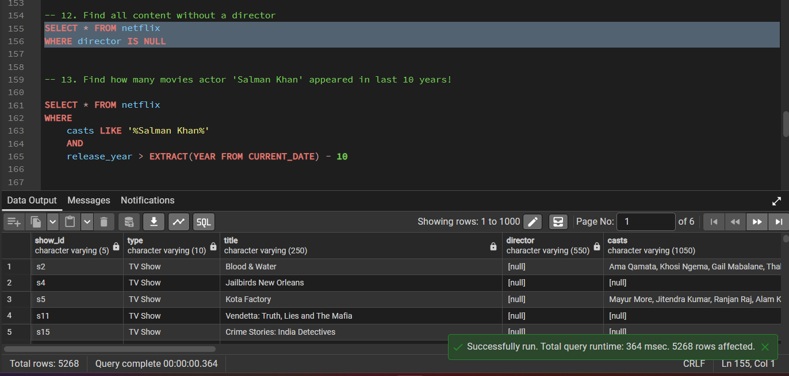
DATA-ANALYST-HARSH-SONI / NETFLIX-SQL-ANALYSIS
Execution evidence / Q12 — Missing directors
The NULL director query returned 5,268 records.
39

Slide 40
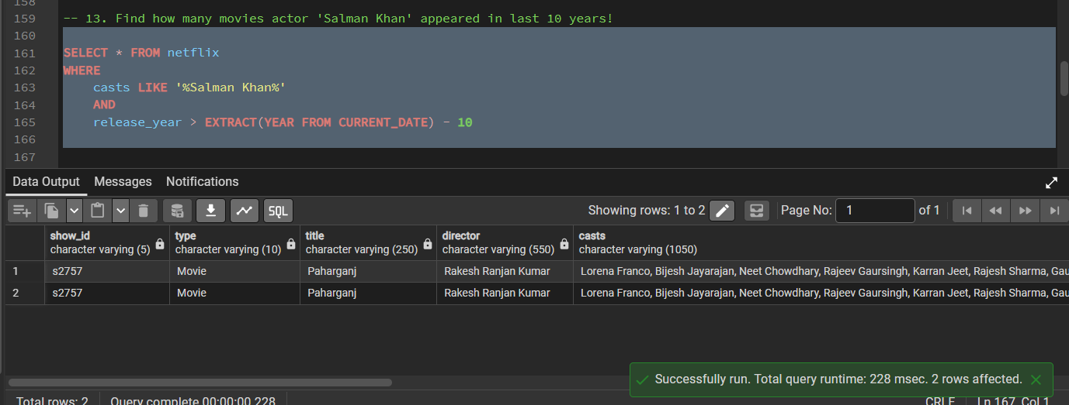
DATA-ANALYST-HARSH-SONI / NETFLIX-SQL-ANALYSIS
Execution evidence / Q13 — Salman Khan appearances
The executed query returned 2 rows. Add type = 'Movie' if the intended analysis is restricted to movies.
40

Slide 41
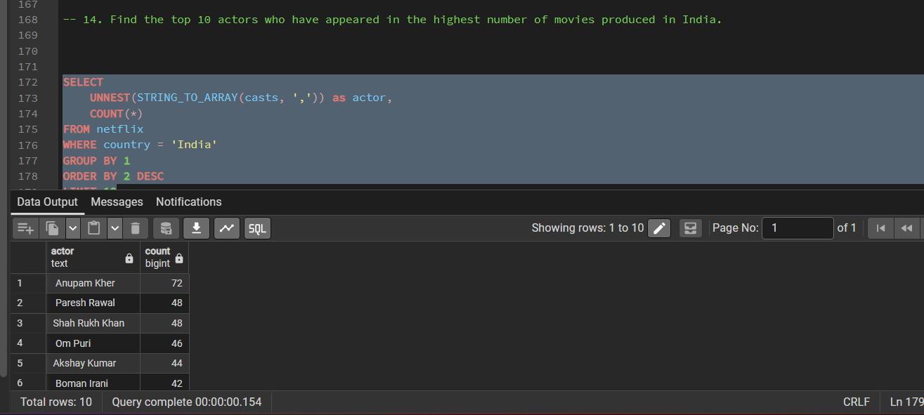
DATA-ANALYST-HARSH-SONI / NETFLIX-SQL-ANALYSIS
Execution evidence / Q14 — Top actors in Indian content
Top visible result: Anupam Kher (72), followed by Paresh Rawal (48) and Shah Rukh Khan (48).
41

Slide 42
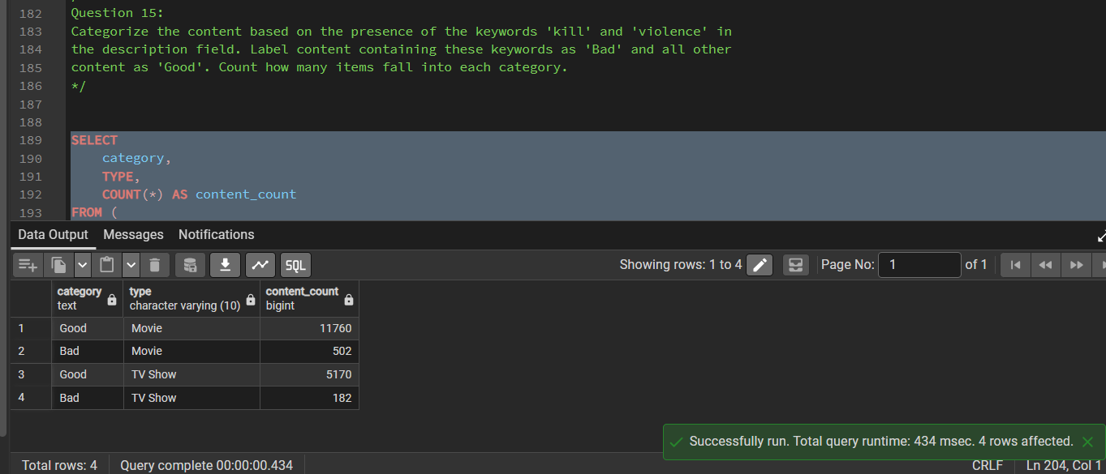
DATA-ANALYST-HARSH-SONI / NETFLIX-SQL-ANALYSIS
Execution evidence / Q15 — Keyword-based categories
Movie: 11,760 Good / 502 Bad. TV Show: 5,170 Good / 182 Bad. Labels indicate keyword matches only, not content quality.
42

