Slide 1
Marriage Isn't Dead Yet Analyzing Marriage and Divorce Trends in America
Ese Ekrebe

Slide 2
Introduction
"Marriage Isn't Dead Yet" is a data-driven project aimed at analyzing the trends in marriage and divorce in the United States.
This project challenges common perceptions about marriage and divorce, providing a nuanced understanding based on statistical data

Slide 3
Objectives
To explore historical and current trends in marriage and divorce rates in the U.S.
To understand the impact of demographic changes on marriage rates.
To analyze state-specific marriage and divorce statistics, with a focus on notable cases like Nevada.

Slide 4
Technologies Used
Frontend: JavaScript, HTML5, CSS3, Bootstrap
Backend: Flask for API development
Data Visualization: D3.js, Plotly
Database: SQLite
Data Scraping: Beautiful Soup, requests

Slide 5
Key Findings
The number of married couples in the U.S. has increased, likely due to population growth rather than an increased propensity for marriage.
The divorce rate in the U.S. has been declining since the 1990s, contrary to popular belief.
Nevada has the highest rate of marriage and divorce, potentially due to its lenient laws.

Slide 6
Methodology
Research and Methodology
Data Sources: Utilized CDC csv data loaded into an SQLite database, read as JSON in JavaScript for real-time analysis.
Data Processing: Implemented web scraping using Beautiful Soup and request library for live data collection. The data is then stored, categorized, and queried from a SQL database.
Visualization Tools: Employed D3.js and Plotly for dynamic and interactive data visualization. Granim.js is used for aesthetic enhancements.

Slide 7
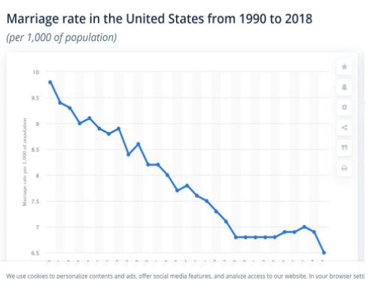
Marriage Trends in the U.S.
Marriage Trends Analysis
Historical trends of marriage rates.
Demographic analysis.
Implications of population growth on marriage statistics.

Slide 8
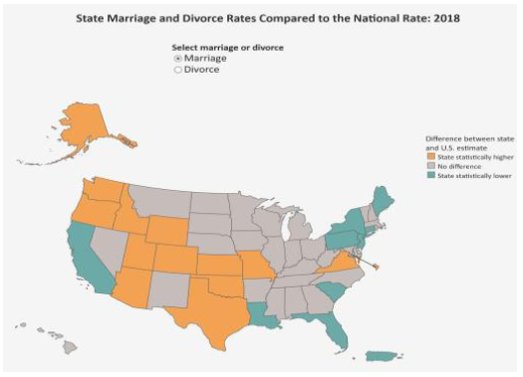
Divorce Trends in the U.S.
Divorce Trends Analysis
Historical data on divorce rates.
Comparison with marriage trends.
Analysis of divorce rates in subsequent marriages.

Slide 9
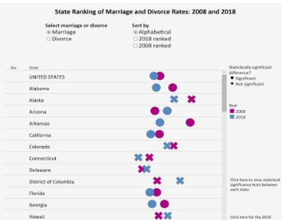
State-Specific Insights
Nevada's high marriage and divorce rates.
Comparison with other states.
Possible reasons behind these trends.

Slide 10
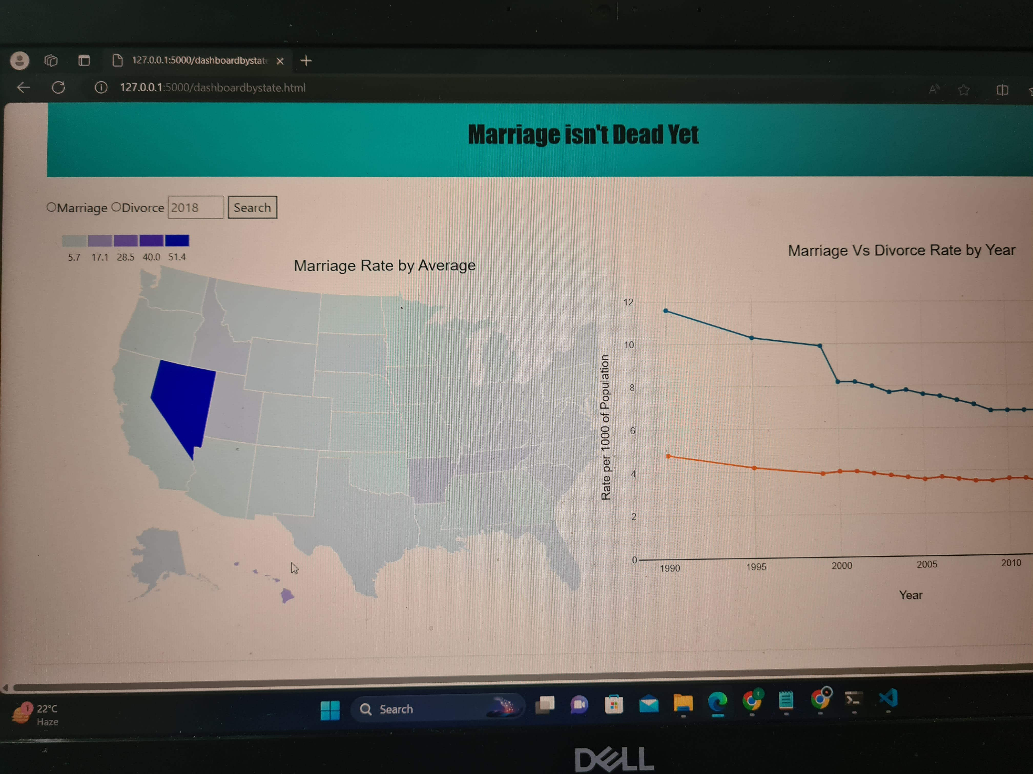
Data Visualization Techniques

Slide 11
Conclusion and Implications
Marriage Trends: Despite common beliefs, the institution of marriage is not declining in significance. While the number of married couples in the U.S. has increased, this is more attributable to population growth rather than an increased inclination towards marriage.
Divorce Trends: Contrary to popular opinion, the divorce rate in the U.S. is declining. The analysis reveals that while divorce was more common in the 1990s, there has been a significant decrease in divorce rates in recent years.
State-Specific Insight: Nevada stands out with the highest marriage and divorce rates in the U.S., likely due to its lenient laws and easy accessibility for marriage and divorce.
Technological Approach: The project leveraged advanced data analysis and visualization techniques using tools like D3.js, Plotly, and Beautiful Soup, enhancing the understanding of complex marriage and divorce trends across different states.
Overall Implication: The findings challenge common misconceptions about marriage and divorce in modern society, highlighting the need for data-driven analysis in understanding societal trends.

Slide 12
THANK YOU
Ese Ekrebe

