Slide 1
Corona Virus Analysis
Correlations between hospital bed capacity per capita & death rates
Team Corona Curious

Slide 2
The Questions
Question 1
Question 2
Question 3
Is there a correlation between the number of hospital beds and the number of COVID-19 deaths?
Are COVID-19 deaths more prevalent in any one US state or region?
Is there a correlation between COVID death rates and state population?
Notes:
(Aditya)

Slide 3


Data Sources
Source 1
Source 2
Source 3
Integrity:
Data available at daily level by state
Number of cases is reliant on accuracy of reporting
Number of deaths may be misattributed to COVID
Limitations:
Values are aggregated at state level, limiting ability to drill to community level
Integrity:
Data is aggregated at yearly level and shows hospital beds per 1000 capita per state
Hospital beds split across government, non-profit, and for-profit
Limitations:
Data is rounded to nearest 0.1 bed, impacting level of detail
Population swings throughout the year are not accounted for
Integrity:
Census data was complete for all states in 2021. Minimal cleaning required
Data included population per state
Limitations:
Data is incomplete for all years. 2021 population data was used to compare vs 2020 case/death rate due to more complete data
Notes:
(Aditya)

Slide 4
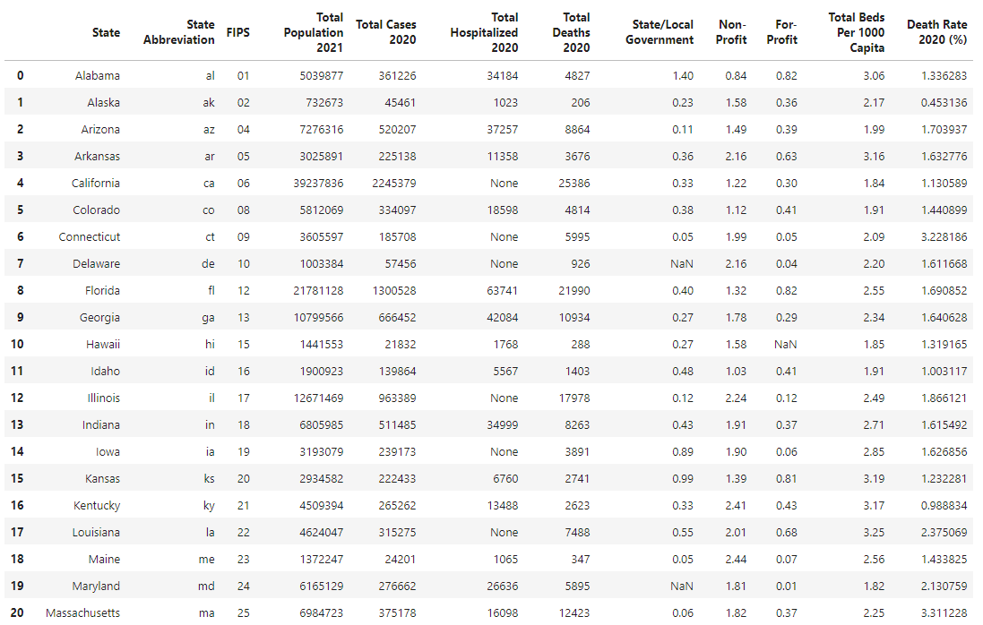
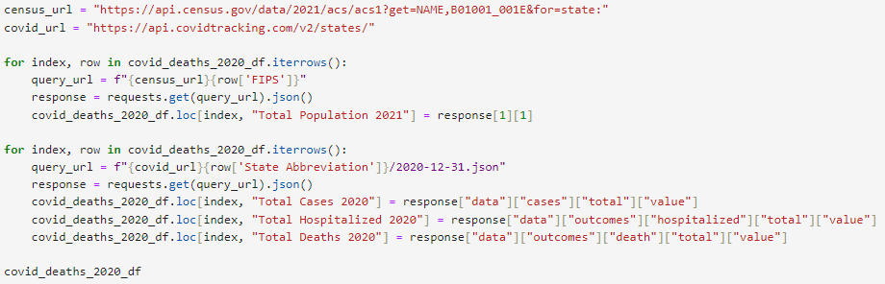
Data Selection
Used requests, JSON, and loops to gather data from the US Census Bureau and Covid Tracking Project API’s.
Read CSV’s from KFF.org and merged dataframes
Notes:
(Sungmin)

Slide 5









Tools Used
JSON
Notes:
(Sungmin)

Slide 6
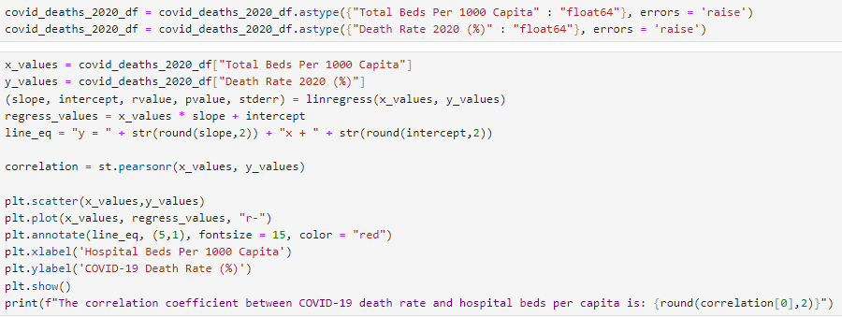

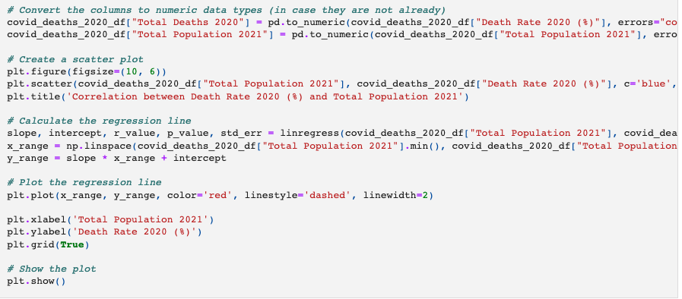
Analysis process
1
The output of our data cleaning process was a dataframe with the following key information:
States
Hospital beds per 1000 capita
COVID-19 death rate
Population size
(1) A scatter plot and linear regression model was used to evaluate the correlation between hospital beds per capita and COVID-19 death rate
(2) A heatmap was created to visualize the prevalence of COVID-19 deaths across states
(3) An additional scatter plot and linear regression model was used to evaluate the correlation between hospital beds per capita and COVID-19 death rate
2
3
Notes:
(Guntas)

Slide 7
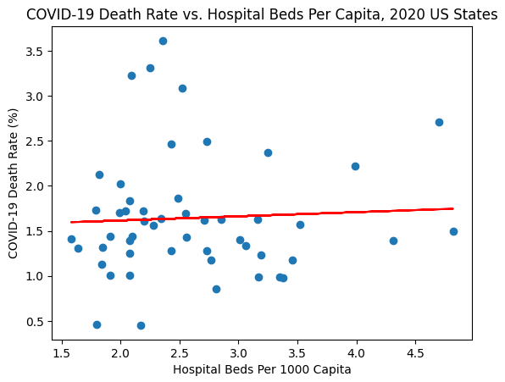
Is there a correlation between hospital bed availability and COVID death rate?
Hypothesis:
Greater hospital bed availability will reduce the death rate by COVID due to increased probability of care.
Conclusion:
The number of hospital beds available is not correlated with the COVID death rate. The analysis showed a 0.05 correlation coefficient (weak positive correlation).
Possible Explanations:
High hospital bed availability may not be best measure of care. Hospitals may not be accessible to everyone in the state equally.
Notes:
(Guntas)

Slide 8
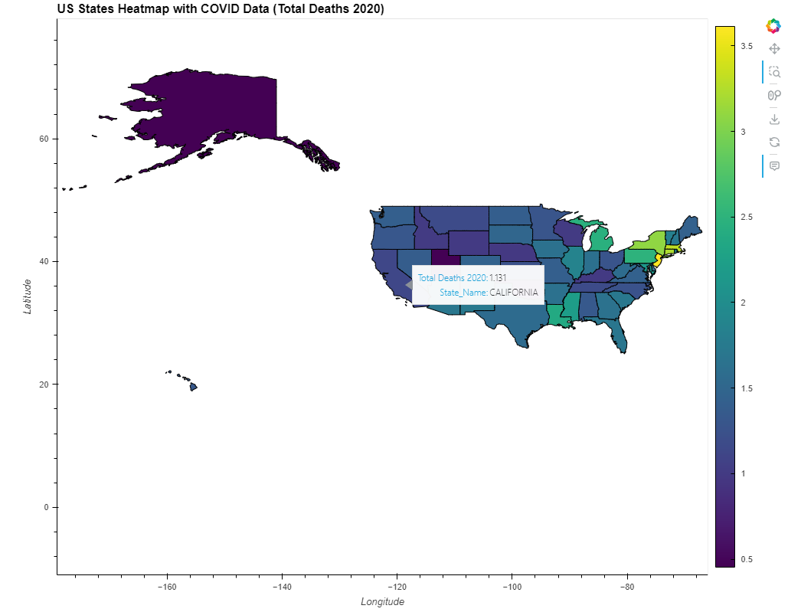
Are COVID-19 deaths more prevalent in specific US states or regions?
Hypothesis:
COVID deaths will be more prevalent in states/regions with higher population density, such as the Northeast.
Conclusion:
Covid deaths were most prevalent in densely populated states such New Jersey, Massachusetts, Connecticut, New York, and Pennsylvania.
The lowest death rates were in states with low population density: Alaska, Utah, Oklahoma, Nebraska, and Wyoming. With the exception of Alaska, the lowest death rates occurred in the Midwest/Great Plains region.
Possible Explanations:
High population density increases risk of spread.
Notes:
Ese

Slide 9
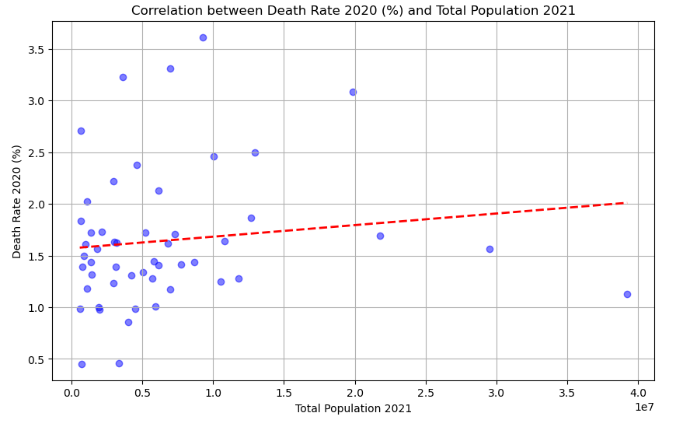
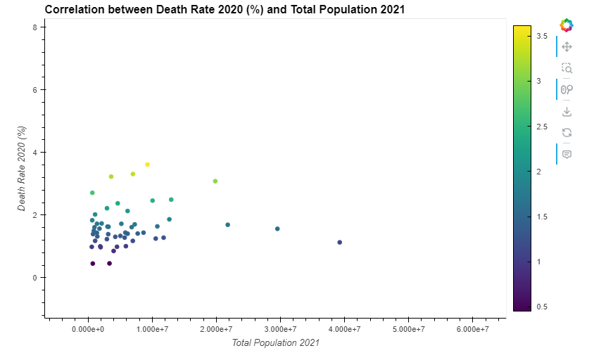
Is there a correlation between COVID-19 death rates and state population?
Hypothesis: COVID-19 death rates will be positively correlated with state population size
Conclusion: COVID-19 death rate and state population size are not correlated. The analysis showed a 0.12 correlation coefficient.
Possible Explanations: Population size is likely not a large contributing factor to COVID-19 death rate compared to population density, which indicates proximity of individuals within certain areas. This explains why states with large population sizes but low population density (CA, TX, FL) have lower death rates than states with large population sizes and high population density (NY).
Notes:
(mary)

Slide 10
Implications of Findings
Next steps:
Build in land area per state to calculate population density
Check correlation of population density to infection and death rate
Check additional factors such as the age, health, and demographic statistics per state
Future avenues of analysis
Notes:
(mary)

Slide 11

Team Corona Curious
Aditya Batchu
Ese Ekrebe
Mary Mackin
Guntas Padda
Sungmin Yim
Notes:
Everyone read off their own name

