Slide 1
Module shiny on flexdashboard (wordcloud)
러닝스푼즈
2018년 4월

Slide 3
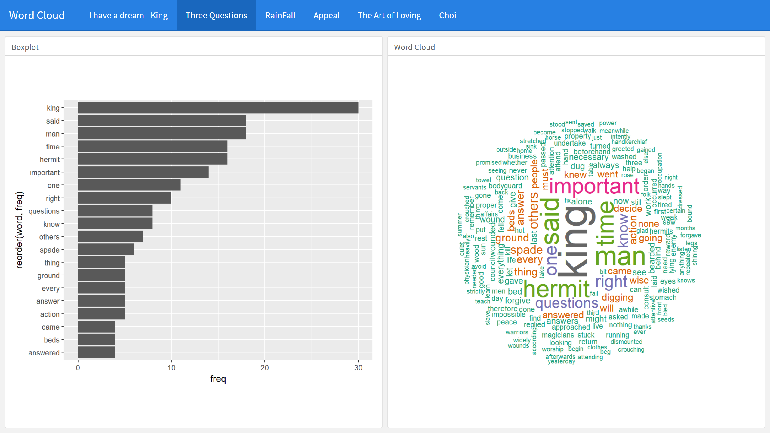
Review - Flexdashboard

Slide 4
Preview – Shiny on Flexdashboard
여러분이 생각하는 interactive한 문서의 모습을 그려보세요.

Slide 5
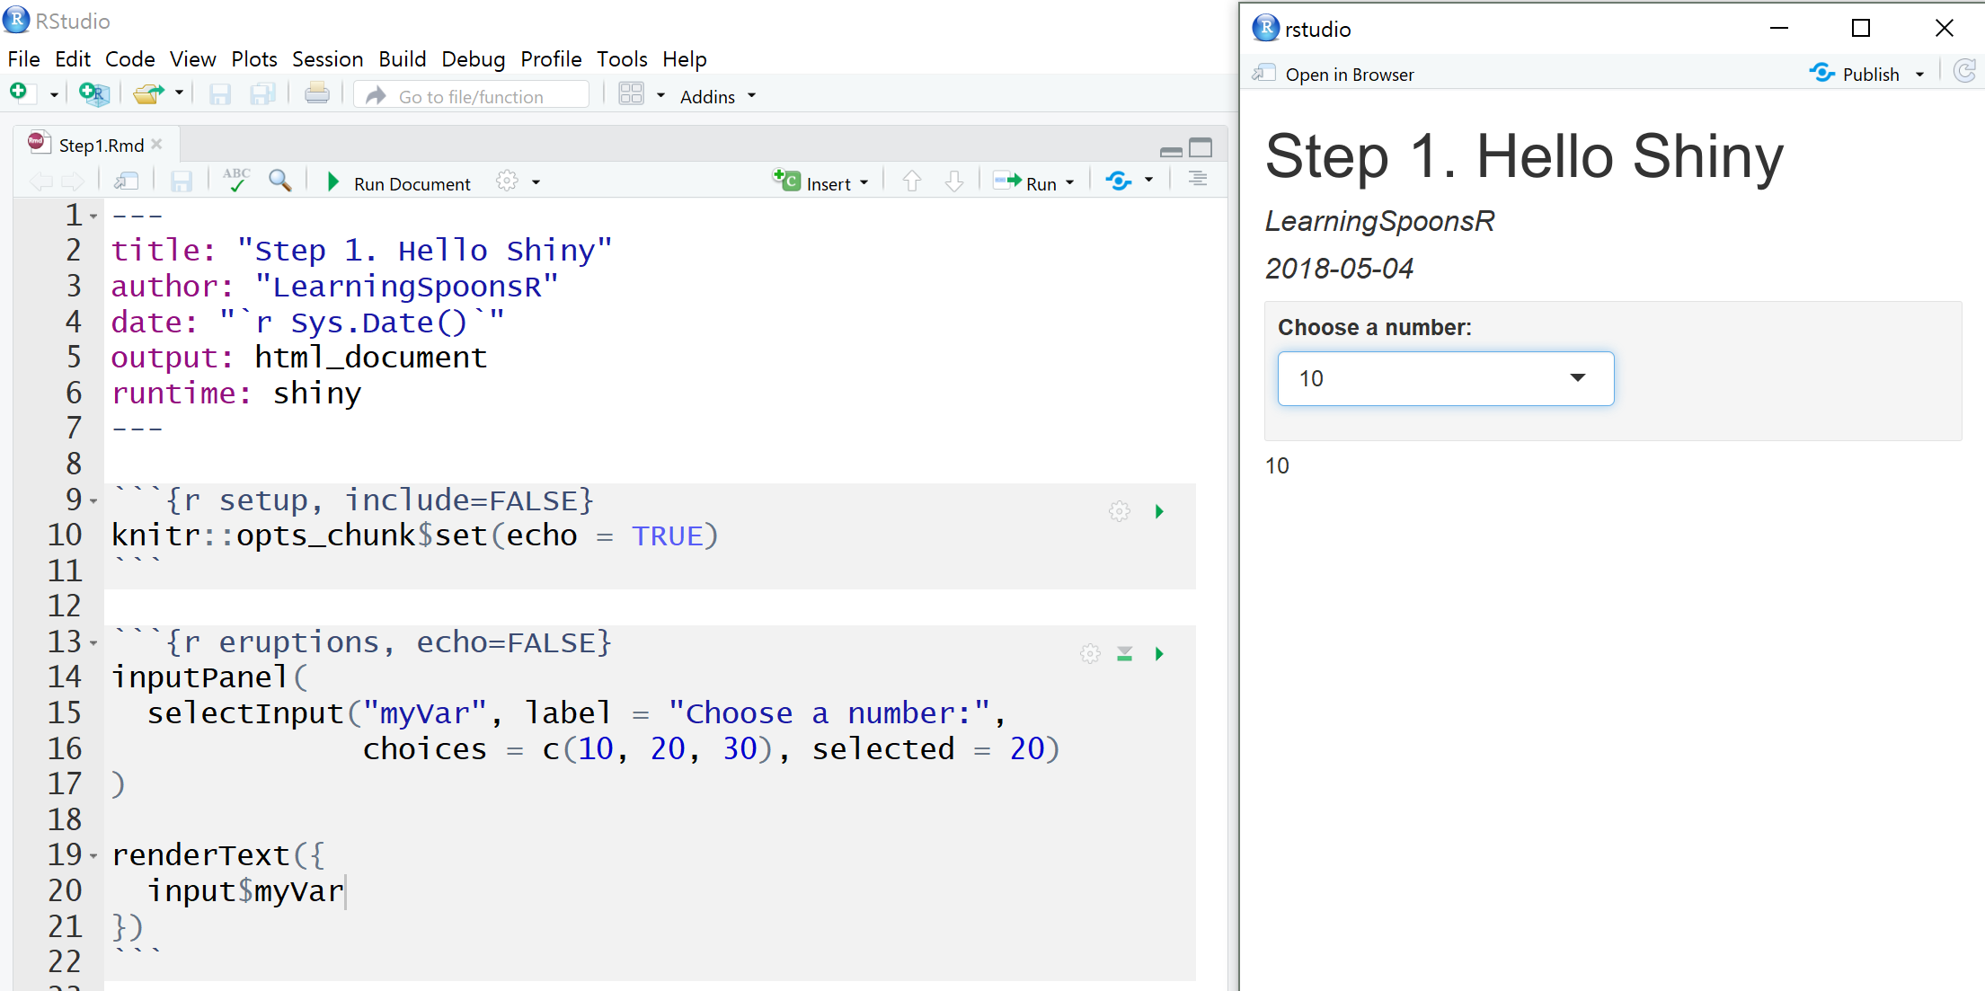
Part I. “Hello Shiny”
파일 – 새파일 – 새 R Markdown – Shiny

Slide 6
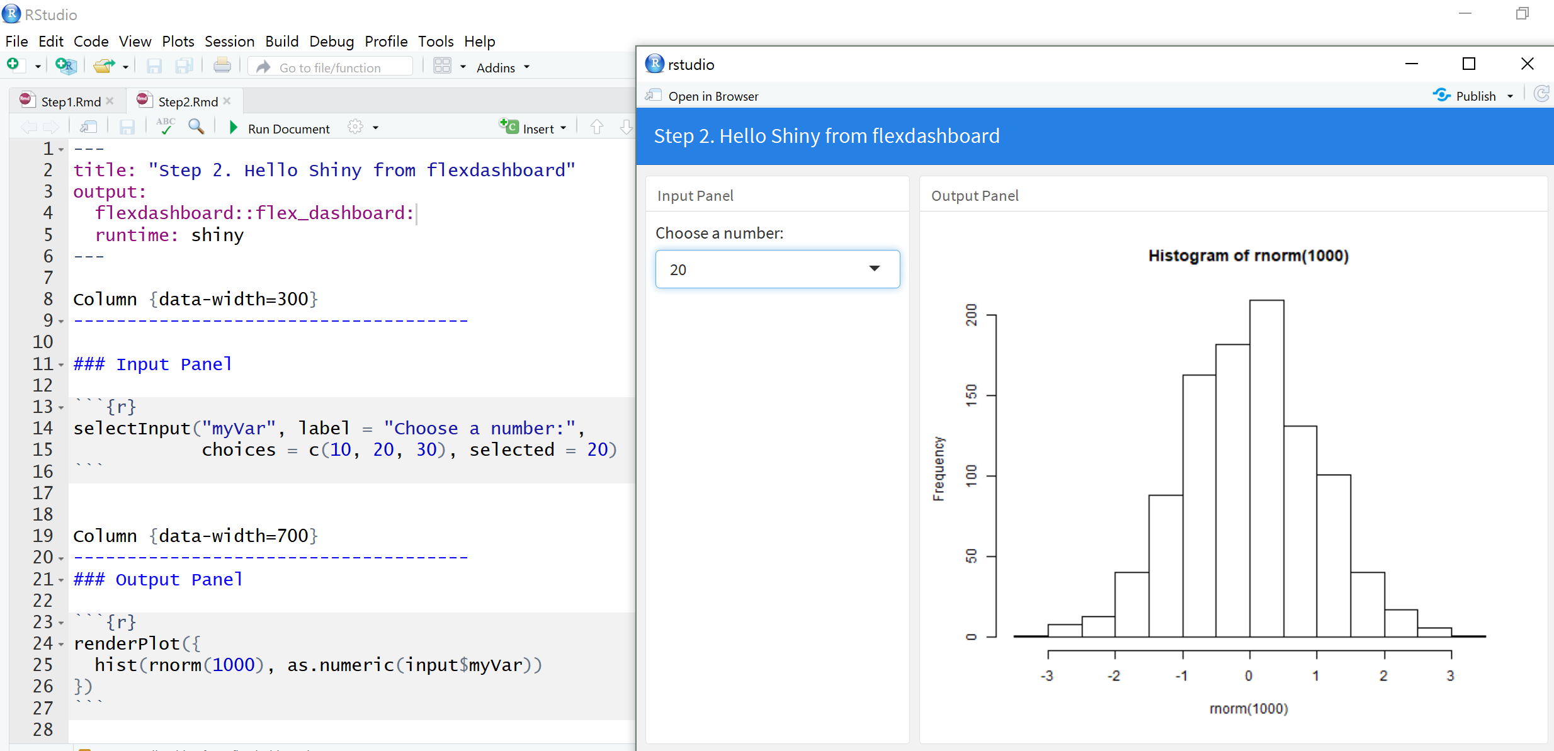
Part II. “Hello Shiny” from flexdashboard
파일 – 새파일 – 새 R Markdown – From Template - flexdashbard

Slide 7
Part III. Wordcloud shiny + flexdashboard

Slide 8
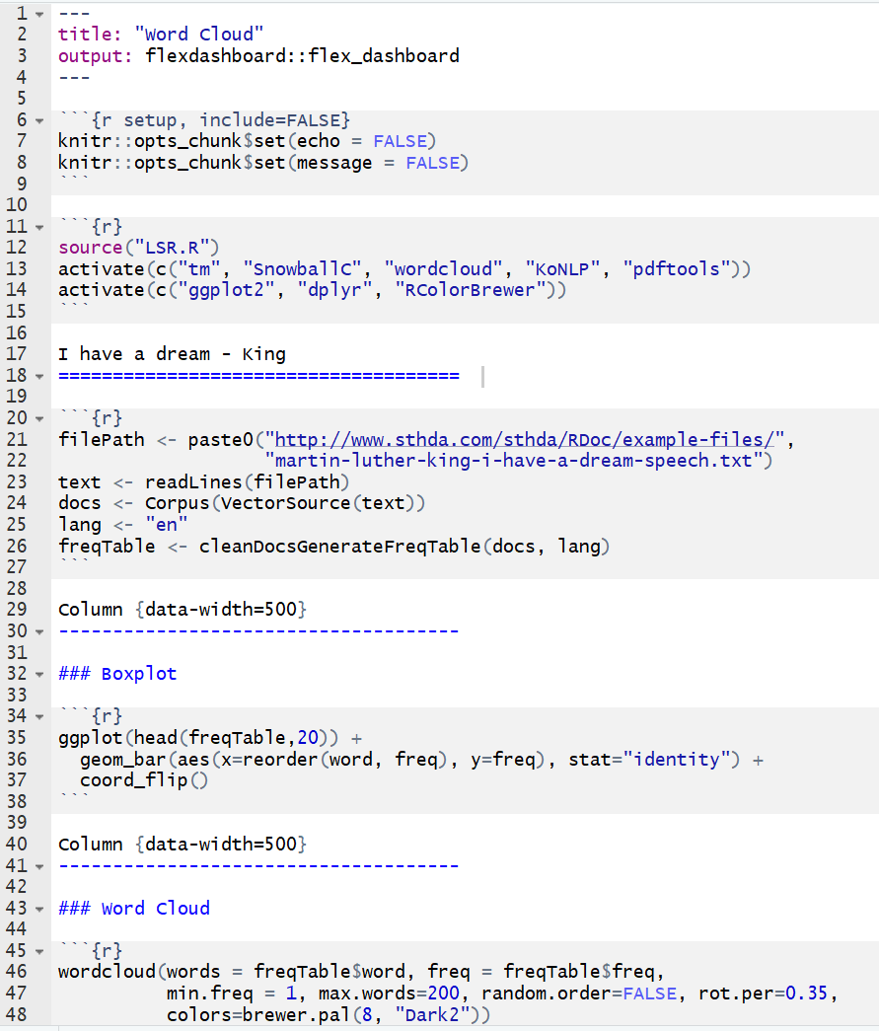
Review – flexdashboard

Slide 9
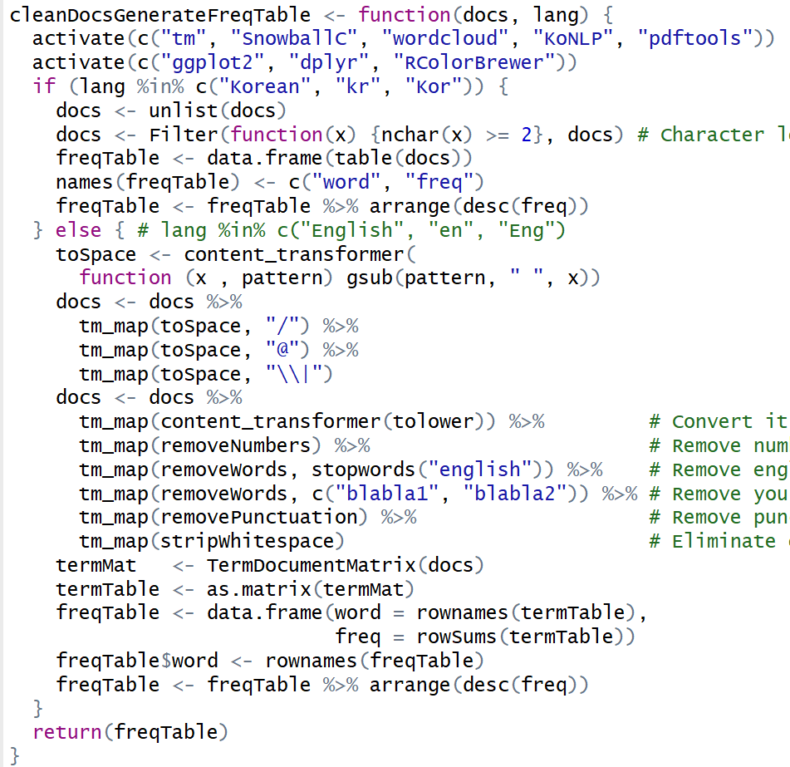
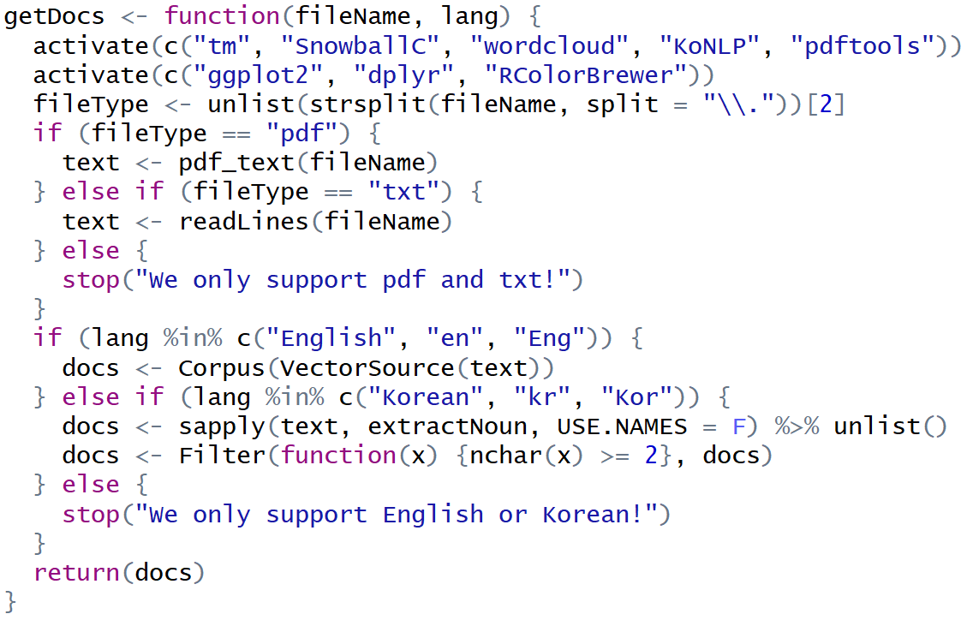
LSR.R에는 다음의 두 함수가 있습니다.

Slide 10
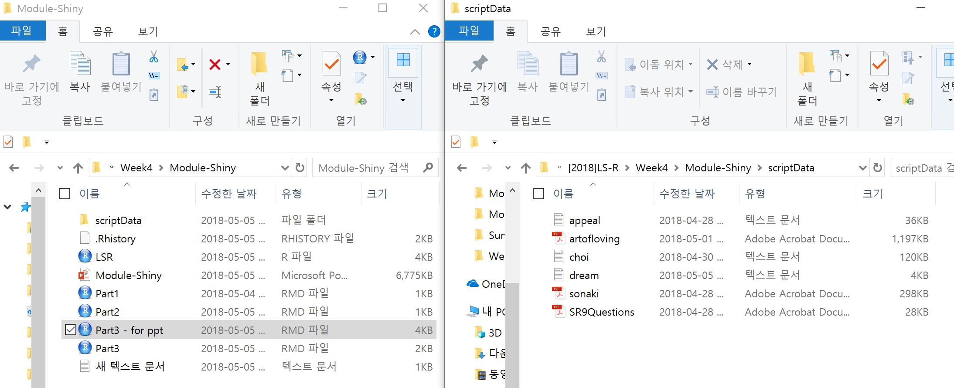
작업 환경

Slide 11
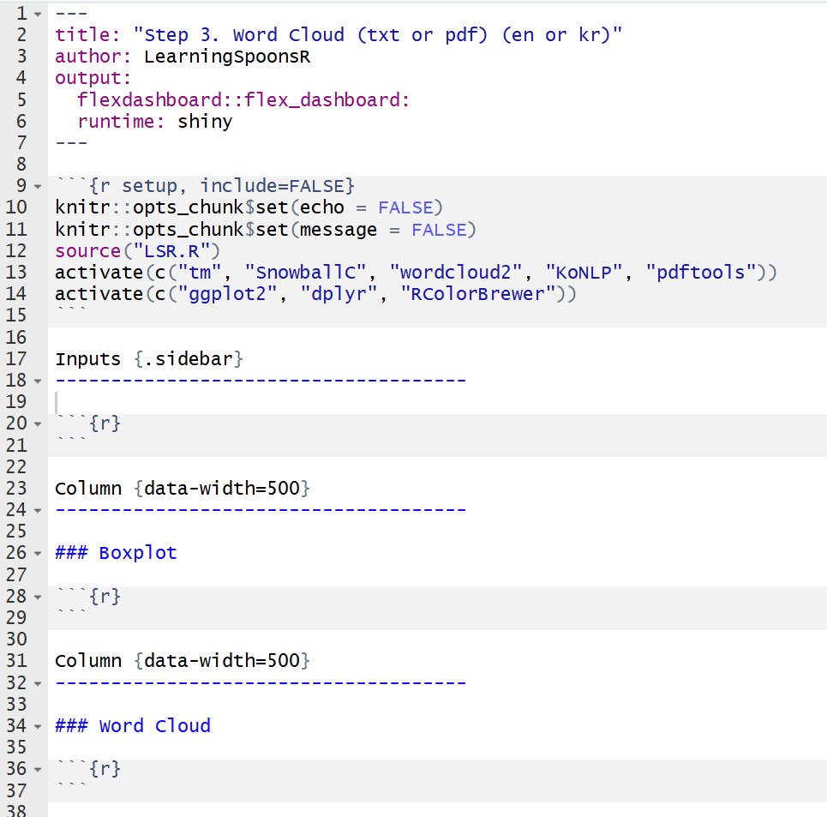
Step 1. Setup & Design Panel

Slide 12
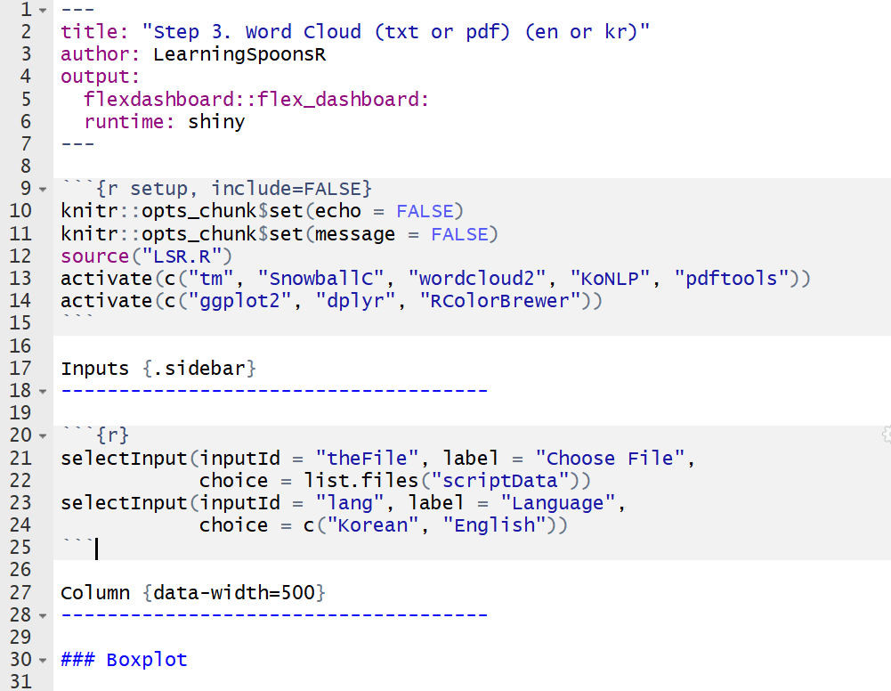
Step 2. Inputs sidebar

Slide 13
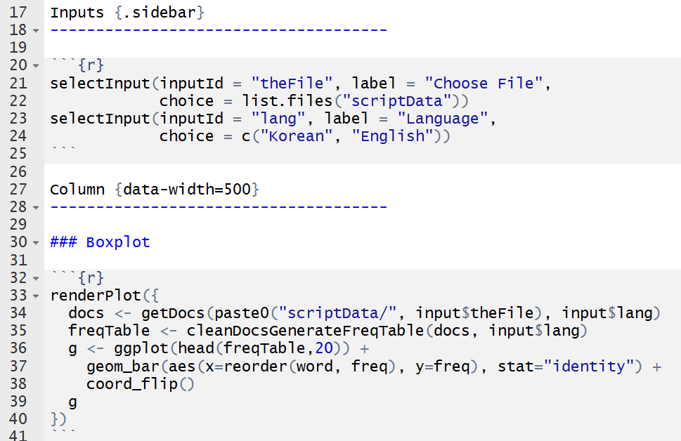
Step 3. barplot

Slide 14
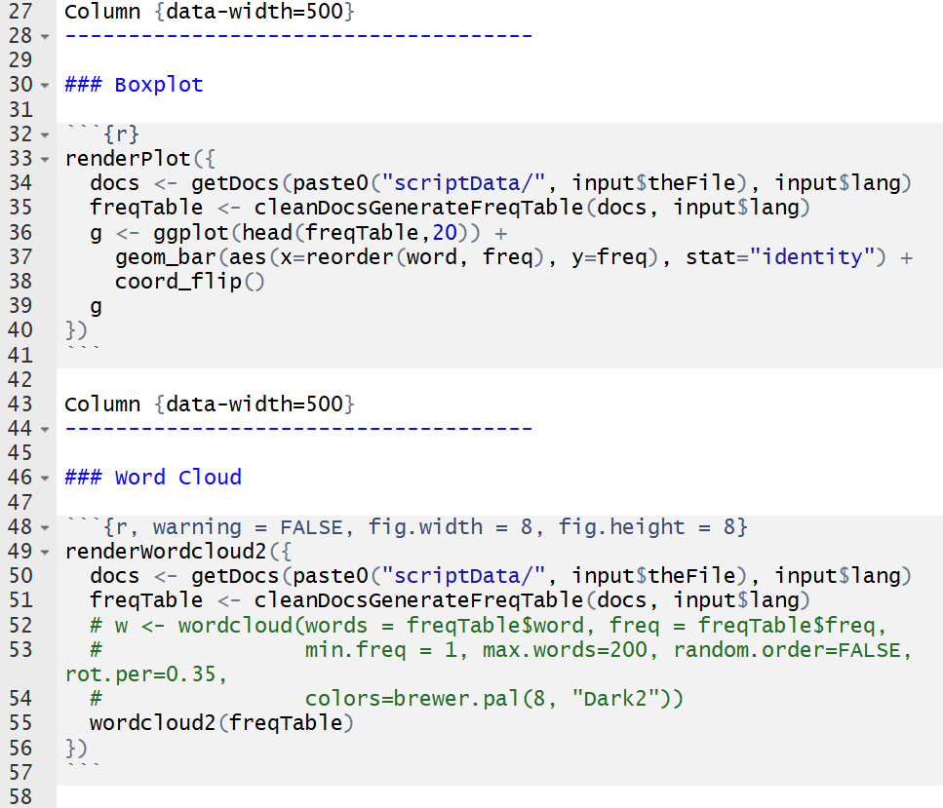
Step 4. wordcloud
https://cran.r-project.org/web/packages/wordcloud2/vignettes/wordcloud.html

Slide 15
프로그램 시연!

Slide 16
Part IV. More Shiny on Flexdashboard

Slide 17
Control Widgets
Function | Widget | 비고
checkboxGroupInput | A group of check boxes | 복수선택 가능
checkboxInput | A single check box | Boolean
dateInput | A calendar to aid date selection
dateRangeInput | A pair of calendars for selecting a date range
numericInput | A field to enter numbers
radioButtons | A set of radio buttons | 복수선택 불가
selectInput | A box with choices to select from | 드랍다운 메뉴
sliderInput | A slider bar
textInput | A field to enter text
submitButton | A submit button
http://shiny.rstudio.com/gallery/widget-gallery.html

Slide 18
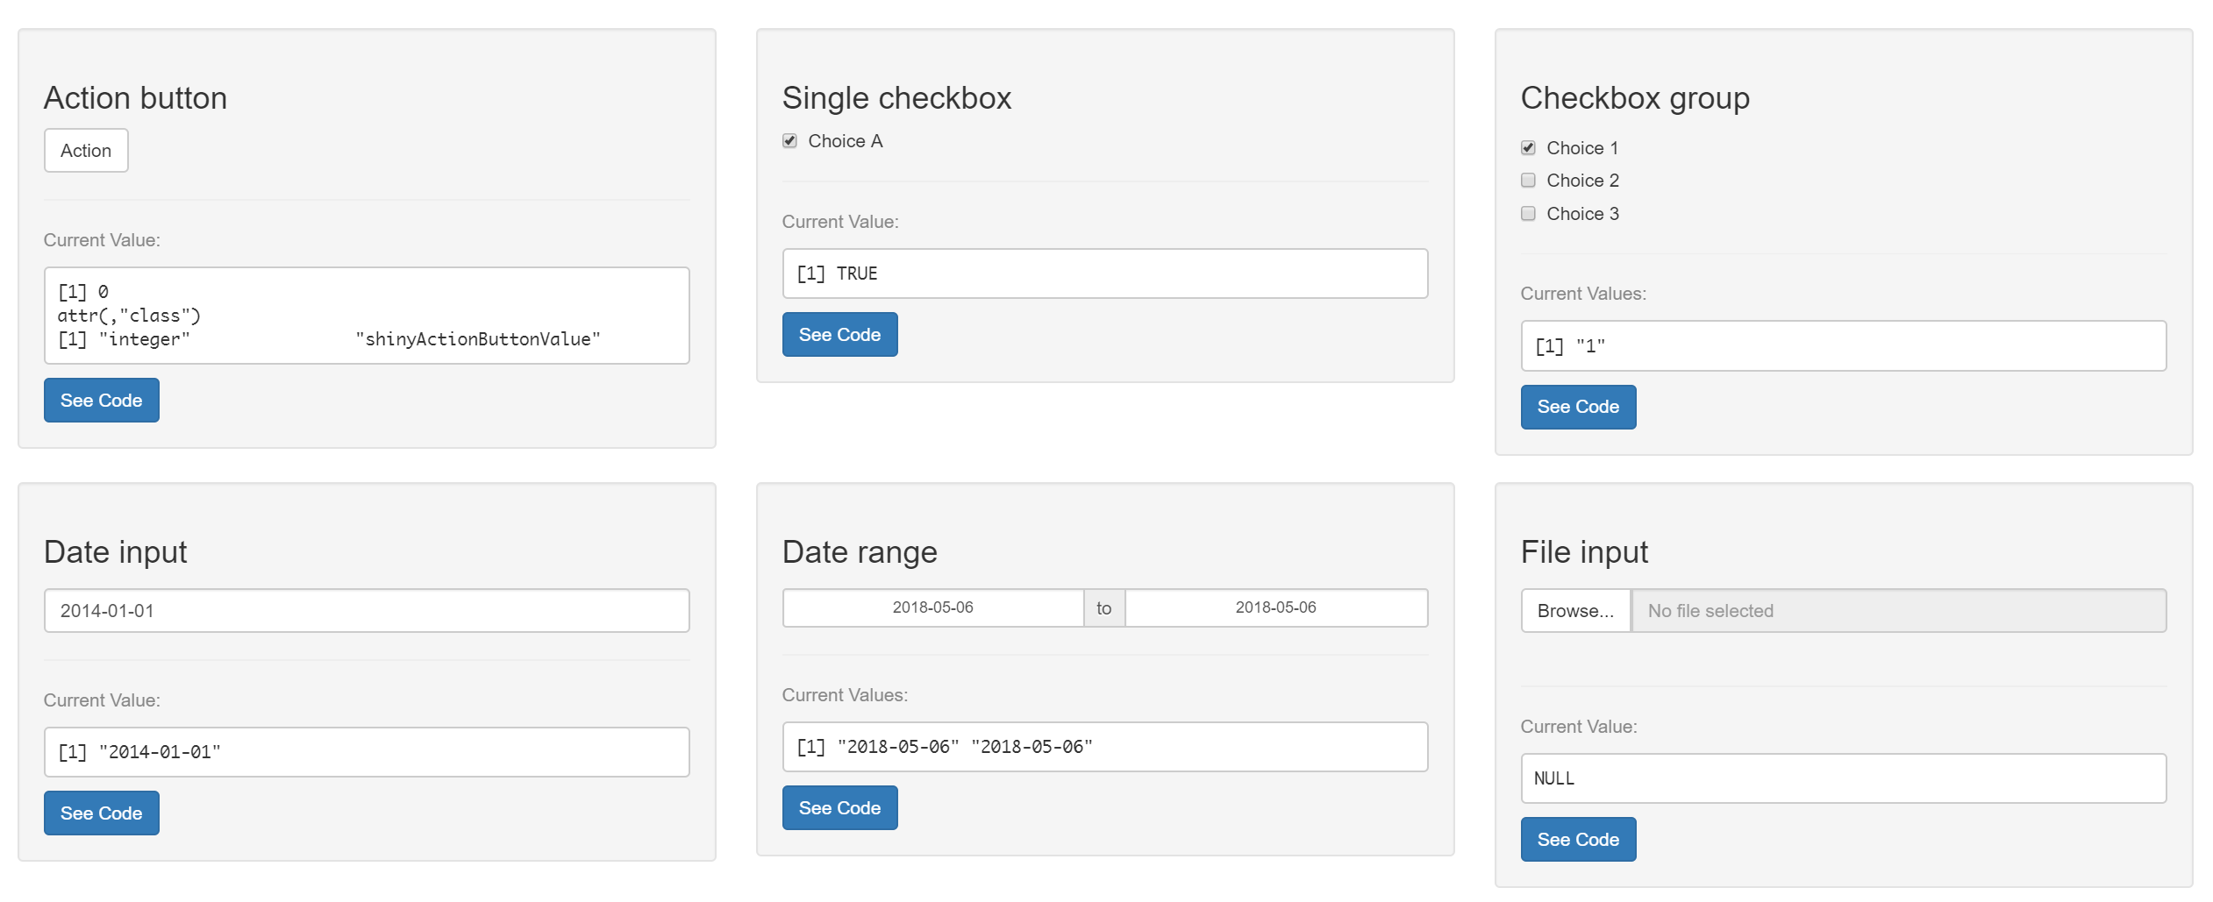
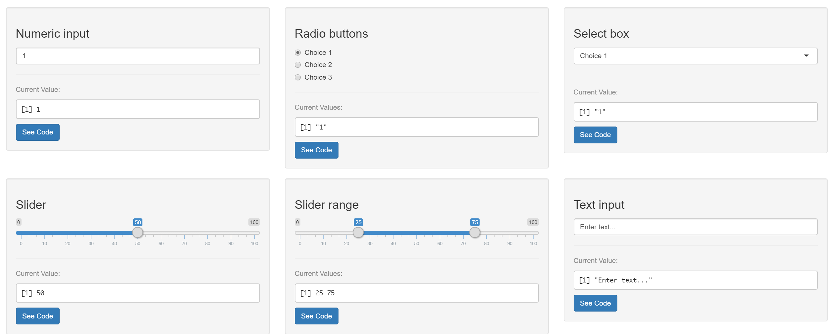

Slide 19
Rendering
renderText
renderTable
renderPlot
renderDygraph
renderWordCloud2
…
https://shiny.rstudio.com/tutorial/

