Slide 1
AI-Powered Analysis of ORCID and RLA Data for Technology Landscaping
Presenter: Luhan Cheng
Notes:
ORCID profiles provide a substantial amount of information about research communities. ORCID is considered a key data source for providing valuable and open-access data about researchers and their research works. However, ORCID also has potential to inform Technology Landscaping regarding researchers and their associated research networks, with potential applications including identifying technical expertise, emerging research communities, and investment opportunities.
This presentation features a case study leveraging over 100,000 Australian ORCID researcher profiles and their research outcome collected from ARDC Research Link platform. We demonstrate how we have collected, connected, and analysed this dataset to observe the time-series evolution of the Australian research communities. The resulting animation will illustrate five years of historical developments within these communities. This will also establish a robust foundation for projecting future technological trends in Australia.
Aligning with the technical aspect of this presentation, we demonstrate an AI pipeline using LLM model to analyse our data and achieve the visualisation results. This makes the solution presented in our work accessible and interoperable with many research infrastructure solutions in universities. We will discuss the technical challenges and opportunities observed while developing and deploying this solution in Nectar Cloud. We believe the lessons learned from our work can help identify potential new use cases for application of AI pipelines to analyse ORCID and other open scholarly data.

Slide 2
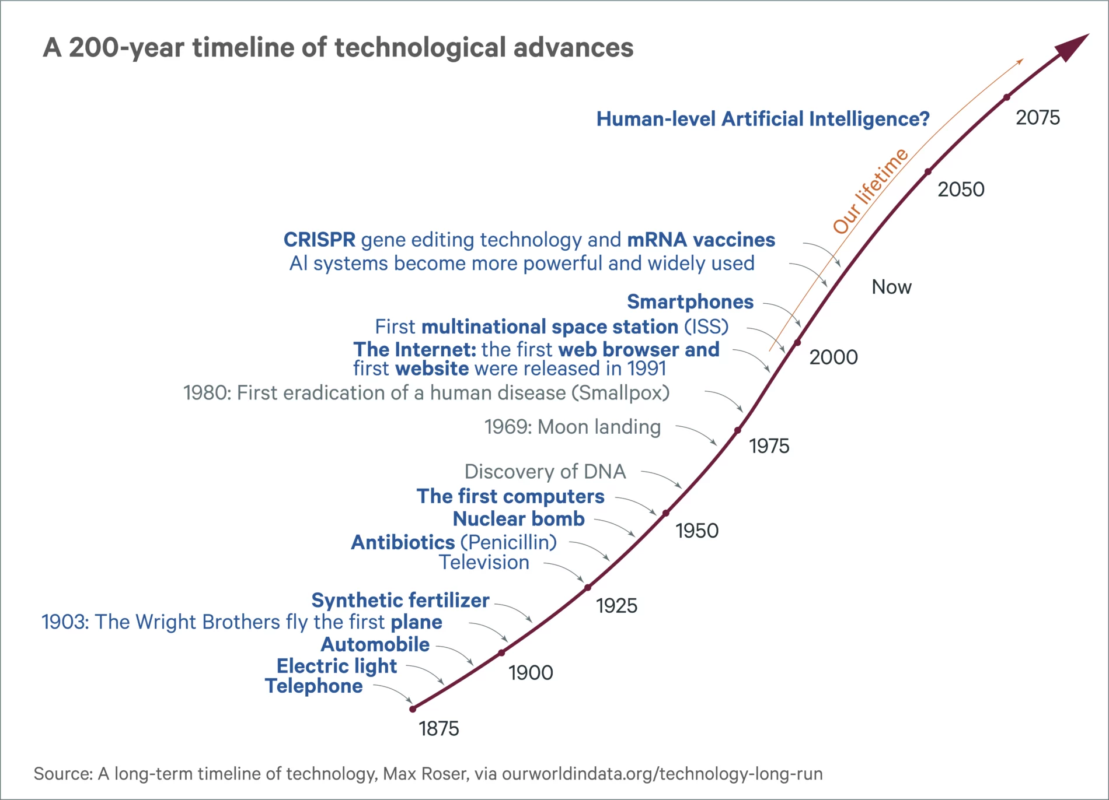
Technology Landscaping
Using AI to identify key technologies strategically relevant to organisations, research projects and industry.
Understand the innovation trends, opportunities and risks
Make rational decisions on how to allocate resources
https://ourworldindata.org/technology-long-run
Notes:
This slide will be presenting the keywords trends, so the x axis will be time, y axis will be the frequency and the bubble size will be funding amount.

Slide 3
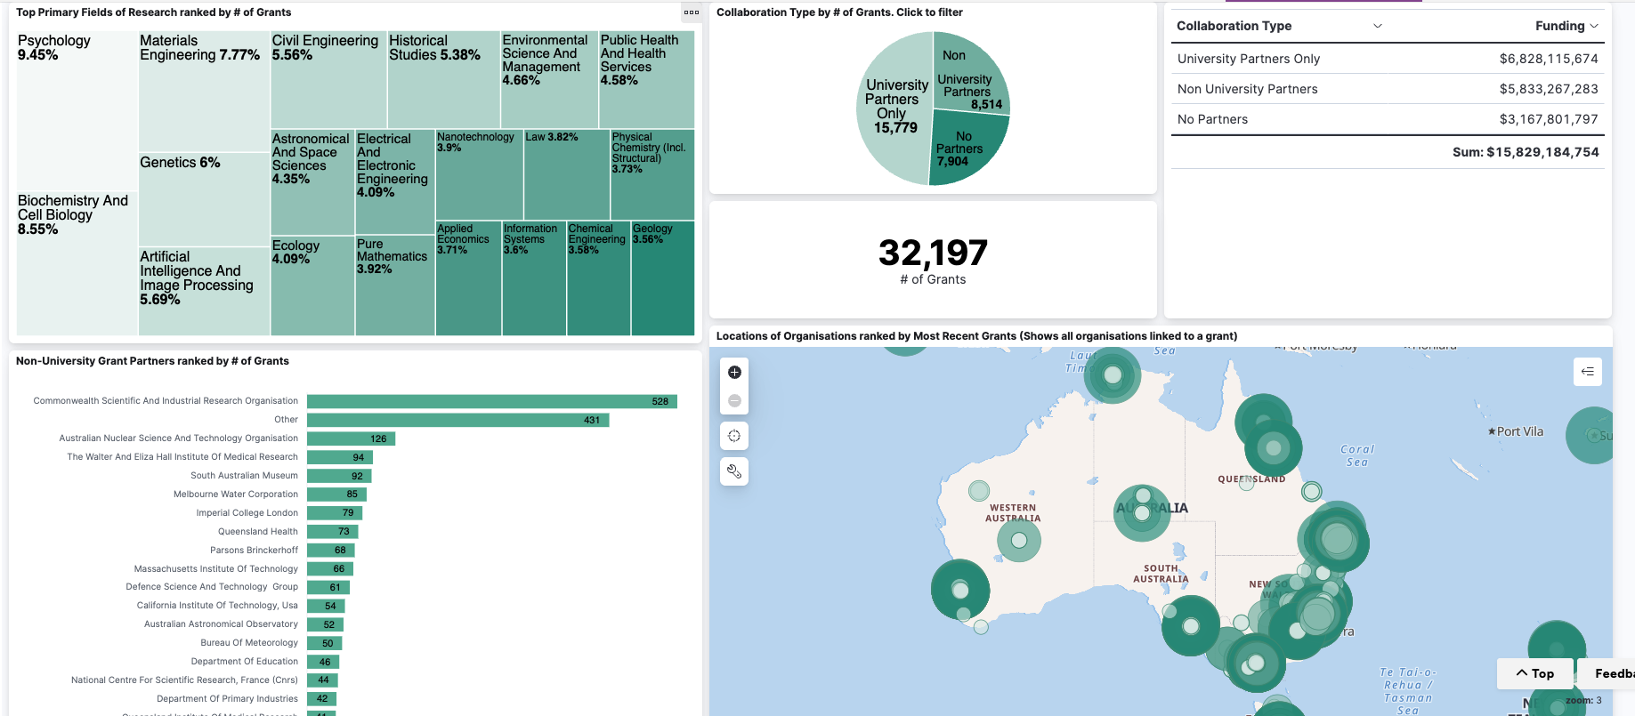
What is RLA

Slide 4
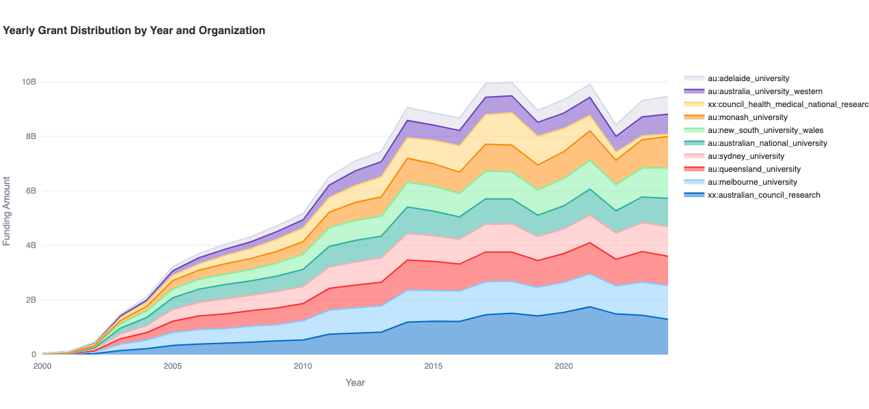
The value of ORCID data
Notes:
ORCID data

Slide 5
Sample Grant
Table 1
Title | ARC Training Centre for Information Resilience.
grant_summary | ARC Training Centre for Information Resilience. The proposed centre aims at building workforce capacity in Australian organisations to create, protect and sustain agile data pipelines, capable of detecting and responding to failures and risks across the information value chain in which the data is sourced, shared, transformed, analysed and consumed...
Funding_amount | 4883406.0
Start_year | 2021
End_year | 2026
funder | Australian Research Council
Linked_researchers | ['0000-0002-5414-8276', '0000-0002-4259-9774', '0000-0002-6920-7072', '0000-0002-7311-3693’,…]

Slide 6
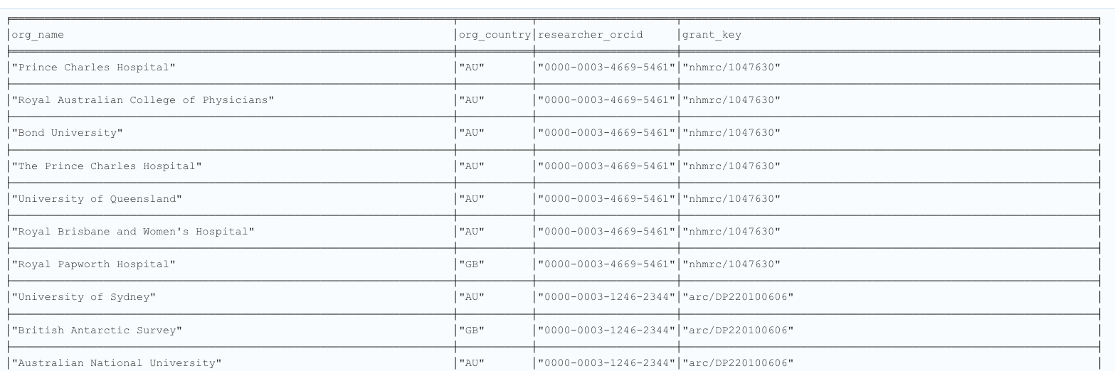
Linking Organisation using ORCID
Notes:
Need a slide

Slide 7
ARDC data API
83k Grants
809k researchers
310k organisations

Slide 8
Why extract keywords and build categories using LLM
Existing categories does not capture emerging trends
Existing categories do not update frequently (10+ year time interval for ANZSRC)
LLM can approximate domain expert knowledge while being much easier to scale up
Notes:
This slide will be presenting the keywords trends, so the x axis will be time, y axis will be the frequency and the bubble size will be funding amount.

Slide 9
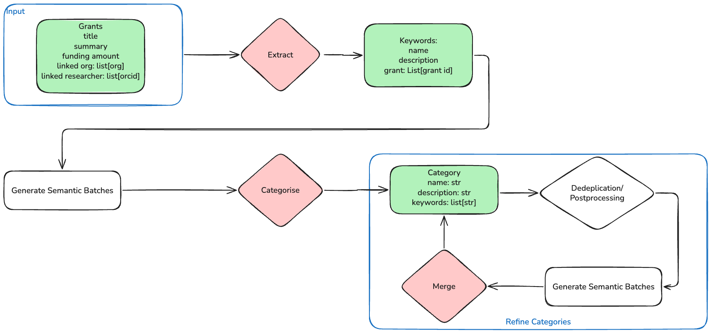
Overview of the workflow
Notes:
This slide show an overview of the workflow. I’m going to expand it further in the next few slides

Slide 10
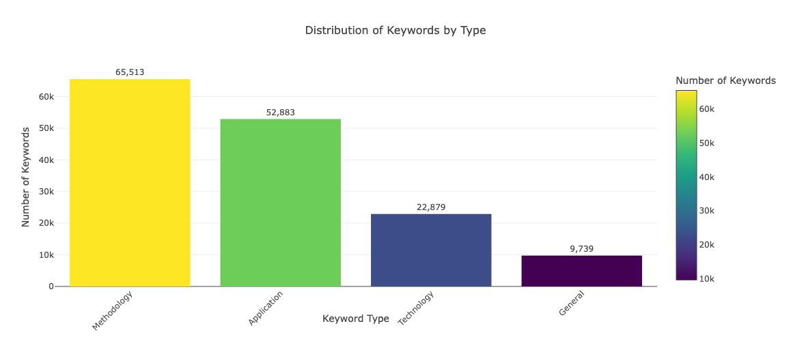
What are the keywords detected by our methods

Slide 11
Sample Keyword
Table 2
name | laser interferometry
type | Methodology
description | A technique that uses laser beams and interferometers to measure extremely small changes in distance, enabling the detection of gravitational wave signals.
grants | ['arc/FT100100613', 'arc/LE0989093', 'arc/DP110103347']
organisation_name | ['Australian National University', 'University of Otago', ‘Australian National University', 'University of Western Australia’,…]
organisation_country | ['AU', 'NZ', 'AU', 'AU’,….]
researcher_orcid | ['0000-0001-6210-5842', ‘0000-0001-6210-5842', '0000-0001-6210-5842', '0000-0001-6210-5842’,…]

Slide 12
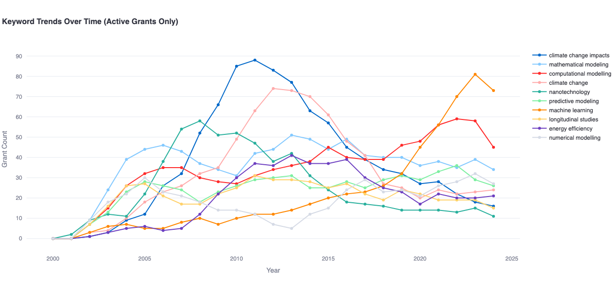
Keywords Trends

Slide 13
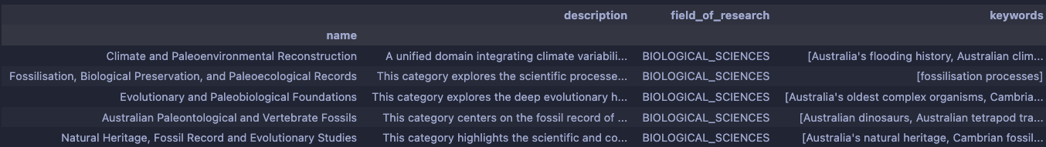
Category Sample

Slide 14
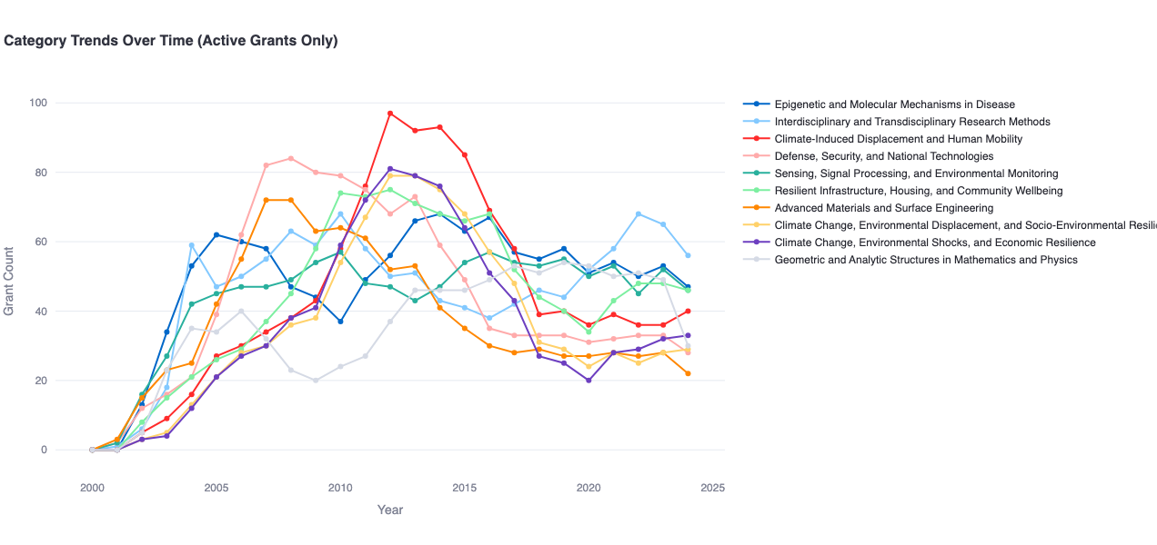
Category Overview

Slide 15
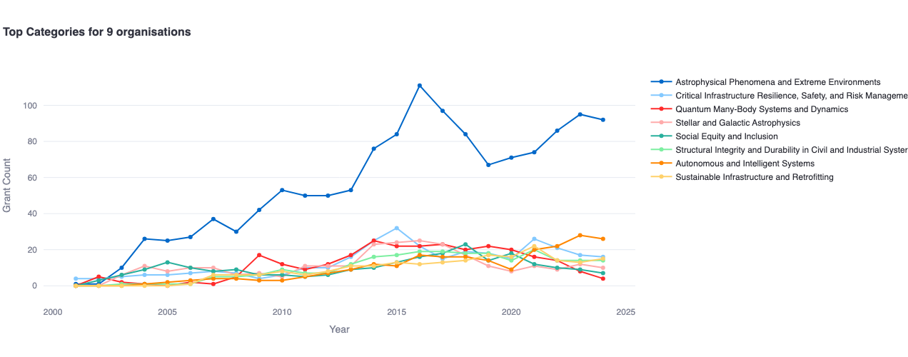
Swinburne

Slide 16
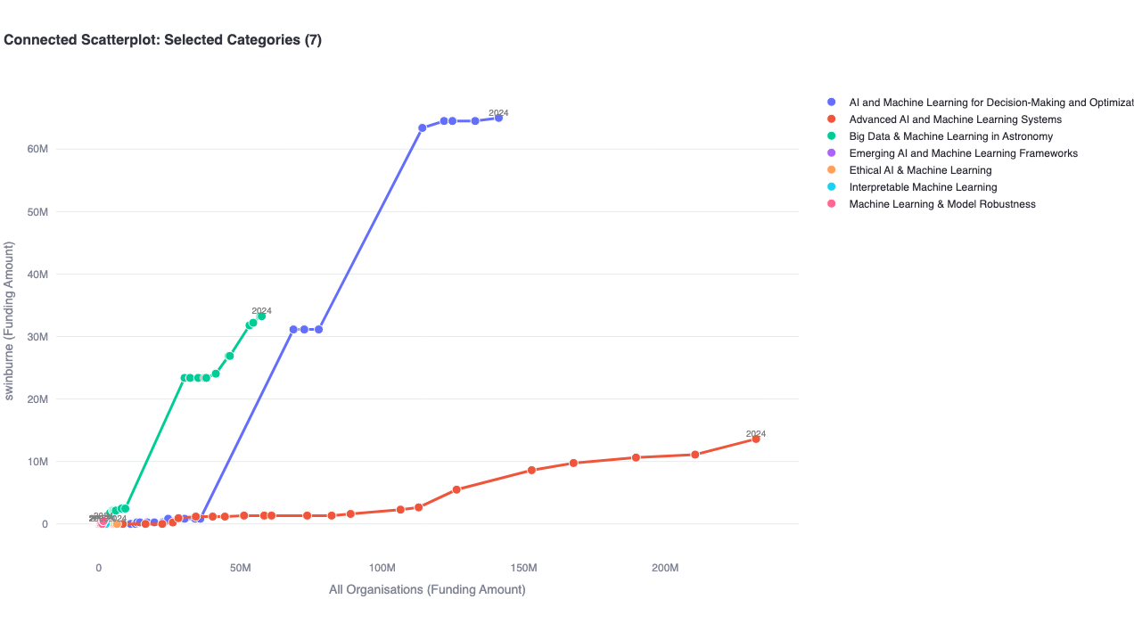
Swinburne compared with rest of Australia in machine learning

Slide 17
Methodology

Slide 18
Overview of the workflow
Notes:
This slide show an overview of the workflow. I’m going to expand it further in the next few slides

Slide 19
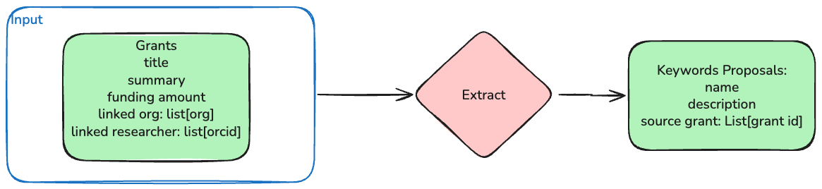
Keywords Extraction
Notes:
In this slides we illustrate how we extract keywords from grants. We feed these 77k grants files each individually to Qwen4 4B Instruct 2507 model. And ask the LLM to identify keywords of 4 different types, general, technology, methodology and application.

Slide 20
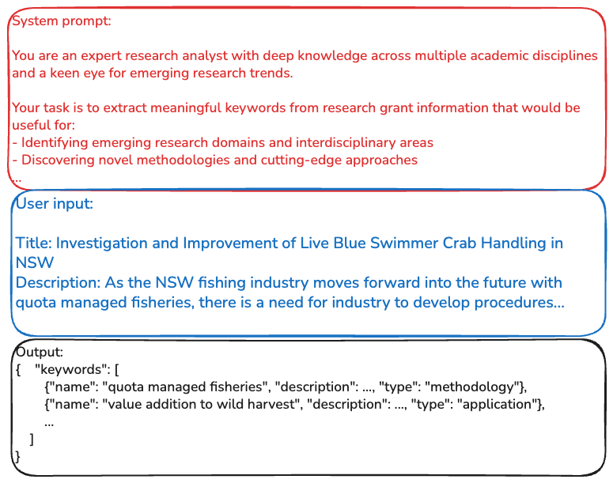
Keywords Extraction
Notes:
This slides shows an example system prompt, user input and output. At the top red box is system prompt, which defines the task objectives, list constraints etc. The middle blue box is an example grants input. We use html tag to delimit different fields of the grants. For those grants that do not have an description we simply use their title to extract keywords.

Slide 21
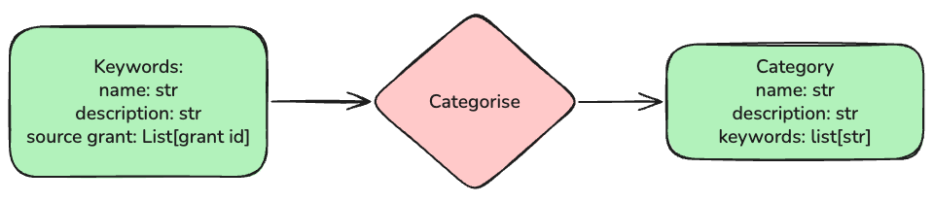
Categorisation
Notes:
Ideally we want to put all keywords in one huge batches that can be fed into a long context model like gemini-2.5-pro. However there are two issues
Even 1 mil context window is insufficient given the that we have generated around 200k keywords (along with their descriptions)
It is very difficult to do quality control as we will see in next slide
We use json schema to enforce LLM to reference back to input keywords. This is akin to the recall metrics, and it is our primary matric.
We also measured keyword precision (aka the how much does model hallucinate keywords), but In practice it is quite minimal
Therefore, we are taking batches of 50 keywords to create category
With this setting the output category is able to correctly cover around 90% of the input keywords

Slide 22
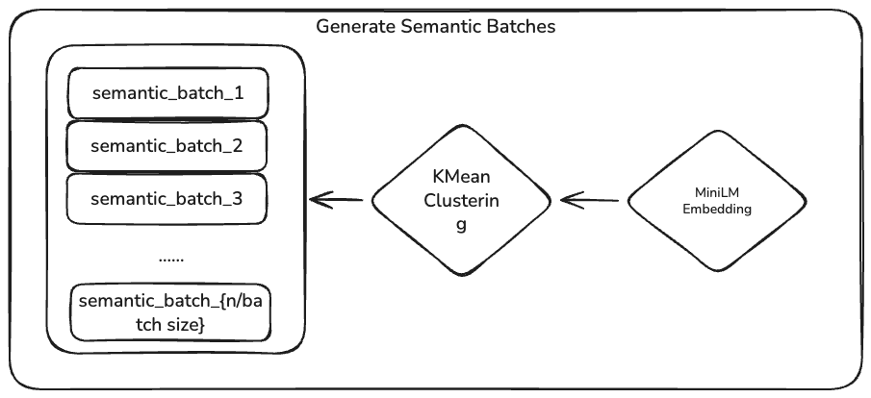
Semantic Batching
Notes:
Ideally we want to put all keywords in one huge batches that can be fed into a long context model like gemini-2.5-pro. However there are two issues
Even 1 mil context window is insufficient given the that we have generated around 200k keywords (along with their descriptions)
It is very difficult to do quality control as we will see in next slide
We use json schema to enforce LLM to reference back to input keywords. This is akin to the recall metrics, and it is our primary matric.
We also measured keyword precision (aka the how much does model hallucinate keywords), but In practice it is quite minimal
Therefore, we are taking batches of 50 keywords to create category
With this setting the output category is able to correctly cover around 90% of the input keywords

Slide 23
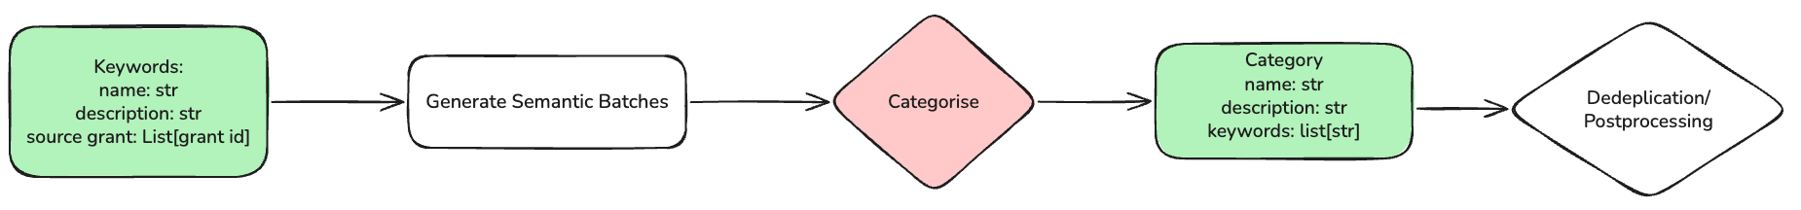
Categorisation
Notes:
Ideally we want to put all keywords in one huge batches that can be fed into a long context model like gemini-2.5-pro. However there are two issues
Even 1 mil context window is insufficient given the that we have generated around 200k keywords (along with their descriptions)
It is very difficult to do quality control as we will see in next slide
We use json schema to enforce LLM to reference back to input keywords. This is akin to the recall metrics, and it is our primary matric.
We also measured keyword precision (aka the how much does model hallucinate keywords), but In practice it is quite minimal
Therefore, we are taking batches of 50 keywords to create category
With this setting the output category is able to correctly cover around 90% of the input keywords

Slide 24
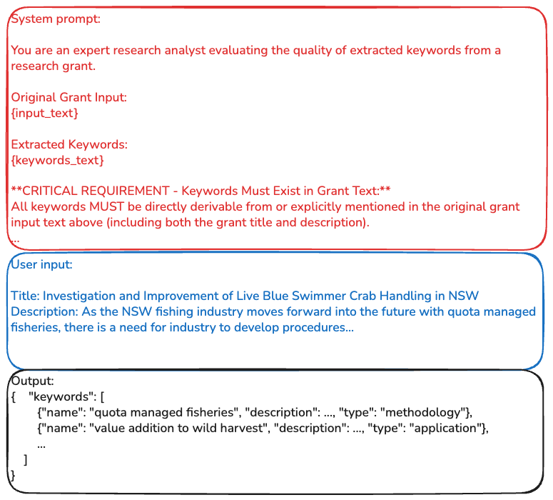
Categorisation
Notes:
However, the problem is our are still gonna to have duplicated keywords proposals across batches. In next step, we attempt to further generalise these categories using a merge routine.

Slide 25
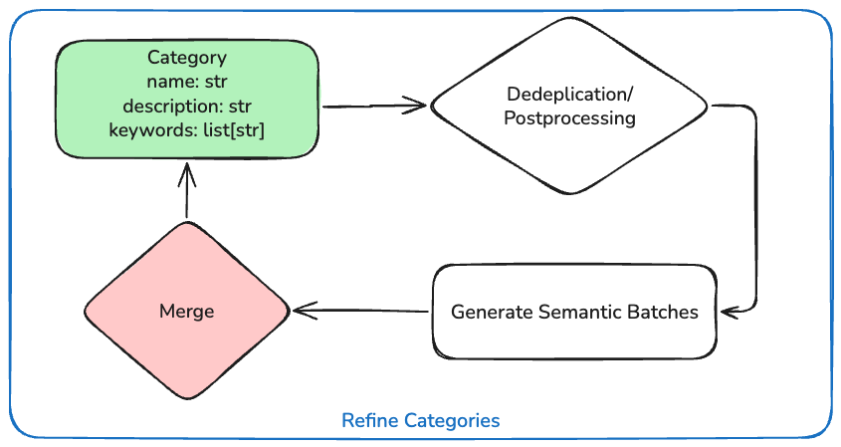
Merge
Notes:
Instead of randomly sampling batches. We decide to instead bias towards semantically similar categories proposals. We first run a deduplication workflow to get rid of categories with the same name. We then use minim to embed each proposal into a dense vector, and run a clustering algorithm on it with the constraint on roughly how many samples should belong to each cluster.
This way each batch should only contain similar proposals, this approach have 2 benefits
it majorly address the problem of intra-batch generalism, which generates precise output categories.
It helps with reducing inter-batch similarity
Note that this approach does not fully address the problem of similar batches, and it also introduce a couple more hyper parameters.

Slide 26
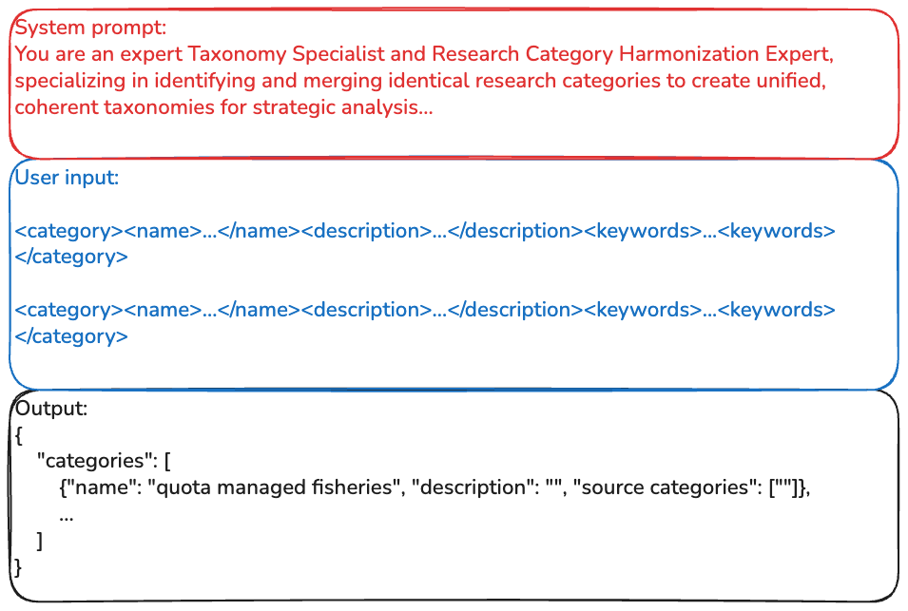
Merge
Notes:
We can actually just treat our category proposals as keywords, and use a very similar prompts to further abstractlise the categories. However, There are a few problems. And similarly we can use keywords converge as the metric for quality control
As the batch size increase, the catastrophic forgetting of source categories increase (this is even more severe than keywords categorisation as now we have a category object siting between input and output)
The natural compression rate is pretty bad (around 25%)
If we force compression rate by specifying how many categories should be outputted for each batch, it either does not follow such specification or just encounter catastrophic forgetting
If we run multiple iterations of this it will generate generalist categories instead of the specific ones that are useful for tech landscaping
In summary, the problem with random sampled batch is that if we choose a large batch, it will likely output generalist categories. And if we choose small batch, it requires too many iterations which again leads to generalist categories
So what can we do to fix it?

Slide 27
Future works
Quality control for the categorisation and merge process
Further examination of different clustering/embedding algorithms
Notes:
The quality control for categorisation process is still somewhat shaky. It might be useful to implement a QA process similar to how keywords proposals are reviewed.
It is possible to put merge and classify processes into a loop. So we can look at the results of the classification, if there are too many grants belongs to multiple categories, that might indicate our taxonomy is too coarse
Most of hyper parameter choices like batch size and clustering parameters are eyeballed with very limited samples, a further hyper parameter tuning would be good.

