Slide 1
Radare2
In Soviet Russia Radare2 Debugs You!
John Bird
Ruxcon 2017
Melbourne Australia

Slide 2
Introduction
Who am I?
What will this talk cover?
What will you need to already know?
What will you get out of it?

Slide 3
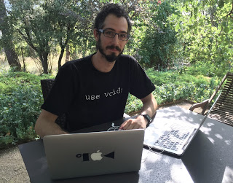
Radare2 background
“The radare project began in February of 2006 to provide a free and simple command-line hexadecimal editor with support for 64-bit offsets. The intention was to use the tool to perform searches and help recover data from hard-disks.”
Largely developed by Sergi Alvarez (aka pancake)

Slide 4
Radare2
Radare is a portable reversing framework that can...
Disassemble (and assemble for) many different architectures
Debug with local native and remote debuggers (gdb, rap, webui, r2pipe, winedbg, windbg)
Run on Linux, *BSD, Windows, OSX, Android, iOS, Solaris and Haiku
Perform forensics on filesystems and data carving
Be scripted in Python, Javascript, Go and more
Support collaborative analysis using the embedded webserver
Visualize data structures of several file types
Patch programs to uncover new features or fix vulnerabilities
Use powerful analysis capabilities to speed up reversing
Aid in software exploitation

Slide 5

Is Radare2 better than [product]?
http://rada.re/r/cmp.html

Slide 6
Utilities
Radare comes with a set of useful utilities:
Rabin2 – extract info from binaries
Rasm2 – assembler/disassembler
Rahash2 – hashing/encryption/decryption and more
Radiff2 – diff binaries
Rafind2 – locate patterns within files/memory
Ragg2 – Compiler, shellcode generation and more
Rarun2 – sets up environment for running binaries
Rax2 – calculator, base converter and more

Slide 7
GUIs
The learning curve is tough
UIs are available
Native WebUI
Bokken – GTK/Python (https://inguma.eu/projects/bokken)
R4w – .Net (https://github.com/m4ndingo/radare2gui_dotnet)
Cutter – Qt/C++ (https://github.com/radareorg/cutter)

Slide 8
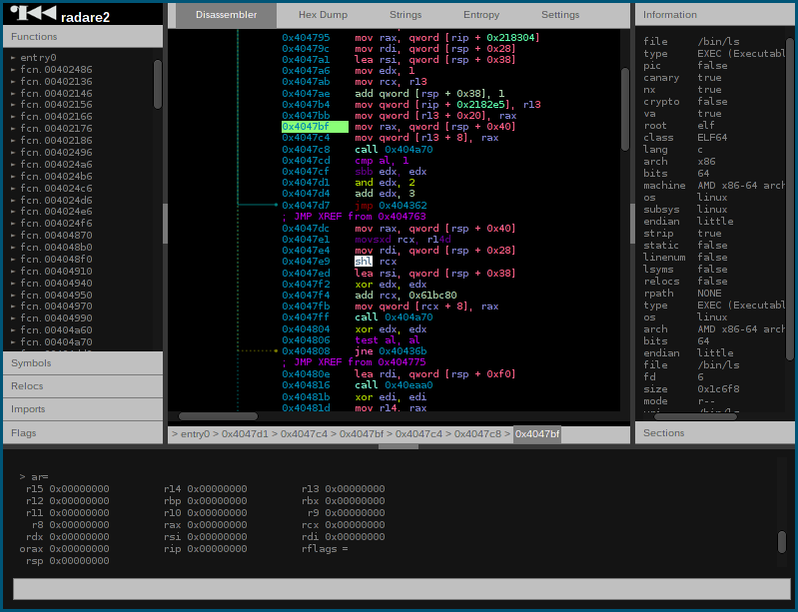
WebUI

Slide 9
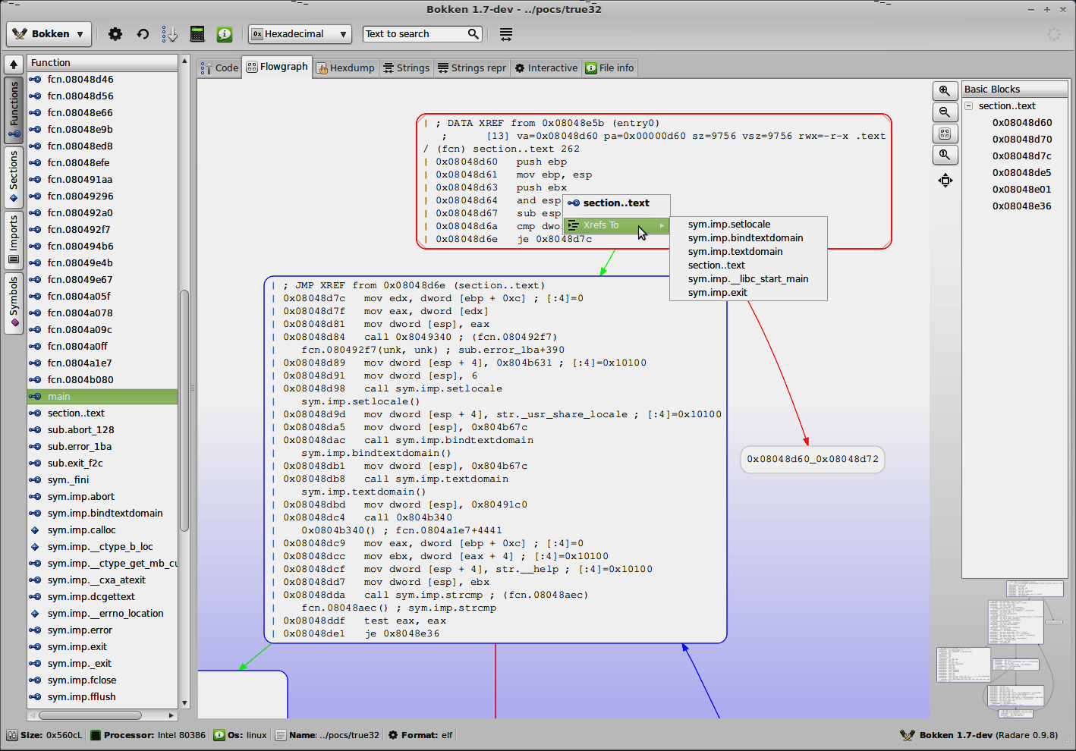
Bokken

Slide 10
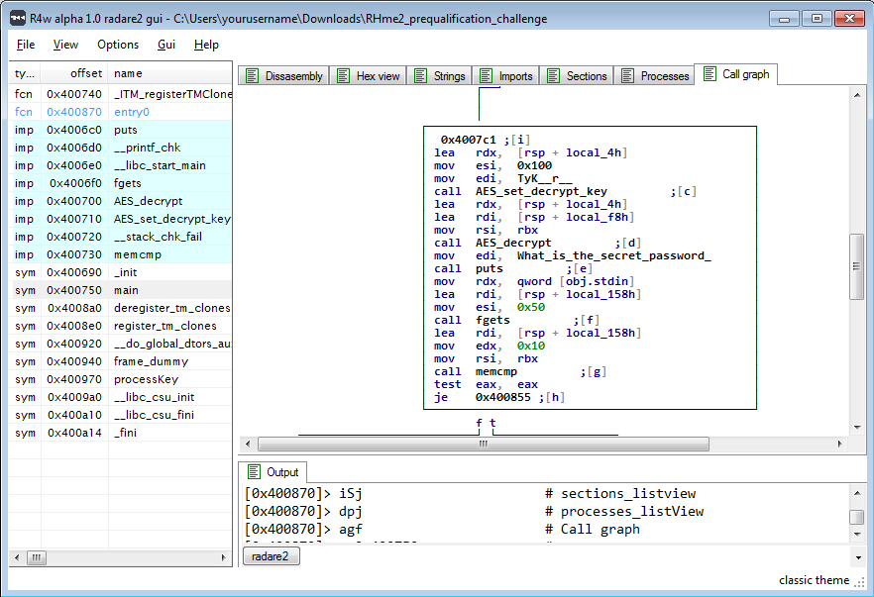
R4w

Slide 11
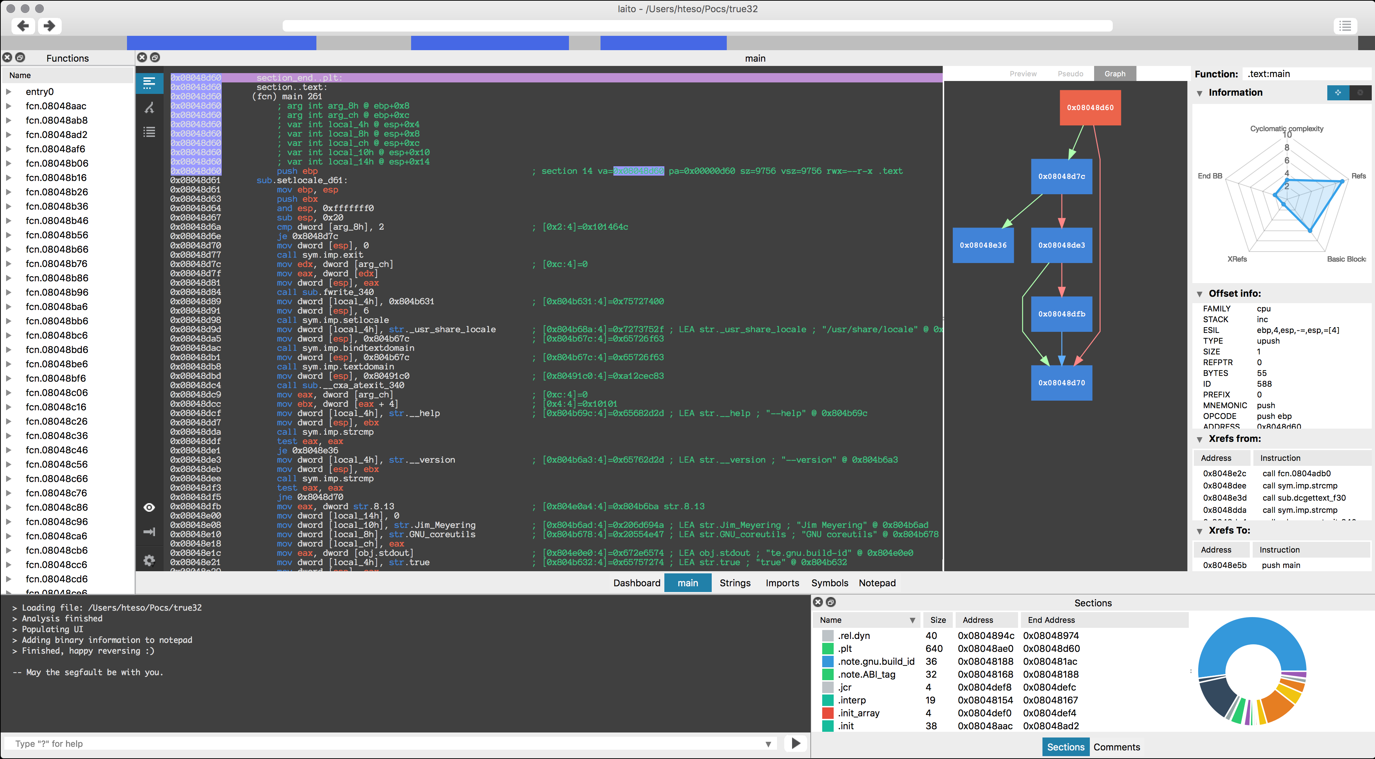
Cutter

Slide 12
Demos
Find the flag - Ruxcon CTF 2013 (?)
Garfunkel1 - Ruxcon CTF 2016
ROP demo - ROP Primer level 0
https://www.vulnhub.com/entry/rop-primer-02,114/
Stack overflow - 64bit AppSec Primer level 1
https://www.vulnhub.com/entry/the-pentesters-64-bit-appsec-primer-beta,155/

Slide 13
Stop! Demo time.
See above

Slide 14
Help
Source:
https://github.com/radare/radare2
Book:
https://www.gitbook.com/book/radare/radare2book
Cheat sheets:
https://github.com/radare/radare2/blob/master/doc/intro.md
https://github.com/zxgio/r2-cheatsheet/raw/master/r2-cheatsheet.pdf
IRC – irc://irc.freenode.net/#radare
Telegram - #radare
Twitter - @radareorg

Slide 15
Is this the end?

Slide 16
Questions?
See above

