Slide 1
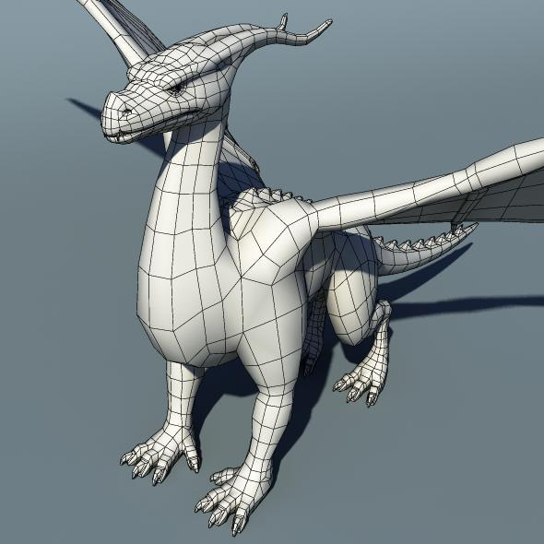
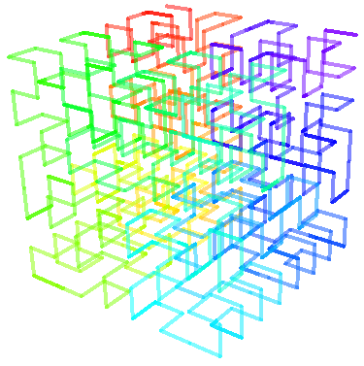
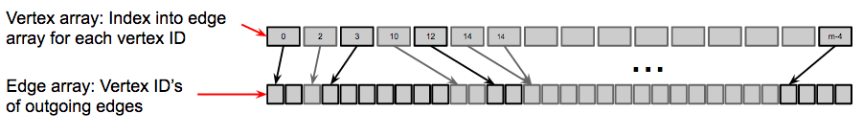
2.08
1
Fast Data-graph Computation for Physical Simulation
James Thomas, Keel Foundation Scholar
Predrag Gruevski, William Hasenplaugh, Charles Leiserson
Hilbert curve – used to order vertices so that adjacent vertices are nearby in the array
Mesh graph – the specific graph of interest

