Slide 1
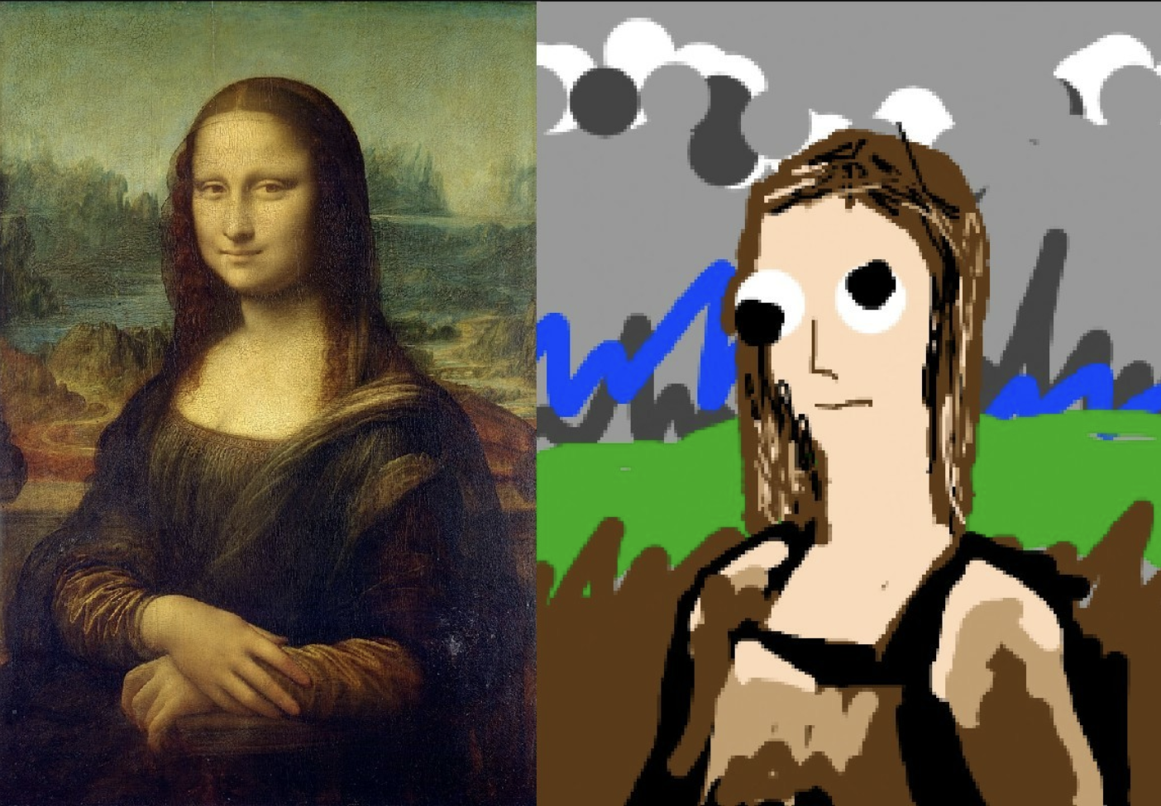
What you think this course will give you
What this course will give you

