Slide 1
数据叙事概览：从数据可视化讲起
王成军

Slide 2
内容简介
概念 Concepts
功能 Functions
过程 Process
理论 Theory

Slide 3
概念 Concepts
1

Slide 4
定义可视化
“使用图像、表格、动画进行传播”（Wikipedia）
  Images: illustrations; photographs, especially modified photos
  Diagrams: structural diagrams, blueprints, plots & charts
  Animations: based on simulation or other specifications
包括但不限于统计图 （Statistical Graphics）
可视化 (Often Abbreviated “Vis” cf. IEEE InfoVis)
  科学可视化: transformation, representation of data for exploration
  数据可视化: schematic form
    e.g., relational database form ( tuples of attribute values)
    “Data vis” often synonymous with “statistical vis”
  信息可视化: spectrum from “raw data” to “info”, “knowledge”
    Premise: info more structured, organized, abstract than data
    Emphasis on computational tools
    Working with (especially analyzing) large data sets

Slide 5
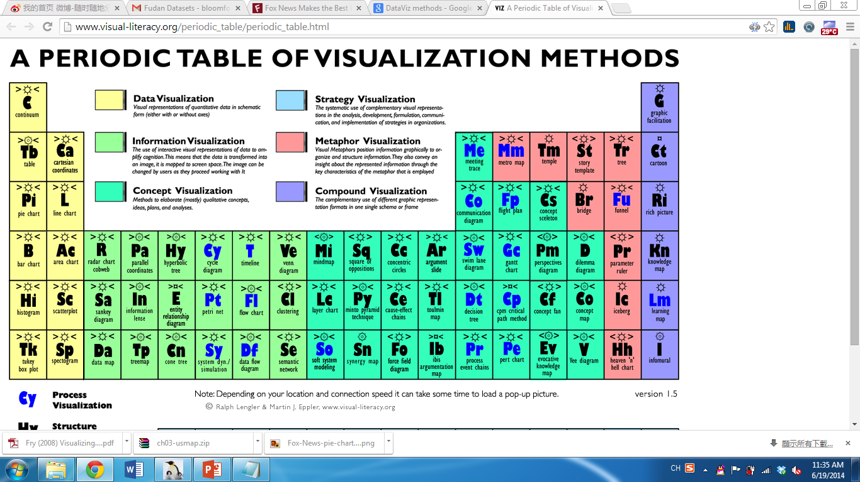
可视化周期表
http://www.visual-literacy.org/periodic_table/periodic_table.html
Notes:
http://www.visual-literacy.org/periodic_table/periodic_table.html 打开此链接，鼠标浮动。

Slide 6
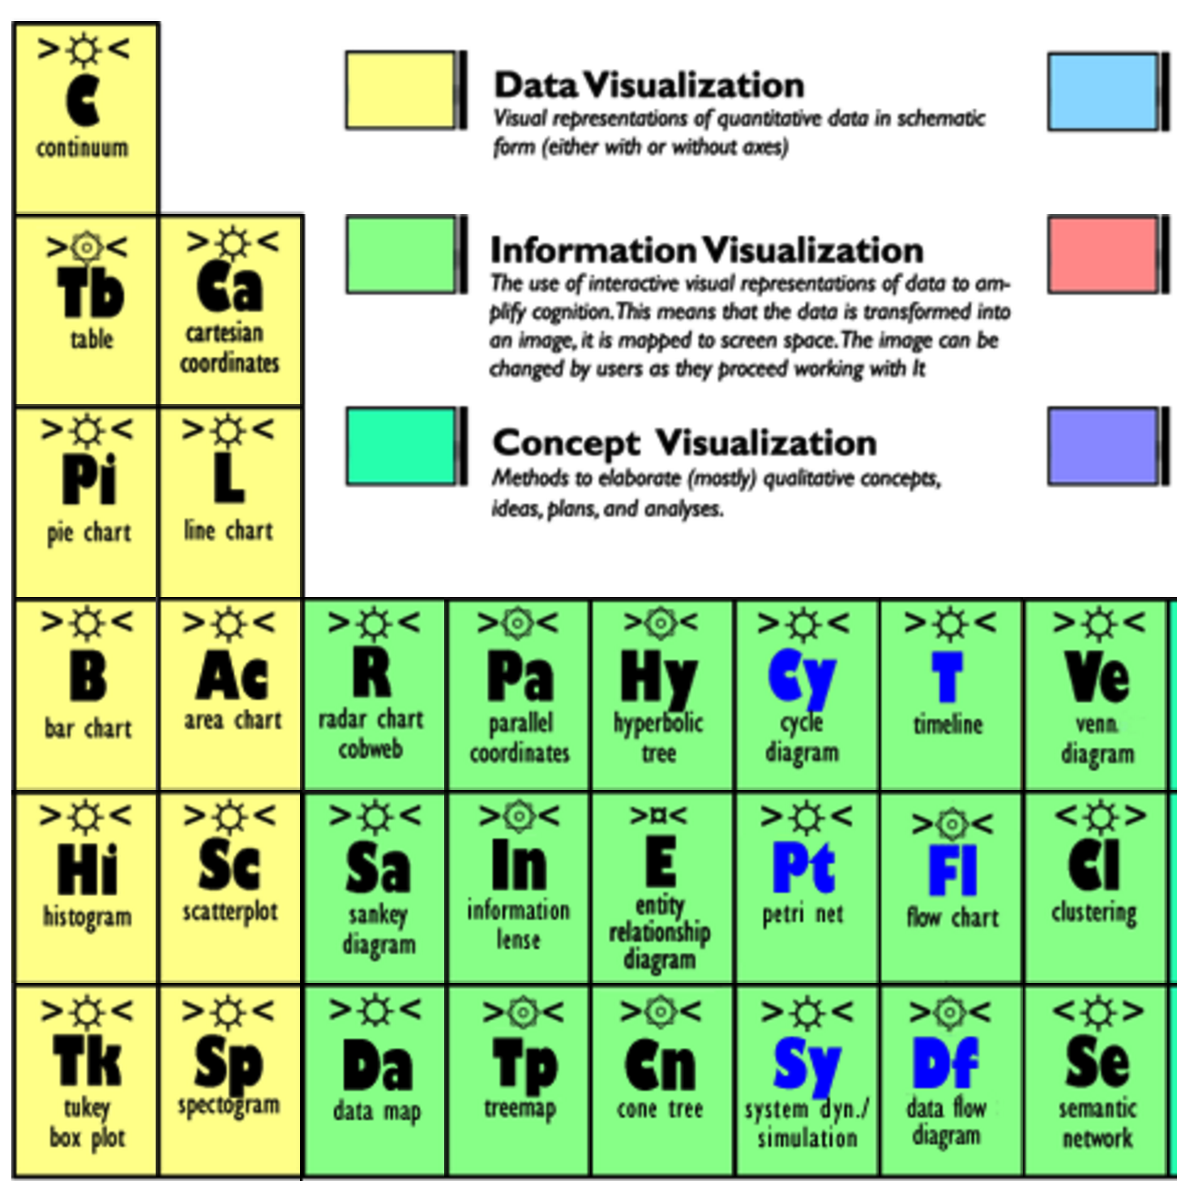
Notes:
http://www.visual-literacy.org/periodic_table/periodic_table.html 打开此链接，鼠标浮动。

Slide 7
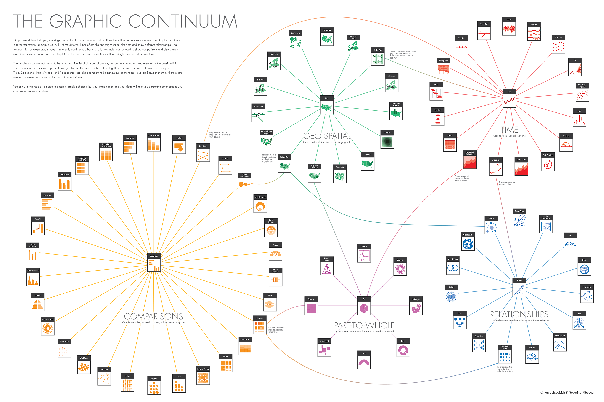
Line
Map
Bar
Scatter
Pie
Jon Schwabish and Severino Ribecca

Slide 8
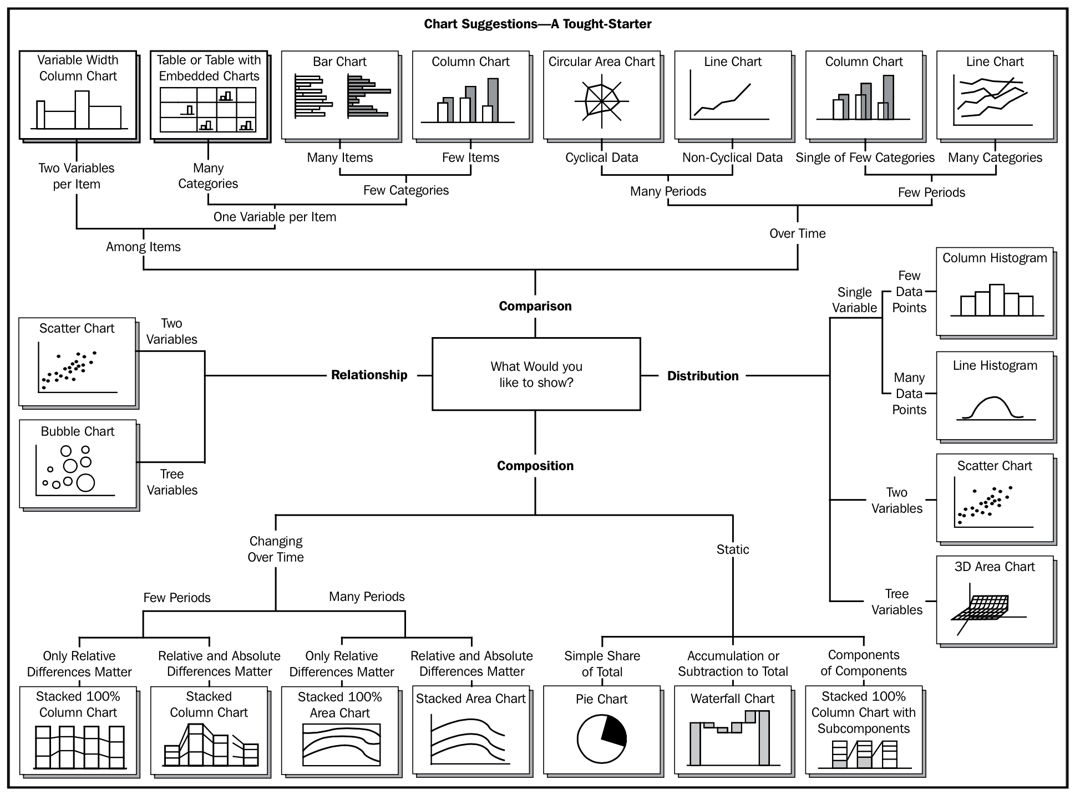
比较
关系
分布
组成

Slide 9
数据可视化
数据可视化 DataViz is an umbrella term, usually covering both information and scientific visualization.
To convert data into a visual representation (like charts, graphs, maps, sometimes even just tables).
静态、交互与动态 Static vs. interactive vs. dynamic
  Source: Angela Zoss, http://guides.library.duke.edu/datavis/

Slide 10
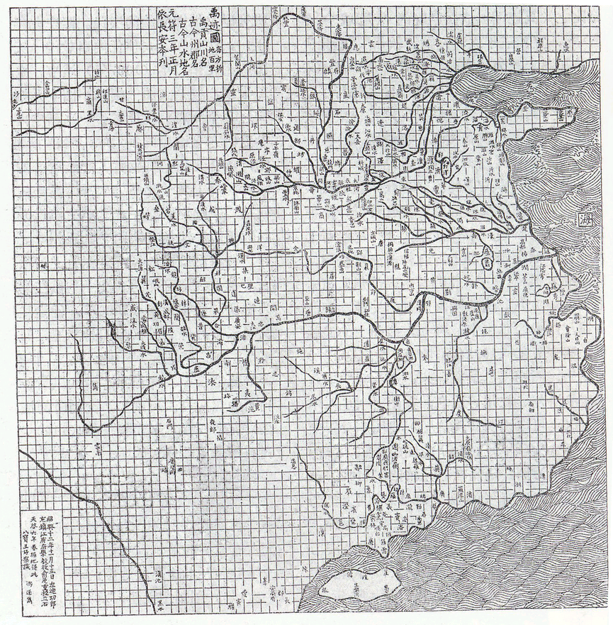
禹迹图
Earliest Grid Map:
Song Dynasty, 960 – 1279 CE)

Slide 11
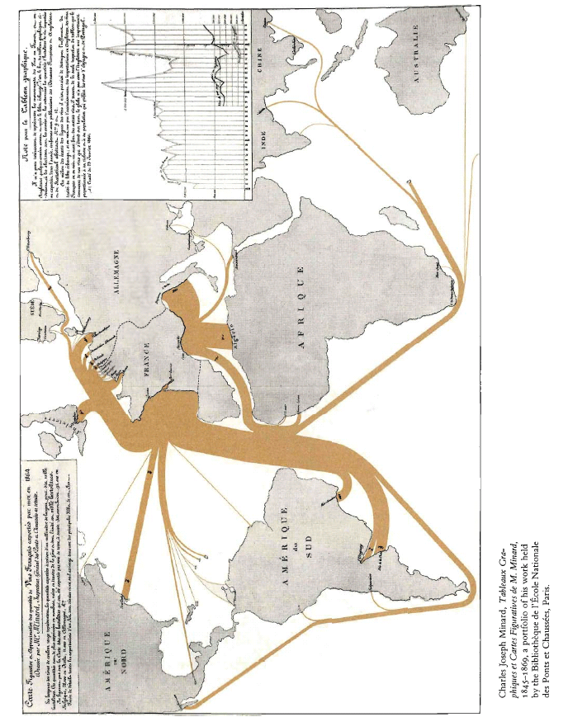
流地图
Minard, 1865 – French Wine Exports

Slide 12

Leonardo Da Vinci

Slide 13
功能 Functions
2

Slide 14
优秀的可视化
优图 Graphical Excellence
  Complex Ideas
  Communicated with
    Clarity
    Precision
    Efficiency
E. R. Tufte 2001 The Visual Display of Quantitative Information. Yale University http://bit.ly/16Se1

Slide 15
清晰传播
Principles | Questions in mind
Apprehension | Does the graph maximize apprehension of the relations among variables?
Clarity | Are the most important elements or relations visually most prominent?
Consistency | Are the elements, symbol shapes and colors consistent with their use in previous graphs?
Efficiency | Are the elements of the graph economically used? Is the graph easy to interpret?
Necessity | Is the graph a more useful way to represent the data than alternatives (table, text)? Are all the graph elements necessary to convey the relations?
Truthfulness | Are the graph elements accurately positioned and scaled?
D. A. Burn (1993), "Designing Effective Statistical Graphs". In C. R. Rao, ed., Handbook of Statistics, vol. 9, Chapter 22.

Slide 16

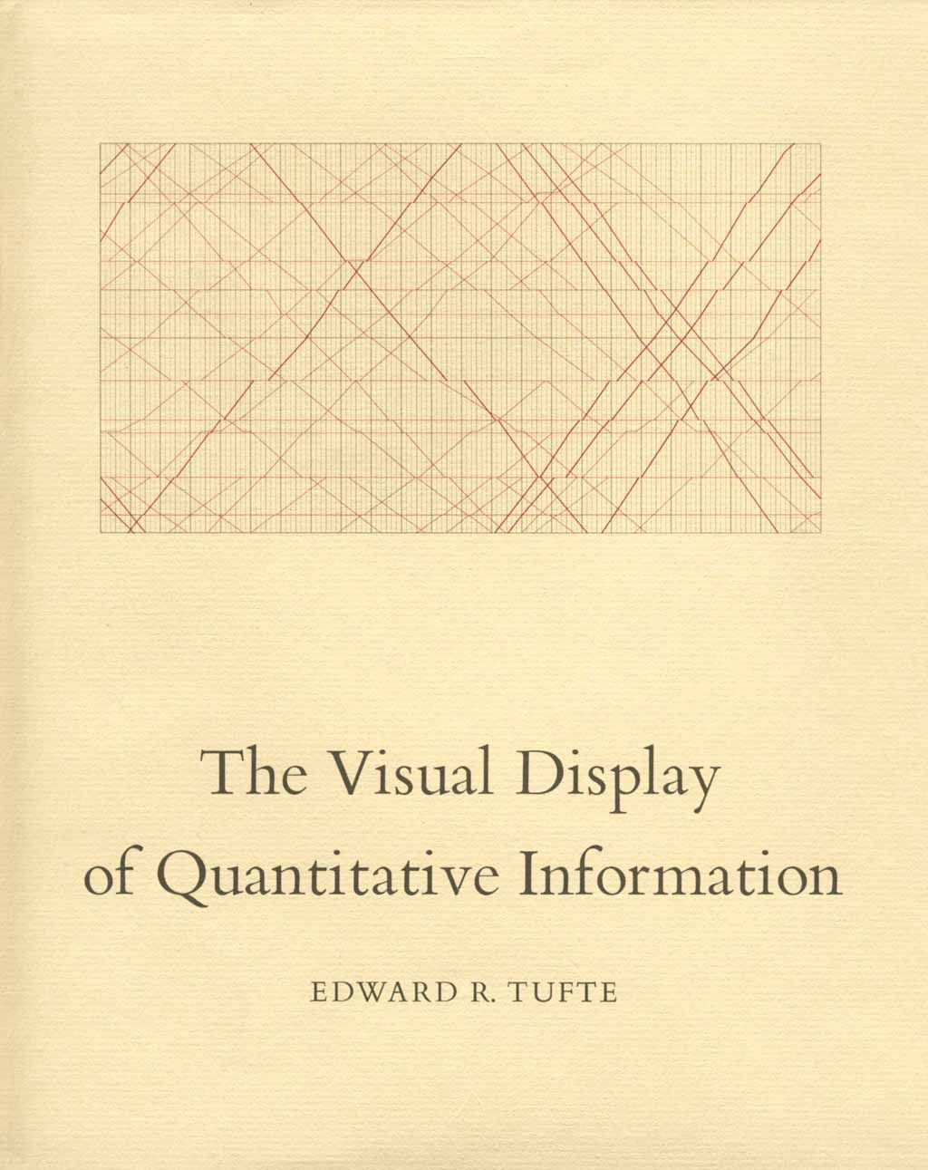
优图原则
好的可视化应该做什么？
  Show the data
  Induce to viewer to think about the data
  Avoid distorting what the data have to say
  Present many numbers in a small space
  Make large data sets coherent
  Encourage the eye to compare different pieces of data
  Reveal the data at several levels of detail, from overview to fine structure
  Serve a clear purpose:
    Description, exploration, tabulation, or decoration
  Be closely integrated with the statistical and verbal descriptions of a data set.
(Tufte 2001/1983)

Slide 17

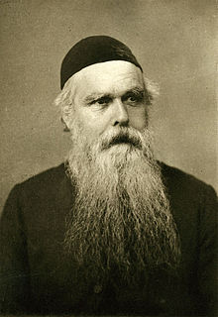
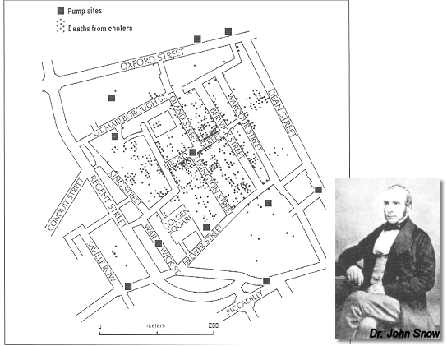
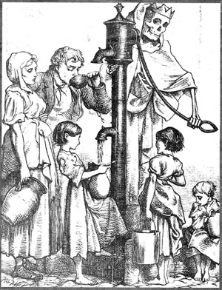
1854年伦敦宽街黑死病爆发
Notes:
John Snow说服了Henry Whitehead

Slide 18
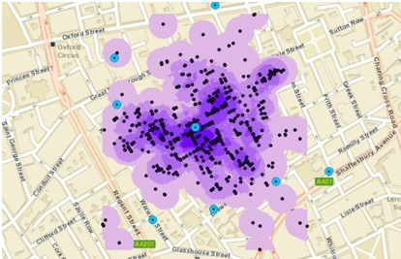
可视化解读
http://www.selkirkgis.com/blog/tag/program-collaboration/

Slide 19
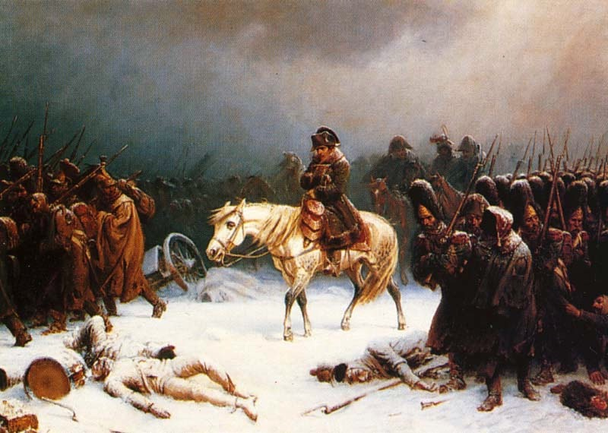
1812年拿破仑军队的溃退
An artistic depiction of Napoleon's retreat from Moscow, by Adolph Northen

Slide 20
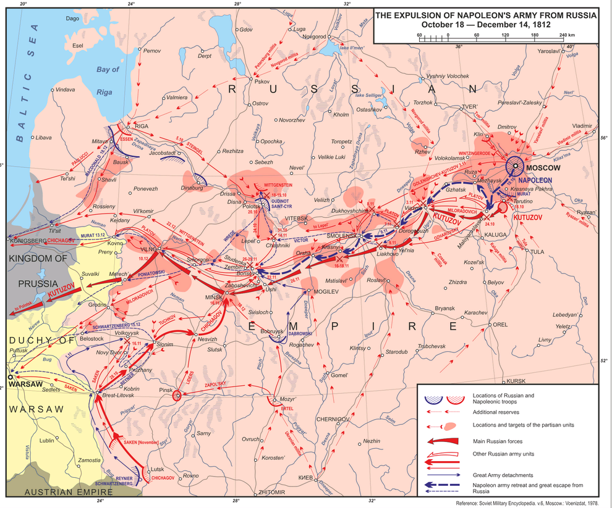
记者如何报道战争？

Slide 21
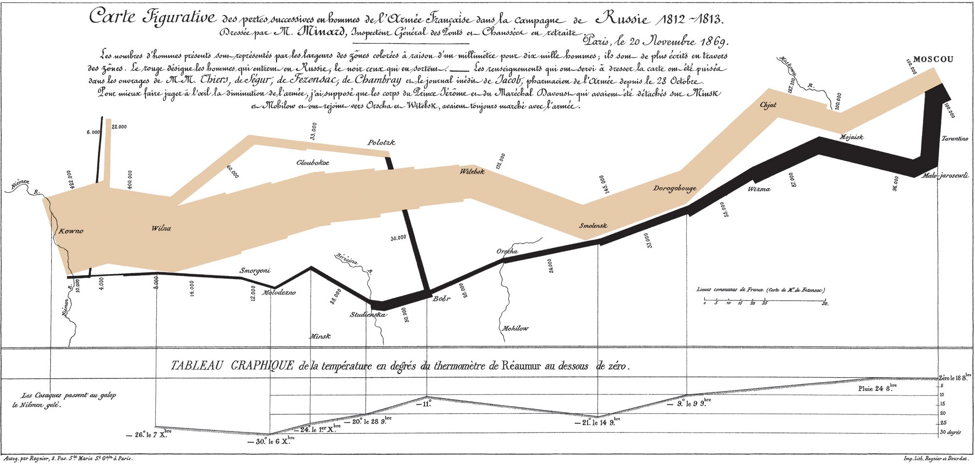
地理空间、军队规模和温度

Slide 22
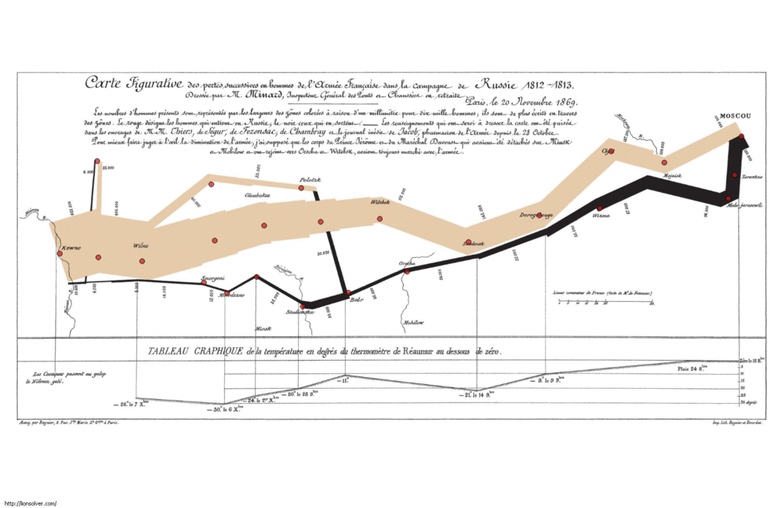
可视化解读
Charles Joseph Minard's famous graph showing the decreasing size of the Grande Armée as it marches to Moscow (brown line, from left to right) and back (black line, from right to left) with the size of the army equal to the width of the line. Temperature is plotted on the lower graph for the return journey (multiplyRéaumur temperatures by 1¼ to get Celsius, e.g. −30 °R = −37.5 °C).

Slide 23
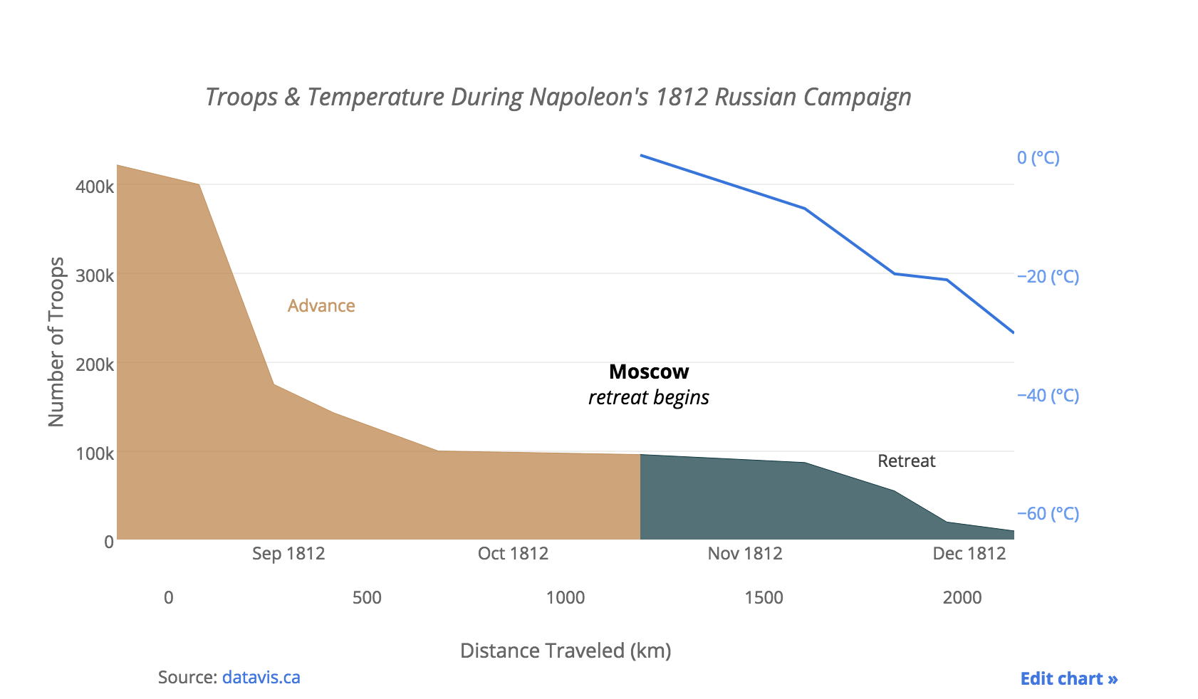

Slide 24
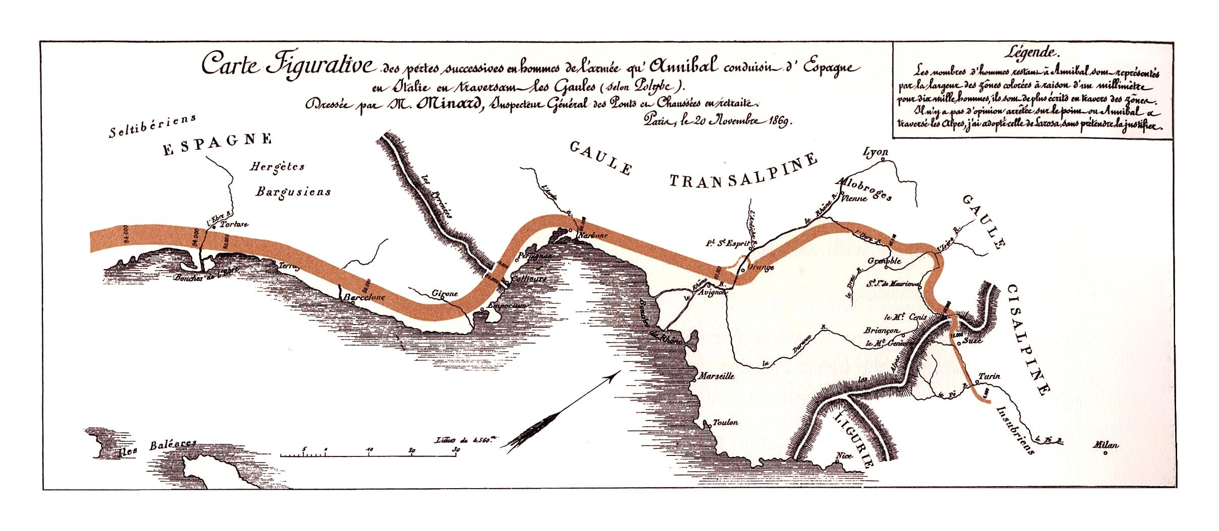
Hannibal’s campaign in Spain, Gaul and Northern Italy

Slide 25
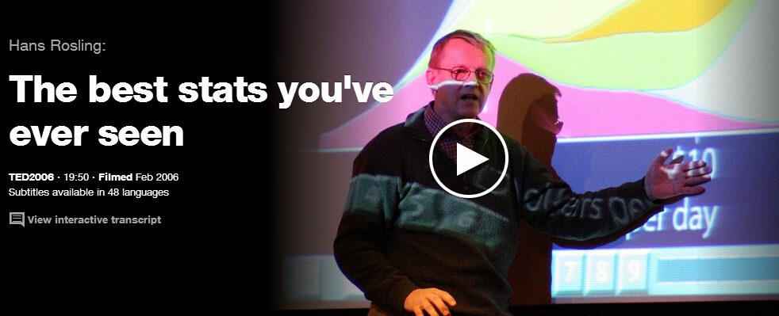
如何更好地呈现统计结果？

Slide 26
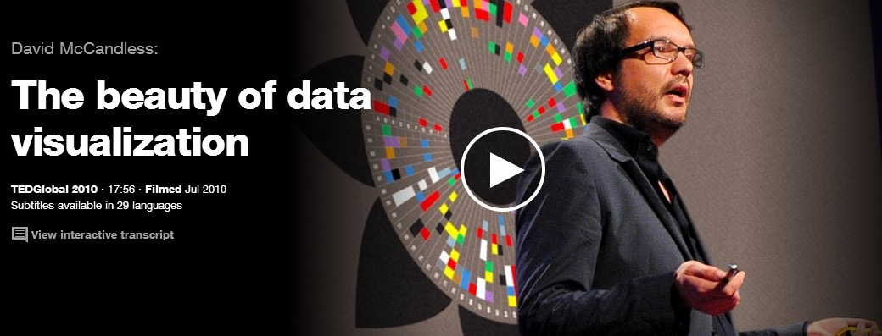
可视化之美

Slide 27
数据新闻&数字叙事
数据新闻
The Data Journalism Handbook
  为何记者要运用数据？
  可视化作为数据新闻的重要工具
  用可视化来讲故事
从可视化到叙事
Question + Visual Data + Context = Story (Shapiro, 2010, p.16)

Slide 28
做数据新闻的商业原因
财新流量数据
数字说频道 2013年10月 － 2014年5月
发布互动数据新闻作品30件
信息图超过300件
累计获得流量870多万
单篇最高访问量接近100万。
青岛爆炸案当日，网站整体访问量达1000万，创新高
周永康，财新＋网易400多万访问量
相关微博被转发5万次，评论4万条
微博阅读量2000万
Notes:
数据来源：黄志敏

Slide 29


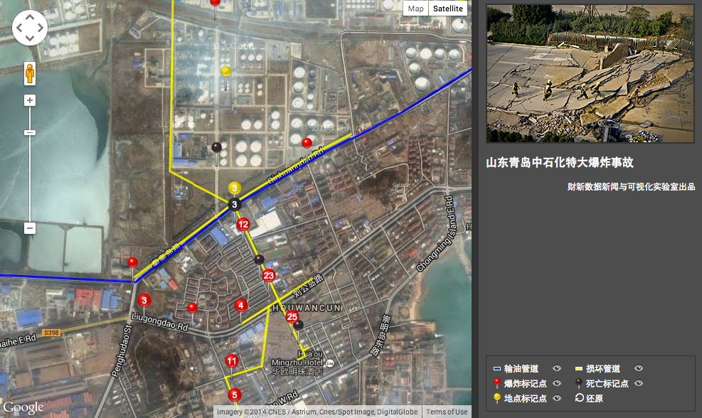
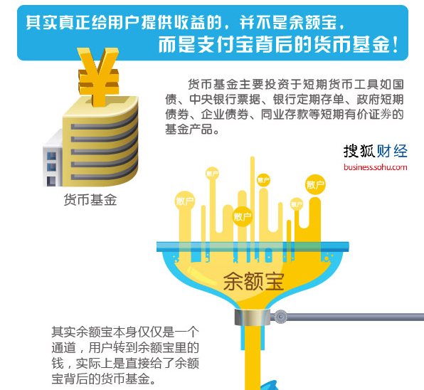
数据新闻实践
http://djchina.org/2014/04/06/favorite_viz_2013/

Slide 30
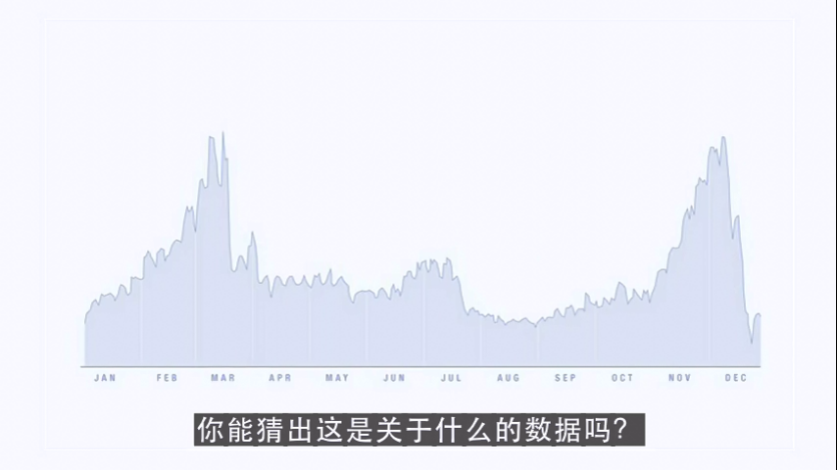

Slide 31
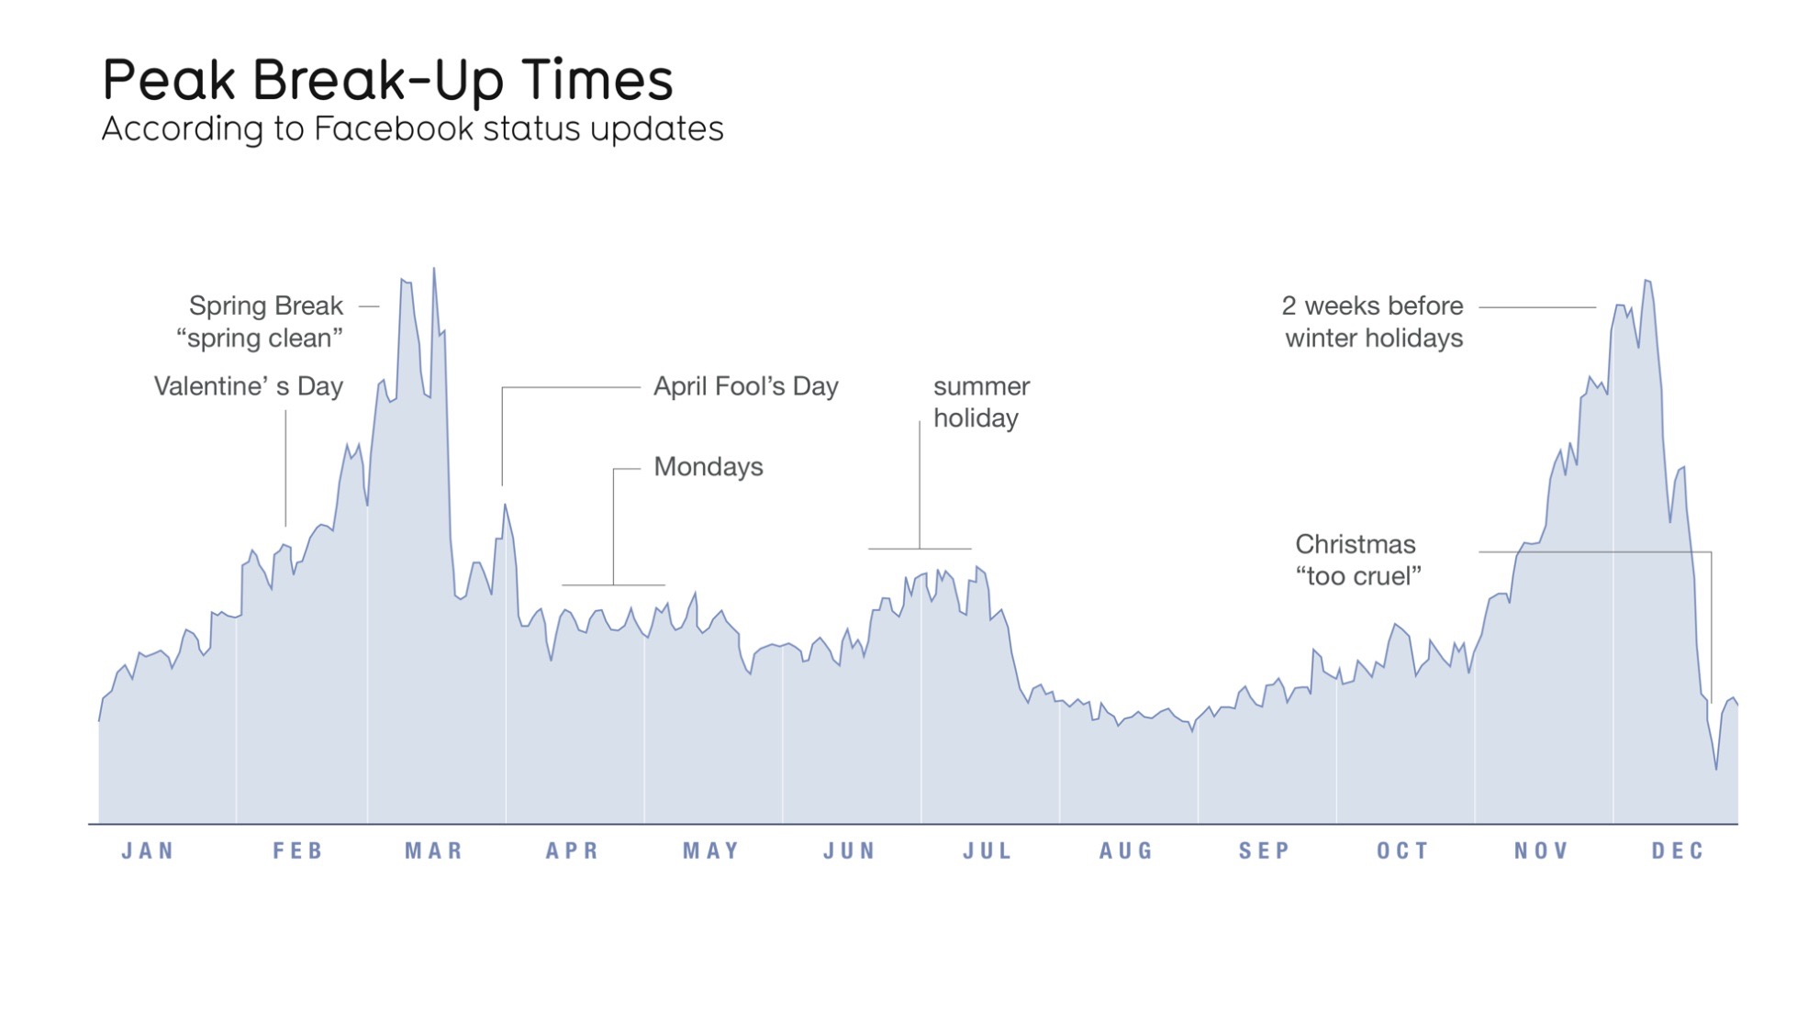
http://www.informationisbeautiful.net/2010/peak-break-up-times-on-facebook/

Slide 32
过程 PROCESS
3

Slide 33
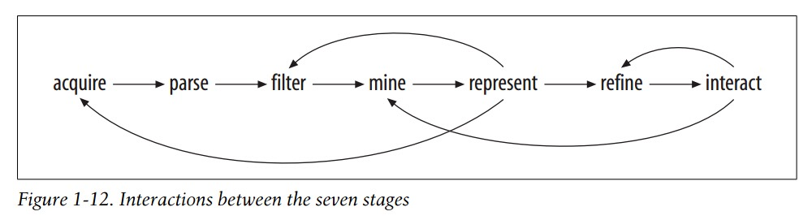
数据可视化的七个步骤
获取、清洗、过滤、挖掘、表征、调整、互动
(Fry, 2008)

Slide 34
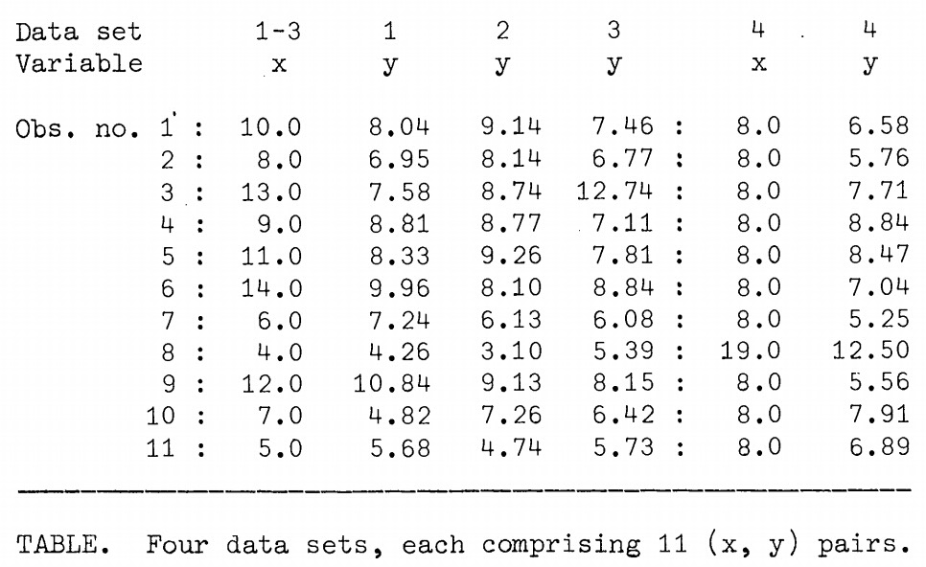
获取、清理、过滤数据
Anscombe, F.J. (1973).Graphs in Statistical Analysis. The American Statistician, Vol. 27, No. 1., pp. 17-21.
Notes:
Mean of x in each case 9 (exact)
Sample variance of x in each case 11 (exact)
Mean of y in each case 7.50 (to 2 decimal places)
Sample variance of y in each case 4.122 or 4.127 (to 3 decimal places)
Correlation between x and y in each case 0.816 (to 3 decimal places)
Linear regression line in each case y = 3.00 + 0.500x (to 2 and 3 decimal places, respectively)

Slide 35
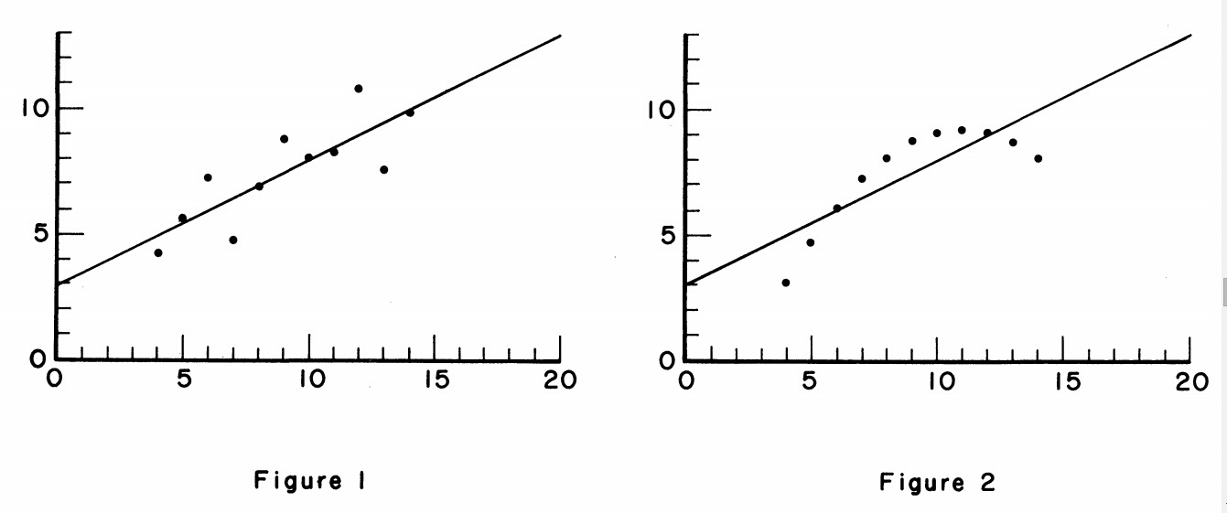
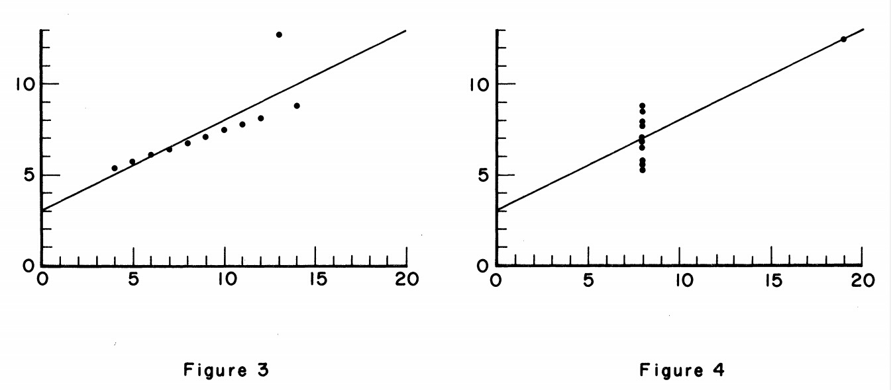
表征数据关系

Slide 36
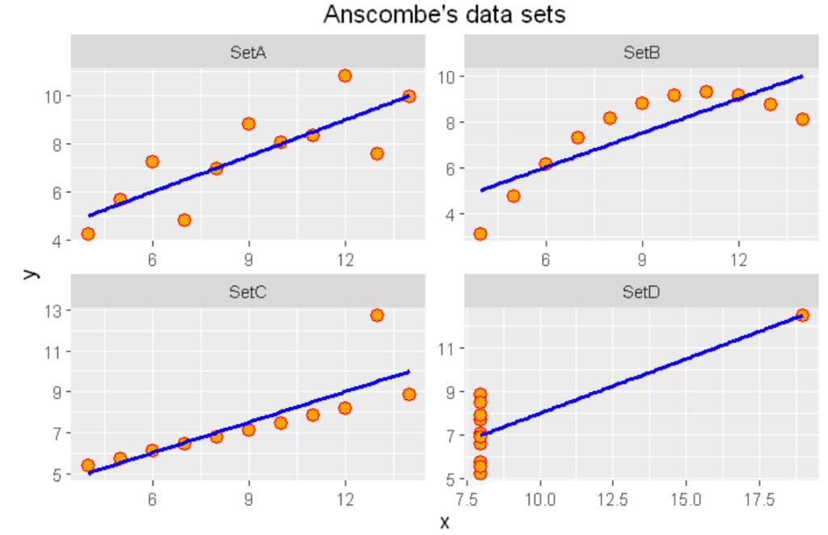
可视化的重要性
我们会发现这四组数据中，
        x值的平均数都是9.0，
        y值的平均数都是7.5；
        x值的方差都是10.0，
        y值的方差都是3.75；
        它们的相关度都是0.816，
        线性回归线都是y=3+0.5x。
也就是说单从这些统计数字上看来，四组数据所反映出的实际情况非常相近，而事实上，这四组数据有着天壤之别。
Anscombe, F.J. (1973).Graphs in Statistical Analysis. The American Statistician, Vol. 27, No. 1., pp. 17-21.
http://computational-communication.com/2016/09/%E5%8F%AF%E8%A7%86%E5%8C%96%E7%9A%84%E9%87%8D%E8%A6%81%E6%80%A7/
Notes:
http://computational-communication.com/2016/09/%E5%8F%AF%E8%A7%86%E5%8C%96%E7%9A%84%E9%87%8D%E8%A6%81%E6%80%A7/

Slide 37
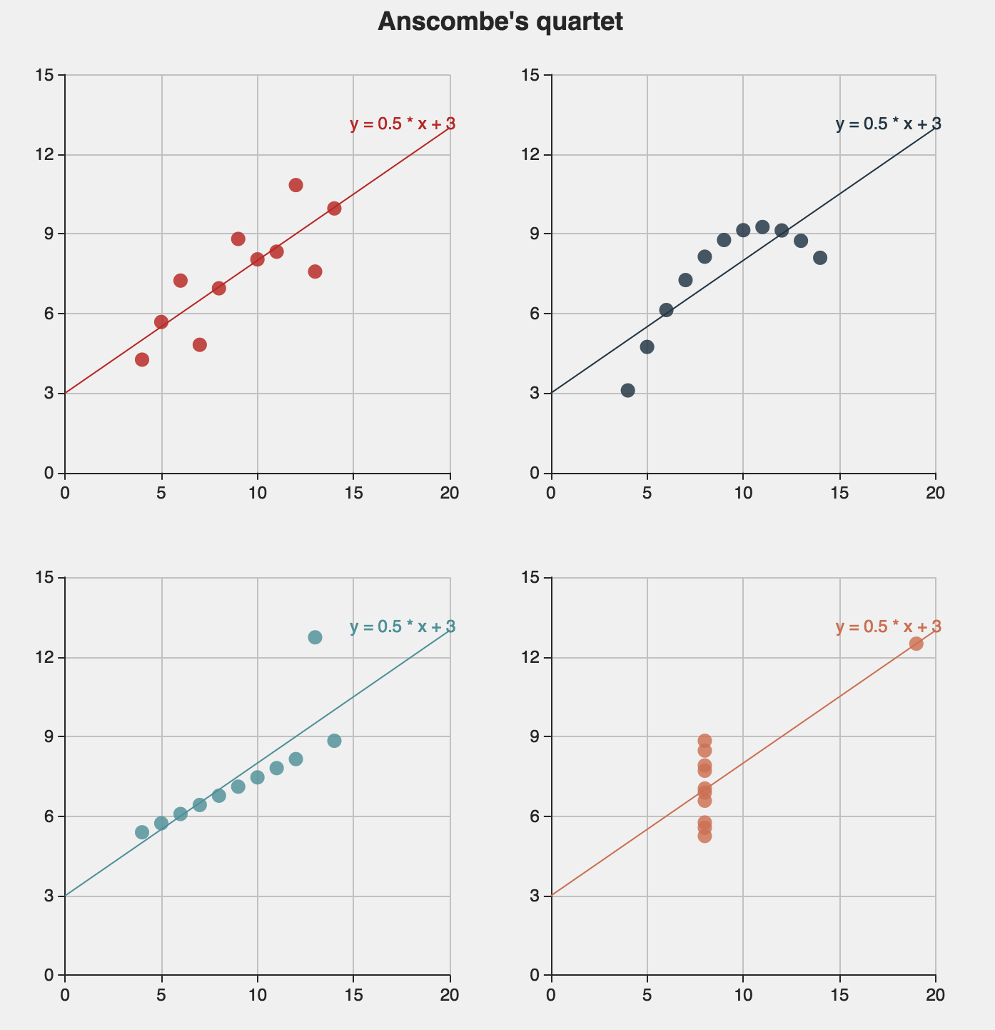
安斯庫姆四重奏
之Echarts版本
http://echarts.baidu.com/demo.html#scatter-anscombe-quartet
ECharts，一个纯 Javascript 的图表库。
ECharts 提供了常规的折线图，柱状图，散点图，饼图，K线图，用于统计的盒形图，用于地理数据可视化的地图，热力图，线图，用于关系数据可视化的关系图，treemap，多维数据可视化的平行坐标，还有用于 BI 的漏斗图，仪表盘，并且支持图与图之间的混搭。
Notes:
http://echarts.baidu.com/demo.html#scatter-anscombe-quartet
打开

Slide 38
可视化目标
See relationships among data points 寻找关系 | Scatterplot
 | Matrix Chart
 | Network Diagram
Compare a set of values 分组比较 | Bar Chart
 | Block Histogram
 | Bubble Chart
Track rises and falls over time 时序涨落 | Line Graph
 | Stack Graph
 | Stack Graph for Categories
See the parts of a whole 了解比例 | Pie Chart
 | Treemap
 | Treemap for Comparisons
Analyze a text 文本分析 | Word Tree
 | Tag Cloud
 | Phrase Net
See the world 地理位置 | Map
http://www.manyeyes.com/software/analytics/manyeyes/page/Visualization_Options.html

Slide 39
从数据到可视化
数据类型：What data types are present in the data source?
数据关系：How are the variables likely to relate?
可视化类型：What visualization type seems to be the best fit for the goal?

Slide 40
  可视化基础
数据类型 Types of data
    Nominal
    Ordinal
    Scale
数据结构 Forms of structure
    Census
    Financial
    Social network
    Web data

Slide 41
可视化基础
位置 Position
形状 Shape
大小 Size
亮度 Brightness
颜色 Color
排列方向 Orientation
纹理 Texture
运动 Motion

Slide 42
    基础图形
单变量 Single variable visualization
  直方图 Histograms
  饼状图 Pie charts
  时间序列 Time series
双连续变量 Two continuous variables
  散点图 Scatterplots
双变量（一个类别变量）Two Variables - one categorical
  箱形图 Boxplots
  柱状图 Bar charts
地图 Maps
网络 Social networks
动态交互图 Interactive and dynamic graphs

Slide 43
理论 THEORY
4

Slide 44
作为视觉传播的可视化
观察者
文本
互动
框架

Slide 45
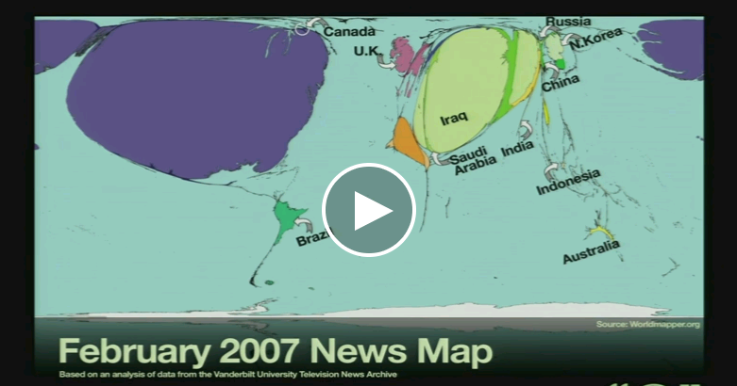
框架理论与视觉传播
媒介眼中的社会
  培养理论
美国媒介中的世界
  框架理论
可视化图形中的世界
http://www.ted.com/talks/alisa_miller_shares_the_news_about_the_news#t-17151

Slide 46
数据驱动
数据可视化主要是数据驱动的 Dataviz differs from the general graphic design in that it is of the data, by the data, and for the data.
  数治 By the data: guided primarily by data results rather than esthetical considerations
  数享 For the data: to tell accurate, informative, and understandable quantitative stories
  数有 Of the data: an integrated phase of the discovery rather than a post-analysis phase to decorate the findings

Slide 47
图像诚实
Graphic integrity
标注和基准一致 Consistency in Labeling, Baselines
时间一致 Consistency in Time (Independent Axis)
警惕数据不全 Dangers of Partial Annual Data
数据的标准化 Need for Data Normalization
不要忽略整体 Context – “Compared to What?”
不要将连续变量当做定序变量 Pravda School of Ordinal Graphics

Slide 48
Tufte’s Six Principles
1. Make Representation of Numbers Proportional to Quantities
  Ratio of size to numerical value should be close to 1
  As physically measured on surface of graphic
2. Use Clear, Detailed, Thorough Labeling
  Don’t introduce or propagate graphical distortion, ambiguity
  Write out explanations of the data on the graphic itself
  Label important events in the data
3. Show Data Variation, Not Design Variation
4. Use Standardized (e.g., Inflation-Adjusted) Units, Not Nominal
5. Depict N Data Dimensions with N Variable Dimensions
  Don’t use more than N information-carrying dimensions for N-D data
  When graphing data in N-D, use N-D ratio (see #1 above)
6. Quote Data in Full Context ( Don’t Quote Out of Context)
See also How to Lie With Statistics (Huff, 1984): http://bit.ly/3wAgS0

Slide 49
撒谎因子Lie Factor
撒谎因子是图像中的效果与数据中的效果的比值，即图形在表达数据变化时的失真程度

Slide 51
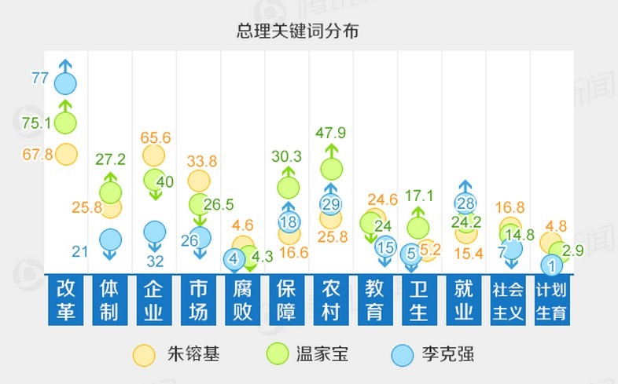
http://news.qq.com/newspedia/baogao.htm

Slide 52

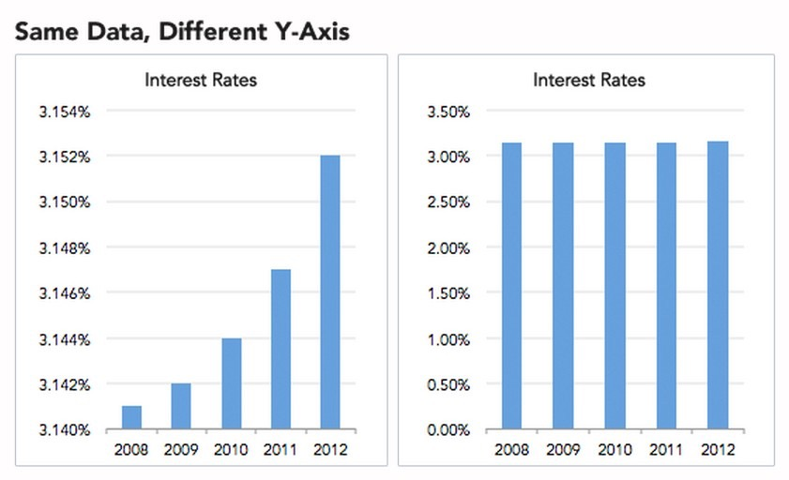
坐标轴起点
http://static.guim.co.uk/sys-images/Guardian/Pix/pictures/2013/8/1/1375343461201/misleading.jpg
Source: http://data.heapanalytics.com/how-to-lie-with-data-visualization/

Slide 53
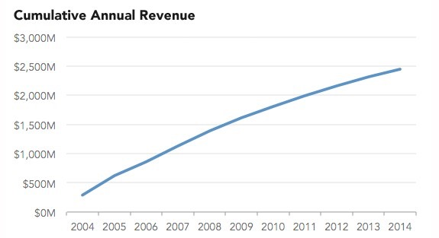
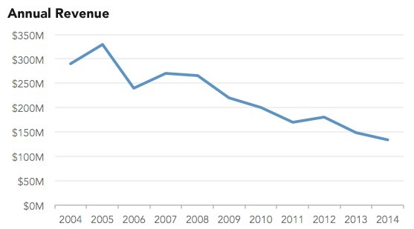
累计增长曲线
Source: http://data.heapanalytics.com/how-to-lie-with-data-visualization/

Slide 54
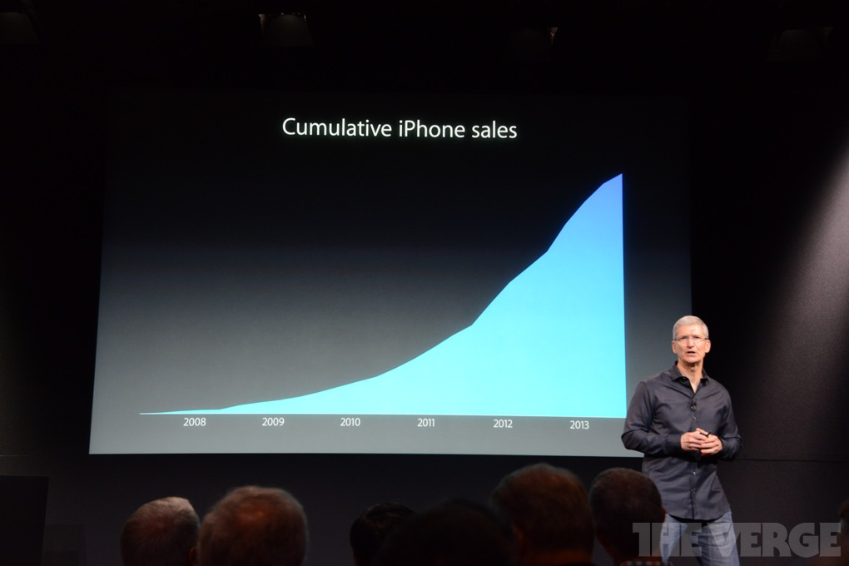
苹果的销售量
Source: http://qz.com/122921/the-chart-tim-cook-doesnt-want-you-to-see/

Slide 55
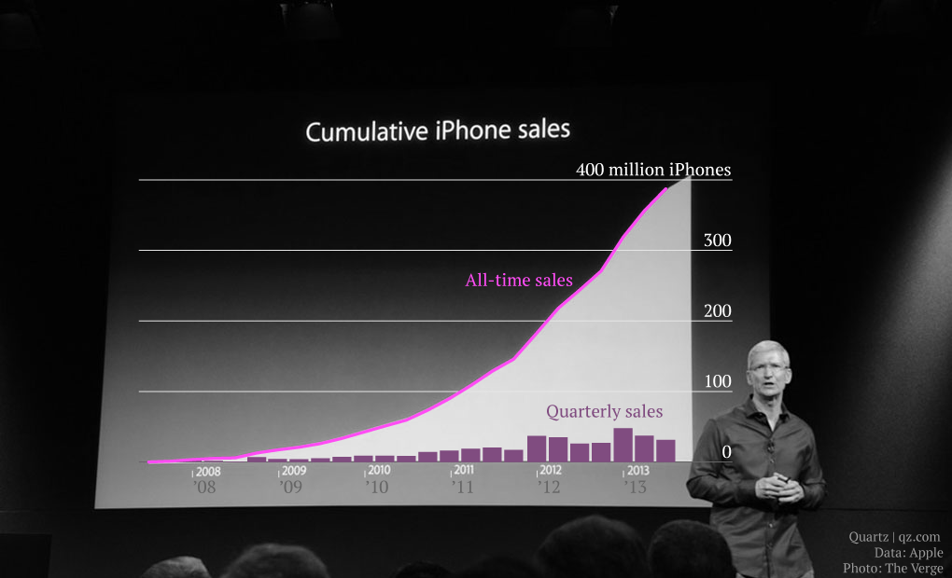
Source: http://qz.com/122921/the-chart-tim-cook-doesnt-want-you-to-see/

Slide 56
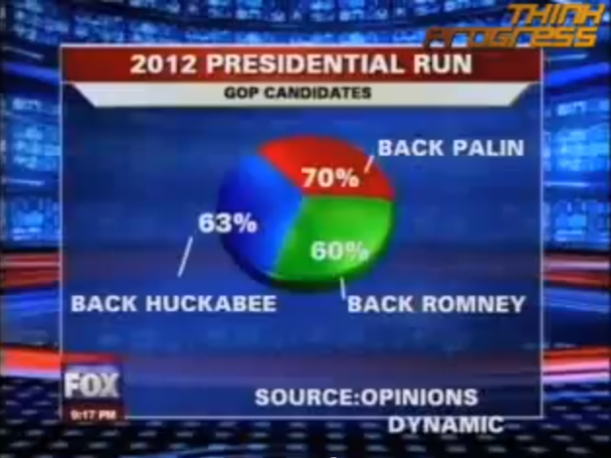
尽量不用饼状图
http://flowingdata.com/2009/11/26/fox-news-makes-the-best-pie-chart-ever/

Slide 57
图片垃圾
Chartjunk
Edward Tufte (1942-) 统计学家
1）Data-ink Ratio 数据笔墨比例，即有多少笔墨是用在数据上了
2）Data Density 数据密度，一定大小的空间内表示了多少数据

Slide 58
优图
Gives to Viewer
  Greatest number of ideas – data
  In shortest time – “ink ratio” really rate per time (cognitive effort)
  With least ink – filled space, pixels, primitives, rendered objects
  In smallest space – total size of graphic, page, viewport, window

Slide 59
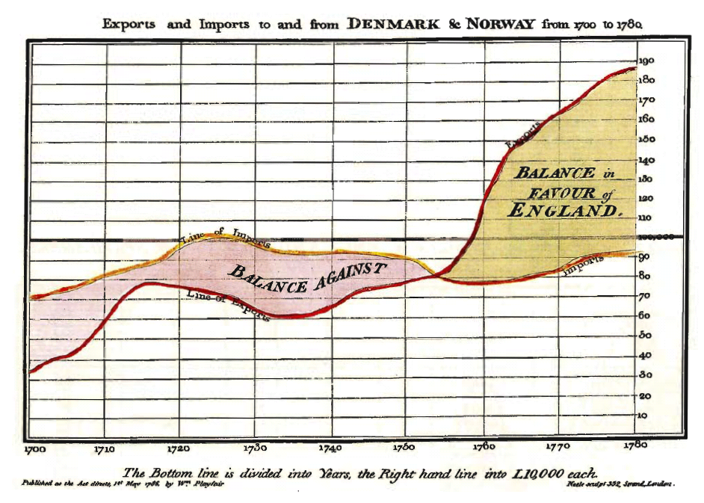
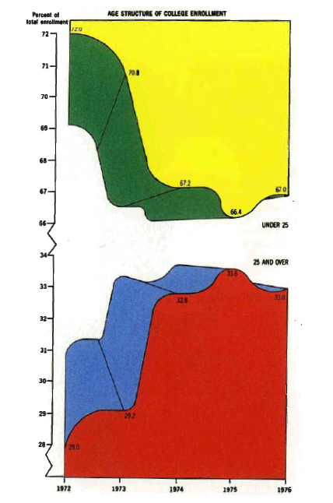
数据笔墨比例
“Duck” here refers
to self-promoting
decorative graphics

Slide 60
数据叙事既是
科学也是艺术
Finding the right way view your data is as much an art as a science.

Slide 61
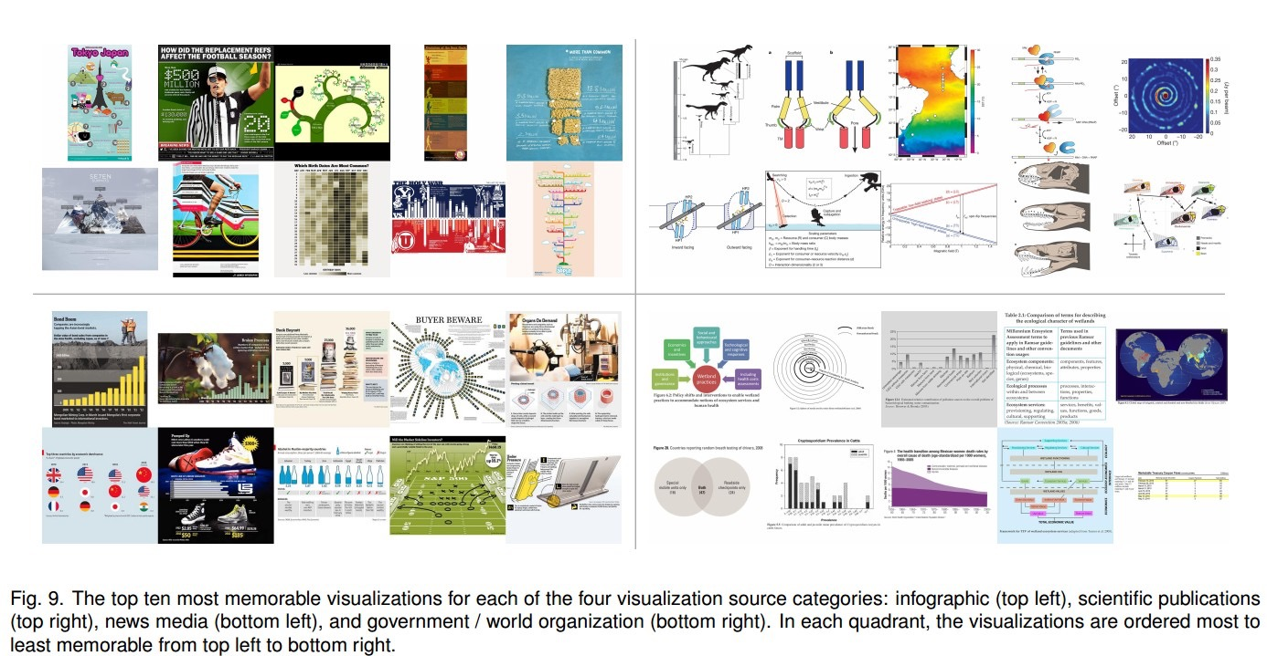
可视化如何抓住读者？
Borkin MA, Vo AA, Bylinskii Z, Isola P, Sunkavalli S, Oliva A, Pfister H. What Makes a Visualization Memorable?. IEEE Transactions on Visualization and Computer Graphics (Proceedings of InfoVis 2013). 2013.

Slide 62
直觉 vs. 抽象？
图像垃圾有用吗？
  It's easy to spot a "bad" data visualization—one packed with too much text, excessive ornamentation, gaudy colors, and clip art.
  Design guru Edward Tufte derided such decorations as redundant at best, useless at worst, labeling them "chart junk."
  Yet a debate still rages among visualization experts: Can these reviled extra elements serve a purpose?
形象的结果 Intuitive results (e.g., attributes like color and the inclusion of a human recognizable object enhance memorability)
抽象的结果 Less intuitive results (e.g., common graphs are less memorable than unique visualization types).

Slide 63

加入创意

Slide 64
传达风险信息
Communicating Risk
Notes:
Open before:
http://www.nytimes.com/2014/05/02/upshot/how-not-to-be-misled-by-the-jobs-report.html

Slide 65
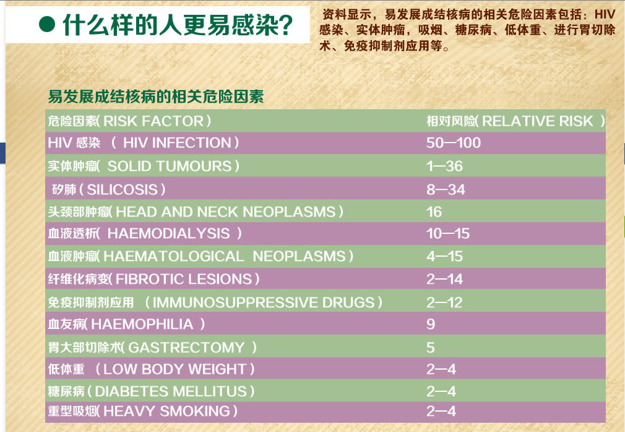

Slide 66
据世界卫生组织信息，PM2.5 值从每立方米
35微克降低到15，会使终生的健康方面风险降低12%。
decrease from 35 to 15 µg/m³ PM_{2.5}decreases lifetime health risks by 12%, according to the WHO.
这是什么意思？我们如何传达这一信息？What does this mean? How can we communicate it?
Notes:
Ref:
http://whqlibdoc.who.int/hq/2006/WHO_SDE_PHE_OEH_06.02_chi.pdf (Chinese)
http://whqlibdoc.who.int/hq/2006/WHO_SDE_PHE_OEH_06.02_eng.pdf (English)

Slide 67
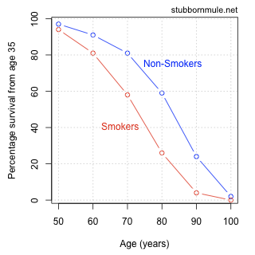
抽烟导致的死亡情况
Deaths from smoking
非吸烟者
从35岁起生存率
吸烟者
年龄（岁）
Notes:
http://www.stubbornmule.net/2010/10/visualizing-smoking-risk/

Slide 68
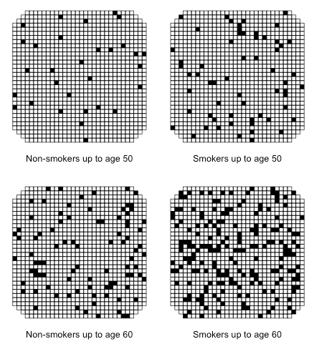
非吸烟者（至50岁）
吸烟者（至50岁）
非吸烟者（至60岁）
吸烟者（至60岁）
Notes:
http://www.stubbornmule.net/2010/10/visualizing-smoking-risk/

Slide 69
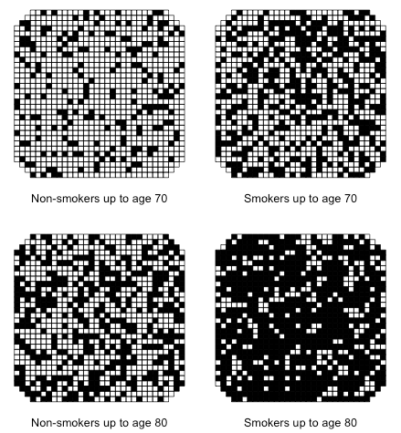
非吸烟者（至70岁）
吸烟者（至70岁）
非吸烟者（至80岁）
吸烟者（至80岁）
Notes:
http://www.stubbornmule.net/2010/10/visualizing-smoking-risk/

Slide 70

In The Visual Display of Quantitative Information, Edward Tufte argues that the “ink to data ratio” should be kept as low as possible, but the RCT uses a lot of ink just to display a single number! Still, I do think that the RCT can be an effective tool and perhaps this can be justified by thinking of it as a way of visualizing numbers rather than data (but maybe that’s a long bow).

Slide 71
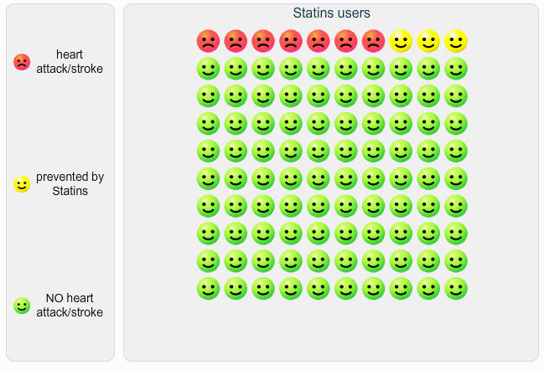
他汀（降血脂药物）使用者
突发性心脏病/中风
被他汀预防的
无心脏病/中风
该可视化作品表现的是频率 （每百人），不是可能发生率
This visualization shows frequency (out of 100), not probability.
Notes:
http://understandinguncertainty.org/comparison

Slide 72
传达不确定性
Communicating Uncertainty
对未知的结果大多数人都很难理解和做决定
It’s hard for most people to understand and make decisions about uncertain outcomes.
大多数风险都很小，而且只能通过比较才能理解。
Most risks are small, and can only be understood by comparison
可接受风险是一个主观概念，因人而异
Acceptable risk is subjective
通过显示多少人经历或不经历坏的结果来做视觉化， 而不只是通过数字。
Visualize by showing how many people do and do not experience the bad outcome -- not just numbers.

Slide 73
数据新闻所需技能
  传统报道能力 traditional reporting
  数学及统计 math and statistics
  数据分析编程 programming for data analysis
  网站编程 web programming
  平面设计 graphic design
  互动设计 interaction design
  写作Writing

Slide 74
Readings
Tufte E.T. (2001). The Visual Display of Quantitative Information. 2nd Edition. Cheshire, Conn. : Graphics Press.
Cairo, A. (2013). The Functional Art: An Introduction to Information Graphics and Visualization. Berkely CA : New Riders.
Fry, B. (2008). Visualizing Data. Sebastopol, CA : O'Reilly Media, Inc.
47

Slide 75
Thank you

