Slide 1

Library Carpentry
Introduction to Data
This work is licensed under a Creative Commons Attribution-ShareAlike 4.0 International License. Exceptions: logos, embeds to and from external sources and direct quotations

Slide 2
Where to go for help
Stickers
Helpers
Sticky notes
github.com/???

Slide 3
Week 1: Introduction to Data
18:00-18:45 Jargon Busting
18:45-19:30 Foundations
19:30-20:15 Regular Expressions

Slide 4
Jargon Busting
Teams of 5 or 6
Write terms you want busting on stickies
Cluster (retaining duplicates)
Discuss and explain
Note resolved terms
Note unresolved terms
Report back

Slide 5
Foundations
The Computer is Stupid
Why automate
Keyboard shortcuts are your friend
Plain text formats are your friend
Structuring files and folders

Slide 6
Foundations
The Computer is Stupid
ERROR

Slide 7
Foundations
Why automate?
Borrow, borrow, borrow
There is no correct language
Professional development
Knowing some code ~ evaluating software
Making time to do fun stuff!
Andromeda Yelton, "Coding for Librarians: Learning by Example", Library Technology Reports 51:3 (April 2015), doi: 10.5860/ltr.51n3

Slide 8
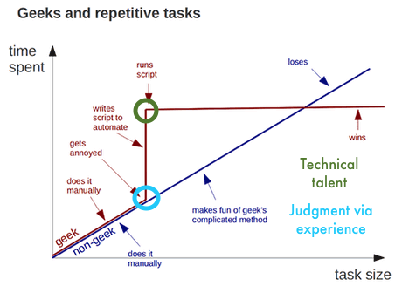
Foundations
Why automate?
Credit: Andy Kirk

Slide 9
Foundations
Keyboard shortcuts are your friend
Efficiency and control

Slide 10
Foundations
Plain text formats are your friend
Computers process them better
Platform agnostic
Display orientated files aren't your friend
Markdown

Slide 11
Foundations
Structuring files and folders
Consistent and predictable data structure
Semantic-data hybrid directory names
Your own system is fine
Links files and directories with names
You are the most likely person to forget what you once did!

Slide 12
Regular Expressions
Match on types of character
Match patterns
Capture the parts that match your pattern

Slide 13
Regular Expressions
organi[sz]e
organise (match)
organize (match)
reorganise (match part so will also find)
reorganize (match part so will also find)

Slide 14
Regular Expressions
[ABC] matches A or B or C.
[A-Z] matches any upper case letter.
[A-Za-z0-9] matches any upper or lower case letter or any digit.

Slide 15
Regular Expressions
. matches any character at all.
\d matches any single digit.
\w matches any part of word character.
\s matches any space, tab, or newline.
\b matches a word boundary.
^ asserts start of the line.
$ asserts end of the line

Slide 16
Regular Expressions
^[Oo]rgani.e\b

Slide 17
Regular Expressions
* matches proceeding character any number of times including zero.
+ matches proceeding character any number of times excluding zero.
? matches the proceeding character one or zero times.
{VALUE,VALUE} matches proceeding character a defined number of times.
| simply means or.

Slide 18
Regular Expressions
^[Oo]rgani.e\w*

Slide 19
Regular Expressions
[Oo]rgani.e\w+$

Slide 20
Regular Expressions
^[Oo]rgani.e\w?\b

Slide 21
Regular Expressions
^[Oo]rgani.e\w?$

Slide 22
Regular Expressions
\b[Oo]rgani.e\w{2}\b

Slide 23
Regular Expressions
\b[Oo]rgani.e\b|\b[Oo]rgani.e\w{1}\b

Slide 24
Regular Expressions
Teams of 4
Work through excersse
Split into two teams and write:
- strings that need regex
- regex that need outputs
Test each other!
After the session: take the quiz!

