Slide 1
Data Governance – An Introduction
Martin Catherall

Slide 2
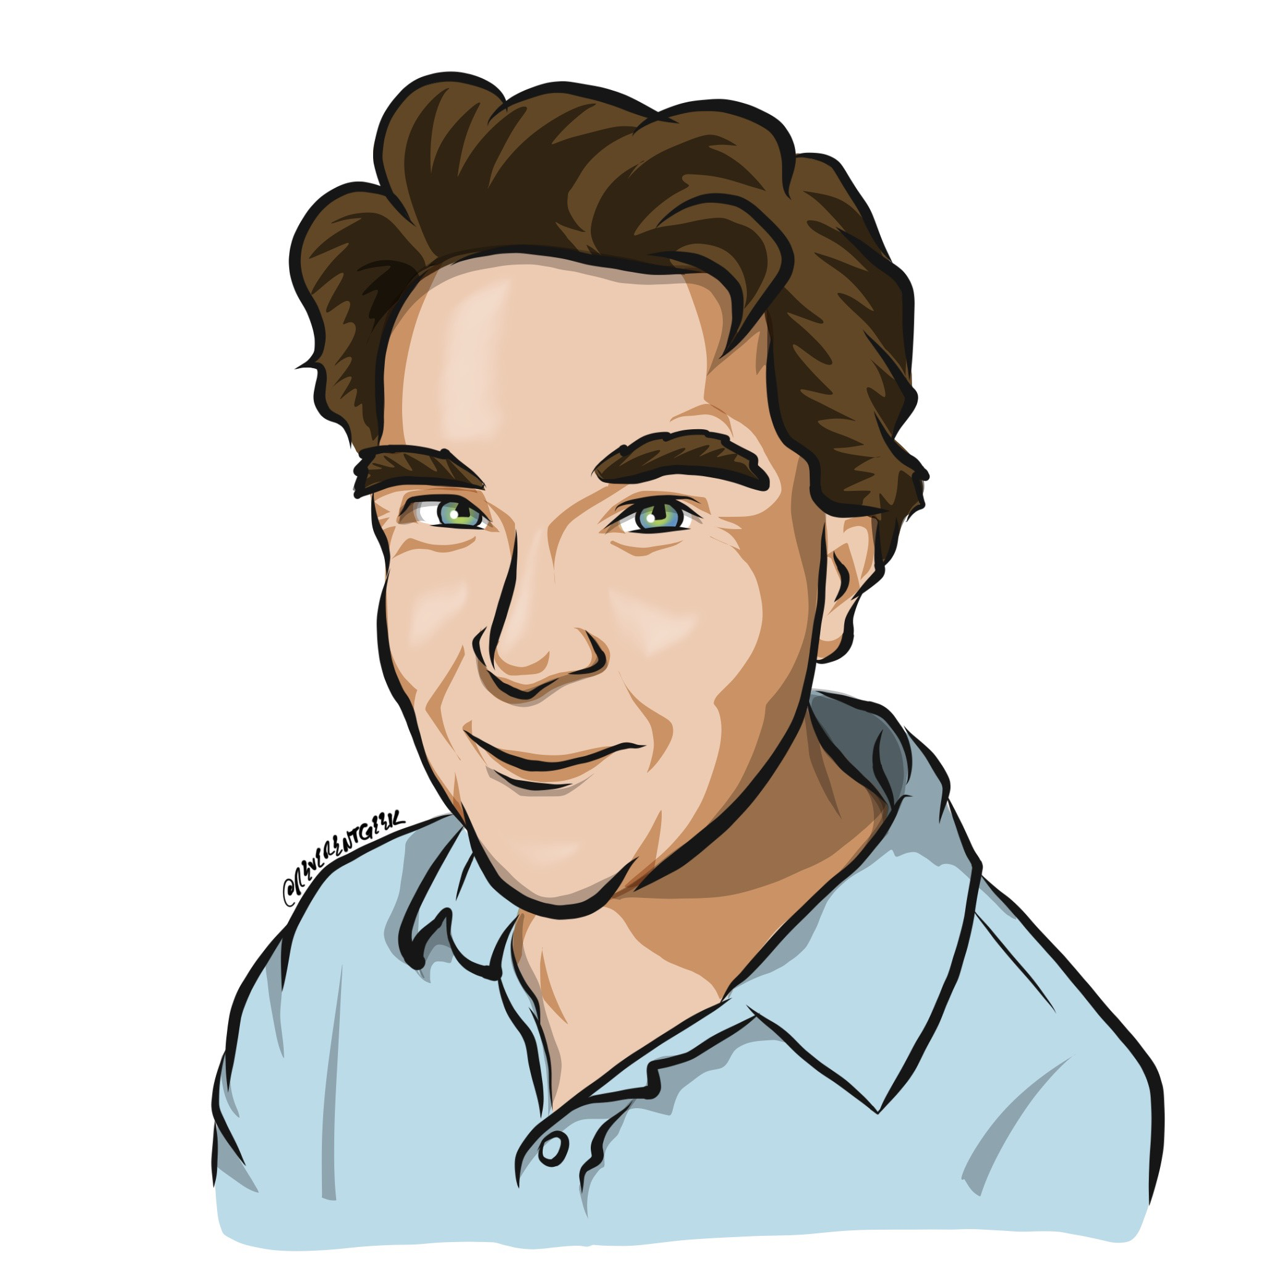
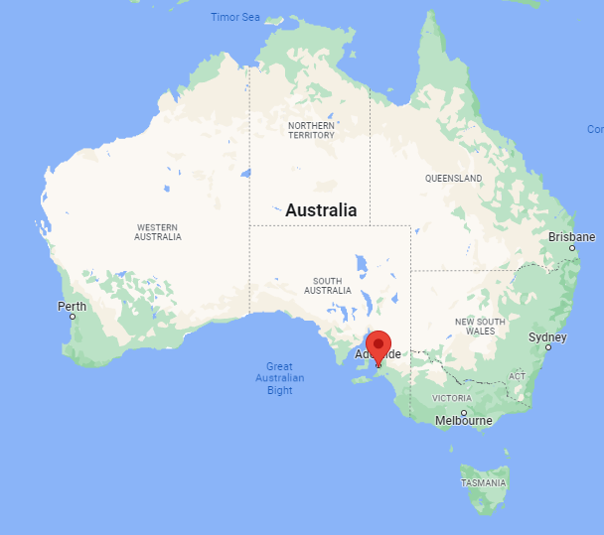
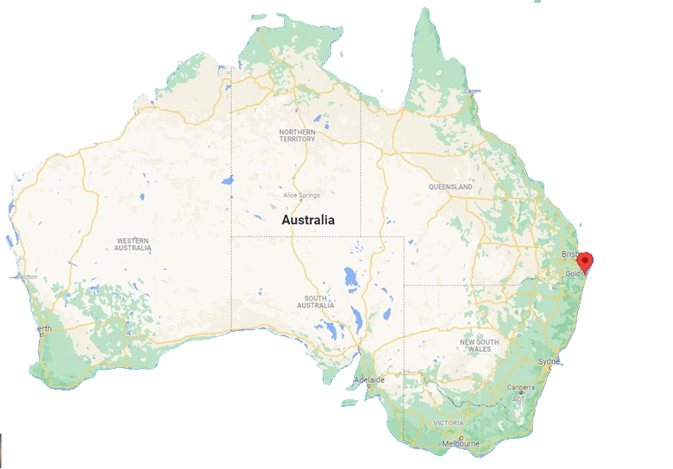
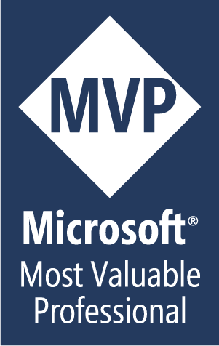
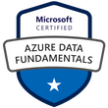
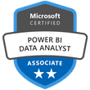

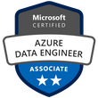
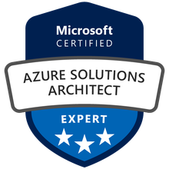
Martin Catherall
Senior Data Consultant
Senior Data Analytics Consultant
SQL Server (20+ years)
Microsoft Azure (~8 years)
Microsoft Fabric (~2 years)
@MartyCatherall
www.MartinCatherall.com

Slide 3
Data Governance
What’s it all about?
Data
&
Governance
Presentation Aims
Provide a framework for your ongoing research
What might be involved in “setting up Data Governance”
Note:- Tech* is only part of the jigsaw
*Microsoft products used as examples
Notes:
I hope to cover a lot – certainly the main points.
But I’m not going to cover everything – especially not in detail.
It’s my intention to give you some pointers and hopefully guide you a little.
It’s all down to you at the end of this presentation.
However, I think opportunities in this area are growing fast

Slide 4
Agenda
A High-Level look at Data Governance
An excellent resource for ongoing learning and collaboration
The Business World
The Technical World
Summary
Notes:
Like I say – I won’t cover everything
But here’s an agenda
When we move to the technical piece (which is after the business piece) – I’m going to provide a personal story that hopefully you’ll all relate to as I think the issue I’ll demonstrate is common across the board ☺

Slide 5
Introduction
Setting you up for success!
Hopefully ☺
Notes:
Are all businesses Data Business – or IT business.
All business are people businesses

Slide 6
One Side of Data Governance
Technical
Process
Notes:
Most people watching are likely very familiar with technical process and tooling.
Examples might be ETL or ELT processes – The technical tool has to meet a certain technical criteria – but also the business has be comfortable that it is meeting their goals

Slide 7
Another Side of Data Governance
Business
Process
Notes:
The lots of business processes that relate to data – some of which will be familiar and some of which may not.
Data may be classified into different categories – public | confidential | highly confidential
Data may have to conform to certain compliance standards – HIPPA | GDPR | SOX

Slide 8
Both existing together
Business
Process
Technical
Process
Notes:
And these two words need to live in harmony.

Slide 9
Collaboration is a key ingredient
Collaboration
Business
Process
Technical
Process
Notes:
And we call that harmony “collaboration” – good strong relationships need to be built between these parties and their many sub-departments.

Slide 10
Company Culture
Collaboration
Business
Process
Technical
Process
Notes:
And this collaboration contributes to the overall company culture.

Slide 11
A Path to Guide You!
And make you stronger!
Hopefully ☺
Notes:
Are all businesses Data Business – or IT business.
All business are people businesses

Slide 12
Collaboration is a key ingredient
1
Identify Data Governance Leadership and Scope
Identify Data Governance Leadership and Scope
2
Develop a Data Governance Charter
Develop a
Data Governance
Charter
3
Choose a Model for Data Governance Charter
The IT Team
4
Select a Steering Committee
1
5
Set up a Data Governance Office
10
2
Choose a Model for
Data Governance
Charter
The Business Team
6
Select the Data Governance Working Group
9
3
7
Select the Data Governance Support Team
8
4
Policy and Procedures
Development
Select a Steering
Committee
8
Policy and Procedures Development
7
5
6
9
The Business Team
Select the Data
Governance
Support Team
Set up a
Data Governance
Office
10
The IT Team
Select the
Data Governance
Working Group
Notes:
A roadmap that might be used to build a data governance culture at any organisation.

Slide 13

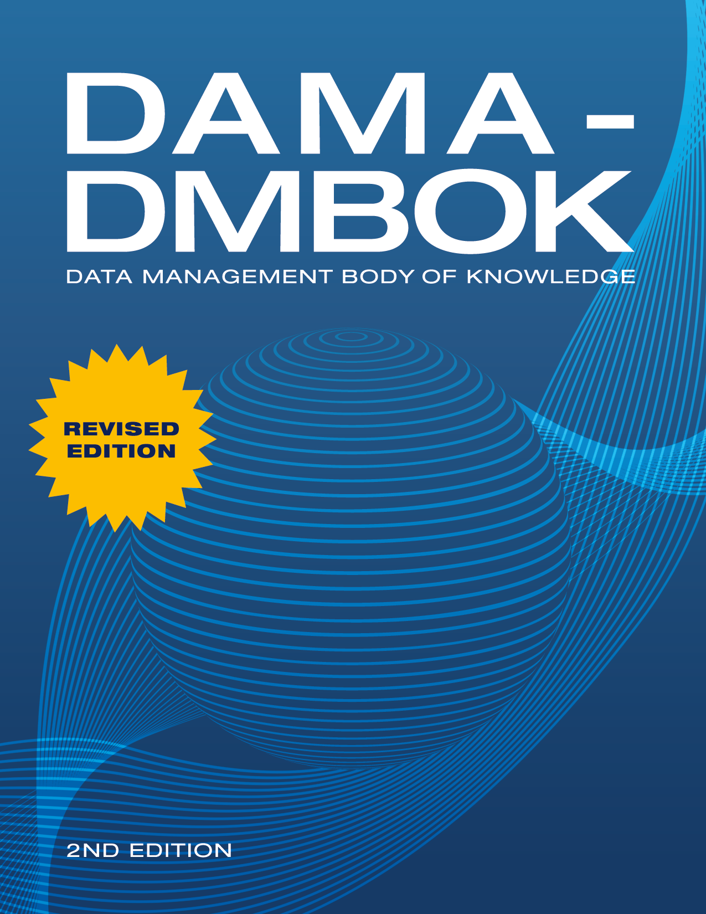
DAMA
https://www.dama.org
DMBoK - Data Management Body of Knowledge
Notes:
Introduce DAMA

Slide 14
Resources
Designing data governance that delivers value | McKinsey
The Path to Modern Data Governance
Global and industry frameworks for data governance
DMBoK - Data Management Body of Knowledge
sas-data-governance-framework-107325.pdf
DGI Data Governance Framework - The Data Governance Institute
Notes:
Some additional reading – I’ll post links in the chat
Course
You Tube (be careful – take with a grain of salt)
Pluralsight
Linkedin Learning
ect

Slide 15
The Business
Are they’re relying on data?
Hopefully ☺
Notes:
Are all businesses Data Business – or IT business.
All business are people businesses

Slide 16
Business World
Company Performance
Business
Outcomes
Decision Quality
Internal Processes
External Processes
Information Quality
Data Quality
Notes:
How does data contribute to an organisations success

Slide 17
Data Quality
Validity
Complete
Accuracy
Data
Quality
Timely
Consistency
Integrity

Slide 18
Ingredients
Data
Quality
Data
Security
Data
Compliance
Data
Governance
Data
Technology
Data
Process
Data
Culture
Data
Lifecycle
Data
Frameworks
Notes:
Data Governance Frameworks - Data governance frameworks are structured approaches to managing and utilizing data in an organization.
McKinsey.
Eckerson.
PwC enterprise data governance framework.
DAMA DMBOK.
The SAS data governance framework.
The DGI data governance framework.
Other things I might have missed include – ethics, guardrails, guides, policies, Education

Slide 19
The Tech
Tech will only get you so far

Slide 20
The Collaboration
Team Members
Manage Password
People
The
People
The
Process
Process
The
Technology
Technology
Password Manager
Notes:
Give a personal story that mixes both tooling and process.
Password managers and the process used to store passwords.

Slide 21
A Personal Story
How many accounts do you have?
How many of those credentials are committed to memory?
How often do you hit ‘forgot my password?’
Get yourself a good Password Manager.
Get yourself (and your family) a good strong process.
Notes:
Give a personal story that mixes both tooling and process.
Password managers and the process used to store passwords.

Slide 22
Tooling Types
Manage Data Governance
Manage Master Data
Data Quality
Data Obfuscation
Tooling built into your product
Some Examples coming up! – but first roles
Notes:
Give a personal story that mixes both tooling and process.
Password managers and the process used to store passwords.

Slide 23
Data Governance Roles
Data Quality Management
Data Governance Implementation
Data Catalog Management
Metadata Management
Data Stewardship and Collaboration
Data Custodian (Business and Technical)
Compliance and Risk Management
Training and Education
Reporting and Documentation
Notes:
Not a complete list and your milage may vary
Executive sponsor
Data governance lead
Data governance council
Data owner
Data Steward
Data Stakeholder
Data Custodian

Slide 24
Tooling
Microsoft Purview
Profesee
Data Quality Services (SQL Server)
Redgate Data Masker
Dynamic Data Masking, Row Level Security, Tagging
Notes:
Other Tools
Colibra
Cluedin

Slide 25
Demo
Notes:
Just show some features with Microsoft Fabric that contribute to Data Governance
Domains
Tags
Sensitivity Labels
Mention Purview (Data Lineage, Catalog, etc)

Slide 26
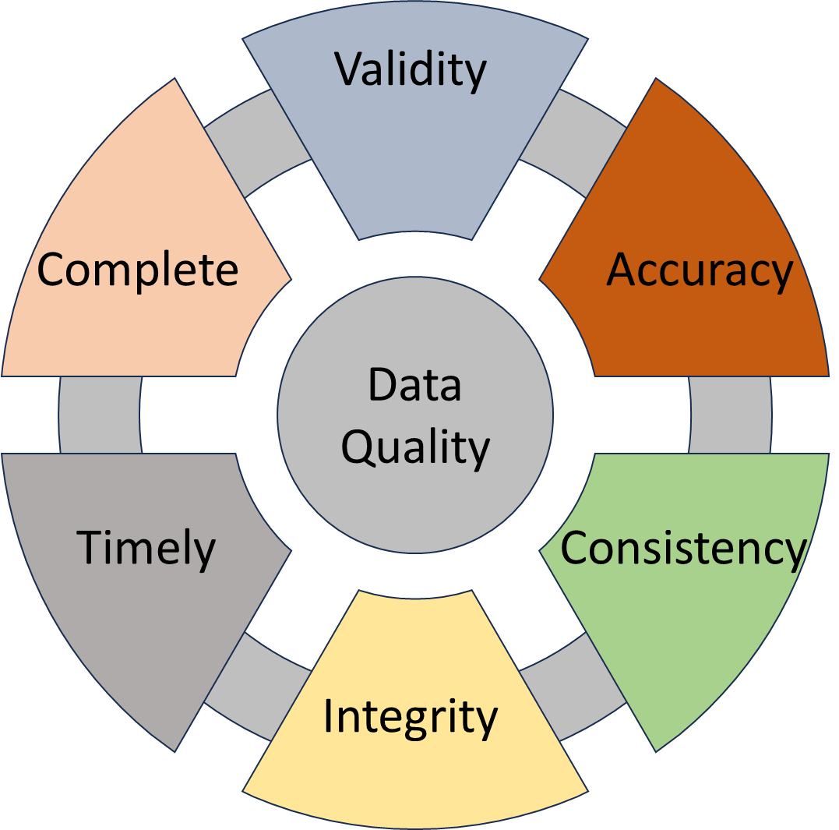
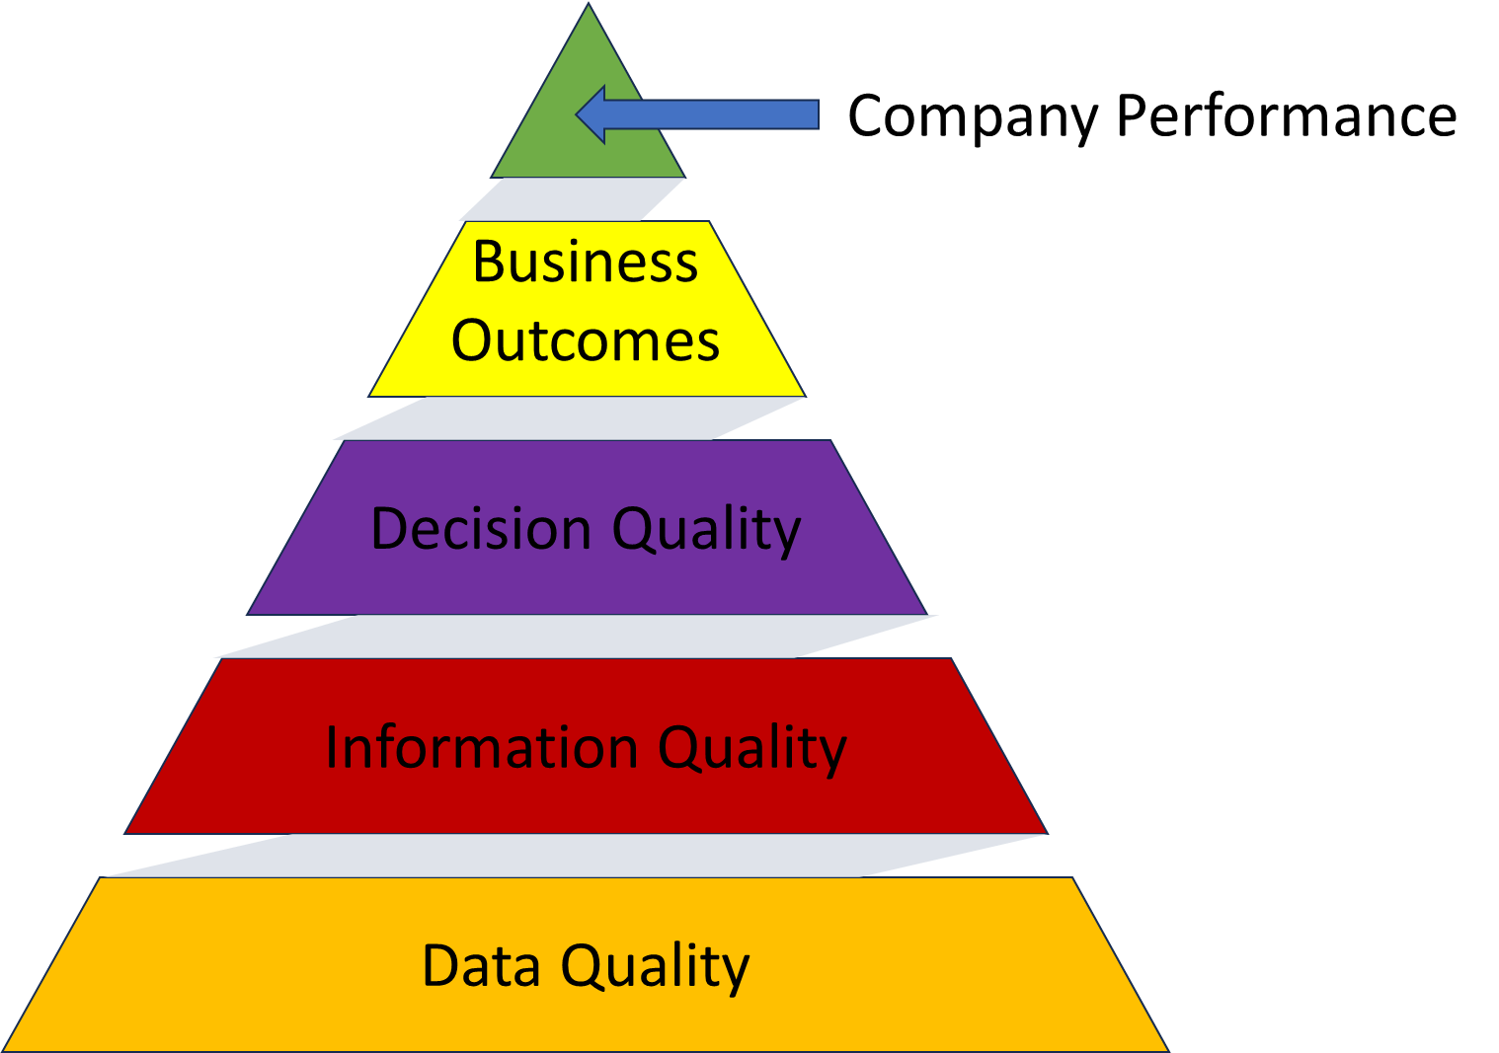
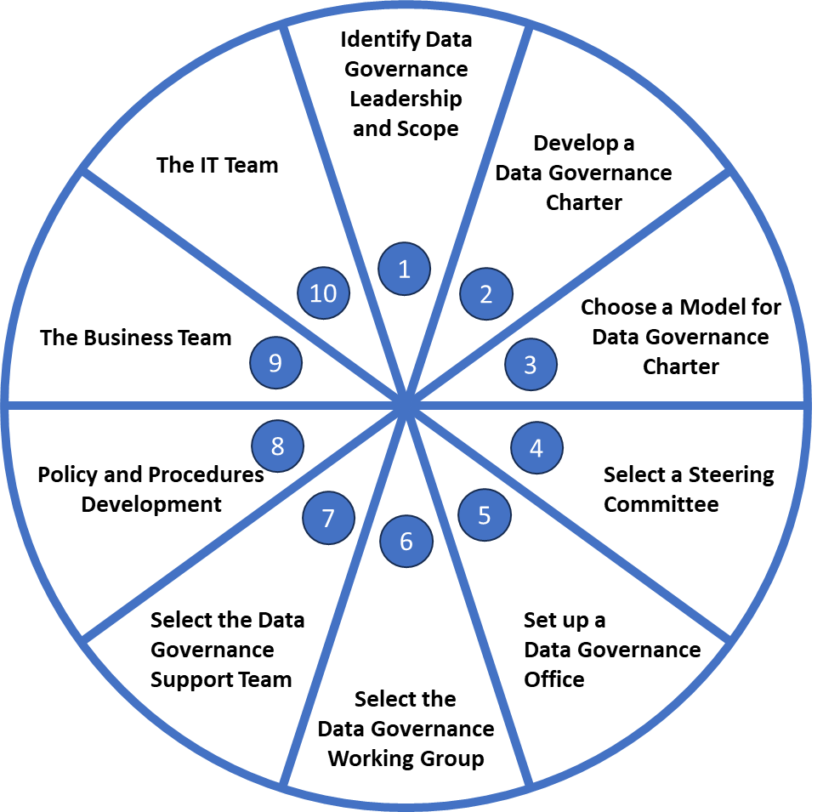
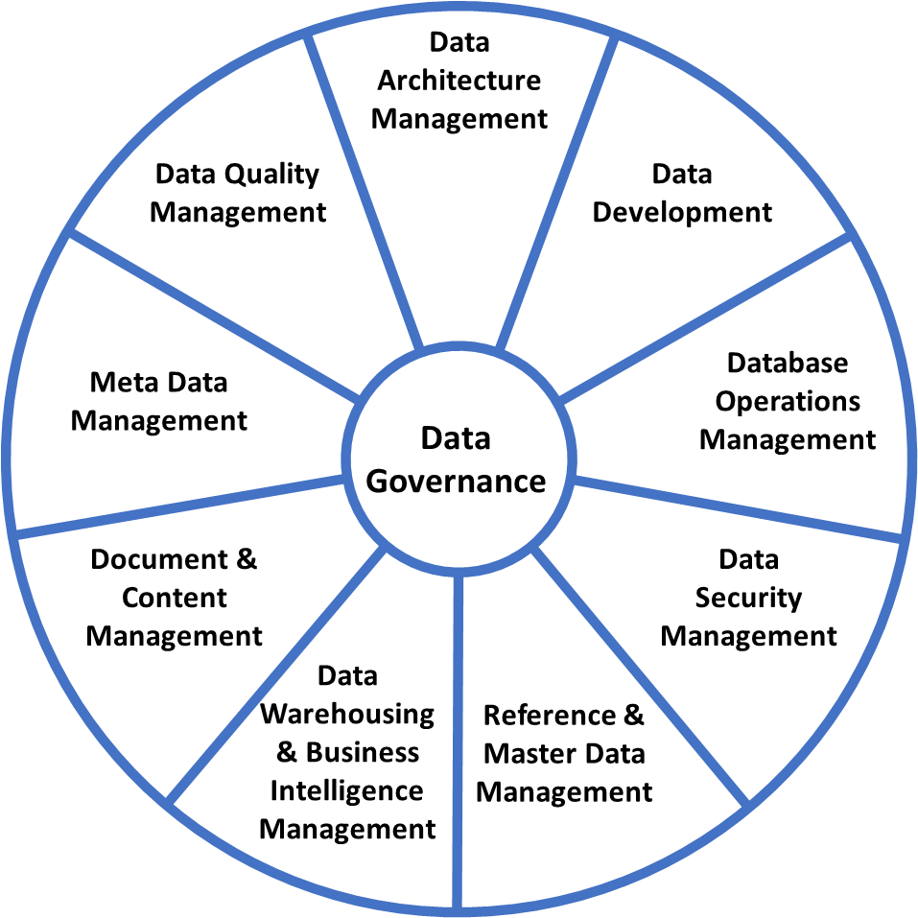
Summary
It’s about data – but it’s also about people and process.
Yes, it has a technical side – there are many options.
Improve your personal governance.
Know your ‘big ticket items’
Security
Compliance
Build your resources and your networks

Slide 27


Slide 28


Slide 29



Slide 34
Validity
Complete
Accuracy
Data
Quality
Timely
Consistency
Integrity

Slide 35
Validity
Complete
Accuracy
Data
Quality
Timely
Consistency
Integrity

Slide 36
Validity
Complete
Accuracy
Data
Quality
Timely
Consistency
Integrity

Slide 39
Business World
Company Performance
Business
Outcomes
Decision Quality
Information Quality
Data Quality

Slide 40
Company Performance
Business
Outcomes
Decision Quality
Information Quality
Data Quality

Slide 43
Ensure Data Quality
Enhance Data Security
Enhance Data Compliance
Correct Technology (tooling)
Process
Culture (People)
Implement Lifecycle Management
Establish a data governance framework Establish a Data Governance Framework
Data Literacy
Key Components and Frameworks
Operations and Best Practices
Requirements
Privacy
Auditing

Slide 46
13

Slide 47
Teşekkürler
Gracias
Thank You
Merci
Danke
Bedankt
Obrigada
Спасибо
谢谢
감사합니다
Cảm ơn
شكرا
Tak
Děkuji
Hvala
Tänan
Kiitos
Dziękuję
Ευχαριστώ

