Slide 1
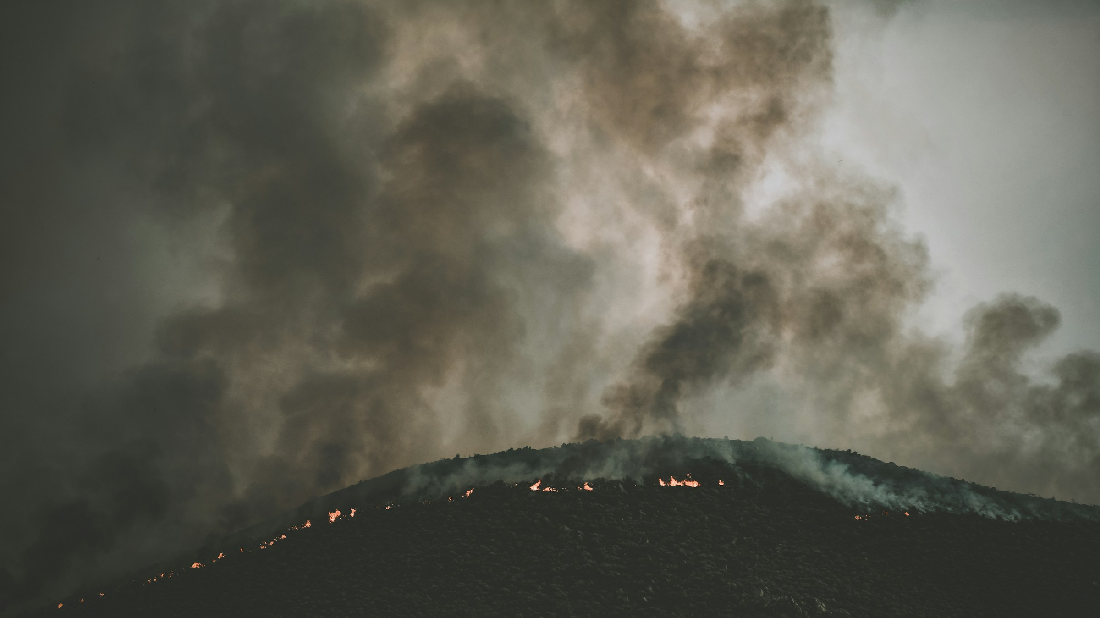


Emergency Response & Wildfire Analysis with CrateDB
Dardan Xhymshiti & Sindi Ziu

Slide 2
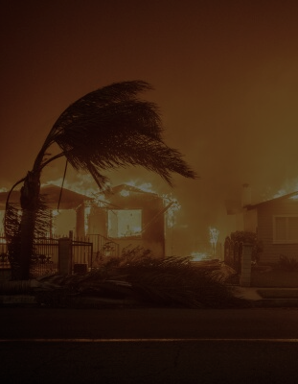
Domain & Data Sources
Natural disasters
Wildfires & Emergency response in US
Data sources
National Interagency Fire Center | Current Wildland Fire Incident Locations
The Department of Forestry and Fire Protection (California)
Simulated emergency calls data in Los Angeles
Type of data: Relational / Non-relational, Textual, Geo, Time series

Slide 3
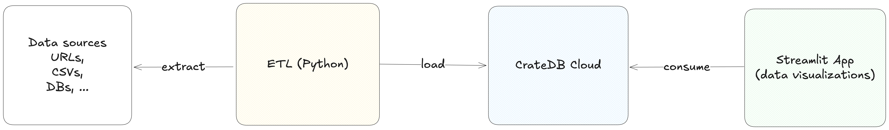
Architecture / Tech Stack
Python 3.10+ (Poetry, Crate driver, Pandas, …), CrateDB, Streamlit

Slide 4

Analytics
Emergency calls near fire locations
Utilized the distance function
Wildfire locations that fall into a specific area
Utilized Polygon shapes and within clause.
Emergency calls related to wildfires
Utilized text searching with match clause
Most common emergency call topics
The average response times between call receipt and incident discovery
The distribution of fires across different states/cities

