Slide 1
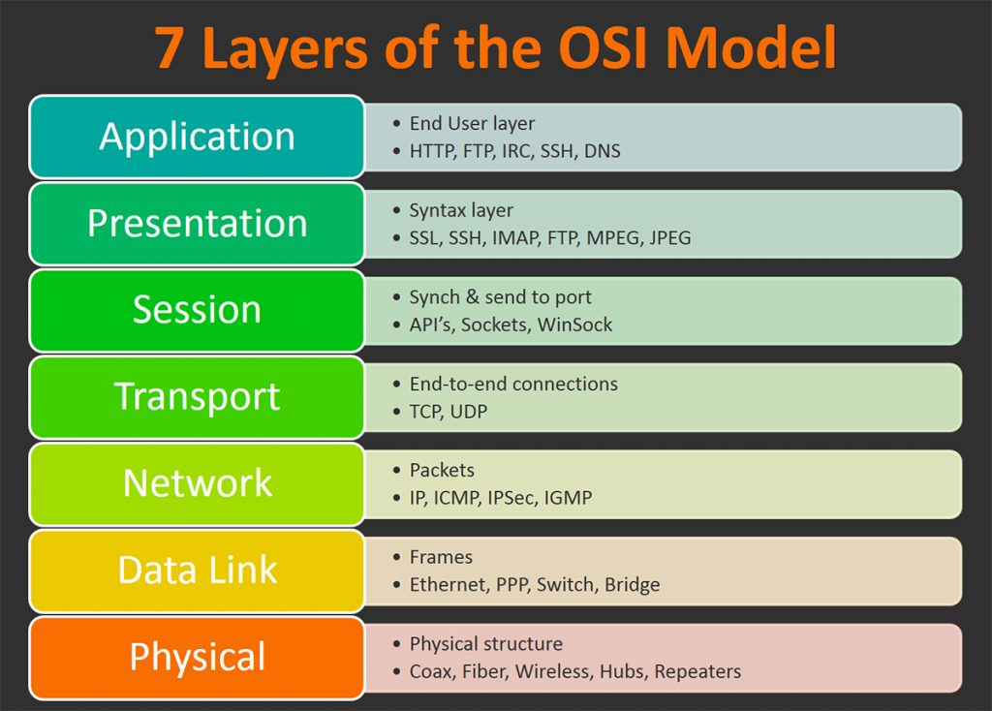
HTTP (Hypertext Transfer Protocol)
Application layer protocol
Top of the OSI Model
Used to deliver data on the web.
Stateless
Requests / Responses

Slide 2
HTTP Communication Flow
A HTTP client establishes a connection.
Sends a HTTP Request to retrieve back some data.
The server receives that request, finds the data the client was asking, prepares the HTTP Response with the data.
The server returns the HTTP Response to the client.
The connection between the two is terminated.

Slide 3
JSON over HTTP
POST /api/login HTTP/1.1
Content-Type: application/json
{
"username": "admin",
"password": "admin"
}
HTTP/1.1 200 OK
Content-Type: application/json
{
"access_token": "Axd0amasjbai901iu2bieuq==",
"refresh_token": "Aisndoaisnd1iu2983asd="
}

Slide 4
Programming Language HTTP libraries.
There are a lot of programming languages that can be used to write HTTP servers and clients.
Python: FastAPI, Flask, Django
Golang: net/http, gorrilla/mux
Nodejs: ExpressJS
Java: Spring Boot

Slide 5
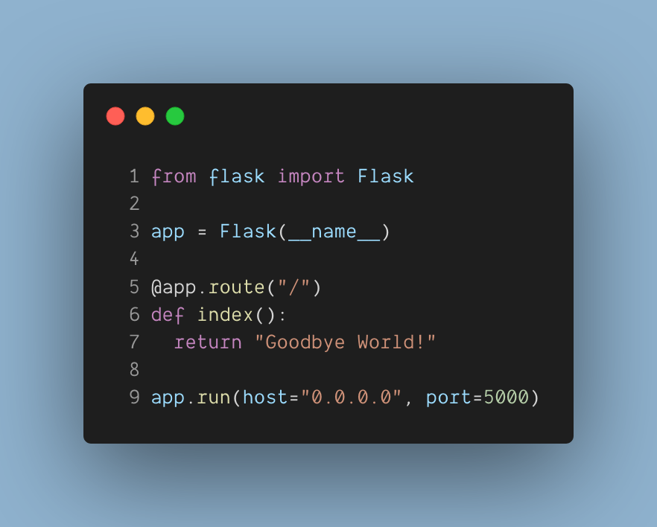
Python Flask Http server

Slide 6
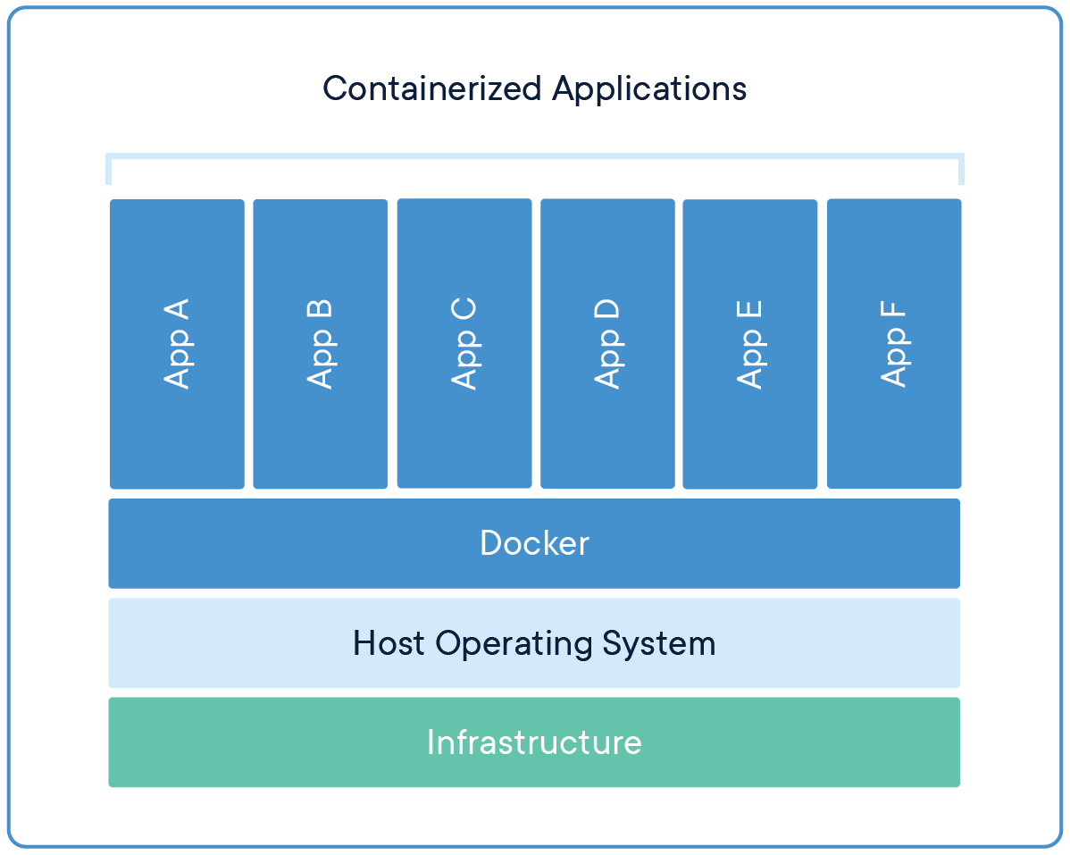
Docker Container Engine
Docker Images:
Lightweight standalone, executable package of software.
Includes everything needed to run an application.
Docker images become containers at runtime.
Docker Containers:
Isolate software from its environment.
Isolates containers from each-other.
Ensure that it works uniformly in every environment and machine.
No more: "IT RUNS ON MY MACHINE, YOURS IS BROKEN"

Slide 7
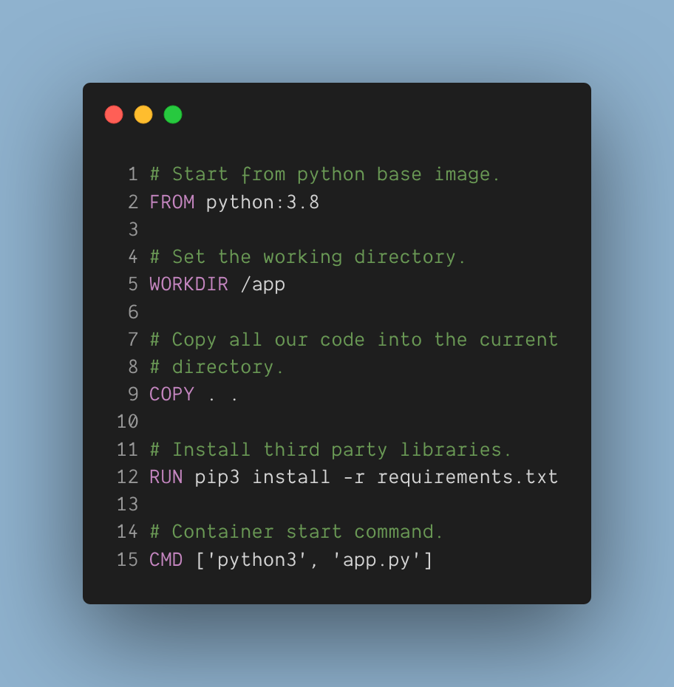
Example Dockerfile for our HTTP Server.

Slide 8
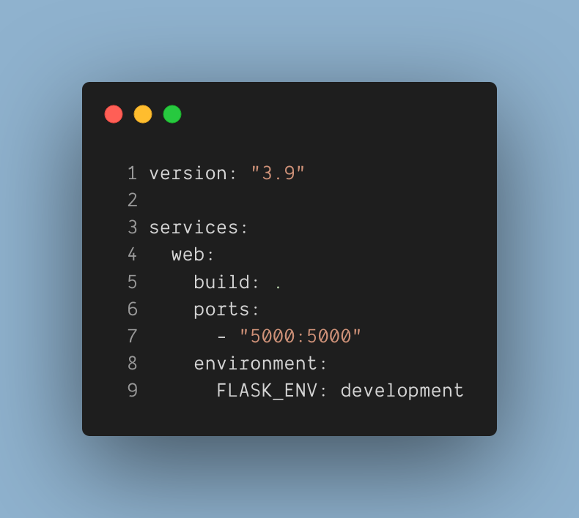
Example Docker Compose File

