Slide 1
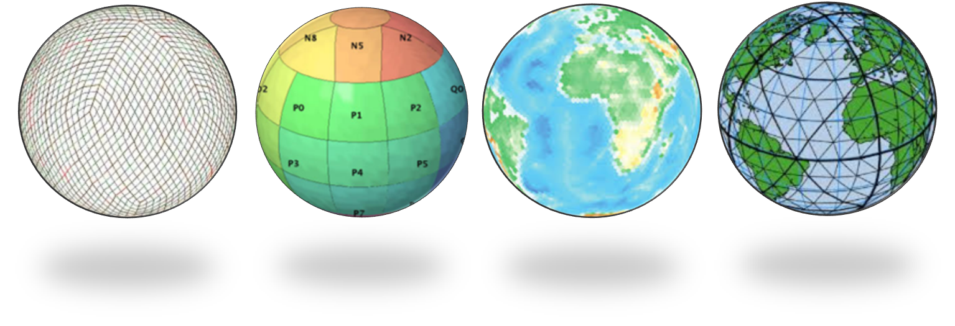
Discrete Global Grid Systems and Python
Clinton Dow – Geoprocessing @ Esri
Open Geospatial Consortium DGGS Standards Working Group
Notes:
Esri Corporate Template-Dark v3.4
16:9 version – January 29, 2017
For more templates, sample files, and icons, see https://compass.esri.com/resources/presentations/Pages/Main.aspx
To add footer text in Windows
On the Home tab, under Insert, click Text, and then click Header and Footer.
Click the Slide tab, select the Footer check box, and then type the footer text that you want.
Click either Apply or Apply to All.
To add footer text on a Mac
On the View menu, select Header and Footer.
Select the Footer check box and then type the footer text that you want.
Click either Apply or Apply to All.
If footers don't appear on the slides
If footers don't appear on title slides, in the Header and Footer dialog box make sure the Don't show on title slide check box is not selected.
If the footers are missing from other slides, the placeholders for these items might have been removed from specific slide layouts or the slide master.

Slide 2
Overview
The Challenge of Big Data at a Global Scale
What is a Discrete Global Grid System
OGC Abstract Standard
DGGS for Global-scale Big Data
Cell Shapes
Raster Representation
Vector Representation
Scalable DGGS with Python
Global Grids and the Future of Geospatial Computing

Slide 3
The Challenge of Big Data at Global Scale

Slide 4
Global Geospatial Data
Earth Observation data from Remote Sensing are measurements
Requiring a well defined spatial area
Senses parts of the electromagnetic spectrum
Visible light
Ultraviolet
Etc
Taken at regular intervals with a predictable cycle in time
To deal with this in a natively digital way
Discretisation
Quantisation
Earth Observation Data

Slide 5
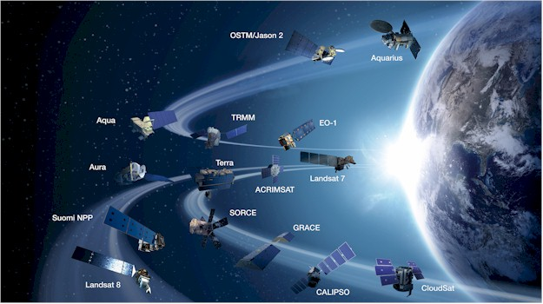
The 3 V’s of Contemporary Earth Observation Data
Volume
Observations are more frequent, higher resolution and multi-dimensional
Variety
A more diverse array of sensors than ever before
Velocity
Real time demands
Credit: Peter Strobl, ESA
Volume, Variety and Velocity

Slide 6
What is a Discrete Global Grid?

Slide 7
Enter Discrete Global Grid Systems
A DGGS is an Earth Reference Model
Designed to be an information/addressing grid
The OGC defines a DGGS as:
“… a spatial reference system that uses a hierarchical tessellation of cells to partion and address the globe. DGGS are characterized by the properties of their cell structure, geo-encoding, quantization strategy and associated mathematical functions.”
What is a DGGS?

Slide 8
Enter Discrete Global Grid Systems (con’t)
Any tessellation of the earth does not necessarily count as a DGGS
Single resolution computational grids are not sufficiend
MUST have a hierarchy of grids with successively finer resolution
A DGGS must have ‘Equal Area’ cells
Equal area cells are critical to:
Ensure uniform coverage
Perform meaningful statistical analysis
Enable standardized interoperability between DGGS and traditional addressing methods
What is a DGGS?

Slide 9
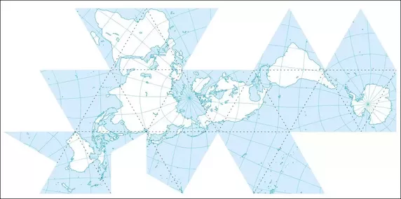
History of Discrete Global Grid Systems
Digital Earth Concept – “The earth as a computer”
Early History
1962 – Geoscope (R. Buckminster Fuller)
1990s – GeoFusion -> Esri ArcGlobe, Boeing Keyhole
1998 – Al Gore & Michael Goodchild bring concept to mainstream
2005 – Google Earth (via Keyhole)
2010+ - PYXIS Innovation, HealPIX
Full Systems leveraging Global Grids
Reference Frame
Data Store
Operations (Interoperability, Quantisation)
Volume, Variety and Velocity

Slide 10

Open Geospatial Consortium Abstract Standard
Initial Submission was a Standardization Document
Implementation Details for a DGGS
Rejected in favor of an Abstract Standard Document
A document which defines how to define an implementation standard
Open for Comments in early 2017 – Closed April 6
Technical Committee Meeting next month
http://www.opengeospatial.org/pressroom/pressreleases/2553
Volume, Variety and Velocity

Slide 11
Why Standardize?
Lack of diversity and standardized applications
Limits exposure to the public
Prevents development of analysis tools for Global Scale data
Introduces potential for erroneous interoperability
OGC Standard defines
A concise definition for the concept
Characteristics of a conformant DGGS
Core functional algorithms
http://www.opengeospatial.org/pressroom/pressreleases/2553

Slide 12
Cell Shapes

Slide 13
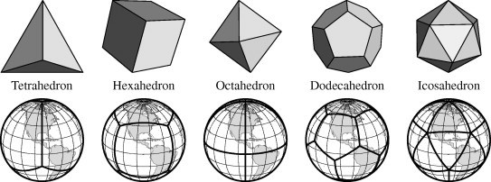
Cell Shapes in a DGGS
Equal Area Cells require a base polyhedron with equal area faces
Platonic Solids
Raster Representation
Compared to Square Pixels, Hexagonal Pixels
Are 13% more efficient at sampling (approximation to a circle)
Are 25% to 50% more efficient for image processing algorithms
The human eye uses a hexagonal arrangement of rods and cones to process images
Correlations in neuroscience?
Six sides are better than four

Slide 14
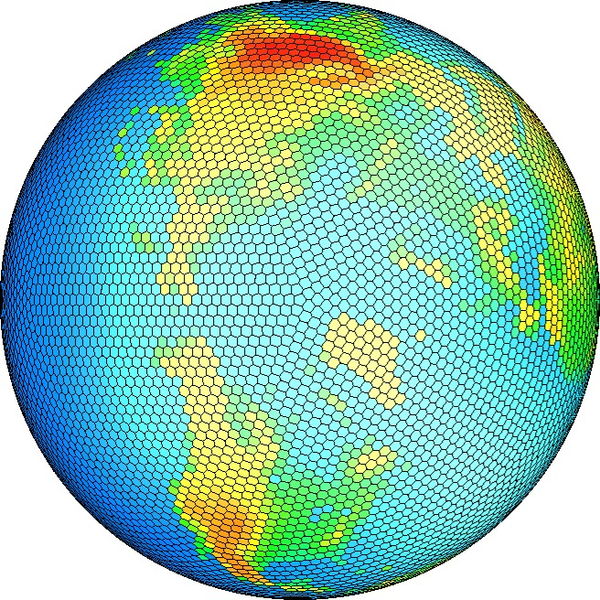
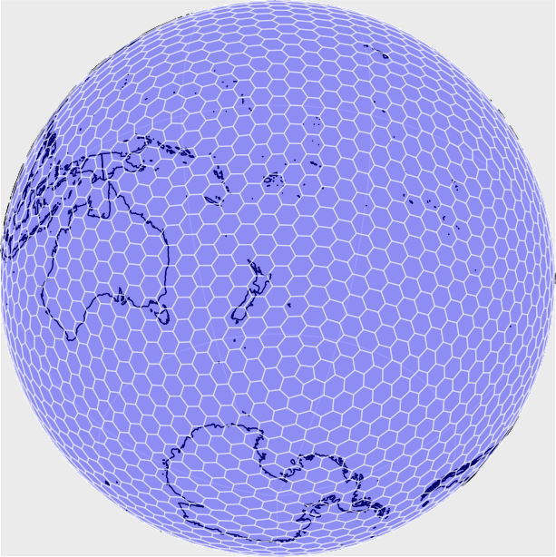
Cell Shapes in a DGGS
The human brain represents location using hexagonal arrangement of neurons
A hexagonal lattice is optimal for:
Least average errors in quantisation
Problem of uniformly covering a surface
Efficiency of packing
Honeycombs
Vector representations
Midpoints of cells
Vertices and Edges
Interoperability between traditional maps and DGGS maps
Hexagons!

Slide 15
DGGS in Python

Slide 16

Considering Python for DGGS implementations
Advantages
Ubiquity in GIS and the online world
ArcPy, QGIS and more…
APIs for essentially all scalable platforms
Lambda, Elastic Computing
Mature statistical libraries
Pandas/GeoPandas
SciPy
NumPy
Well known among Geographers
Disadvantages
Not completely optimal compared to compiled languages
Snakes on a (ellipsoidal) plane

Slide 17
Thank you! cdow@esri.com http://www.opengeospatial.org/pressroom/pressreleases/2553

