Slide 1

British Airways
Customer Review Analysis

Slide 2
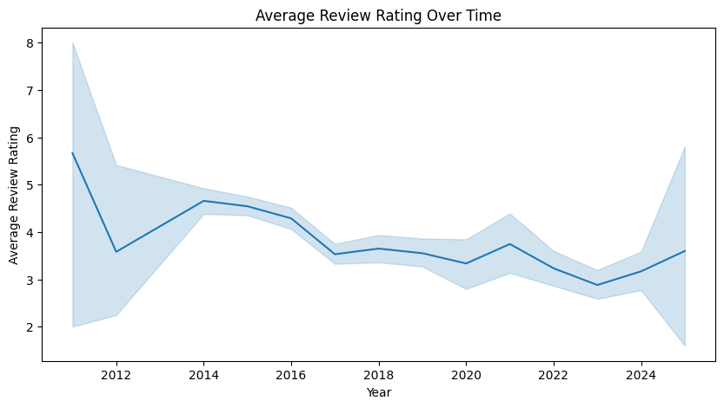
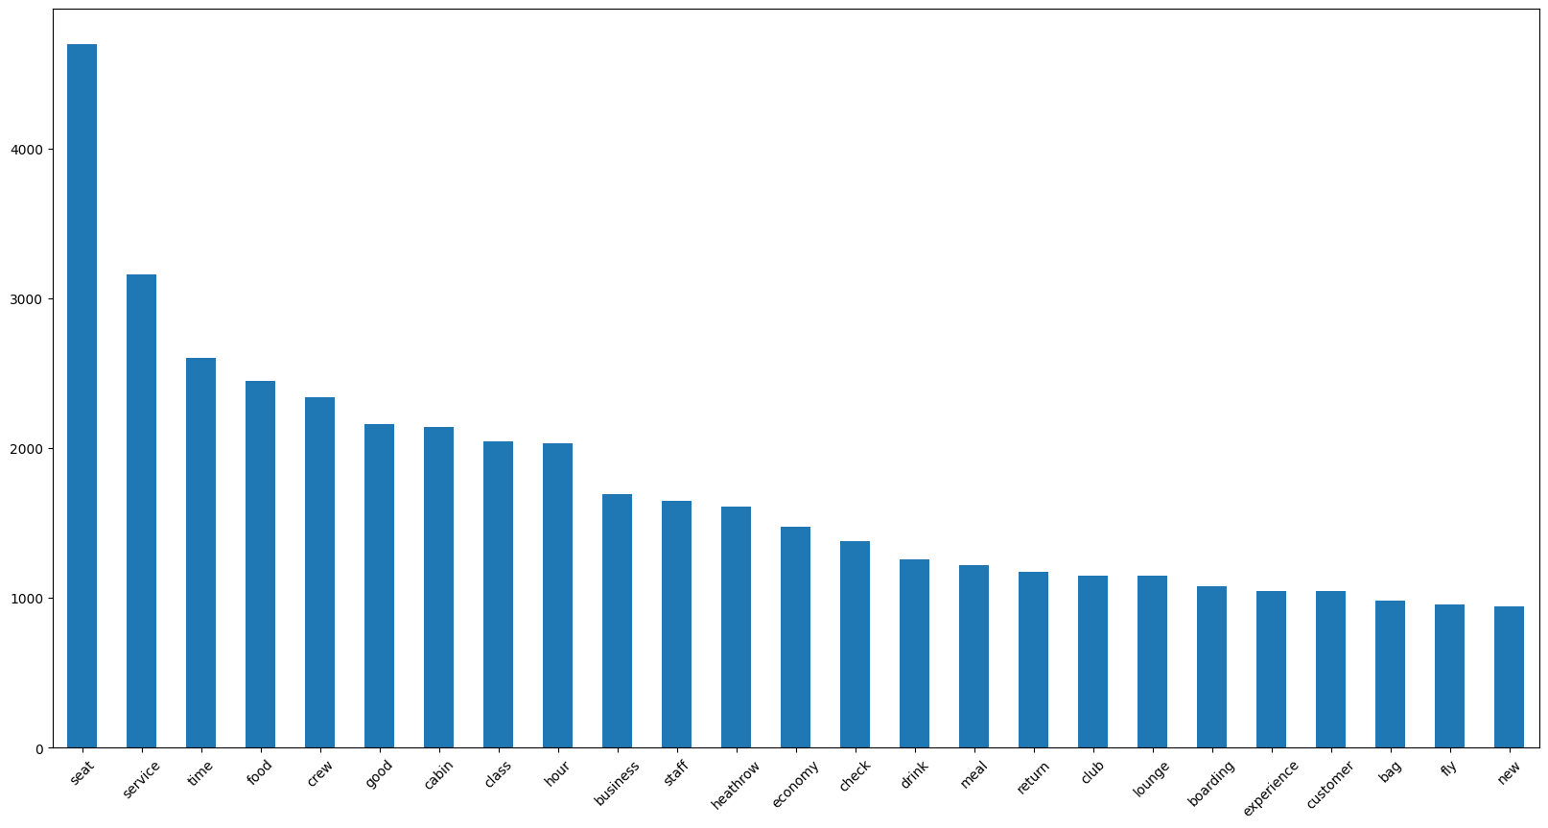
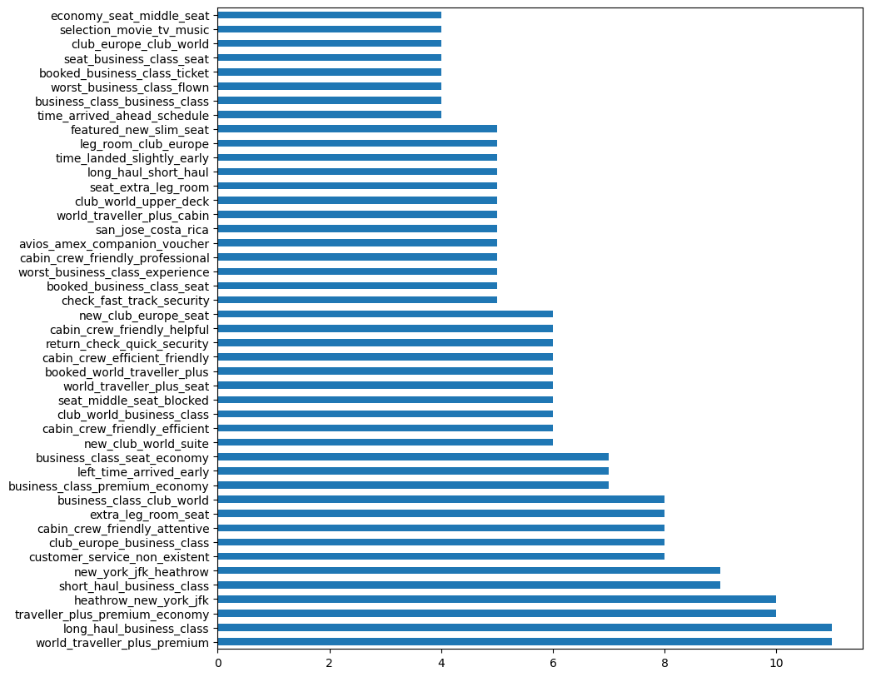

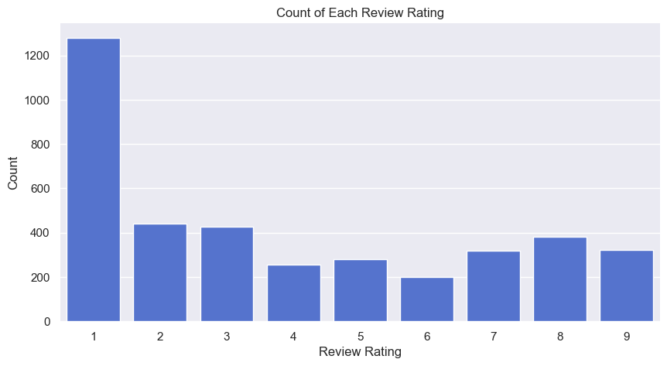
Average Rating: 3.9
Avg Rating of Verified Trip : 3.39
Avg Rating of Non Verified Trip : 4.15
Verified Trip: 1306
Non Verified Trip: 2600
From the Count of Review we can tell people who had negative reviews tends to post review most likely.
Average rating is falling throughout the years.

