Slide 1

British Airways
Predicting Customer Bookings for British Airways

Slide 2
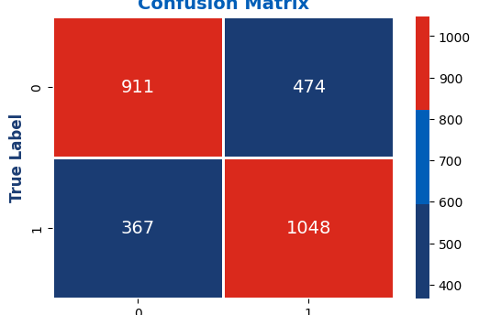
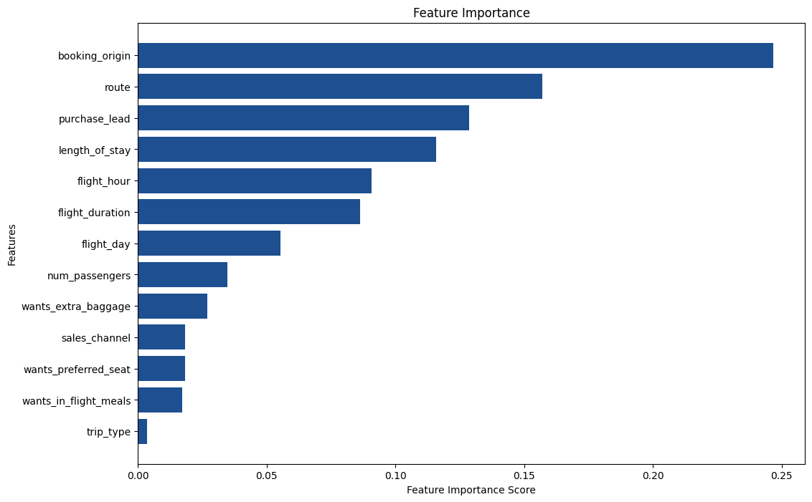
British Airways
The best Model is the one with accuracy 70%, and the feature which contribute the most towards the prediction is booking_origin and route.

