Slide 1
&mut self
Kevin Martin S1’18

Slide 2
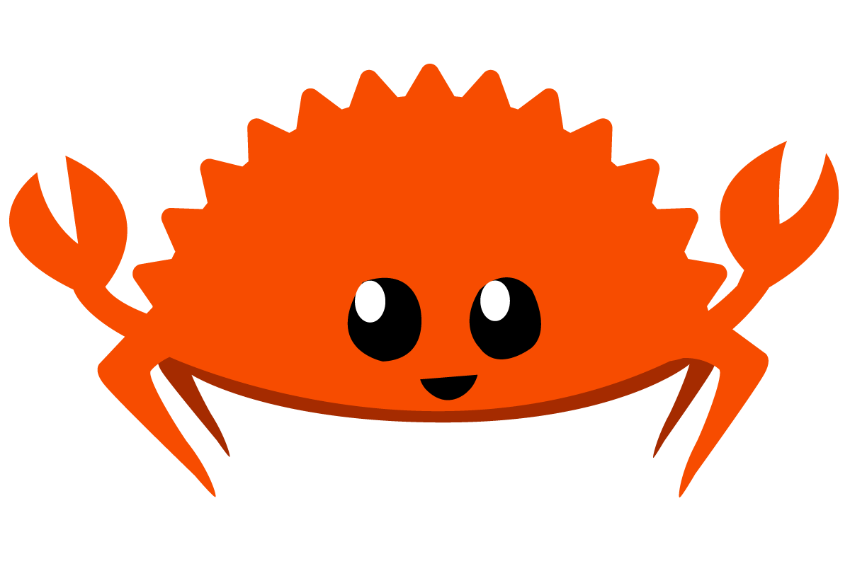
&mut self
Kevin Martin S1’18

Slide 3
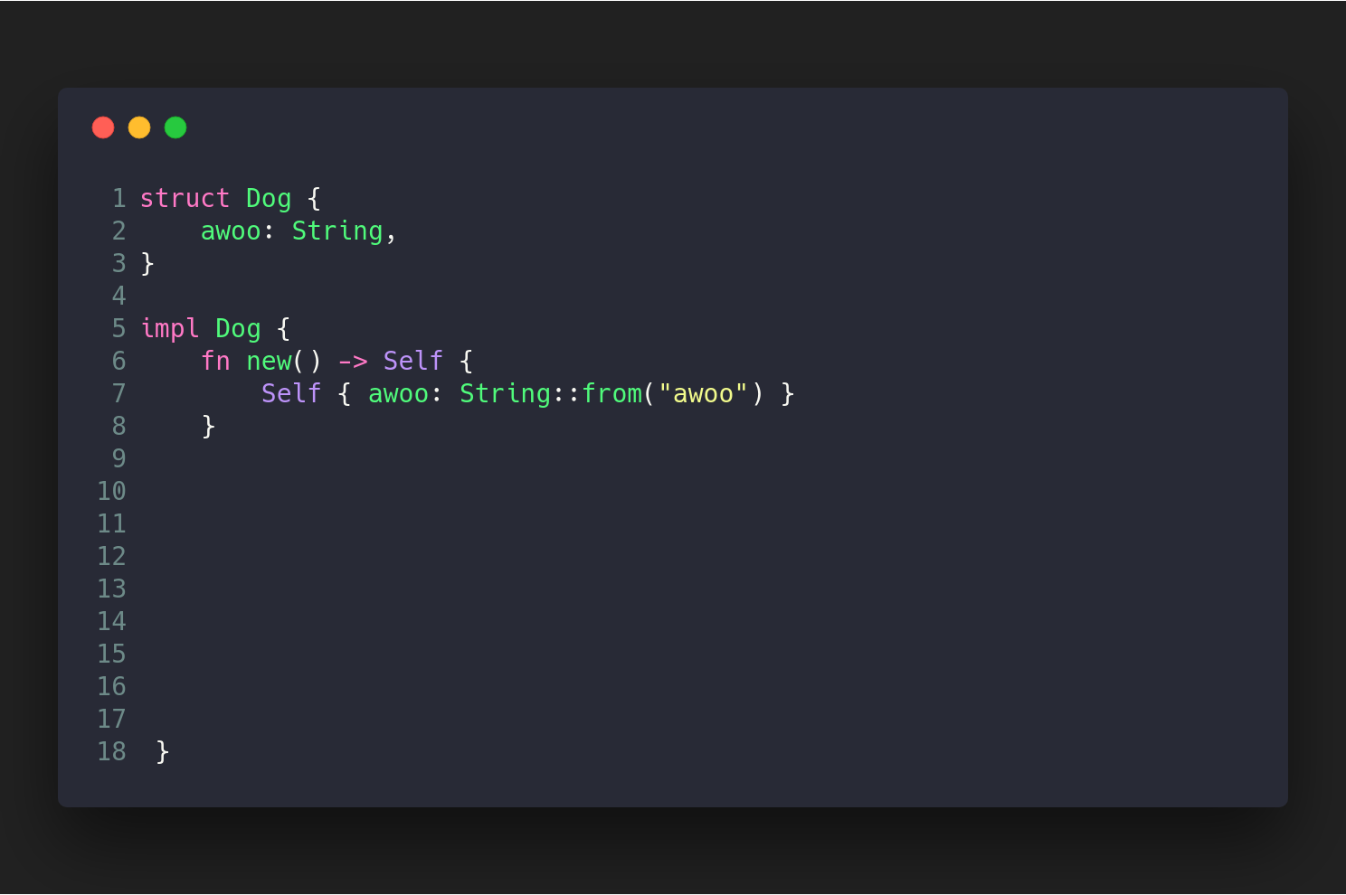

Slide 4
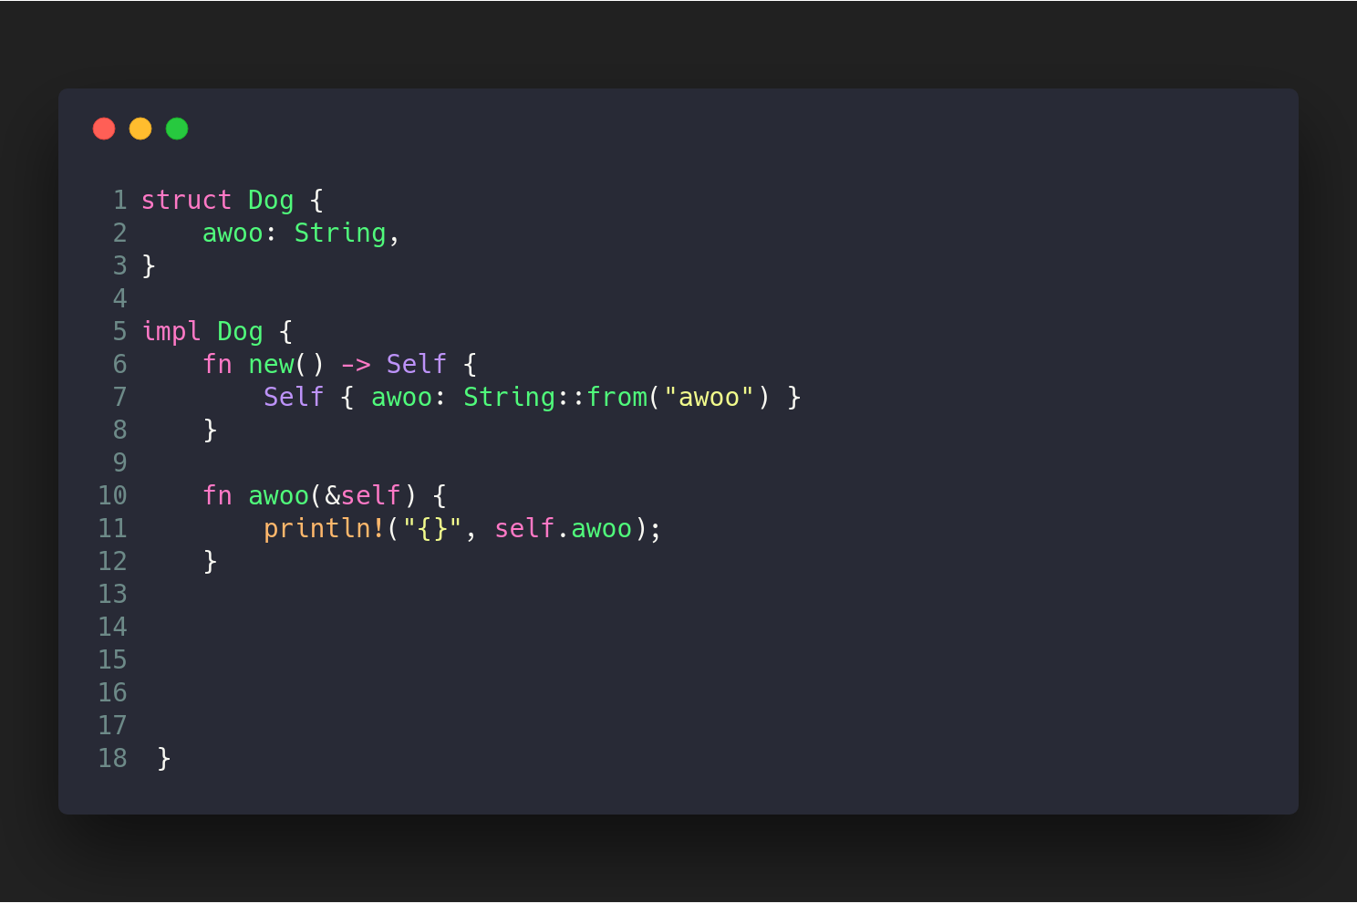

Slide 5
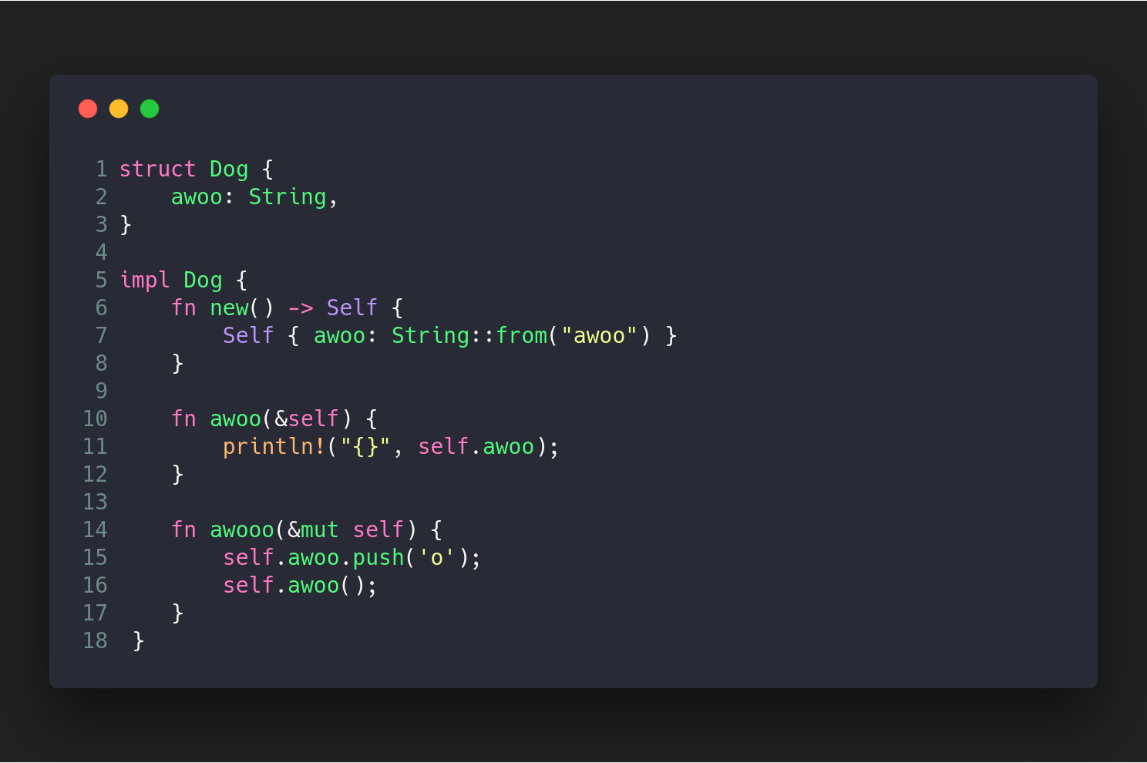

Slide 6
What do we do?

Slide 7
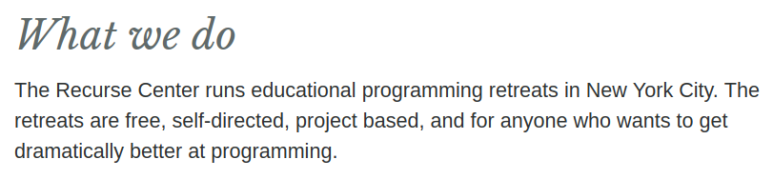

Slide 9
What did I do?

Slide 10
What did I do?
I became a dramatically better programmer!

Slide 11
How?

Slide 12

How?

Slide 13
How?
There might not be an easy answer to that question.

Slide 14
So let’s talk about Rust instead!

Slide 15
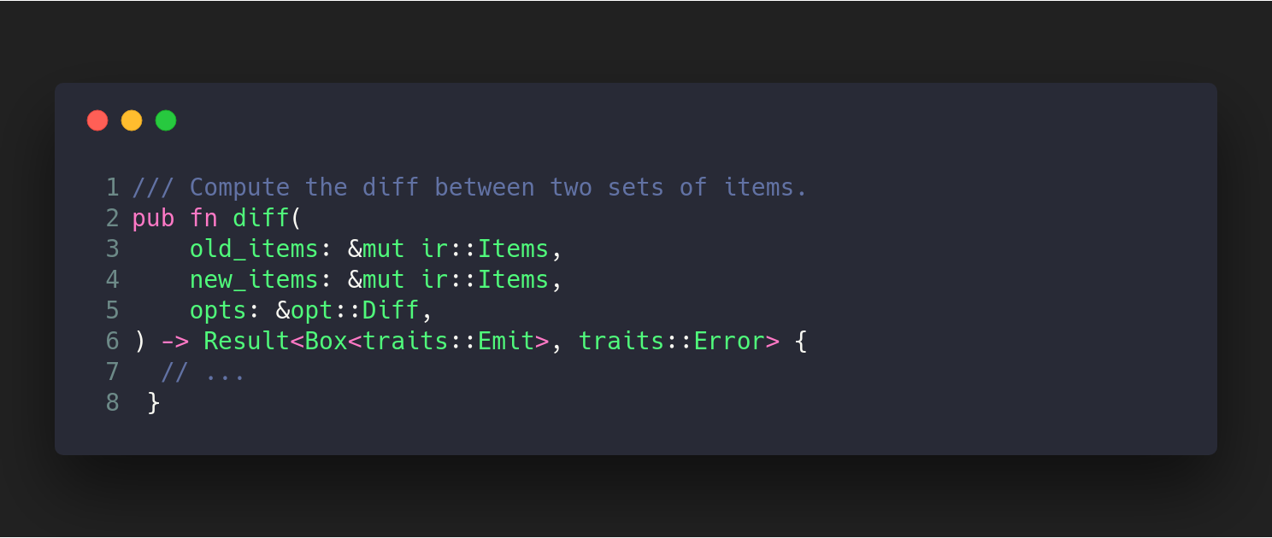

Slide 16
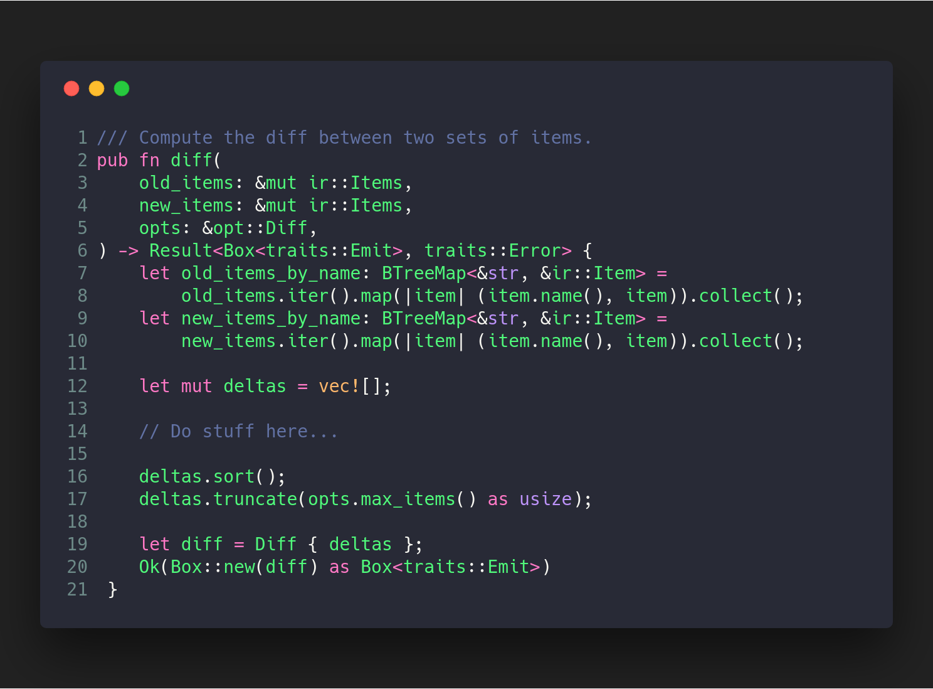

Slide 17
Calculating a diff imperatively...

Slide 18
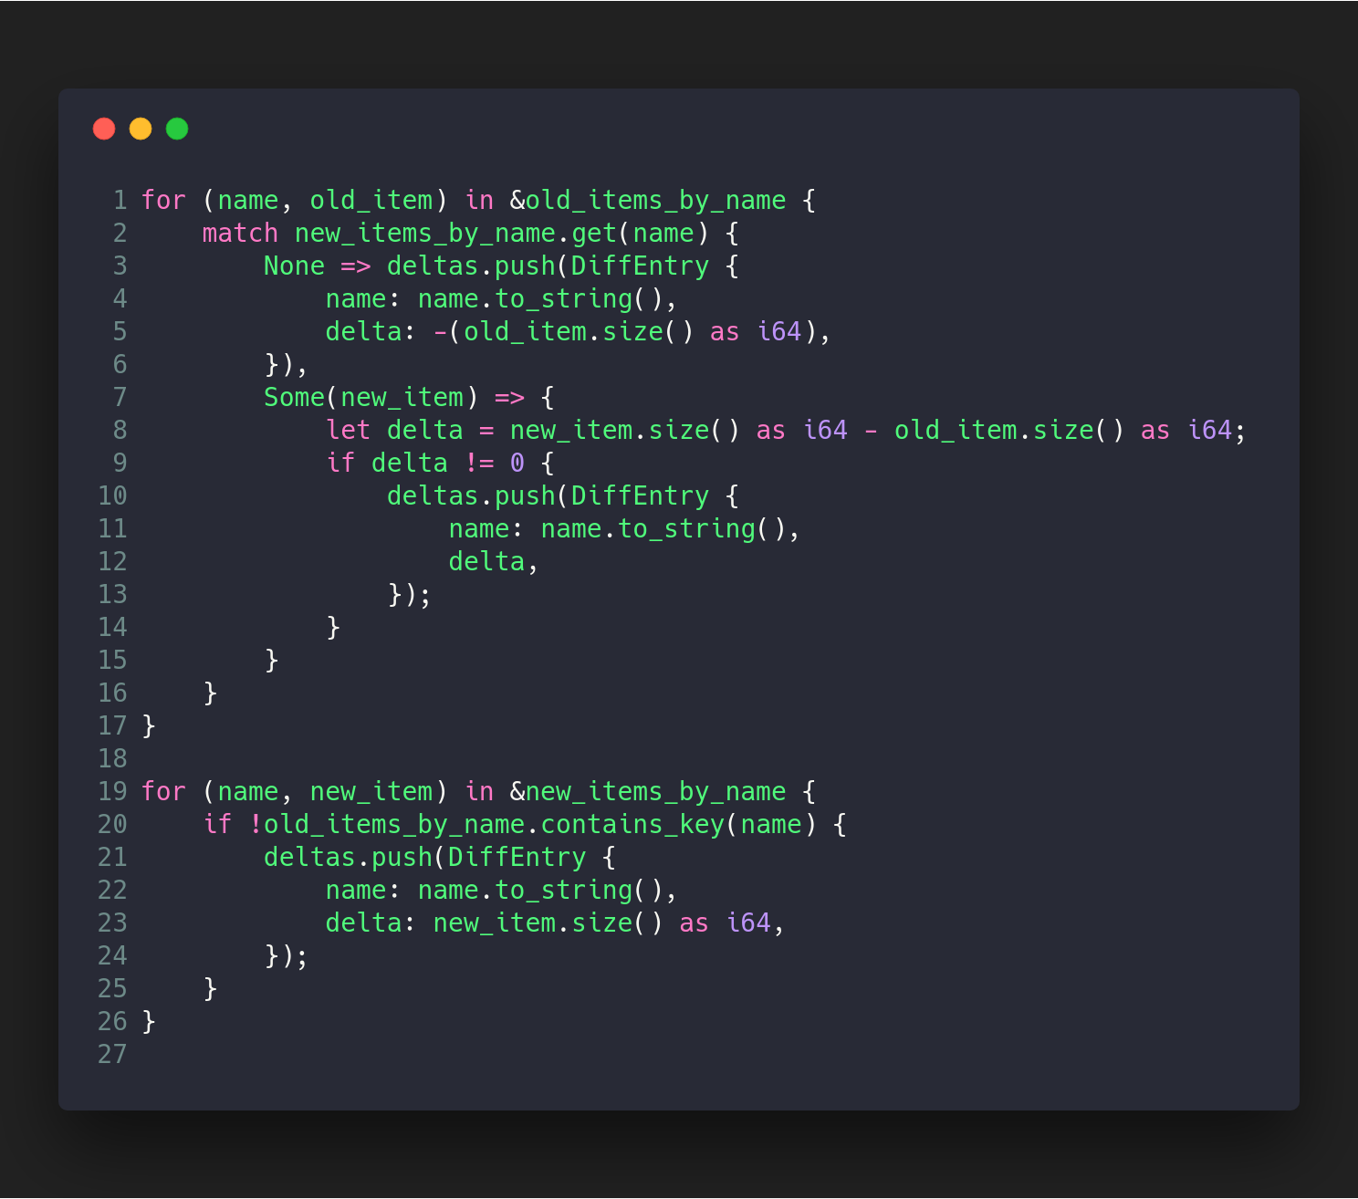

Slide 19
Calculating a diff functionally...

Slide 20
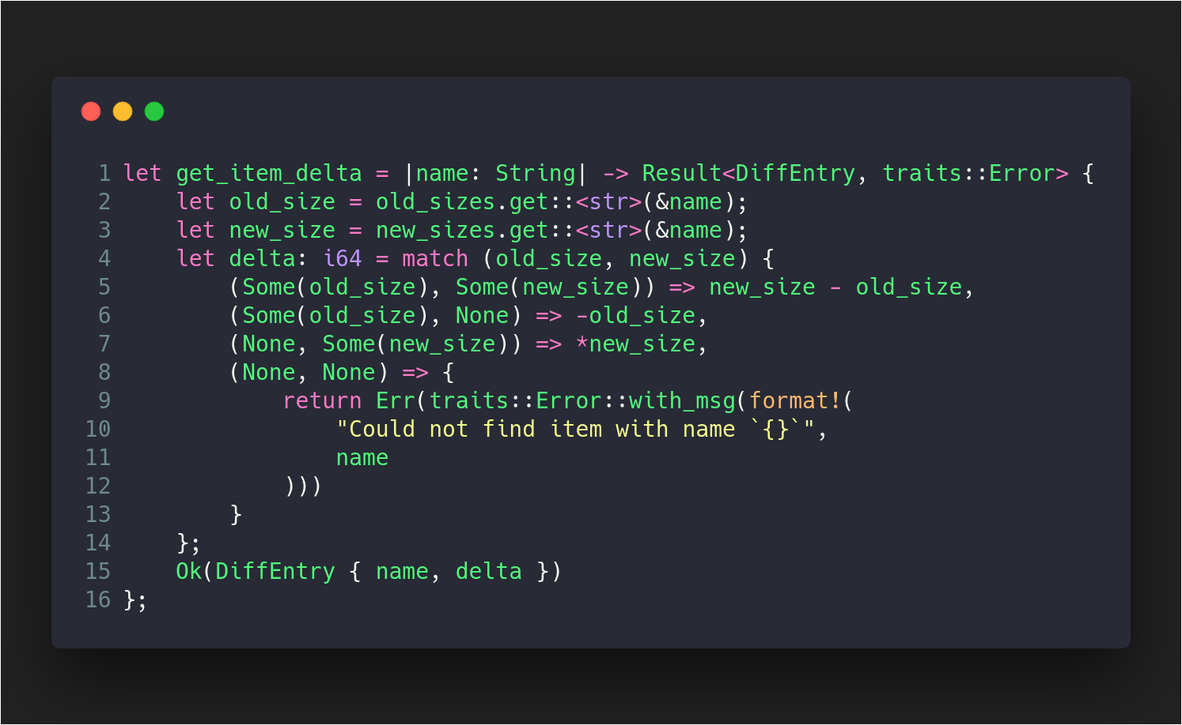

Slide 21
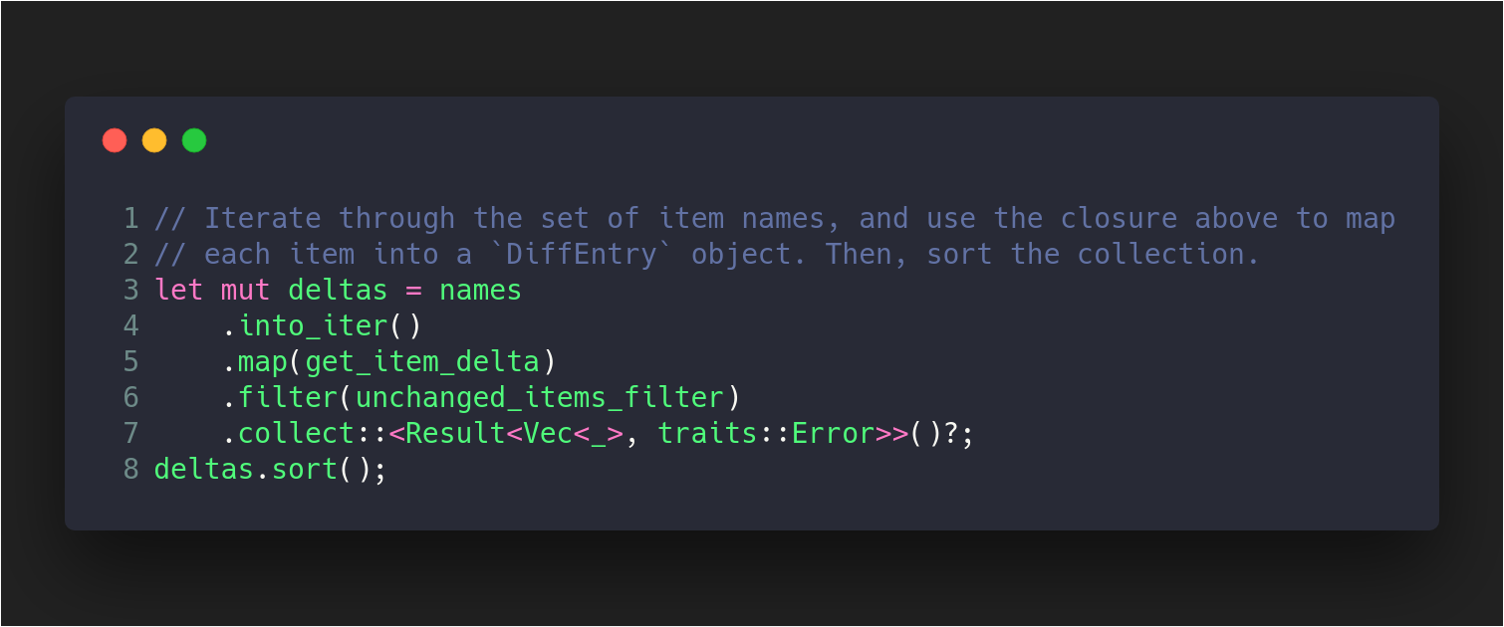

Slide 22
What did I learn?

Slide 23
What did I learn?
Becoming fluent in a new programming language

Slide 24
What did I learn?
Becoming fluent in a new programming language

Slide 25
What did I learn?
Becoming fluent in a new programming language
Working with new programming paradigms

Slide 26
What did I learn?
Becoming fluent in a new programming language
Working with new programming paradigms
Working in previously unexplored domains

Slide 27
How did these things help me become a better programmer?

Slide 28
How did these things help me become a better programmer?

Slide 29
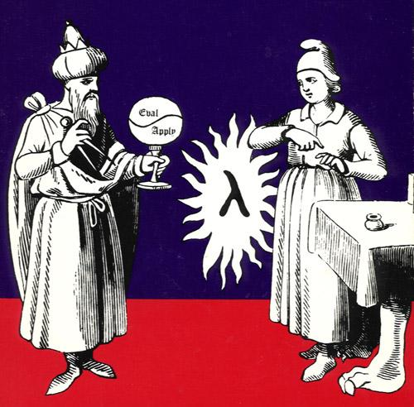

Slide 30
“I think that it’s extraordinarily important that we in computer science keep fun in computing. When it started out it was an awful lot of fun. [After a while] we began to feel as if we really were responsible for the successful error-free perfect use of these machines. I don’t think we are.
I think we’re responsible for stretching them setting them off in new directions and keeping fun in the house. I hope the ﬁeld of computer science never loses its sense of fun. [...]
What you know about computing other people will learn. Don’t feel as if the key to successful computing is only in your hands. What’s in your hands I think and hope is intelligence: the ability to see the machine as more than when you were ﬁrst led up to it that you can make it more.”
― Alan J. Perlis

Slide 31


