Slide 1
GPU
GPU
GPU
GPU
GPU
GPU
GPU
GPU
PCIe Swtich
PCIe Swtich
PCIe Swtich
PCIe Swtich
CPU
QPI/UPI
CPU
NUMA Node
NUMA Node
RDMA HCA
RDMA HCA
NUMA Node
CPU
QPI/UPI
NUMA Node
CPU
PCIe Swtich
PCIe Swtich
PCIe Swtich
PCIe Swtich
GPU
GPU
GPU
GPU
GPU
GPU
GPU
GPU

Slide 2
Data Batch
Data Batch
Model-0
Model-1
Model-2
Device-0
Device-1
Device-2
Trained Model
Trained Model

Slide 3

































PS-0
PS-1
GPU-0
$$A_{0}$$
$$B_{0}$$
$$C_{0}$$
$$D_{0}$$
$$E_{0}+E_{4}$$
$$∑A$$
$$∑B$$
GPU-1
$$A_{0}+A_{1}$$
$$B_{1}$$
$$C_{1}$$
$$D_{1}$$
$$E_{1}$$
GPU-2
$$A_{2}$$
$$B_{1}+B_{2}$$
$$C_{2}$$
$$D_{2}$$
$$E_{2}$$
Worker-0
Worker-1
Worker-2
GPU-3
$$A_{3}$$
$$B_{3}$$
$$C_{2}+C_{3}$$
$$D_{3}$$
$$E_{3}$$
$$A_{0}$$
$$B_{0}$$
$$A_{1}$$
$$B_{1}$$
$$A_{2}$$
$$B_{2}$$
GPU-4
$$A_{4}$$
$$B_{4}$$
$$C_{4}$$
$$D_{3}+D_{4}$$
$$E_{4}$$
data batch-0
data batch-1
data batch-2
push
pull

Slide 4

等价的torch.fx.Graph 计算图模型
待训练的torch.nn.Module模型
class Model(nn.Module)
模型转换
模型分析
模型元信息
模型算子执行时间
模型显存用量
P2P通信测试
带宽测试结果
模型划分
模型划分结果
放置训练
GPU-0
GPU-1
GPU-2
PCIe / NVLink
PCIe / NVLink
CUDA Runtime

Slide 5













$$Forward Start$$
$$Forward End$$
$$Forward Start$$
$$Forward End$$
$${Node}_{v}$$
$$Virtual Node$$
$${Node}_{u}$$
$$Backward End$$
$$Backward Start$$
$$Backward End$$
$$Backward Start$$
$$Forward$$
$$Backward$$

Slide 6
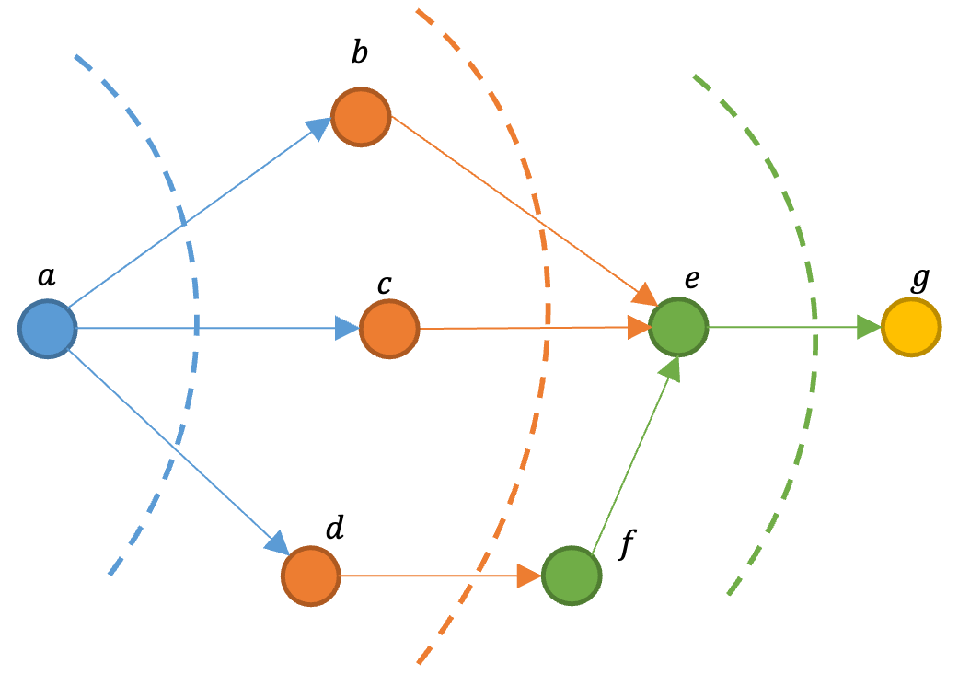
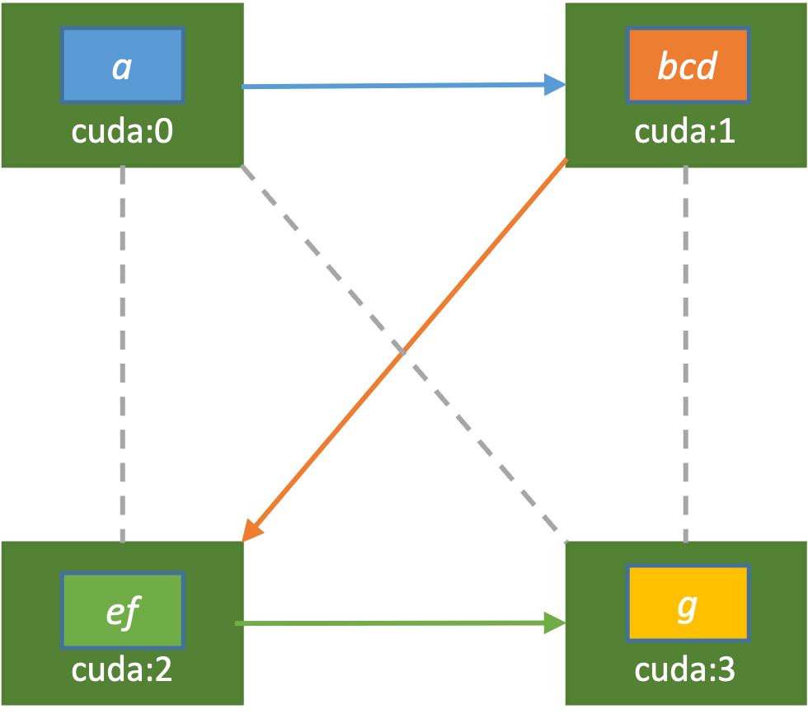
模型划分
模型训练

Slide 7







$${Device}_{x}$$
$${Device}_{y}$$
$${Node}_{u}$$
$$MoveTo$$
$${Node}_{v}$$
$$Forward$$
$$Backward$$

