Slide 1
Rockbuster stealth
Robert Riemer – August 2023

Slide 2








Presentation overview
Introduction
Main Questions
Data Overview
Movies by Revenue
Rental Duration
Customers Around the World
Top Customers & Countries
Geographic Distribution

Slide 3


Presentation overview
Limitations
Conclusion

Slide 4
Introduction
What’s the purpose behind the analysis?
Rockbuster Stealth LLC is a movie rental company that used to have stores around the world.
Facing stiff competition, the Rockbuster Stealth management team is planning to use its existing movie licenses to launch an online video rental service in order to stay competitive.

Slide 5
Main Questions
What movies contributed most/least to revenue gain?
What was the average rental duration for all videos?
What countries are Rockbuster customers based in?
Where are customers with a high lifetime value based?
Do sales figures vary between geographic regions?

Slide 6
Data overview
Average Money Spent by a Rockbuster Customer
Country with Most Rockbuster Customers
Average Rockbuster Movie Length
Most Common Rockbuster Movie Rating
Most Popular Movie Genre
115
Minutes
Sports
India
PG-13
$102.36

Slide 7
What movies contributed most/least to revenue gain?

Slide 8

Top & bottom 3 movies by revenue
Most Earning Movies
Least Earning Movies
 | Title | Revenue | Genre
 | Title | Revenue | Genre
1 | “Telegraph Voyage” | $215.75 | Music
2 | “Zorro Ark” | $199.72 | Comedy
3 | “Wife Turn” | $198.73 | Documentary
956 | “Oklahoma Jumanji” | $5.94 | New
957 | “Texas Watch” | $5.94 | Horror
958 | “Duffel Apocalypse” | $5.94 | Documentary

Slide 9
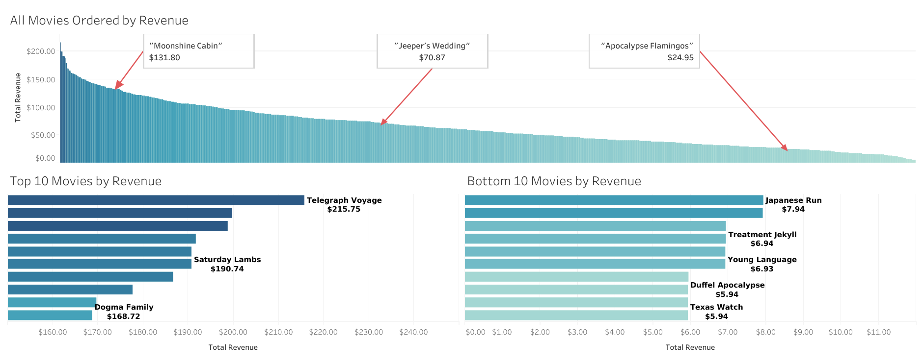
Rockbuster movies by total revenue
Total Revenue Generated: $61,312.04

Slide 10
What was the average rental duration for all videos?

Slide 11

Average rental duration
5 Days
*Min-Max Rental Duration: 3-7 Days*

Slide 12
What countries are rockbuster customers based in?

Slide 13
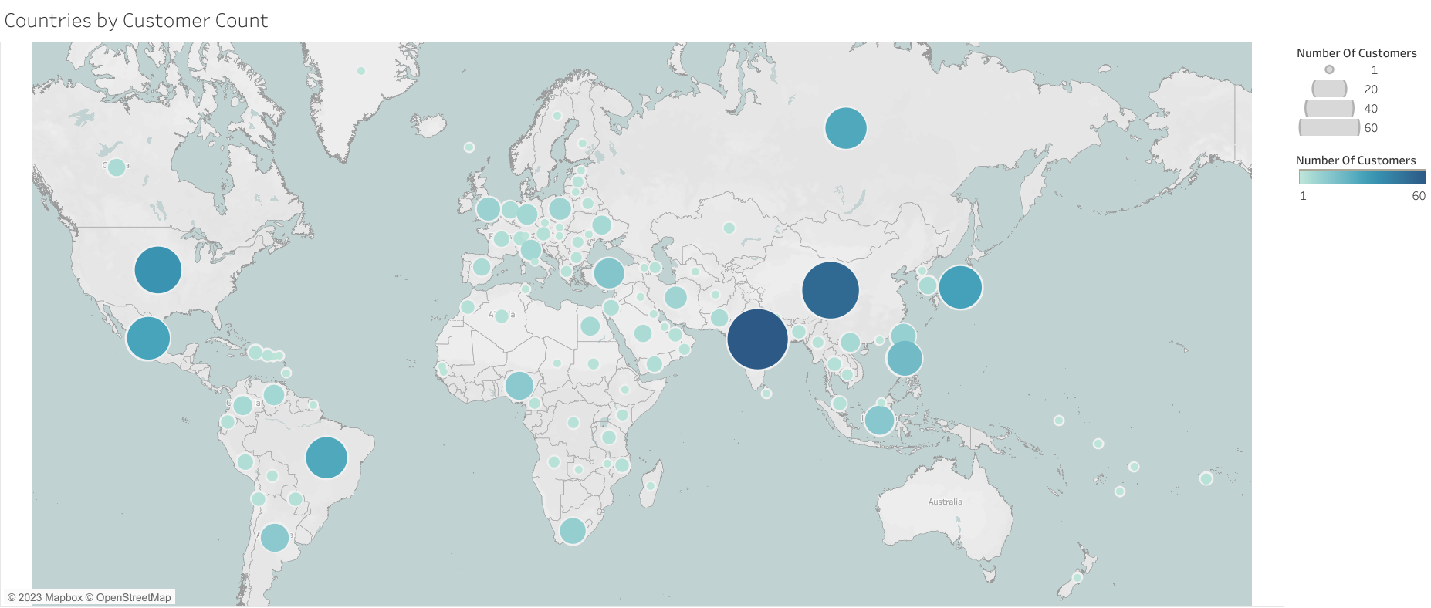
Countries by rockbuster customers
Top Countries by Number of Customers
1. 2. 3. 4. 5. 6. 7. 8. 9. 10.
India China United States Japan Mexico Brazil Russia Philippines Turkey Indonesia
60 53 36 31 30 28 28 20 15 14
41 of the 108 countries only have 1 customer like Sweden
India has the most Rockbuster customers with 60.

Slide 14
Where are customers with a high lifetime value based?

Slide 15
Top paying customers & countries
Eleanor Hunt Karl Seal Marion Snyder Rhonda Kennedy Clara Shaw Tommy Collazo Ana Bradley Curtis Irby Marcia Dean Mike Way
$211.55 $208.58 $194.61 $191.62 $189.60 $183.63 $167.67 $167.62 $166.61 $162.67
1. "India" 2. "China" 3. "United States" 4. "Japan“ 5. "Mexico" 6. "Brazil" 7. "Russian Federation" 8. "Philippines" 9. "Turkey" 10. "Indonesia"
Top Customers Top Countries
$6,034.78 $5,251.03 $3,685.31 $3,122.51 $2,984.82 $2,919.19 $2,765.62 $2,219.70 $1,498.49 $1,352.69

Slide 16
Do sales figures vary between geographic regions?

Slide 17
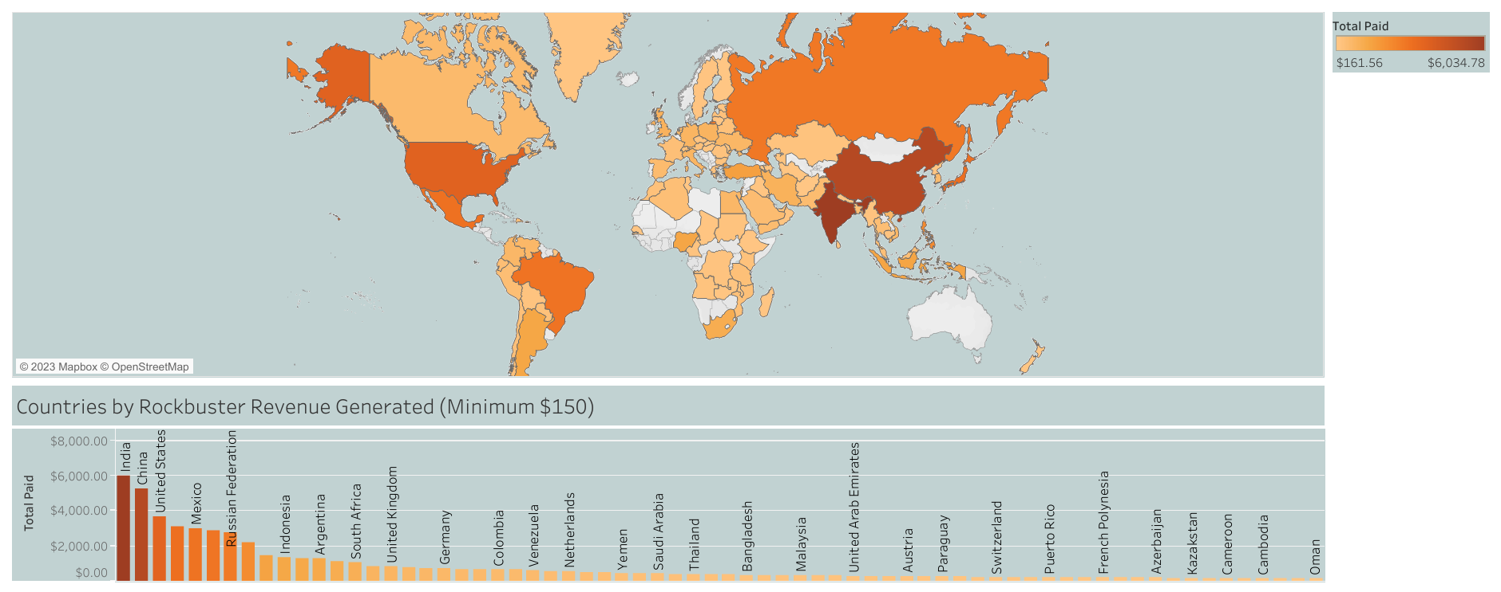
500+ Rockbuster Customers Worldwide!
14 of the 108 countries generate more than $1,000
The top 10 countries generate 52% of all revenue

Slide 18
Analysis limitations
Movies Dates
Customers& Countries
Staff Members
Only movies that were released in 2006 are in the database. There is also no data about the specific date a movie was released.
There are 41 countries that only have 1 Rockbuster customer. This makes any analysis of those specific countries unreliable.
There are only 2 staff members in the Rockbuster database. Any analysis that wants to incorporate staff data will have insufficient data.

Slide 19
conclusion
The top countries generate more than half of all revenue.
India has the most customers and generated revenue.
The average customer spends $102 and rents about 24 movies.
Recommendations
Sports movies are the most popular genre so have plenty of sports movies in stock.
Don’t renew the licenses for the least popular movies.
Implement a loyalty system that rewards top customers for their business.
Next steps
Input more staff member data into the database.
Remove least popular movies from stores and buy new movie licenses to keep selections fresh.
Keep track of customer and country data to stay up to date on current trends and populations.

Slide 20

THANK YOU
Robert Riemer
If you would like to know more or stay connected reach me at
robertriemer7@gmail.com

