Slide 1
Analytical project:
Customer analysis, A/B testing, and ML models
Full analysis cycle: from data to business recommendations
Main stages of the project:
Loading and filtering data
Pre-treatment and cleaning
Restoring clients' gender
A/B testing
Clustering of the client base
Client cluster profiles
Propensity to purchase model
Visualization and conclusions
Final recommendations
Date:December 27, 2025

Slide 2
Loading and filtering data
Goal of the stage:
Connect to the database, load tables and filter clients by country 32.
Actions:
Connecting to the database shop_database.db
Loading tables: personal_datapersonal_data_coeffs purchases
Downloading the additional file personal_data.csv.gz
Filter by country country= 32
Synchronization by ID between tables
Results:
Clients after filtering: 88,786
Purchases after filtering: 665,000+
Removed: 455 lines from personal_data(0.5%)

Slide 3
Data preprocessing and cleaning
Goal of the stage:
Cleanse data of gaps and anomalies and bring it into a unified format for analysis.
Actions:
Fill in the blanks:
color: 101,589 omissions → replaced by 'unknown
product_sex: 266,512 gaps → filled with fashion (1.0)
Color simplification: highlighted color_simple(first color before /)
Correction of negative cost values: 3 cases → replaced with a module
Processing ac_coef: 40values ​​-inf →replaced by the median (0.1032)
Creating purchase aggregates: total_purchases, total_spent, discount_rate, avg_product_sex first_purchase_day, last_purchase_day
Results:
Final data frame: 88,786 clients
Data gaps: 0
Average spending per client: 40,543 ₽
Average number of purchases: 7.49
Share of customers who used discounts: 74.6% Customers without purchases: 0

Slide 4
Restoring clients' gender
Goal of the stage:
Recover missing client gender from supplementary file using machine learning model.
Actions:
32 clients of known gender were used
Selected signs: age(age)education (education)city ​​(city)country (country)
Sign encodededucation (One‑Hot Encoding)
Splitting data intotrain/validation
Two models were trained:Logistic RegressionRandomForest
The best model by metric was selectedF1
Results:
Training sample size: 88,786 clients
Additional clients for prediction: 15,748
Best Model:Random Forest
Metrics:
F1 on validation: 0.5695
F1 on full train: 0.6262
Accuracy in full train: 0.6091
The floor has been successfully restored for all additional file clients.
The result is saved in gender_predictions.csv

Slide 5
A/B‑test
Goal of the stage:
Assess the impact of a personalized discount on customer behavior using an A/B test.
Results:
Total clients in the database: 88,786
Uploaded ID:
test: 5,023
control: 5,021
After comparison:
test group: 4,239 clients
control group: 4,203 clients
Dataset ready for calculation:
Conversions
average check
upliftmetrics
Actions:
LoadingIDfrom files:
ids_first_company_positive.txt —test group
ids_first_company_negative.txt —control group
ComparisonIDwith clients from 32 countries
Formation data frame ab_data with tagstest / control

Slide 6
Clusteringcustomer base
Goal of the stage:
Divide customers into stable segments based on behavioral and demographic characteristics.
Actions:
The following features have been selected:
age (age)
city ​​(city)
personal coefficient (personal_coef)
number of purchases (total_purchases)
total expenses (total_spent)
share of purchases with a discount (discount_rate)
average valueproduct_sex
The features are normalized throughStandardScaler
The number of clusters was checked from 2 to 7
Rating bysilhouette score:
k=2 → 0.221
k=3 → 0.254
k=4 → 0.219
k=5 → 0.243
k=6 → 0.263
k=7 → 0.237
Optimal number of clusters: 6Algorithm trained KMeans
Results:
Total clients in the database: 88,786
Distribution by clusters:
Cluster 0: 22,896
Cluster 1: 1,898
Cluster 2: 5,286
Cluster 3: 19,497
Cluster 4: 2,353
Cluster 5: 36,856
The data is saved in customers_clustered.csv

Slide 7
Client cluster profiles
Goal of the stage:
Understand the characteristics of each customer segment and identify groups with different behaviors and values.
Main characteristics of clusters
Cluster 0 - Medium active clients
22,896 people
Average age: 40
Men: 33.9%
Purchases: 5.6
Expenses: 30,170 ₽
Discounts: 14.2%
Feature: Low use of discounts, average spending
Cluster 1 - Premiumheavy buyers
1,898 people
Average age: 47
Men: 67.9%
Purchases: 47.6
Expenses: 331,788 ₽
Discounts:34.7%
Feature: Most valuable customers, highest spenders
Cluster 2 - Young Clients
5,286 people
Average age: 15
Men: 67.9%
Purchases: 47.6
Expenses: 33,355 ₽
Discounts:0%
Feature: low (0.272), many young buyers
Cluster 3 - Discount Clients
19,497 people
Purchases: 7.4
Expenses: 26,474 ₽
Discounts: 66.7%
Peculiarity:actively respond to promotions and campaigns
Cluster4- Moderately active
2,353Human
Purchases: 7.8
Expenses: 40,635 ₽
Men: 56.3%
Peculiarity:stable, good customers
Cluster4— Male audience
36,856 Human
Purchases:6.8
Expenses: 40456₽
Men: 86.4 %
Peculiarity:largest cluster, high proportion of men
Conclusion:
The client base is divided into 6 distinct segments: from premium heavy buyers to discount and younger customers. These segments can be used for personalized marketing campaigns.

Slide 8
Propensity to Purchase Model (Propensity Model)
Goal of the stage:
Determine the likelihood of customers purchasing the most popular product in city 1188 and identify the most promising segments for targeting.
Actions:
Clients from country 32 and city 1188 selected
The most popular item among their purchases has been identified
Formed target:
1 - the customer purchased this product
0 — did not buy
The following features have been selected:
age (age)
floor (gender)
personal coefficient (personal_coef)
number of purchases (total_purchases)
total expenses (total_spent)
share of purchases with a discount (discount_rate)
average value product_sex
client cluster (one-hot)
The data are normalized through StandardScaler
Two models were trained:
Logistic Regression
Random Forest
Results:
ROC‑AUC Logistic Regression: 0.776
Random Forest ROC‑AUC: 0.776
The best model has been chosen:Random Forest
Calculated for each client propensity_score
Clients are divided into decile groups
Actual response by deciles:
1 decile: 0.14%
2nd decile: 0.16%
3rd decile: 0.49%
4th decile: 1.36%
5th decile: 25.57%
The data is saved in customers_clustered.csv
Conclusion:
The model successfully identified a high-value segment: customers in the top decile have a purchase probability of more than180 times higher than customers in the bottom decile. This allows for effective targeting of marketing campaigns.

Slide 9
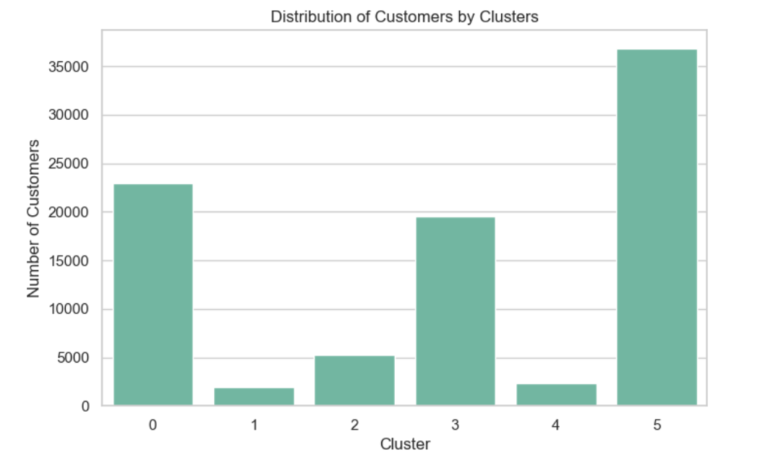
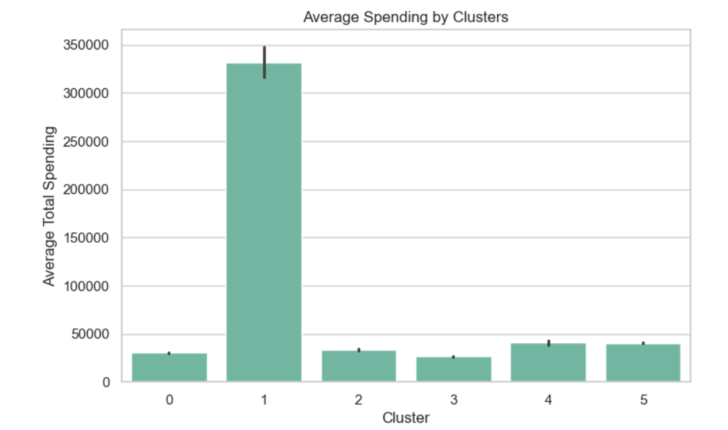
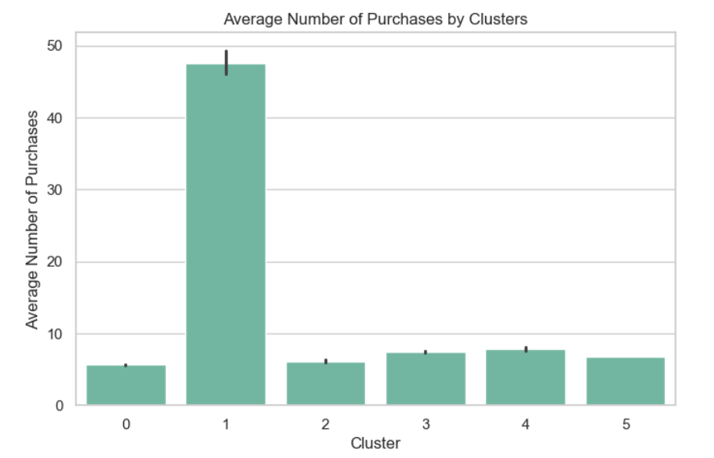
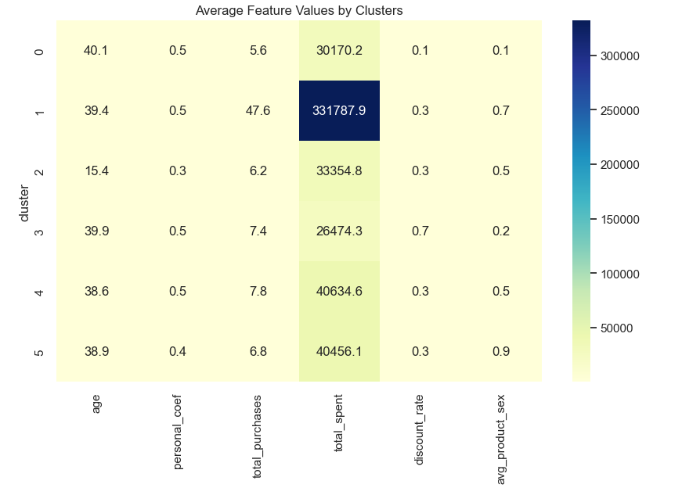
Visualization and conclusions
Show that cluster 5 is the largest (36,856 clients), and clusters 1 and 4 are the smallest.
Show, Whatcluster 1- this is obvious outlier: customers spend on average330,000 ₽, while the rest are less50,000 ₽.
Show that Cluster 1 is a priority forpersonalized offers, loyalty and retention.
Show ,How clusters differ based on key characteristics: age, activity, spending, discounts, and type of goods purchased.

Slide 10
Final conclusions and recommendations
Final conclusions:
The client base has been successfully segmented into 6 clusters with different behavioral profiles.
A propensity to purchase model was built with high accuracy (ROC‑AUC = 0.776)
The visualization showed a strong response in the upper deciles (up to 25.57%)
Cluster 1 - Premium clients with maximum value
Cluster 3 – discount clients sensitive to promotions
Cluster 2 - a young audience, requires a separate approach
Recommendations:
Target the top deciles propensitymodels for increasing conversion
Use cluster profiles for personalized marketing campaigns
Retain Cluster 1 customers through premium offers
Activate Cluster 3 through discounts and promotions
Implement the model into CRM for automaticprioritizationclients
Repeat the A/B test taking into account segmentation and scoring

Slide 11


Thank you for your attention
The project covered:
Complete processing and cleaning of client data
Floor restoration with ML‑Model, A/B-testing and group formation
Clustering and building customer profiles
Propensity to Purchase Model and Response Visualization
Final business conclusions and recommendations
Result:
Analytics allowed us to identify key segments, build a targeting model, and prepare the basis for personalized marketing campaigns.
https://github.com/data-sakit/data-analyst-project

