Slide 1

Metrics for Multi-class and Multi-label Classification
Maximilian Wenzel
Data Science Seminar Summer Term 2021

Slide 2
Motivation for Metrics in Classification
Classification: Categorize an instance/sample into a class or multiple classes
How to determine the performance of a classifier?
Count the number of correct and incorrect predictions
Summarize counts using evaluation metrics
Problems with metrics
Metrics usually not standardized for application domains
Small variations in metrics may even lead to different classifier rankings
Number of possibilities to evaluate classifiers for multi-class and multi-label problems increases

Slide 3
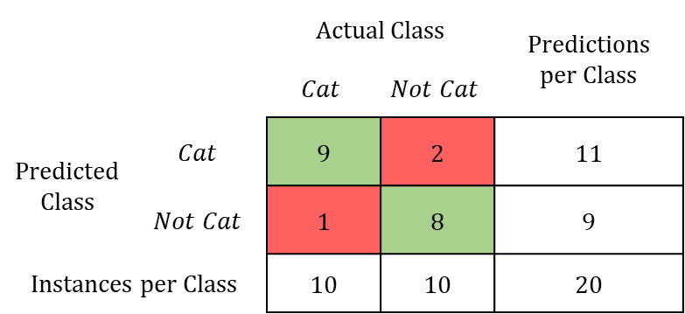

Binary Classification: Confusion Matrix
Counts the number of correct and incorrect predictions of classifier $h$
 |  | Actual Class |  | Predictions per Class
 |  | $$Cat$$ | $$Not Cat$$ | Predicitons per Class
Predicted Class | $$Cat$$ | 9 | 2 | 11
 | $$Not Cat$$ | 1 | 8 | 9
Instances per Class |  | 10 | 10 | 20
Raw confusion matrix is difficult to interpret
➔ Use metrics to summarize absolute confusion matrix values

Slide 4
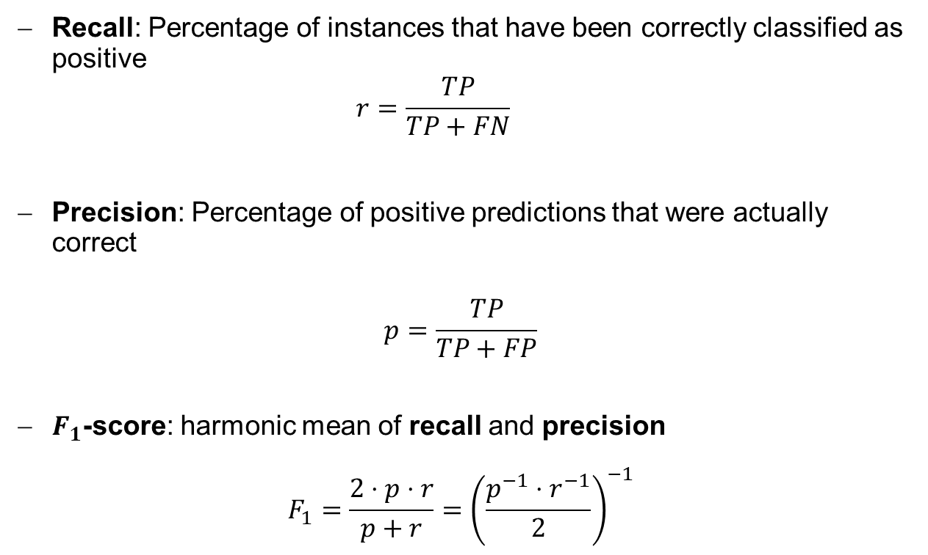
Excerpt of Binary Classification Metrics
Recall: Percentage of instances that have been correctly classified as positive
$$r=\frac{TP}{TP+FN}$$
Precision: Percentage of positive predictions that were actually correct
$$p=\frac{TP}{TP+FP}$$
$F_{1}$-score: harmonic mean of recall and precision
$$F_{1}=\frac{2⋅p⋅r}{p+r}={\left(\frac{p^{−1}⋅r^{−1}}{2}\right)}^{−1}$$

Slide 5

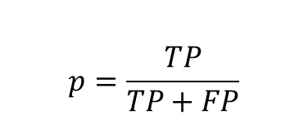
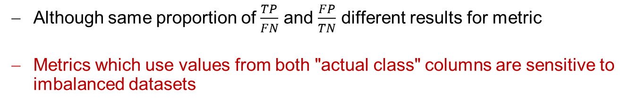
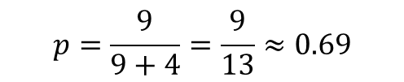
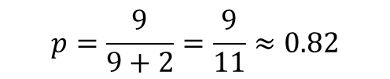

Issue with Imbalanced Datasets
$$p=\frac{TP}{TP+FP}$$
Balanced Dataset:
Equal amount of instances per class
Imbalanced Dataset:
Different amount of instances per class
 |  | Actual Class |  | Predictions per Class
 |  | $$Cat$$ | $$Not Cat$$ | Predicitons per Class
Predicted Class | $$Cat$$ | 9 | 2 | 11
 | $$Not Cat$$ | 1 | 8 | 9
Instances per Class |  | 10 | 10 | 20
 |  | Actual Class |  | Predictions per Class
 |  | $$Cat$$ | $$Not Cat$$ | Predicitons per Class
Predicted Class | $$Cat$$ | 9 | 4 | 13
 | $$Not Cat$$ | 1 | 16 | 17
Instances per Class |  | 10 | 20 | 30
$$p=\frac{9}{9+2}=\frac{9}{11}≈0.82$$
$$p=\frac{9}{9+4}=\frac{9}{13}≈0.69$$
Although same proportion of $\frac{TP}{FN}$ and $\frac{FP}{TN}$ different results for metric
Metrics which use values from both "actual class" columns are sensitive to imbalanced datasets

Slide 6
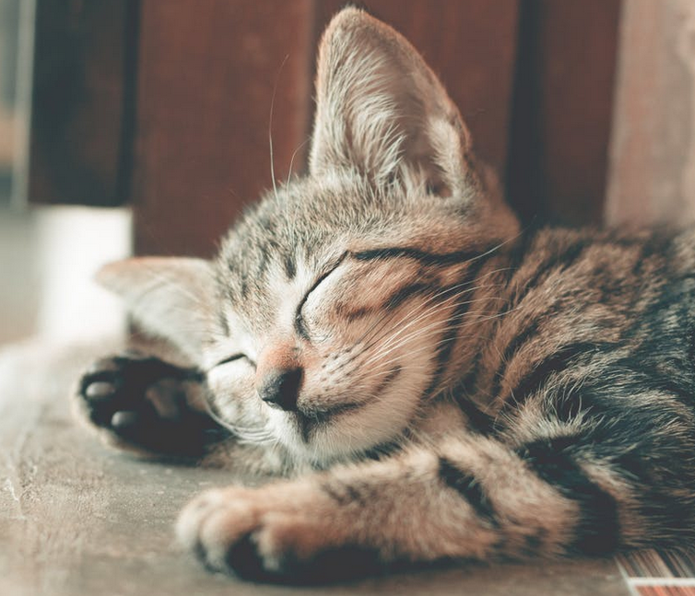



Multi-class Classification
Given:
Instance $x∈𝒳⊆ℝ^{d}$
Label space $𝒴⊆{\left\{0,1\right\}}^{m},$ one-hot-coded vectors
Classifier $h:𝒳→𝒴$, predicts exactly one class per instance
Example: Cat$y_{1}=\left(\begin{matrix}1 \\ 0 \\ 0\end{matrix}\right)$, Dog $y_{2}=\left(\begin{matrix}0 \\ 1 \\ 0\end{matrix}\right)$, Mouse $y_{3}=\left(\begin{matrix}0 \\ 0 \\ 1\end{matrix}\right)$
What kind of animal is this?
Cat, $\left(\begin{matrix}1 \\ 0 \\ 0\end{matrix}\right)∈𝒴$
✓
$$x∈𝒳$$
h

Slide 7
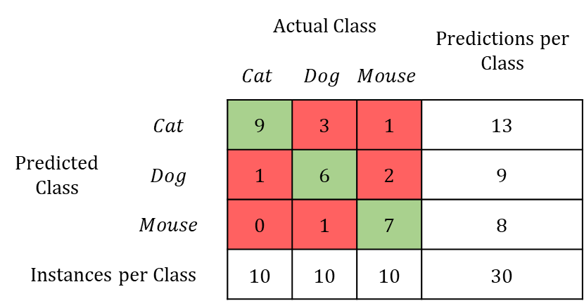
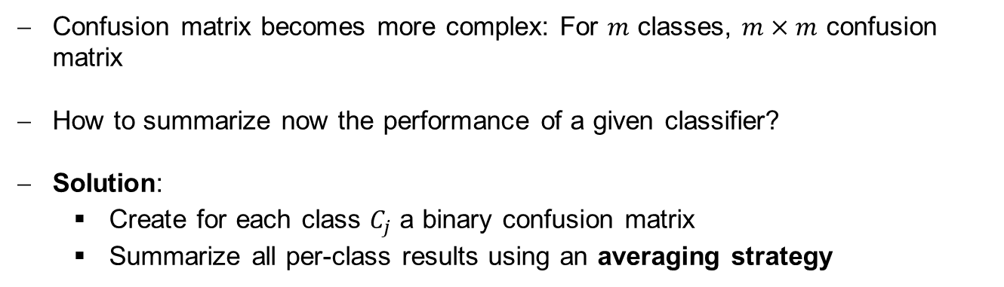
Multi-class Confusion Matrix
 |  | Actual Class |  |  | Predictions per Class
 |  | $$Cat$$ | $$Dog$$ | $$Mouse$$ | Predicitons per Class
Predicted Class | $$Cat$$ | 9 | 3 | 1 | 13
 | $$Dog$$ | 1 | 6 | 2 | 9
 | $$Mouse$$ | 0 | 1 | 7 | 8
Instances per Class |  | 10 | 10 | 10 | 30
Confusion matrix becomes more complex: For $m$ classes, $m×m$ confusion matrix
How to summarize now the performance of a given classifier?
Solution:
Create for each class $C_{j}$ a binary confusion matrix
Summarize all per-class results using an averaging strategy

Slide 8
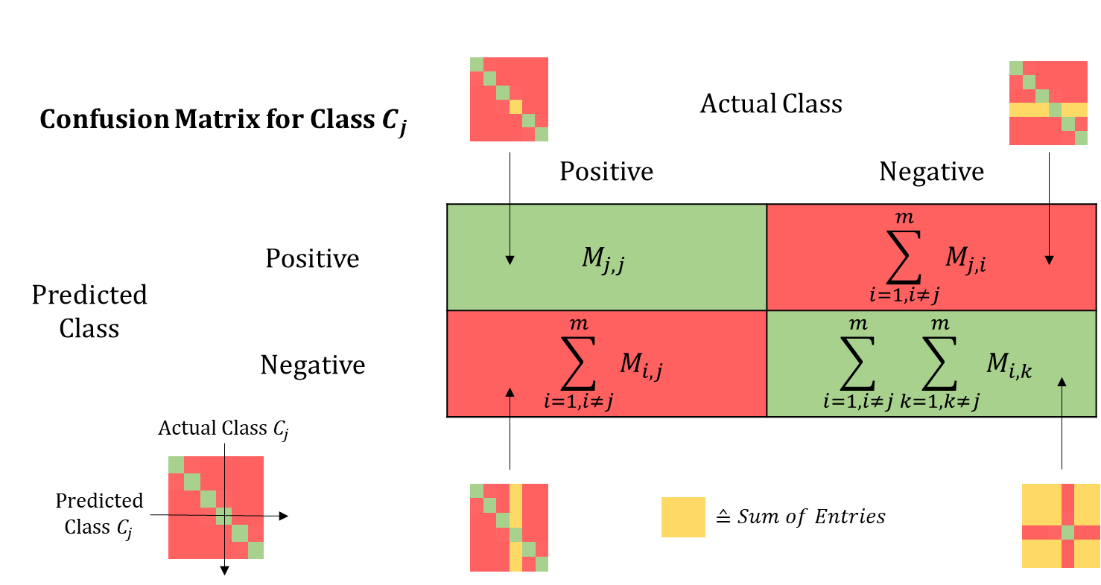
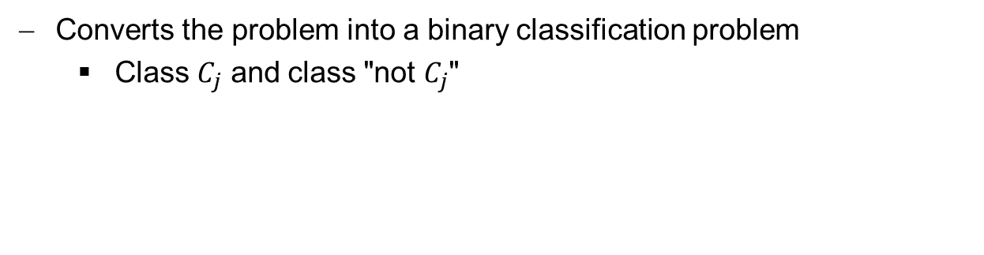
Per-class Confusion Matrix
Converts the problem into a binary classification problem
Class $C_{j}$ and class "not $C_{j}$"
Previously introduced metrics can be computed per class
Problem: How to summarize the results over all classes?

Slide 9
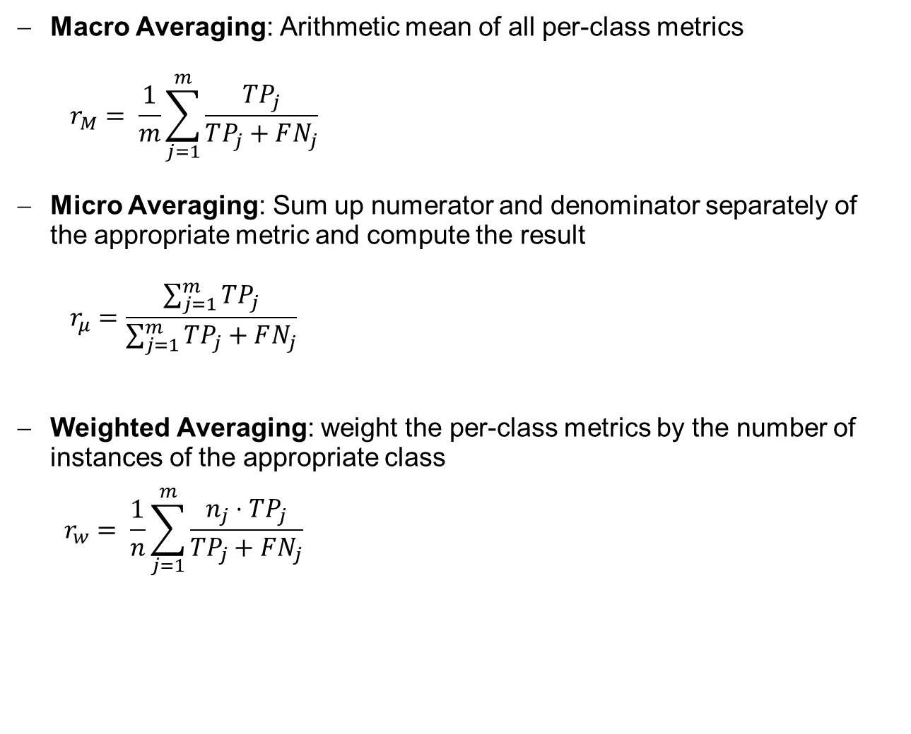
Averaging Strategies
Macro Averaging: Arithmetic mean of all per-class metrics
$$r_{M}= \frac{1}{m}\sum_{j=1}^{m}{\frac{TP_{j}}{TP_{j}+FN_{j}}}$$
Micro Averaging: Sum up numerator and denominator separately of the appropriate metric and compute the result
$$r_{μ}=\frac{\sum_{j=1}^{m}{TP_{j}}}{\sum_{j=1}^{m}{TP_{j}+FN_{j}}}$$
Weighted Averaging: weight the per-class metrics by the number of instances of the appropriate class
$$r_{w}= \frac{1}{n}\sum_{j=1}^{m}{\frac{n_{j}⋅TP_{j}}{TP_{j}+FN_{j}}}$$
Example: macro-averaged
Recall
All per-class results weighted equally
Sensitive to imbalanced datasets
Intentionally weighted by number of instances per class

Slide 10
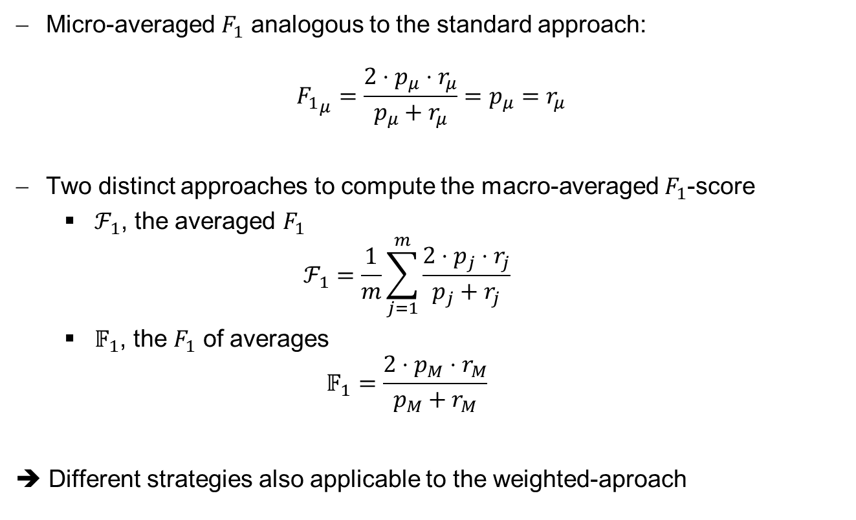
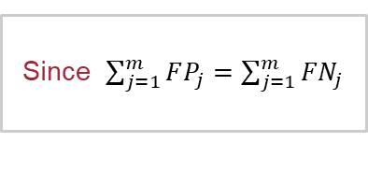
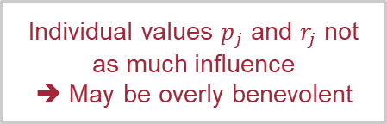
Averaging the $F_{1}$-score
Micro-averaged $F_{1}$ analogous to the standard approach:
$${F_{1}}_{μ}=\frac{2⋅p_{μ}⋅r_{μ}}{p_{μ}+r_{μ}}=p_{μ}=r_{μ}$$
Two distinct approaches to compute the macro-averaged $F_{1}$-score
$ℱ_{1}$, the averaged $F_{1}$
$$ℱ_{1}=\frac{1}{m}\sum_{j=1}^{m}{\frac{2⋅p_{j}⋅r_{j}}{p_{j}+r_{j}}}$$
$𝔽_{1}$, the $F_{1}$ of averages
$$𝔽_{1}=\frac{2⋅p_{M}⋅r_{M}}{p_{M}+r_{M}}$$
➔ Different strategies also applicable to the weighted-aproach
Since $\sum_{j=1}^{m}{FP_{j}=\sum_{j=1}^{m}{FN_{j}}}$
The standard approach, recommended by Opitz and Burst (2019)
Individual values $p_{j}$ and $r_{j}$ not as much influence
➔ May be overly benevolent

Slide 11




Multi-label Classification
Given:
Instance $x∈𝒳⊆ℝ^{d}$
Label space $𝒴⊆{\left\{0,1\right\}}^{m}$
Classifier $h:𝒳→𝒴$, may predict multiple classes/labels per instance
Example: Text classification
What kind of document is this?
$y=\left(\begin{matrix}1 \\ 0 \\ \begin{aligned}0 \\ 1\end{aligned}\end{matrix}\right)∈𝒴$
____________________
h
✓$?$
$$x∈𝒳$$
"Fiction + Poetry"
What if prediction is only partially correct?

Slide 12
Multi-label Classification: Viewpoint of Correctness
Multi-label Correctness
Per-class
Per-instance
Consider each instance separately
How many labels have been predicted correctly/incorrectly?
➔ Derive per-instance confusion matrix
Evaluation and averaging strategies identical to multi-class case
Summarize confusion matrices with averaging strategies

Slide 13
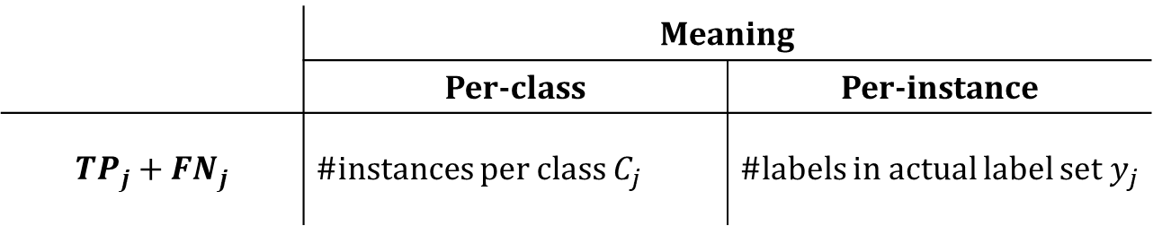
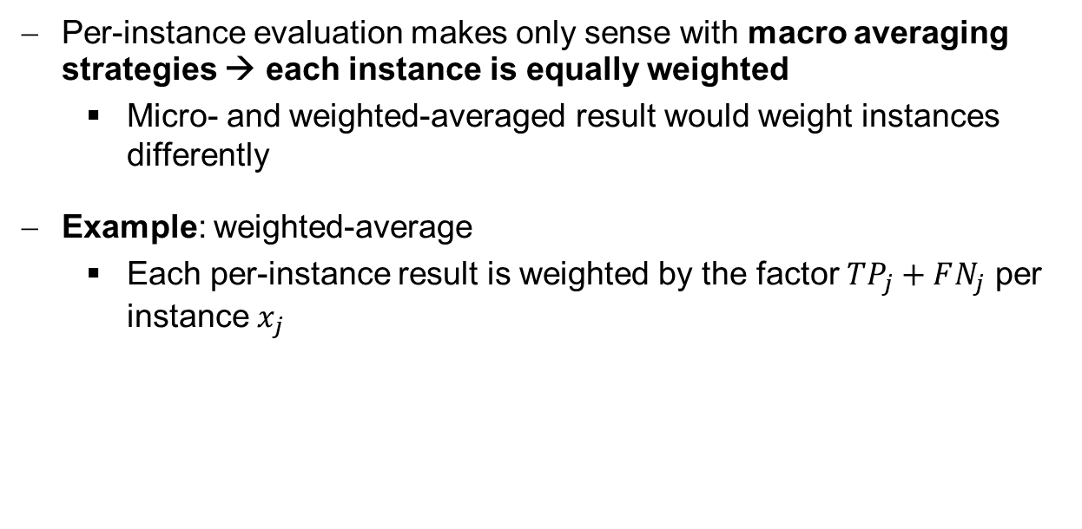
Per-instance Evaluation: Which Averaging Strategies?
Per-instance evaluation makes only sense with macro averaging strategies → each instance is equally weighted
Micro- and weighted-averaged result would weight instances differently
Example: weighted-average
Each per-instance result is weighted by the factor $TP_{j}+FN_{j}$ per instance $x_{j}$
 | Meaning
 | Per-class | Per-instance
$$TP_{j}+FN_{j}$$ | #instances per class $C_{j}$ | #labels in actual label set $y_{j}$

Slide 14
Best Practice When Dealing with Metrics
Always explicitly indicate which metric has been deployed
Include the metric as equation
If the metric has been implemented by a library (e.g. Python SciKit-learn), look up the concrete implementation
If possible include the test dataset evaluation ➔ Computation of metric can be reproduced
MESINESP task: JSON file of the test dataset evaluation
{ "documents": [
{ "id": "id_test_article_1", "labels": [ "code1", "code2", "code3" ] } ,
{ "id": "id_test_article_2", "labels": [ "code5", "code2", "code21" ] }
] }
Source: https://temu.bsc.es/mesinesp2/evaluation/

Slide 15





Binary Classification
Given:
Instance $x∈𝒳⊆ℝ^{d}$
Binary label space $𝒴=\left\{0, 1\right\}$, "yes or no", "$x$ or $y$"
Classifier $h:𝒳→𝒴$
Is this a triangle?
Prediction
Correct?
h
✓
Yes
$$x_{1}∈𝒳$$
$$1∈𝒴$$
h
Yes
✗
$$x_{2}∈𝒳$$
$$1∈𝒴$$

Slide 16





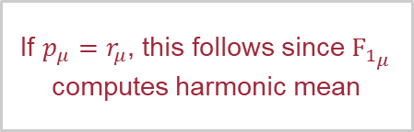

Micro-Precision, Micro-Recall, and Micro-$F_{1}$
We have:
$$p_{μ}=\frac{\sum_{j=1}^{m}{TP_{j}}}{\sum_{j=1}^{m}{(TP_{j}+FP_{j})}} =r_{μ}=\frac{\sum_{j=1}^{m}{TP_{j}}}{\sum_{j=1}^{m}{(TP_{j}+FN_{j})}}={F_{1}}_{μ}=\frac{2⋅p_{μ}⋅r_{μ}}{p_{μ}+r_{μ}}$$
$$\sum_{j=1}^{m}{ }$$
If $p_{μ}=r_{μ}$, this follows since ${F_{1}}_{μ}$ computes harmonic mean
$$\sum_{j=1}^{m}{FP_{j}=\sum_{j=1}^{m}{FN_{j}}}$$
$$FP_{j}$$
$$FN_{j}$$
$$≙Sum of Entries$$

Slide 17
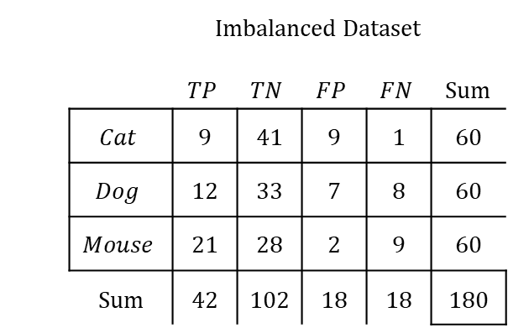
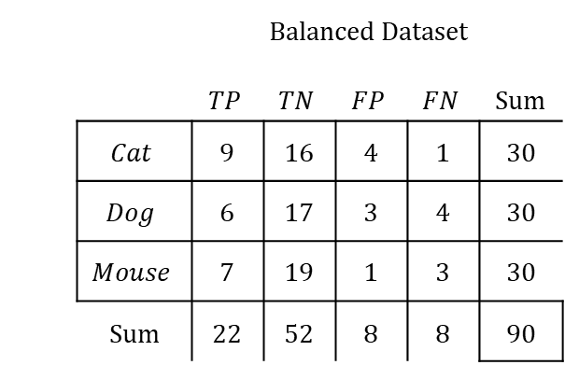
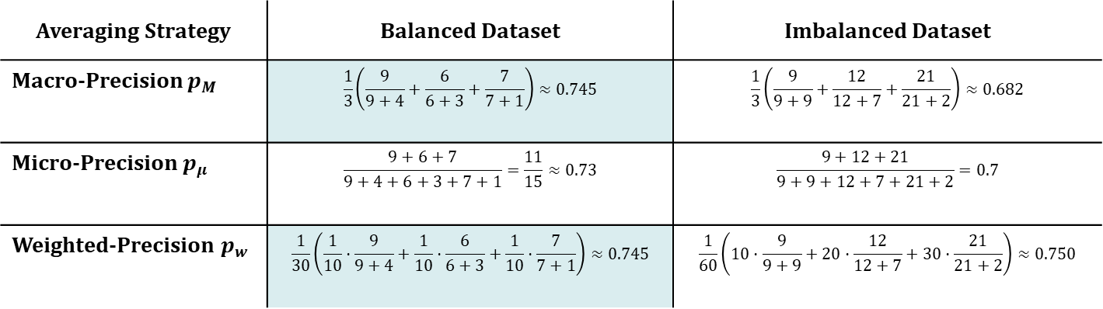
Per-class Averaging Example
Summary of the per-class confusion matrices
 | Balanced Dataset
 |  | $$TP$$ | $$TN$$ | $$FP$$ | $$FN$$ | Sum
 | $$Cat$$ | 9 | 16 | 4 | 1 | 30
 | $$Dog$$ | 6 | 17 | 3 | 4 | 30
 | $$Mouse$$ | 7 | 19 | 1 | 3 | 30
 | Sum | 22 | 52 | 8 | 8 | 90
 | Imbalanced Dataset
 |  | $$TP$$ | $$TN$$ | $$FP$$ | $$FN$$ | Sum
 | $$Cat$$ | 9 | 41 | 9 | 1 | 60
 | $$Dog$$ | 12 | 33 | 7 | 8 | 60
 | $$Mouse$$ | 21 | 28 | 2 | 9 | 60
 | Sum | 42 | 102 | 18 | 18 | 180
Averaging Strategy | Balanced Dataset | Imbalanced Dataset
Macro-Precision $p_{M}$ | $$\frac{1}{3}\left(\frac{9}{9+4}+\frac{6}{6+3}+\frac{7}{7+1}\right)≈0.745$$ | $$\frac{1}{3}\left(\frac{9}{9+9}+\frac{12}{12+7}+\frac{21}{21+2}\right)≈0.682$$
Micro-Precision $p_{μ}$ | $$\frac{9+6+7}{9+4+6+3+7+1}=\frac{11}{15}≈0.73$$ | $$\frac{9+12+21}{9+9+12+7+21+2}=0.7$$
Weighted-Precision $p_{w}$ | $$\frac{1}{30}\left(\frac{1}{10}⋅\frac{9}{9+4}+\frac{1}{10}⋅\frac{6}{6+3}+\frac{1}{10}⋅\frac{7}{7+1}\right)≈0.745$$ | $$\frac{1}{60}\left(10⋅\frac{9}{9+9}+20⋅\frac{12}{12+7}+30⋅\frac{21}{21+2}\right)≈0.750$$

Slide 18
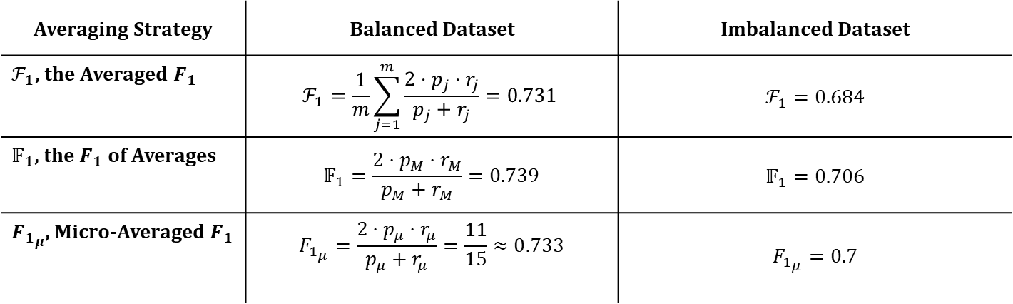
Averaging the $F_{1}$-score
 | Balanced Dataset
 |  | $$TP$$ | $$TN$$ | $$FP$$ | $$FN$$ | Sum
 | $$Cat$$ | 9 | 16 | 4 | 1 | 30
 | $$Dog$$ | 6 | 17 | 3 | 4 | 30
 | $$Mouse$$ | 7 | 19 | 1 | 3 | 30
 | Sum | 22 | 52 | 8 | 8 | 90
 | Imbalanced Dataset
 |  | $$TP$$ | $$TN$$ | $$FP$$ | $$FN$$ | Sum
 | $$Cat$$ | 9 | 41 | 9 | 1 | 60
 | $$Dog$$ | 12 | 33 | 7 | 8 | 60
 | $$Mouse$$ | 21 | 28 | 2 | 9 | 60
 | Sum | 42 | 102 | 18 | 18 | 180
Averaging Strategy | Balanced Dataset | Imbalanced Dataset
$ℱ_{1}$, the Averaged $F_{1}$ | $$ℱ_{1}=\frac{1}{m}\sum_{j=1}^{m}{\frac{2⋅p_{j}⋅r_{j}}{p_{j}+r_{j}}}=0.731$$ | $$ℱ_{1}=0.684$$
$𝔽_{1}$, the $F_{1}$ of Averages | $$𝔽_{1}=\frac{2⋅p_{M}⋅r_{M}}{p_{M}+r_{M}}=0.739$$ | $$𝔽_{1}=0.706$$
${F_{1}}_{μ}$, Micro-Averaged $F_{1}$ | $${F_{1}}_{μ}=\frac{2⋅p_{μ}⋅r_{μ}}{p_{μ}+r_{μ}}=\frac{11}{15}≈0.733$$ | $${F_{1}}_{μ}=0.7$$

Slide 19
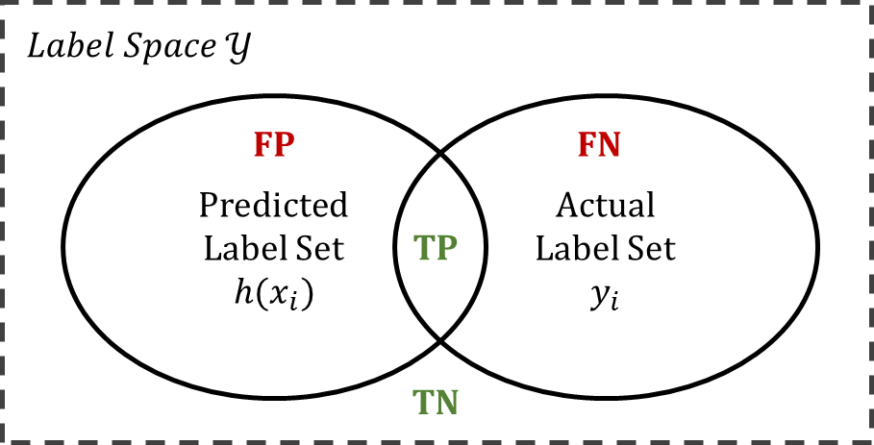
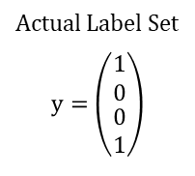
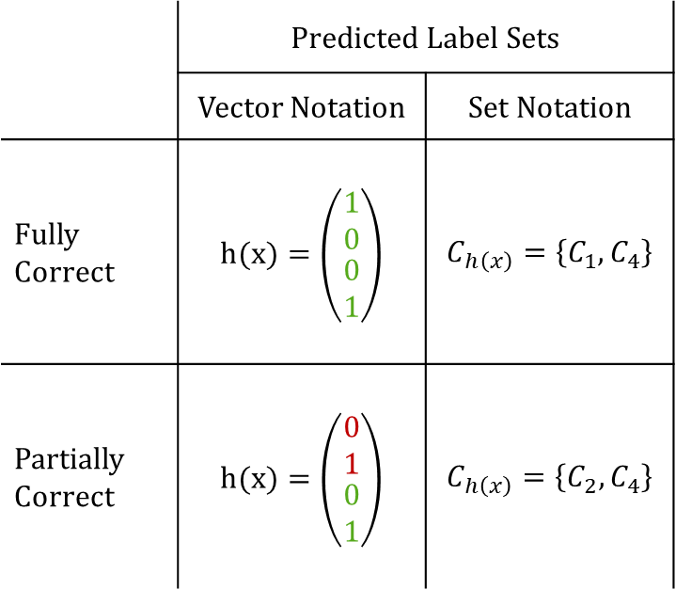
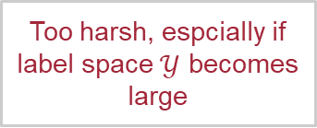
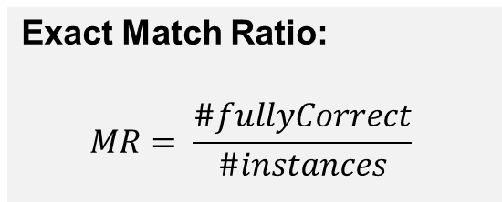
Multi-label Classification: Per-instance evaluation
Too harsh, espcially if label space $𝒴$ becomes large
Actual Label Set
$$y=\left(\begin{matrix}1 \\ 0 \\ \begin{aligned}0 \\ 1\end{aligned}\end{matrix}\right)$$
 | Predicted Label Sets
 | Vector Notation | Set Notation
Fully Correct | $$h(x)=\left(\begin{matrix}1 \\ 0 \\ \begin{aligned}0 \\ 1\end{aligned}\end{matrix}\right)$$ | $$C_{h\left(x\right)}=\left\{C_{1},C_{4}\right\}$$
Partially Correct | $$h(x)=\left(\begin{matrix}0 \\ 1 \\ \begin{aligned}0 \\ 1\end{aligned}\end{matrix}\right)$$ | $$C_{h\left(x\right)}=\left\{C_{2},C_{4}\right\}$$
Exact Match Ratio:
$$MR= \frac{\#fullyCorrect}{\#instances}$$
Per-instance confusion matrix:

Slide 20
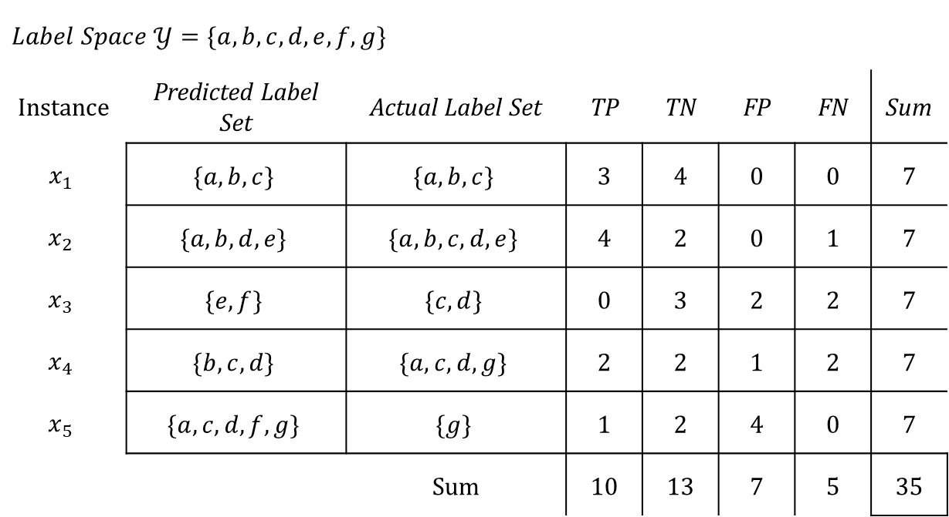
Multi-label Example
$$Label Space 𝒴=\{a,b,c,d,e,f,g\}$$
Instance | Predicted Label Set | Actual Label Set | TP | TN | FP | FN | Sum
$$x_{1}$$ | $$\{a, b, c\}$$ | $$\{a, b, c\}$$ | 3 | 4 | 0 | 0 | 7
$$x_{2}$$ | $$\{a, b, d, e\}$$ | $$\{a, b, c, d, e\}$$ | 4 | 2 | 0 | 1 | 7
$$x_{3}$$ | $$\{e, f\}$$ | $$\{c, d\}$$ | 0 | 3 | 2 | 2 | 7
$$x_{4}$$ | $$\{b, c, d\}$$ | $$\{a, c, d, g\}$$ | 2 | 2 | 1 | 2 | 7
$$x_{5}$$ | $$\{a, c, d, f, g\}$$ | $$\{g\}$$ | 1 | 2 | 4 | 0 | 7
 |  | Sum | 10 | 13 | 7 | 5 | 35

Slide 21

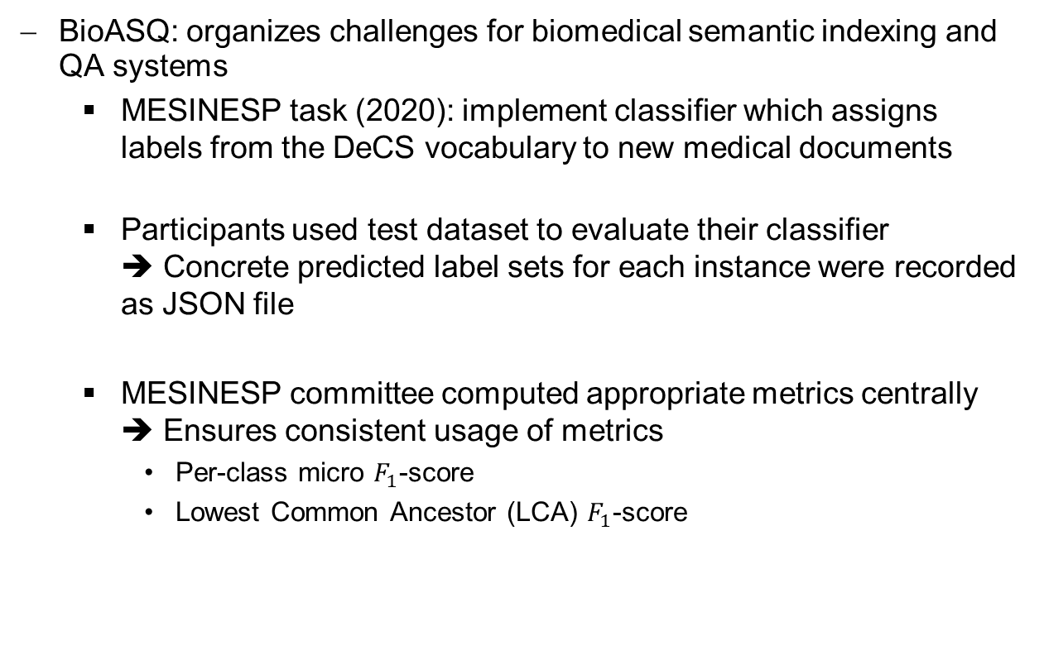
Best Practice When Dealing with Metrics
BioASQ: organizes challenges for biomedical semantic indexing and QA systems
MESINESP task (2020): implement classifier which assigns labels from the DeCS vocabulary to new medical documents
Participants used test dataset to evaluate their classifier ➔ Concrete predicted label sets for each instance were recorded as JSON file
MESINESP committee computed appropriate metrics centrally ➔ Ensures consistent usage of metrics
Per-class micro $F_{1}$-score
Lowest Common Ancestor (LCA) $F_{1}$-score

Slide 22
Conclusion
Confusion matrix summarizes predictions of a classifier on test data
Metrics summarize the values from a confusion matrix
The confusion matrix can be computed...
per class ➔ multi-class/multi-label case
per instance ➔ only multi-label case
Averaging strategies: Summary of all per-class/per-instance metrics
macro, micro, weighted averaging
To ensure reproducibility and prevent misconceptions:
Always include metric as concrete equation
Always reflect if the deployed metric makes sense in an application domain

Slide 23
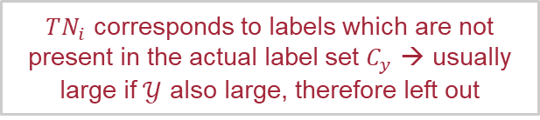
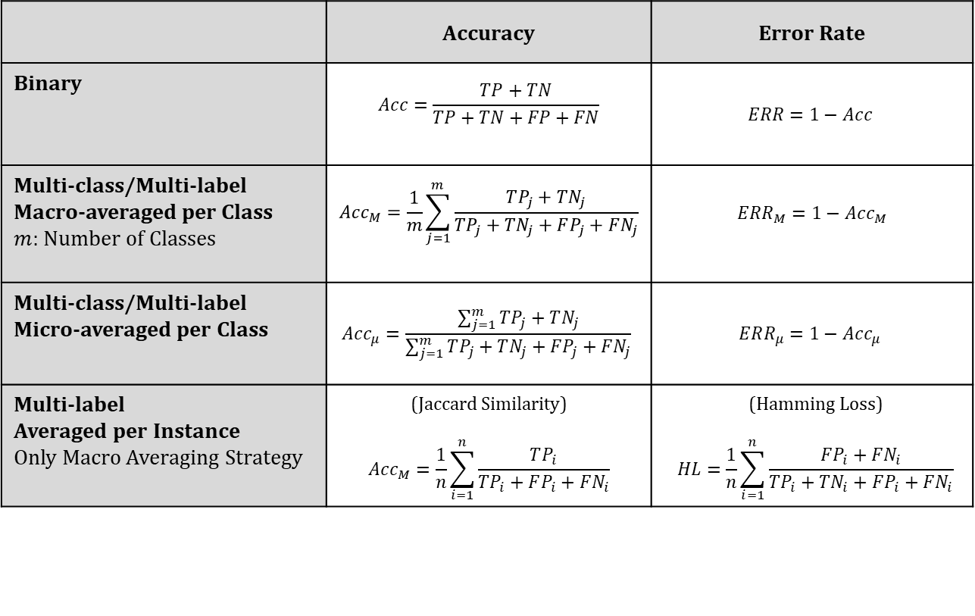
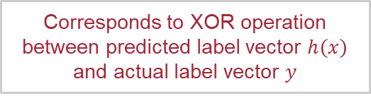
Accuracy and Error Rate
 | Accuracy | Error Rate
Binary | $$Acc=\frac{TP+TN}{TP+TN+FP+FN}$$ | $$ERR=1−Acc$$
Multi-class/Multi-label Macro-averaged per Class $m$: Number of Classes | $$Acc_{M}=\frac{1}{m}\sum_{j=1}^{m}{\frac{TP_{j}+TN_{j}}{TP_{j}+TN_{j}+FP_{j}+FN_{j}}}$$ | $$ERR_{M}=1−Acc_{M}$$
Multi-class/Multi-label Micro-averaged per Class | $$Acc_{μ}=\frac{\sum_{j=1}^{m}{TP_{j}+TN_{j}}}{\sum_{j=1}^{m}{TP_{j}+TN_{j}+FP_{j}+FN_{j}}}$$ | $$ERR_{μ}=1−Acc_{μ}$$
Multi-label Averaged per Instance Only Macro Averaging Strategy | (Jaccard Similarity) $$Acc_{M}=\frac{1}{n}\sum_{i=1}^{n}{\frac{TP_{i}}{TP_{i}+FP_{i}+FN_{i}}}$$ | $$\text{(}\text{Hamming} \text{Loss}\text{)}$$ $$HL=\frac{1}{n}\sum_{i=1}^{n}{\frac{FP_{i}+FN_{i}}{TP_{i}+TN_{i}+FP_{i}+FN_{i}}}$$
$TN_{i}$ corresponds to labels which are not present in the actual label set $C_{y}$ → usually large if $𝒴$ also large, therefore left out
Corresponds to XOR operation between predicted label vector $h\left(x\right)$ and actual label vector $y$

Slide 24
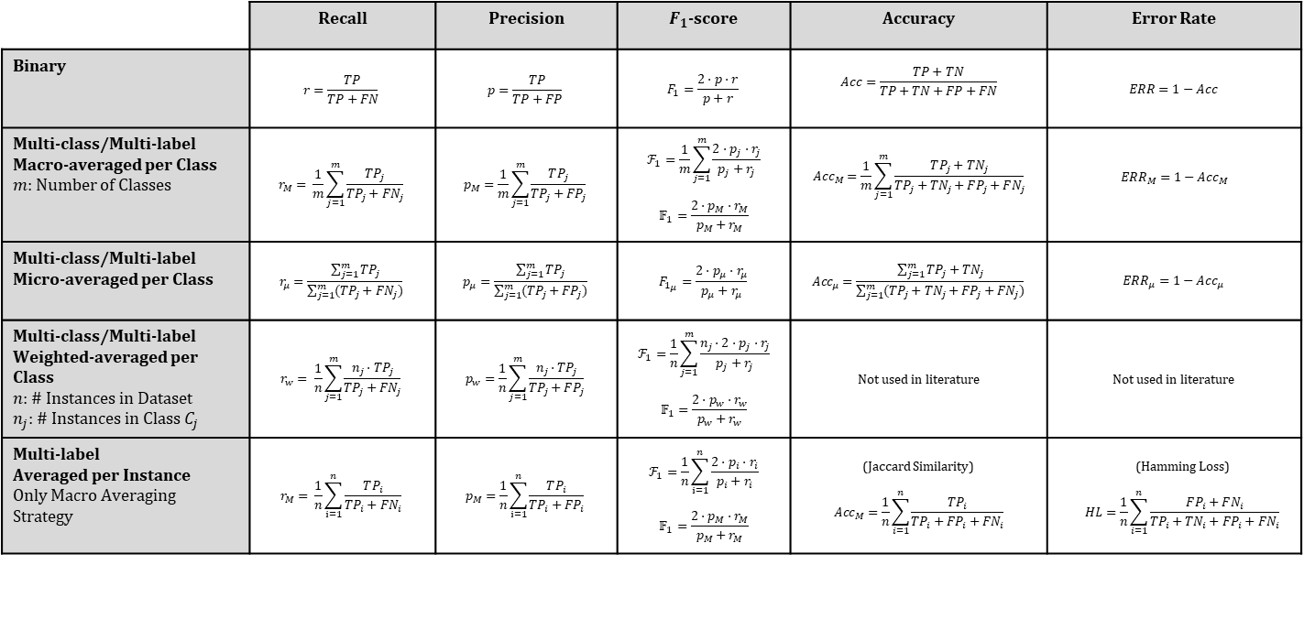
Metric Summary
 | Recall | Precision | $F_{1}$-score | Accuracy | Error Rate
Binary | $$r=\frac{TP}{TP+FN}$$ | $$p=\frac{TP}{TP+FP}$$ | $$F_{1}=\frac{2⋅p⋅r}{p+r}$$ | $$Acc=\frac{TP+TN}{TP+TN+FP+FN}$$ | $$ERR=1−Acc$$
Multi-class/Multi-label Macro-averaged per Class $m$: Number of Classes | $$r_{M}= \frac{1}{m}\sum_{j=1}^{m}{\frac{TP_{j}}{TP_{j}+FN_{j}}}$$ | $$p_{M}=\frac{1}{m}\sum_{j=1}^{m}{\frac{TP_{j}}{TP_{j}+FP_{j}}}$$ | $$ℱ_{1}=\frac{1}{m}\sum_{j=1}^{m}{\frac{2⋅p_{j}⋅r_{j}}{p_{j}+r_{j}}}$$ $$𝔽_{1}=\frac{2⋅p_{M}⋅r_{M}}{p_{M}+r_{M}}$$ | $$Acc_{M}=\frac{1}{m}\sum_{j=1}^{m}{\frac{TP_{j}+TN_{j}}{TP_{j}+TN_{j}+FP_{j}+FN_{j}}}$$ | $$ERR_{M}=1−Acc_{M}$$
Multi-class/Multi-label Micro-averaged per Class | $$r_{μ}=\frac{\sum_{j=1}^{m}{TP_{j}}}{\sum_{j=1}^{m}{(TP_{j}+FN_{j})}}$$ | $$p_{μ}=\frac{\sum_{j=1}^{m}{TP_{j}}}{\sum_{j=1}^{m}{(TP_{j}+FP_{j})}}$$ | $${F_{1}}_{μ}=\frac{2⋅p_{μ}⋅r_{μ}}{p_{μ}+r_{μ}}$$ | $$Acc_{μ}=\frac{\sum_{j=1}^{m}{TP_{j}+TN_{j}}}{\sum_{j=1}^{m}{(TP_{j}+TN_{j}+FP_{j}+FN_{j})}}$$ | $$ERR_{μ}=1−Acc_{μ}$$
Multi-class/Multi-label Weighted-averaged per Class $n$: # Instances in Dataset $n_{j}:$ # Instances in Class $C_{j}$ | $$r_{w}= \frac{1}{n}\sum_{j=1}^{m}{\frac{n_{j}⋅TP_{j}}{TP_{j}+FN_{j}}}$$ | $$p_{w}=\frac{1}{n}\sum_{j=1}^{m}{\frac{n_{j}⋅TP_{j}}{TP_{j}+FP_{j}}}$$ | $$ℱ_{1}=\frac{1}{n}\sum_{j=1}^{m}{\frac{n_{j}⋅2⋅p_{j}⋅r_{j}}{p_{j}+r_{j}}}$$ $$𝔽_{1}=\frac{2⋅p_{w}⋅r_{w}}{p_{w}+r_{w}}$$ | Not used in literature | Not used in literature
Multi-label Averaged per Instance Only Macro Averaging Strategy | $$r_{M}= \frac{1}{n}\sum_{i=1}^{n}{\frac{TP_{i}}{TP_{i}+FN_{i}}}$$ | $$p_{M}=\frac{1}{n}\sum_{i=1}^{n}{\frac{TP_{i}}{TP_{i}+FP_{i}}}$$ | $$ℱ_{1}=\frac{1}{n}\sum_{i=1}^{n}{\frac{2⋅p_{i}⋅r_{i}}{p_{i}+r_{i}}}$$ $$𝔽_{1}=\frac{2⋅p_{M}⋅r_{M}}{p_{M}+r_{M}}$$ | (Jaccard Similarity) $$Acc_{M}=\frac{1}{n}\sum_{i=1}^{n}{\frac{TP_{i}}{TP_{i}+FP_{i}+FN_{i}}}$$ | $$\text{(}\text{Hamming} \text{Loss}\text{)}$$ $$HL=\frac{1}{n}\sum_{i=1}^{n}{\frac{FP_{i}+FN_{i}}{TP_{i}+TN_{i}+FP_{i}+FN_{i}}}$$

