Slide 1
NLP & Data Analytics: Slides Template Subtitle (for lectures e.g.)
Your Name

Slide 2

Learning Goals
First goal.
Second goal.
Third goal.

Slide 3

Example Content Slide
First item
Second item
Third item
Etc.
TODO
Hello world!

Slide 4

About the Style of these Slides
Garr Reynolds: Presentation Zen: Simple Ideas on Presentation Design and Delivery, New Riders, 2011.
Homepage: http://www.presentationzen.com/
Homepage: http://www.presentationzen.com/

Slide 5
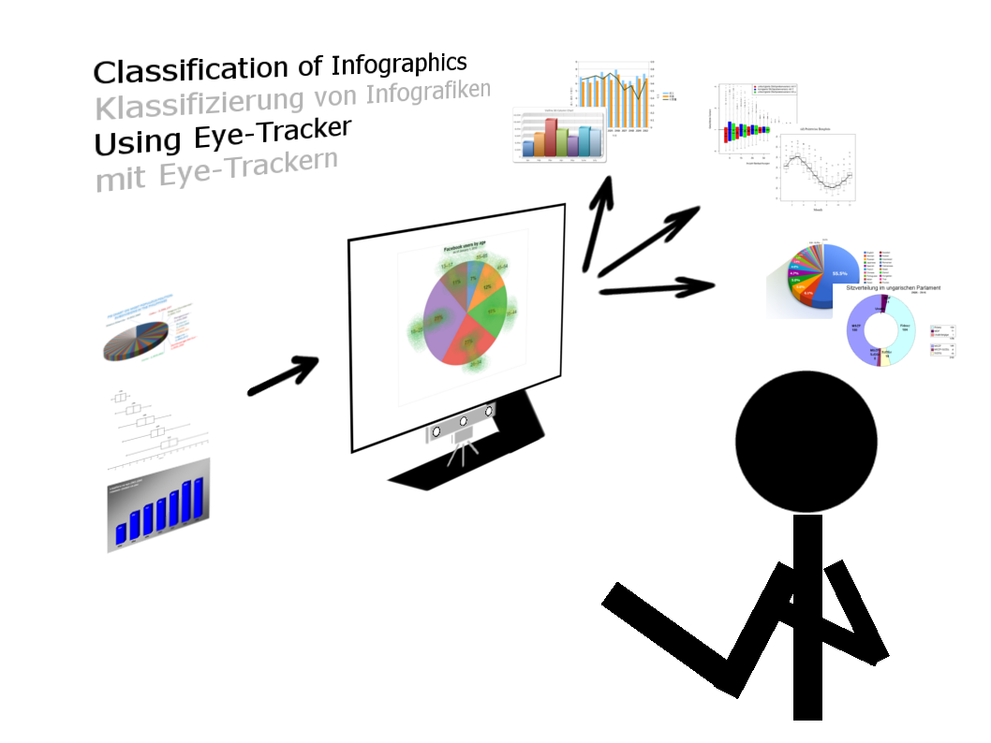
Classification of Infographics

Slide 6

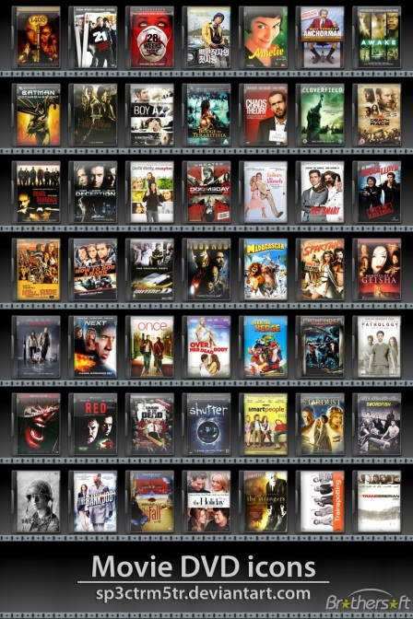
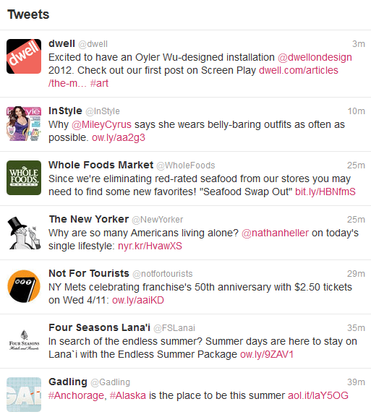
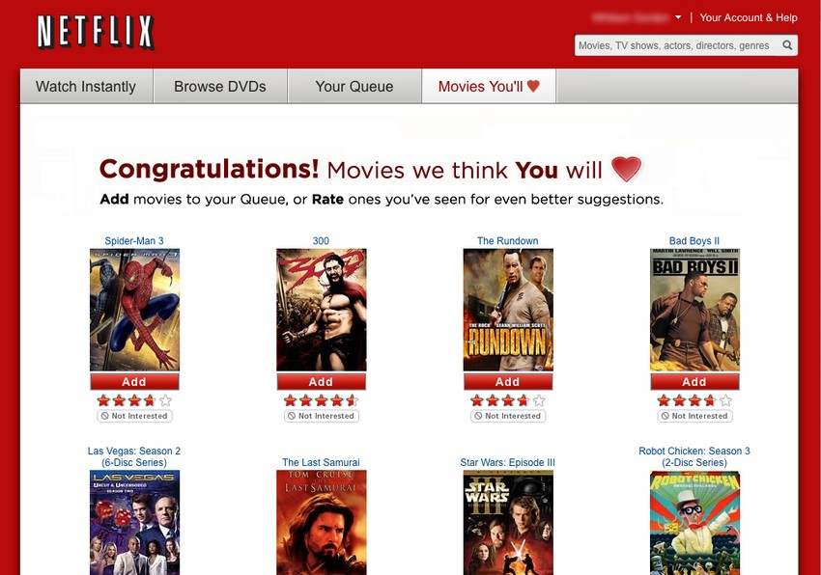
Comparison of User and Item Profiling for Movie Recommendation
User Profile
Item Profile
compute similarity score

Slide 7

Learning Goals
First goal.
Second goal.
Third goal.
Notes:
COMMENT: We will come back to patterns later …

