Slide 1
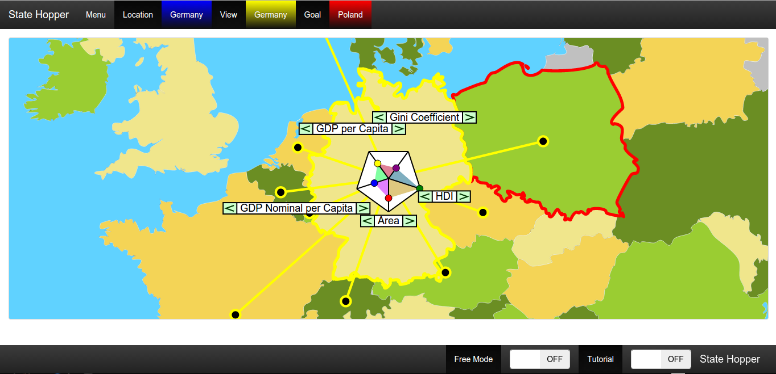
Stat(e)hopper
Try to reach your goal country …
… by hopping from neighbor to neighbor …
… using only data attributes!

