Slide 1
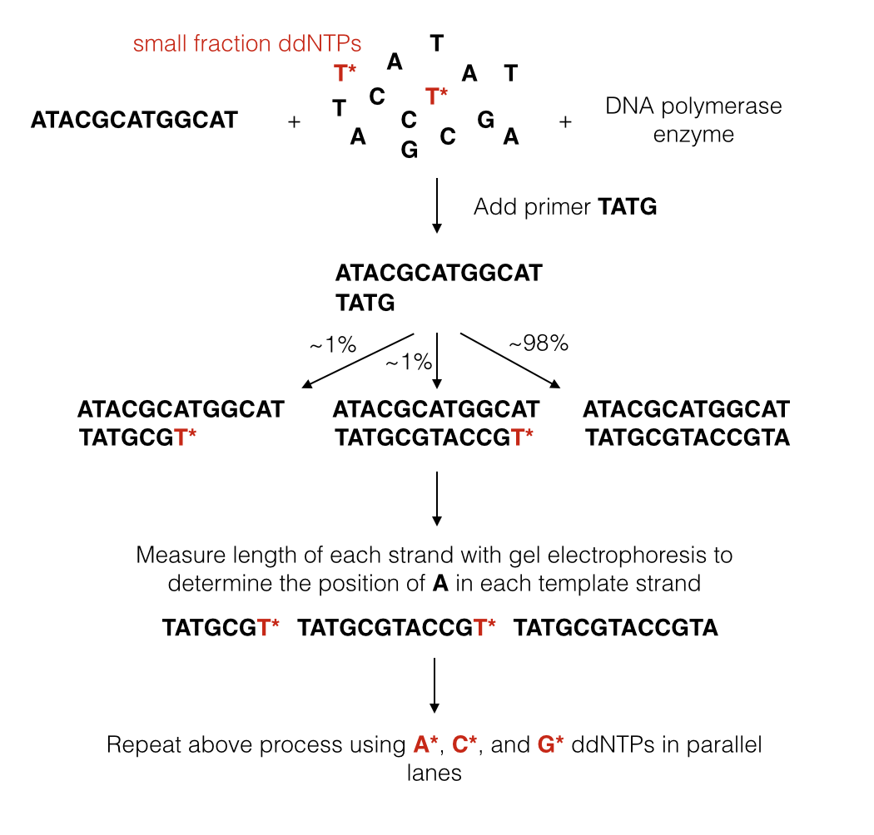

$\frac{\#T^{∗}}{\#T}$ = $\frac{1}{99}$

