Slide 1
2024 Revenue Performance Review
Regional Sales Analysis · January – December 2024
Prepared by Data Analytics Team

Slide 2
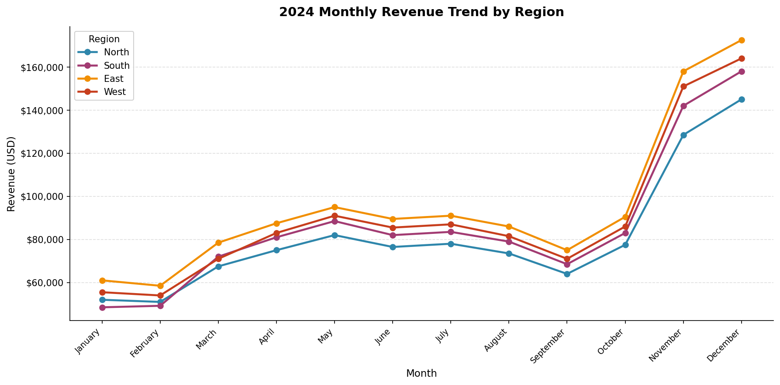
Monthly Revenue Trend by Region
Revenue peaked in November and December across all regions, driven by holiday season demand. East consistently led in monthly revenue, while North recorded the lowest figures. All regions followed a similar seasonal pattern with a mid-year plateau and year-end surge.

Slide 3
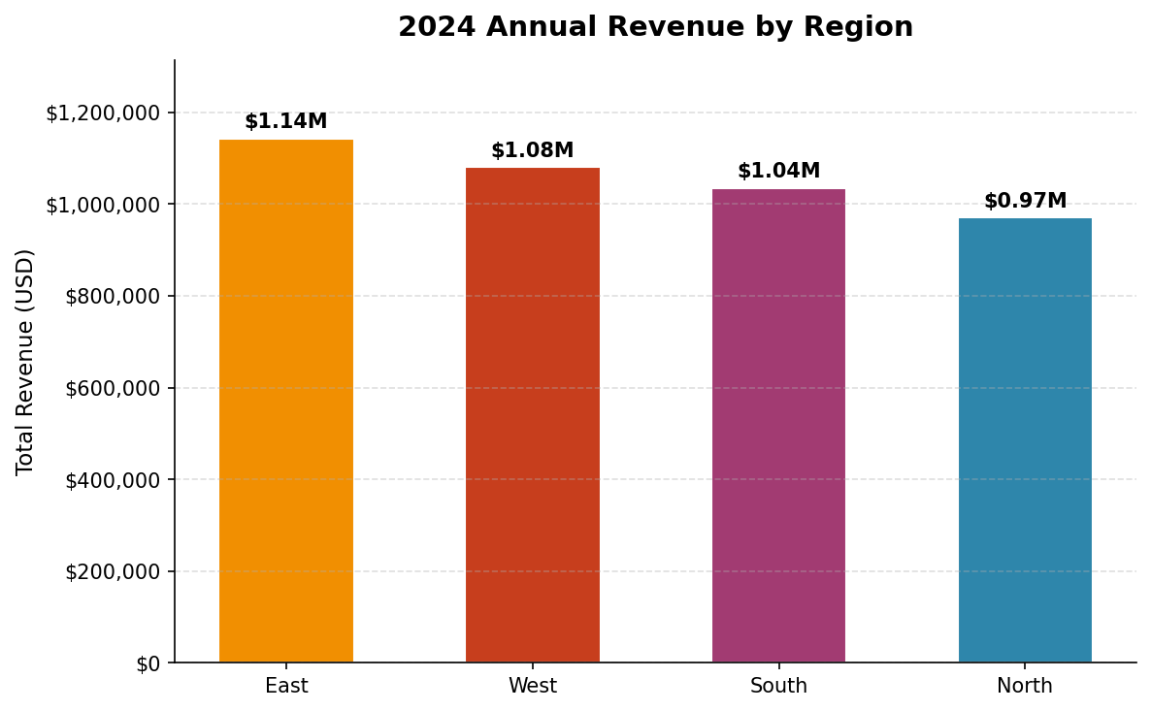
Annual Revenue by Region
East generated the highest annual revenue at approximately $1.14M, outpacing all other regions. West and South ranked 2nd and 3rd respectively, with North trailing at around $870K. The East-to-North gap of roughly $270K highlights a significant regional performance disparity.

Slide 4
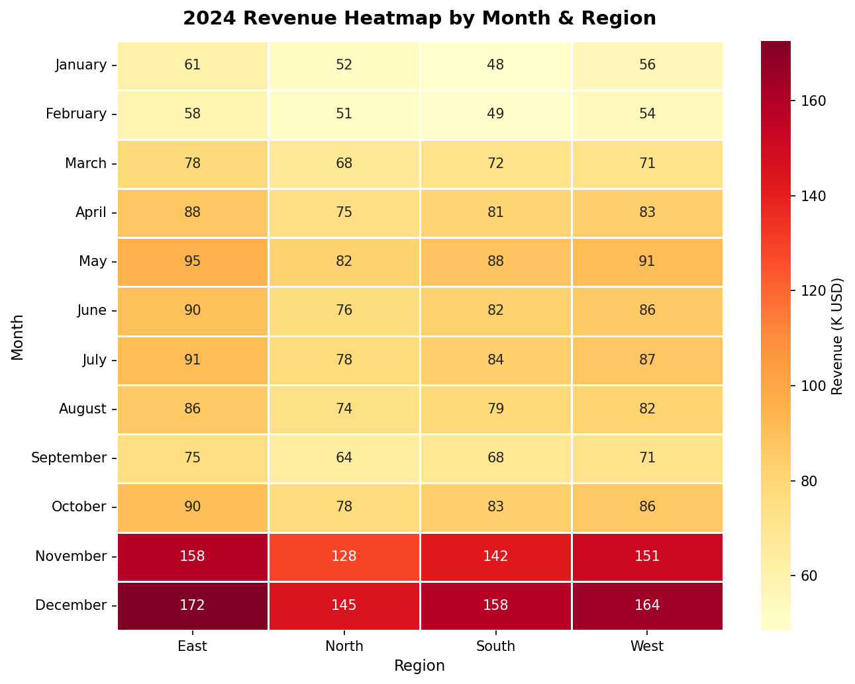
Revenue Heatmap: Month × Region
November and December dominate the heatmap with the deepest tones, confirming Q4 as peak season. January and February represent the weakest months uniformly across all regions. East consistently shows the highest cell values, reinforcing its position as the top-performing region.

Slide 5
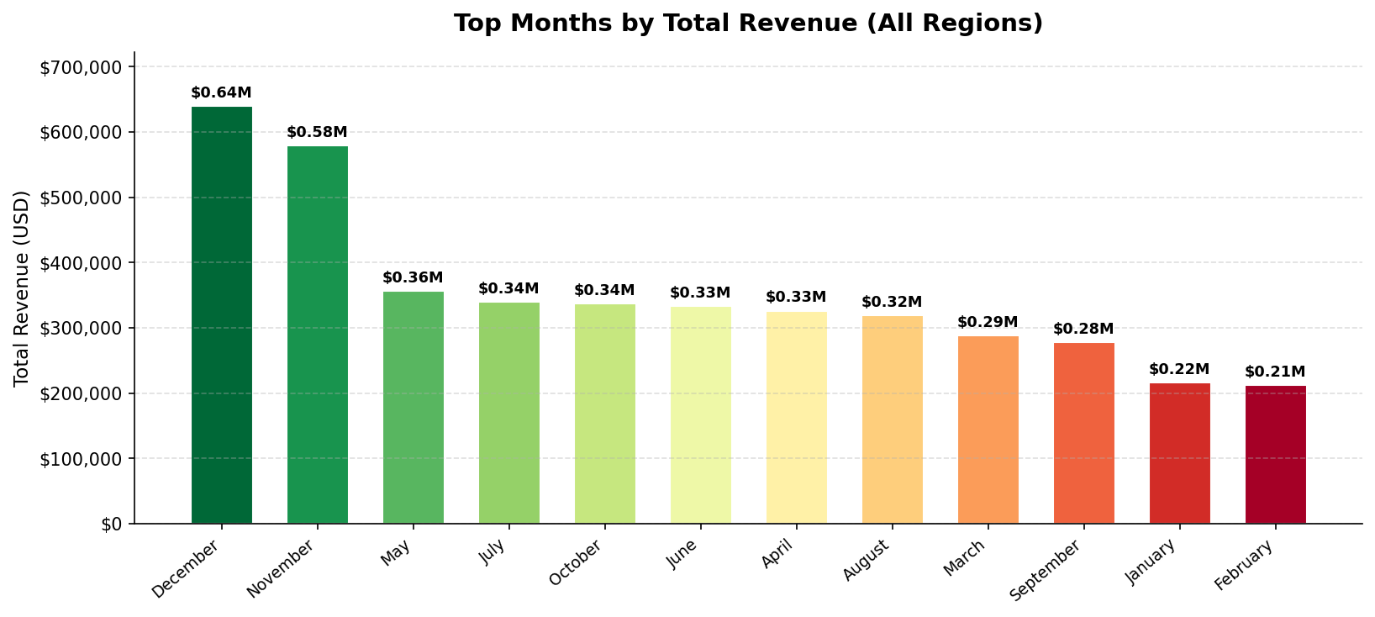
Top Months by Total Revenue
December ranks #1 with over $639K in combined regional revenue, followed closely by November at $579K. These two months alone account for approximately 30% of full-year revenue. Months 5–8 (May–August) form a steady mid-tier cluster, suggesting stable summer demand.

Slide 6
Key Takeaways
1
Q4 Drives ~30% of Annual Revenue
November and December are critical revenue months. Prioritize inventory, staffing, and marketing investments ahead of Q4 to capitalize on peak seasonal demand.
2
East Region is the Consistent Top Performer
East leads in both monthly and annual revenue across all 12 months. Studying East's sales strategies and customer mix could unlock growth levers for other regions.
3
Mid-Year Plateau Signals an Opportunity
May through August shows relatively flat growth across regions. Targeted mid-year promotions or product launches could help smooth the revenue curve and reduce over-reliance on Q4.

