Slide 1
Q & A

Slide 2
Ansible FAQ (1)
Question: Timeout at the “Wait for connection” step
… I have not been able to get past the playbook step of checking that the instances are created (Role directory "openstack-instance:, step name "Wait for connection"). …
Cause:
Only private IP addresses are assigned to instances, which are not accessible from the Internet
Solution:
Connect to University of Melbourne Student VPN

Slide 3
Ansible FAQ (2)
Question:
I am trying to run ansible script to create an instance and it keeps failing with "failed: [localhost] (item={'name': 'demo-2-adv', 'volumes': ['demo-vol-2-1-adv', 'demo-vol-2-2-adv']}) => {"ansible_loop_var": "item", "changed": false, "extra_data": null, "item": {"name": "demo-2-adv", "volumes": ["demo-vol-2-1-adv", "demo-vol-2-2-adv"]}, "msg": "BadRequestException: 400: Client Error for url: https://nova.rc.nectar.org.au:8774/v2.1/f2aba5e6fc964fc18cb2078f3de2da8e/os-volumes_boot, Invalid key_name provided."}”
Cause:
You need to update the playbook to match your settings
Solution:
Update the “key_name” variable to the key pair you have on MRC

Slide 4
Ansible FAQ (3)
Problem:
TASK [openstack-common : Install openstacksdk] ************************************************************** changed: [localhost]
TASK [openstack-images : Retrieve all available Openstack images] ******************************************* fatal: [localhost]: FAILED! => {"changed": false, "msg": "openstacksdk is required for this module"}
Debug: Run playbook in verbose mode
. ./openrc.sh; ansible-playbook -vvv <playbook>

Slide 5
Ansible FAQ (3)
Debug:
The full traceback is: WARNING: The below traceback may *not* be related to the actual failure. File "/tmp/ansible_os_image_info_payload_qlzzWJ/ansible_os_image_info_payload.zip/ansible/module_utils/openstack.py", line 116, in openstack_cloud_from_module sdk = importlib.import_module('openstack') File "/usr/lib/python2.7/importlib/__init__.py", line 37, in import_module …
from openstack import utils File "/usr/local/lib/python2.7/dist-packages/openstack/utils.py", line 13, in <module> import queue fatal: [localhost]: FAILED! => { "changed": false, …

Slide 6
Ansible FAQ (3)
Cause:
OpenStackSDK dropped Python 2 support since version 0.40.0
https://pypi.org/project/openstacksdk/#history
Solution:
Use Python 3
Install a version of OpenStackSDK that supports Python 2
Debugging:
Turn on verbose mode (when possible)
Google the error message
Check on Github and StackOverflow for solution

Slide 7
Ansible FAQ (3)
Cause:
OpenStackSDK dropped Python 2 support since version 0.40.0
https://pypi.org/project/openstacksdk/#history
Solution:
Use Python 3
Install a version of OpenStackSDK that supports Python 2
Debugging:
Turn on verbose mode (when possible)
Google the error message
Check on Github and StackOverflow for solution

Slide 8
Ansible FAQ (4)
Question:
I've tried to add a Proxy configuration … I can use apt to update, but still can not connect to the docker repository
Cause:
Docker daemon is behind HTTP/HTTPS proxy
Solution:
Create a systemd drop-in directory /etc/systemd/system/docker.service.d for the docker service
Create a file called /etc/systemd/system/docker.service.d/http-proxy.conf that adds the HTTP_PROXY, HTTPS_PROXY and NO_PROXY environment variables
Flush the changes and restart the Docker service

Slide 9
Ansible FAQ (4)
Ansible Solution:
Create a file called http-proxy.conf that contains
[Service]
Environment="HTTP_PROXY=http://wwwproxy.unimelb.edu.au:8000/”
Environment="HTTPS_PROXY=http://wwwproxy.unimelb.edu.au:8000/”
Environment="NO_PROXY=localhost,127.0.0.1,localaddress,172.16.0.0/12,.melbourne.rc.nectar.org.au,.storage.unimelb.edu.au,.cloud.unimelb.edu.au"
file module: Create directory /etc/systemd/system/docker.service.d
copy module: Copy the http-proxy.conf to /etc/systemd/system/docker.service.d/
systemd module: Flush the changes and restart the Docker service
$ sudo systemctl daemon-reload && sudo systemctl restart docker

Slide 10
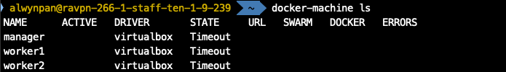
Docker FAQ & Tips (1)
Problem:
docker-machine ls showing the machine state is “Timeout”
Cause:
VPN / Antivirus / Internet Security is on
Debugging:
Turn off VPN / Antivirus / Internet Security

Slide 11
Docker FAQ & Tips (2)
Problem:
Dockerised application is running slow
Docker commands suddenly stopped working, no error message was given
Docker build failed halfway with no error message
Cause:
Not enough resources were allocated to Docker
Solution:
Check Docker … Preferences … Resources … Advanced, and make sure reasonable resource was allocated to Docker.

Slide 12
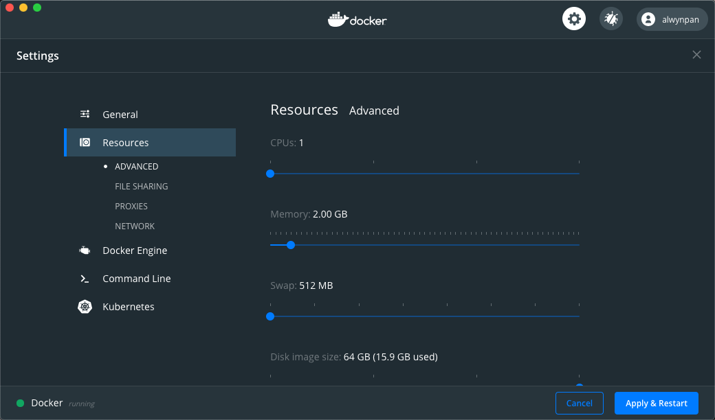
Docker FAQ & Tips (2)

Slide 13
Docker FAQ & Tips (3)
Question: The difference between COPY and ADD in a Docker file
FROM alpine:latest
WORKDIR /demo
RUN mkdir -p copy add1 add2
COPY ["release-1.18.0.tar.gz", "./copy/"]
ADD ["release-1.18.0.tar.gz", "./add1/"]
ADD ["https://github.com/nginx/nginx/archive/release-1.18.0.tar.gz", "./add2/"]

Slide 14
Docker FAQ & Tips (3)
Use cases:
COPY
Copy local files from a specific location into a Docker image
ADD
Extract a local tar file into a specific directory into a Docker image
Download a file as is from an URI into a Docker image

Slide 15
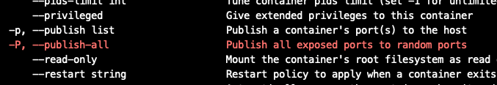
Docker FAQ & Tips (4)
Question: The difference between EXPOSE and publish ports
FROM nginx:latest
EXPOSE 8080
___________
$ docker run --name test1 -p 180:80 -d nginx-test:latest
$ docker run --name test2 -P -d nginx-test:latest
$ docker run --name test3 -P -d nginx:latest

Slide 16

Docker FAQ & Tips (4)
EXPOSE
Tells Docker daemon and user which port(s) your service listens on
Publish
Publishes the port (no matter exposed or not) to the host
Nginx:latest image Dockerfile

Slide 17
Docker FAQ & Tips (5)
Question: The difference between Build Time ENV and Run Time ENV
FROM python:latest
ARG OPENSTACKSDK_VER=0.46.0
ENV REQUESTS_VER=2.18.0
COPY [ "entrypoint.sh", "/" ]
RUN pip install openstacksdk==${OPENSTACKSDK_VER}; \
chmod +x /entrypoint.sh
ENTRYPOINT [ "/entrypoint.sh" ]

Slide 18
Docker FAQ & Tips (5)
Question: The difference between Build Time ENV and Run Time ENV
FROM python:latest
ARG OPENSTACKSDK_VER=0.46.0
ENV OPENSTACKSDK_VER=${OPENSTACKSDK_VER}
ENV REQUESTS_VER=2.18.0
COPY [ "entrypoint2.sh", "/" ]
RUN pip install openstacksdk==${OPENSTACKSDK_VER}; \
chmod +x /entrypoint2.sh
ENTRYPOINT [ "/entrypoint2.sh" ]

Slide 19
Docker FAQ & Tips (4)
Built Time Variable (build arg)
Variables defined in the Dockerfile, and works at build time only.
Use ”docker build --build-arg KEY=VALUE” to init or override
Run Time Variable
Variables defined in Dockerfile / Entrypoint / application, and works at run time only.
Use “docker run -e KEY=VALUE …” to init or override

Slide 20
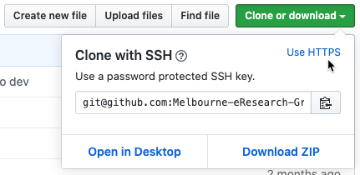
A New Question
Question: How to clone a GitHub repo behind the HTTP/HTTPS proxy?

Slide 21
A New Question
Question: How to clone a GitHub repo behind the HTTP/HTTPS proxy?
Clone via HTTPS (use username / password)
git clone https://github.com/<username>/<repo>.git
Clone via SSH (use private / public key)
git clone git@github.com:<username>/<repo>.git
Adding a new SSH key to your GitHub account

Slide 22
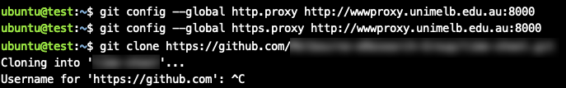
A New Question
HTTPS option (command line):
git config --global http.proxy http://wwwproxy.unimelb.edu.au:8000
git config --global https.proxy http://wwwproxy.unimelb.edu.au:8000
HTTPS option (Ansible):
git_config module

Slide 23
A New Question
SSH option (command line):
sudo apt install socat vim
vim ~/.ssh/config
host github.com
user git
hostname ssh.github.com
port 443
proxycommand socat - PROXY:wwwproxy.unimelb.edu.au:%h:%p,proxyport=8000
HTTPS option (Ansible):
copy module or blockinfile module

Slide 24
Docker Demo 5
Rolling update:
docker service update --update-parallelism 1 --update-delay 5s \
--image=alwynpan/comp90024:demo1 nginx
Rollback:
docker service update --rollback nginx

Slide 25
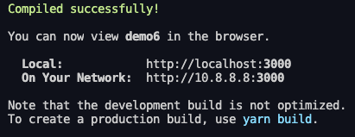
Docker Demo 6
Create React App
npx create-react-app demo6
Run the app:
yarn start

Slide 26
Docker Demo 6
.dockerignore
Before the docker CLI sends the context to the docker daemon, it looks for a file named .dockerignore in the root directory of the context. If this file exists, the CLI modifies the context to exclude files and directories that match patterns in it. This helps to avoid unnecessarily sending large or sensitive files and directories to the daemon and potentially adding them to images using ADD or COPY.
Reference: https://docs.docker.com/engine/reference/builder/#dockerignore-file

Slide 27
Docker Demo 6
React UI (simple)
Build: docker build -t react:simple .
Run: docker run --name simple -p 5000:5000 -d react:simple

Slide 28
Docker Demo 6
Challenge – image size, the smaller the better
React UI – reduced size
Pre-build: yarn build
Build: docker build -t react:nginx -f Dockerfile.nginx .
Run: docker run --name small -p 8080:80 -d react:nginx

Slide 29
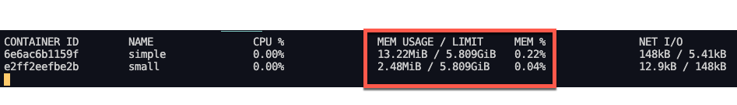
Docker Demo 6
Node vs Nginx (image size)
Node vs Nginx (resource usage)

Slide 30
Docker Demo 6
Multi-stage build
With multi-stage builds, you use multiple FROM statements in your Dockerfile. Each FROM instruction can use a different base, and each of them begins a new stage of the build. You can selectively copy artifacts from one stage to another, leaving behind everything you don’t want in the final image.
Reference: https://docs.docker.com/develop/develop-images/multistage-build/#use-multi-stage-builds

Slide 31
Docker Demo 6
React UI (multi-stage)
Build: docker build -t react:multi -f Dockerfile.multi-stage .
Run: docker run --name multi -p 8081:80 -d react:multi

Slide 32
Docker Demo 6
React UI (multi-stage) –Build only one stage
Build: docker build --target build -t react:build -f Dockerfile.multi-stage .
Run: docker run --name build -p 5001:5000 -d react:build

