Slide 1
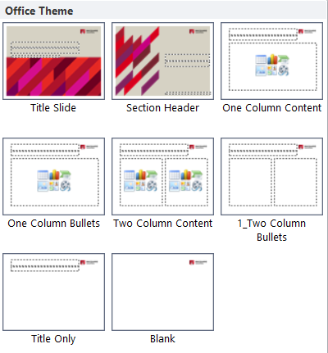
Instructions
BASIC POWERPOINT TEMPLATE
FOOTERS
To update the footer on all slides complete the following:
On any slide go to Insert | Header & Footer
Click in the Footer Section to replace OFFICE | FACULTY | DEPARTMENT with the correct information.
Ensure capitals are used.
Click the checkbox next to Don’t show on title slide.
Click Apply to all.
Be sure to apply the appropriate layout to take full advantage of the template masters provided.
With a slide selected, click the ‘Layout’ button
from the ‘Home’ tab.
Select the layout that is most appropriate for the content existing on the slide.
Master slides have been set up for custom slides (shown on right).
A slide has been created in this deck with tables that are editable (no master slide created for these).

Slide 2
Title slide
USE AS FIRST SLIDE IN PRESENTATION

Slide 3
Title slide
USE AS FIRST SLIDE IN PRESENTATION

Slide 4
Title slide
USE AS FIRST SLIDE IN PRESENTATION

Slide 5
Section header
Use for topic changes

Slide 6
One column content
USE WHEN ONE COLUMN REQUIRED
This text frame has been designed not to include bullets.
Content is Arial size 18.
Select this layout by going to Home | New Slide | One column content.
Change a slide to this layout by going to Home | Layout | One column content. This can be useful when converting presentations from an older style.

Slide 7
One column bullets
Use when one column and bullets required
Bullets are set in Arial size 18.
  Second-line bullets are Arial size 18.
    Third-line bullets are Arial size 18.
Use Tab and Shift + Tab to promote and demote bullets.
  Note: Your cursor must be at the beginning of the bullet for this to work.
  You can also use the ‘Increase List Level’ and ‘Decrease List Level’ buttons under Home | Paragraph.
Select this layout by going to Home | New Slide | One column bullets.
Change a slide to this layout by going to Home | Layout | One column bullets. This can be useful when converting presentations from an older style.

Slide 8
Two column content
USE WHEN two COLUMNs REQUIRED
COMBINE TEXT AND GRAPHIC
Two column content slide allows you to combine both text and graphic.
Add text to one of the placeholders
In the other placeholder click on the first icon on the second row to browse for a graphic.
This text frame has been designed not to include bullets.
Content is Arial size 18.
This layout is also useful when you want to combine text and a graphic.
Select this layout by going to Home | New Slide | Two column content.
Change a slide to this layout by going to Home | Layout | Two column content. This can be useful when converting presentations from an older style.
This text frame has been designed not to include bullets.
Content is Arial size 18.
This layout is also useful when you want to combine text and a graphic.
Select this layout by going to Home | New Slide | Two column content.
Change a slide to this layout by going to Home | Layout | Two column content. This can be useful when converting presentations from an older style.

Slide 9
Two column bullets
Use when Two columns and bullets required
Bullets are set in Arial size 18
  Second-line bullets are Arial size 18.
    Third-line bullets are Arial size 18.
Use Tab and Shift + Tab to promote and demote bullets.
  Note: Your cursor must be at the beginning of the bullet for this to work.
  You can also use the ‘Increase List Level’ and ‘Decrease List Level’ buttons under Home | Paragraph.
Select this layout by going to Home | New Slide | Two column bullets.
Change a slide to this layout by going to Home | Layout | Two column bullets. This can be useful when converting presentations from an older style.

Slide 10

Table slide
Copy, paste and modify when table required
TABLE STYLES
Due to a limitation in how PowerPoint table styles are applied, it is important to follow the steps below if you need to add extra rows.
Create alternate colour rows:
Move outside the table.
Select the row whose colour you want to copy.
Click the format painter tool on the Home ribbon.
Click the row that needs the new colouring applied.
Title here | Title here | Title here | Title here | Title here

Slide 11
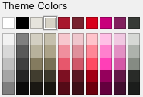
Smart Art slide
EXTERNAL
SMART ART
Due to a limitation in how Smart Art is inserted into presentations, copy and paste this slide as a base.
If the colours don’t follow pattern, click on the shape and choose from these two colours found in the colour palette.
Text
Text
Text
Text
Text
Text
Text
Text
Text
Text
Text
Text

Slide 12

Example of picture slide

Slide 13













































Icons library – Sand, page 1
Copy and paste where needed

Slide 14











































Icons library – Sand, page 2
Copy and paste where needed

Slide 15













Icons library – Sand, page 3
Copy and paste where needed

Slide 16













































Icons library – Charcoal, page 1
Copy and paste where needed

Slide 17












































Icons library – Charcoal, page 2
Copy and paste where needed

Slide 18















Icons library – Charcoal, page 3
Copy and paste where needed

