Slide 1
COVID-19
Time Series Visualization Tracker: Containment and closure policies
Source: Oxford Covid-19 Government Response Tracker

Slide 2
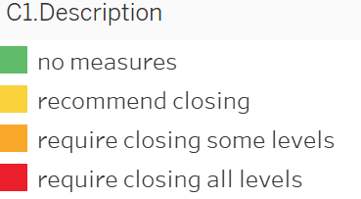
COVID-19
C1 | School Closing

Slide 3
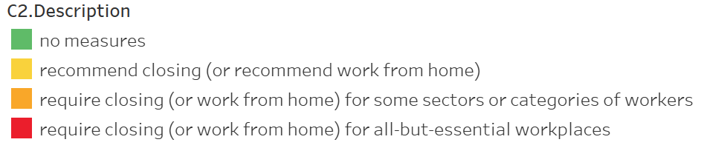
COVID-19
C2 | Workplace Closing

Slide 4
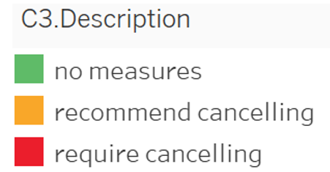
COVID-19
C3 | Cancel Public Event

Slide 5
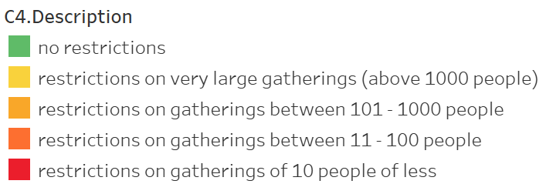
COVID-19
C4 | Restriction on Gatherings

Slide 6
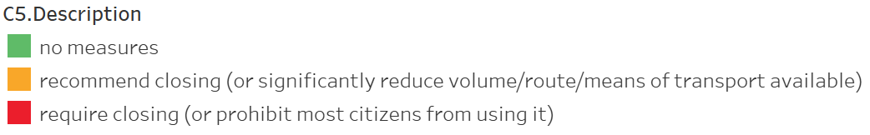
COVID-19
C5 | Close Public Transport

Slide 7
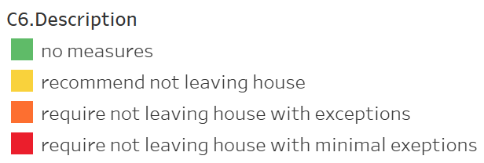
COVID-19
C6 | Stay at Home Requirement

Slide 8
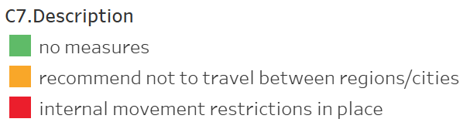
COVID-19
C7 | Restrict on Internal Movement

Slide 9
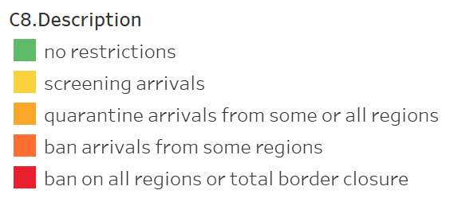
COVID-19
C8 | International Travel Control

