Slide 1
SQL Retrieval
Locking and using views

Slide 2
Locking is for ACID
Databases are usually multi-user. Dozens of people entering and a few reporting is typical for even a medium-sized company sales company.
Locking records is what slows databases down. Because only when all relevant update operations have completed on a record can a read be allowed.

Slide 3
Transactions and locking levels
Transactions are the mechanism to ensure consistency
Transactions are often used to prevent stupid mistakes
Begin a transaction, make some changes, do some checks and rollback if you have it wrong.
But they are used to ensure integrity and consistency
SQL-92 defines Isolation Levels
Serializable is the highest and default level for a new database.
Analytics and Reporting Queries
These should not change production tables.
So, with every query, state no locking is required.
For example
SELECT first_name, last_name, FROM dbo.person p WITH (NOLOCK) JOIN dbo.employee e WITH (NOLOCK) ON e.person_id = p.person_id WHERE p.person_id = 1;

Slide 4
A view is captured select statement
It is an SQL primitive
CREATE VIEW view_name AS SELECT column_name(s) FROM table_name WHERE condition
And it allows you to capture a complicated SQL select query
You then use it like a table select v.* from view_name v
So this can make SQL queries simpler.
They can be thought of as sub-functions
SQL Server Management Console has a Query Designer GUI
With this you can design queries graphically but only to create views
Visual Studio and Excel have a Query Designer

Slide 5
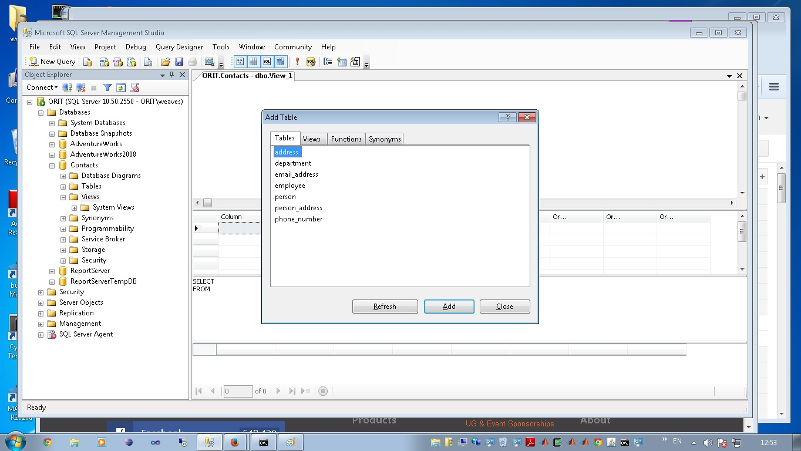
Notes:
To access the view designer, use the Database Explorer, find your database, open the views and right click on the Views folder container.
You should find “New View”.
After that, follow the wizard.

Slide 6
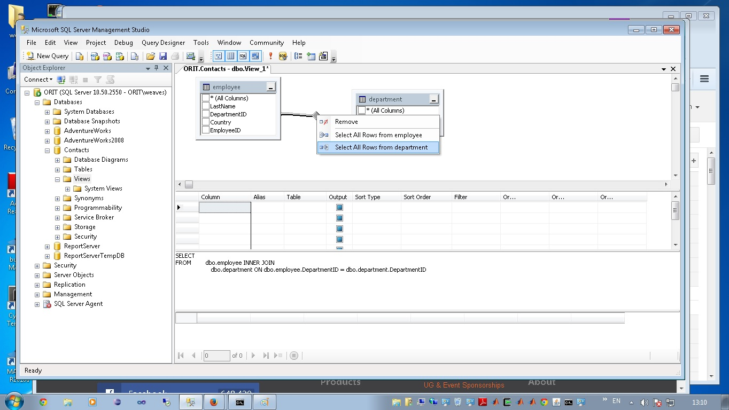
Notes:
Here you can see, the query designer gives you a graphical view of a join.
You produce this by adding two tables and then left-click-and-hold of one fields in one table, to a field in the other.

Slide 7
Views are very widely used
Relational Databases
Apply Codd’s normalization rules to reduce tables back to key and unique data
Views are typed
The output of select defines an output table.
A view is fixed in output and can save the query analyser time.
Reports for human consumption
Are best presented with all the key references de-referenced to produce a complete record
Functions and Procedures
To simplify the processing within functions and procedures
Views are used to eliminate all the SELECT
To be consistent with processing and handling exceptions
Because of this: the Views section is very often the most populated
Views are traditionally prefixed with “vw”

Slide 8
Limitations on Views
Functions only
No procedures
No processing steps, no temporary tables
Annoyingly
order by is not preserved if the view is used in another query
The cost of computation is a SELECT
Views are a convenience
They still require a SELECT to performed

Slide 9
Cached Databases
Views still cost
Because a view is a SELECT statement their use can require a lot of locking.
This can make databases very slow – even if you use WITH(nolock).
Analytic databases are cached read-only
Are very often a simplified view of the data is cached, that means
Create a new database with minimal isolation – read uncommitted is usually suitable if the database is wholly read-only. If you keep summary tables, you should use read committed. This latter level waits for update operations to complete before allowing a read.
Run a job in the live database that snapshots all the tables you want to use in the cached version
Select from the tables through views that remove all of the complicated look-ups.
Write the output of those views to new tables in the new snapshot database
You then run analytics against the snapshot database
In industry, this is very common practice
Developers, analysts and auditors usually run their jobs against simplified fast, un-locked, read-only databases – sometimes generated hourly.
The live production database is only used for data input.

Slide 10
BTW: Cloned Databases
Clone a live database
This is one of the fundamental operations you expect to find in a database system. It is described as “snapshotting”.
A clone of a live database is used by developers
Only to improve data input procedures
Because reporting uses a cached database
Issues
To clone a database, you need to not change its state
Either, do not change data, or, write an ingenious sub-system that journals all of the changes whilst the system is cloned and replays them after cloning.
The latter is available in high-end Enterprise databases.
Because of this, long-term read-only data is removed from the live database and put into tables in other database.
Synonyms are used to reference this data.

Slide 11
SQL Server: SSAS, SSRS, SSIS
Cached databases
SQL Server has institutionalized the cached database.
The SQL Server Analytics Server must be given a set of tables and takes copies using views.
The SQL Server Report Server can do this optionally.
SQL Server Integration Service
This is SQL Server’s suite of utilities for uploading new data to a database.
Usually, you upload to a new table and then insert each record normally.
For small amounts of data, this is fine, but for large data sets that might be replacing whole sets of reference data, it is best to load using a separate database and then cut-over the data.

Slide 12
As Data Science Consultants …
You won’t be usually be involved in database design.
It’s a specialist field – very often a standard is bought from a company and adapted to the site.
Involved in generating analytics from a live database.
Find out how live the analytics needs to be.
Consider using a Cached Database. The tradeoff is
it may take two hours to generate data in a live database for analytics and it will force locks that will impact other users.
It may take one hour to cache a database and then one hour to generate analytics from it. The impact on other users will only be for one hour.
Extract Transform and Load a live database
You may need to load new data sources into a database.
Prototype against a new database. Then see if you can merge using synonyms into the live system.

