Slide 1
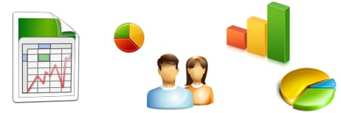
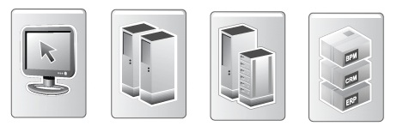
Staging Layer
Business Intelligence
Exception Handling
Presentation Layer
Integration Meta Data
Integration Layer / Data Vault
Staging Layer
Source Systems

Slide 2
Integration Metadata
Information Delivery
Exception Handling
Presentation Layer
Integration Metadata
Integration Layer / Data Vault
Staging Layer
Source Systems

Slide 3
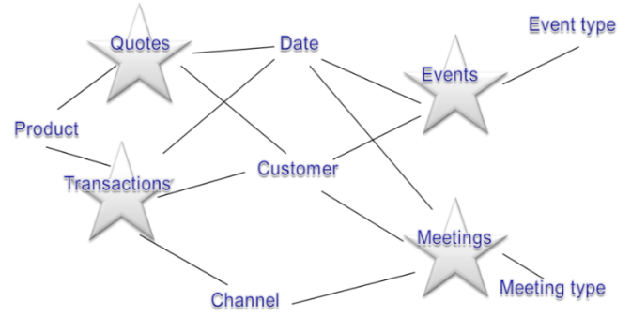
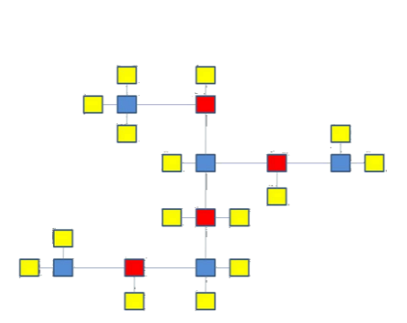
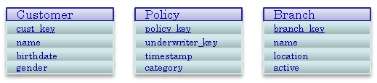
Reference Architecture
Business Intelligence
Exception Handling
Presentation Layer
Integration Meta Data
Integration Layer / Data Vault
Data Warehouse
Examples of each Layer
Staging Layer
Source Systems

Slide 4
Reference Architecture
Exception Handling
Integration Meta Data
Presentation Area
Prepare data / information for consumption
Apply subject area specific business logic (Raw / Information Marts)
Define structure and hierarchy
Aggregation and transformation
Helper Area (optional)
Semi-aggregates
Helper tables
Performance improvements
Presentation Layer
Integration Area
Key distribution
History management
Data Integration to core DWH model
Raw data, but organised
Interpretation Area (optional)
Application of enterprise-wide (generic) business logic
Integration Layer
Staging Area
Prepare data / information for consumption
Apply subject area specific business logic (Raw / Information Marts)
Define structure and hierarchy
Aggregation and transformation
Persistent Staging Area (optional)
Archive source data / transactions
Insert only (effective-dated)
Staging Layer

Slide 5
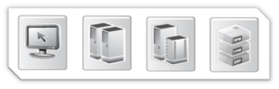
Integration Layer
Staging Layer
Regular feeds.
Re-initialisation processing, and/or regular feeds.
Core requirements:
Log record source information
Log process information
Set load date/time stamp
Force row order
<Table or file>
Archiving
<Table or file>
Staging Area
Persistent Staging Area
Transient: truncate & load
Load (delta of) source data
Streamline data types
Derive event date/time
Persistent: archive of all received data
Load using SCD2 insert-only mechanism
Delta loading
Delta loading

Slide 6
Presentation Layer
Integration Layer
<Table or file>
<Table or file>
<Table or file>
Error handling
Derivations
Error detection
Raw Data Vault (Integration Area / Mandatory)
Business Data vault (Interpretation Area / Optional)
Generation and assignment of persistent surrogate keys (DWH keys)
Store history
Manage relationships
Raw data
Apply enterprise wide business logic
Cleaned data
Error handling / error bitmaps
Staging Layer

Slide 7



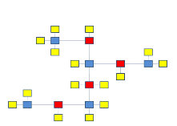
Presentation Layer
History
Representation
Apply Information Mart business logic
Manage structures and hierarchies
Calculate facts and metrics
Load to any presentation model
Aggregation
Raw / Information Mart Area
Business Logic
Point-in-time tables
Grey area
Integration Layer
Bridge tables
Note: data can be loaded from both the Raw and Business Data Vault.

Slide 8
In this hypothetical example the Customer Code is the business key, and is therefore mapped to the Hub Customer Integration Layer table.
The Address information also needs to be mapped to Hub Customer, but the business key is not present in the Address table.
In this case, a view that joins both tables together will make it easier for upstream integration
View Address
ID
Address Type
Customer Code
Address
Post_Code
CIty
Customer table
ID
Customer Code
Name
Address table
ID
Address Type
Address
Post_Code
CIty
Historical Staging Area
The joined table must be joined from the Historical Staging Area, against the most recent record for the key or a point-in-time equivalent. This is because duplication in data must be prevented, and time-variant attribute may be included in the join.
It is not possible to join tables in the Staging Area as the data delta and loading frequency may differ leading to empty joins. Even if a full data delta is present the resulting dependency in loading makes this a bad option.
Adopting views in the Staging Layer means that the outlying table (the Historical Staging Area) needs to be updated before it is joined to the driving Staging Area table. This will make sure all data is present prior to the join, meaning no data will be left out.
Staging Area

Slide 9
Oracle is queried via the Attunity Oracle connector
SSIS directly accesses SQL Server
Current state source selection
Most recent state History selection
Source table
(MIDAS – Oracle)
History Area table
(C-Customer – SQL Server)
SSIS
Hash keys for the full record are created by Oracle
SSIS compares both datasets using a Merge Join operation and interprets the join results (Insert, Update or Delete)
Data delta is inserted in the Staging Area
Staging Area table
(C-Customer – SQL Server)

Slide 10
Business Intelligence
The decoupling views are effectively the Dimensional Model (or other Mart types) as exposed to BI.
Decoupling View
(decoupling only one-on-one with underlying table)
Decoupling View – Virtual Mart
(decoupling with business logic)
pres schema
Table
(physical storage for performance reason, if required)
Fully virtual Data Marts are recommended if performance allows for this, as most BI solutions are either MOLAP or in-memory.
ben schema
Logic View
(join and business logic)
Logic View - Logic
(join and business logic)
This approach is conceptually the same for all dimension types (i.e. type 1, 2 or mixed)
Presentation Layer
Integration Layer

Slide 11
Business Intelligence
Decoupling View
pres.dim_<table>
Type 1 dimensions are considered the ‘standard’ and expected to be able to support the majority of the questions.
Therefore, these do not have any suffixes in the name of the views and tables
pres schema
Table
ben.dim_<table>_TBL
Type 1 example
(with table added for materialisation)
ben schema
Logic View
ben.dim_<table>_VW
Presentation Layer
Integration Layer

Slide 12
Business Intelligence
Decoupling View
pres.dim_<table>_Pit
Type 2 dimensions are considered an exception, in the sense that the majority of the tables are expected to be type 1.
Therefore, these tables and views have a ‘_Pit’ suffix to identify them.
pres schema
Table
ben.dim_<table>_Pit_TBL
Type 2 and mixed history example (with table added for materialisation)
ben schema
Logic View
ben.dim_<table>_Pit_VW
Presentation Layer
Integration Layer

