Slide 1
IBM Hackathon 2019
User Query on Stack Overflow
Team Name:
Data Spartans
Team Strength: 3
Team Members:
Hitesh Varma P.
Aditya Kumar
Rohan Banerjee

Slide 2
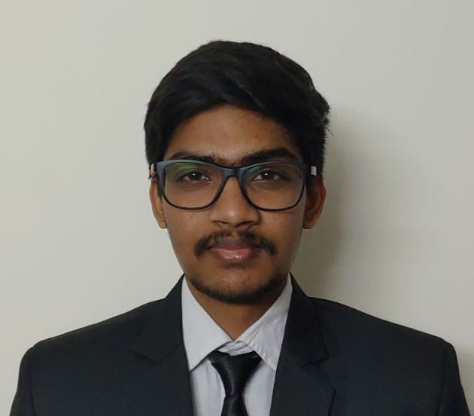

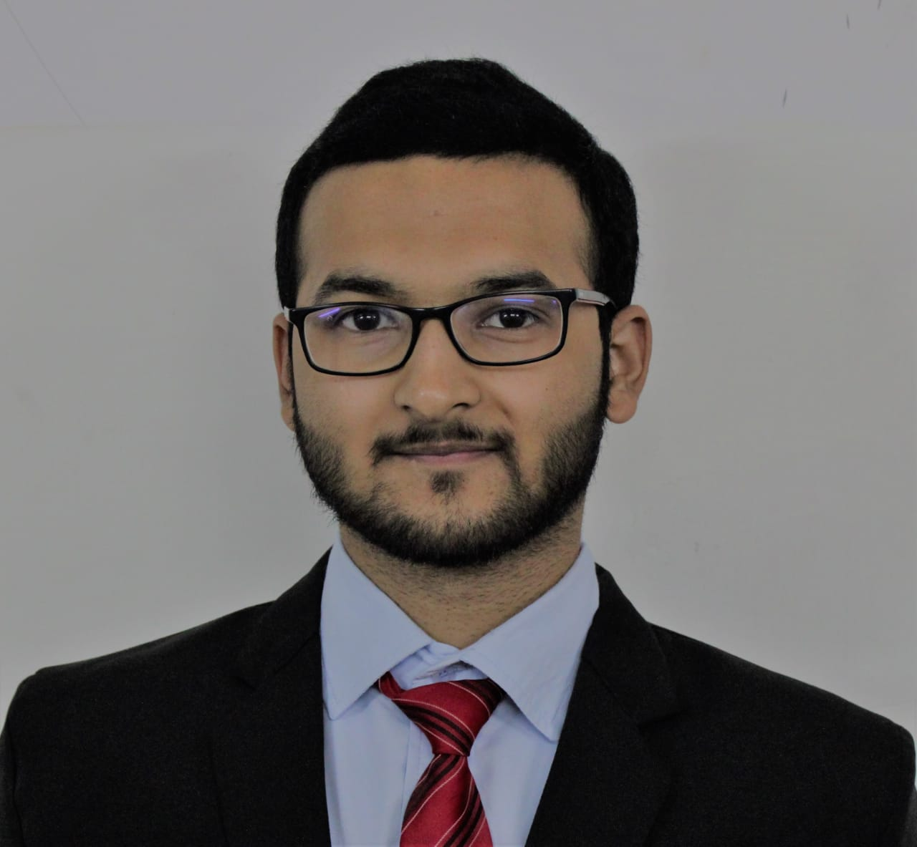
Data spartans
Hitesh Varma P.
Flask Backend
Data Science & Frontend
Aditya Kumar
Core modules and CLI script
Algorithms & Machine Learning
Rohan Banerjee
Frontend
Data Science & Frontend

Slide 3
Technologies used:
NLTK library for Natural Language Processing.
Flask, along with HTML, CSS and JS for building the web application.
Py-Stackexchange library for dealing with the Stack Exchange API.
Html2text library for displaying answers on the command line.
Requests library for sending API requests.

Slide 4
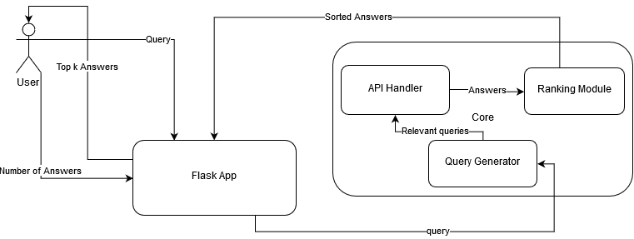
Architectural design

Slide 5
Ui/UX tools used:
We have used HTML and CSS for our frontend.
For styling of home page we used online styling source. And the slider in home page is done using basic CSS maintaining the color contrast of the background.
Taking help from some websites and after editing we prepared a logo for our project which was displayed in the home page.
After entering the query, for results page we have used the same online styling source for design. And have maintained the color contrast based on confidence score value from the backend results calculation.
The frontend and backend operations are linked using flask.

Slide 6
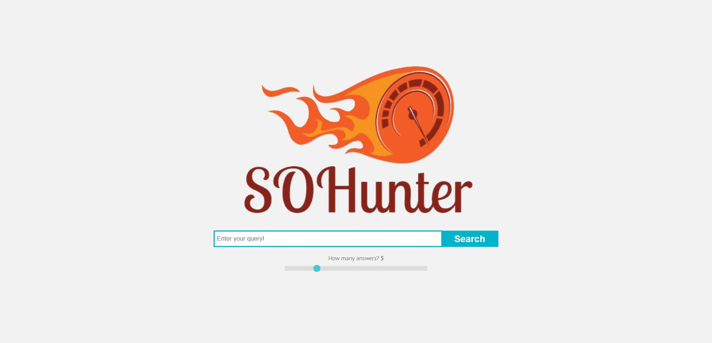
Home page

Slide 7
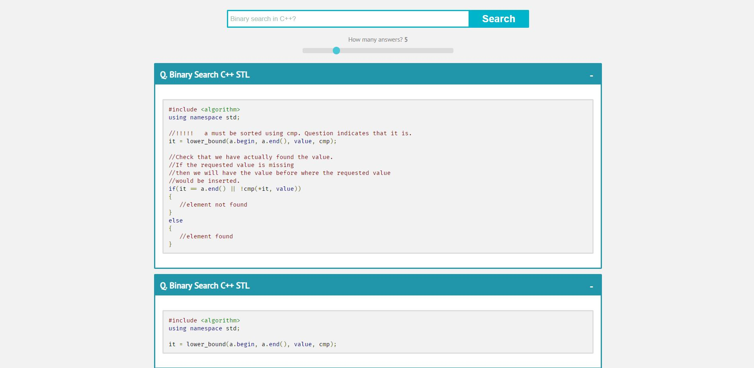
Result page

Slide 8
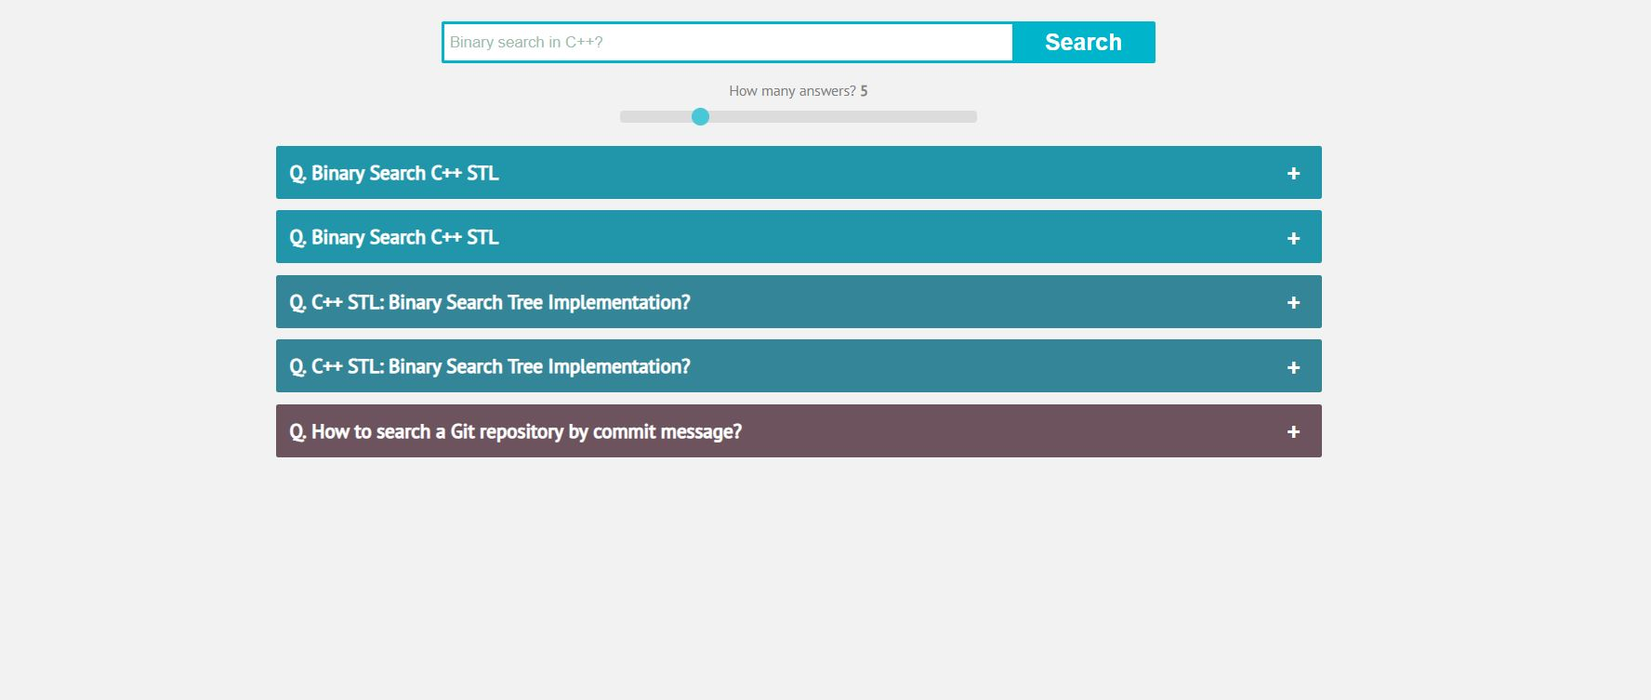
Change in color contrast
Based on Confidence score

