Slide 1

NTT DATA Datathon FME-UPC Challenge 2023

Slide 2






Healthcare Challenge
Check out our article here!
La aplicación de la inteligencia artificial a la cadena de suministro sanitaria determinará la sostenibilidad del sistema | NTT DATA
Healthcare supply chain optimization can contribute to solving some essential healthcare challenges in Spain.
What are the main challenges that healthcare logistics need to overcome?
Lack of centralization and coordination of purchase policies
Low collaboration between supply chain actors
Shortage of centralized logistic structures for multiple healthcare centers, reducing global vision on stock and hindering their management
Lack of efficiency in the contracting and purchasing procedures
Shortage of efficient systems to support costs management and resources optimization
Changing environments that require continuous adjustment of their professionals
Processes with a high level of digital support but with difficulties in exploiting collected information, with low levels of automatization

Slide 3
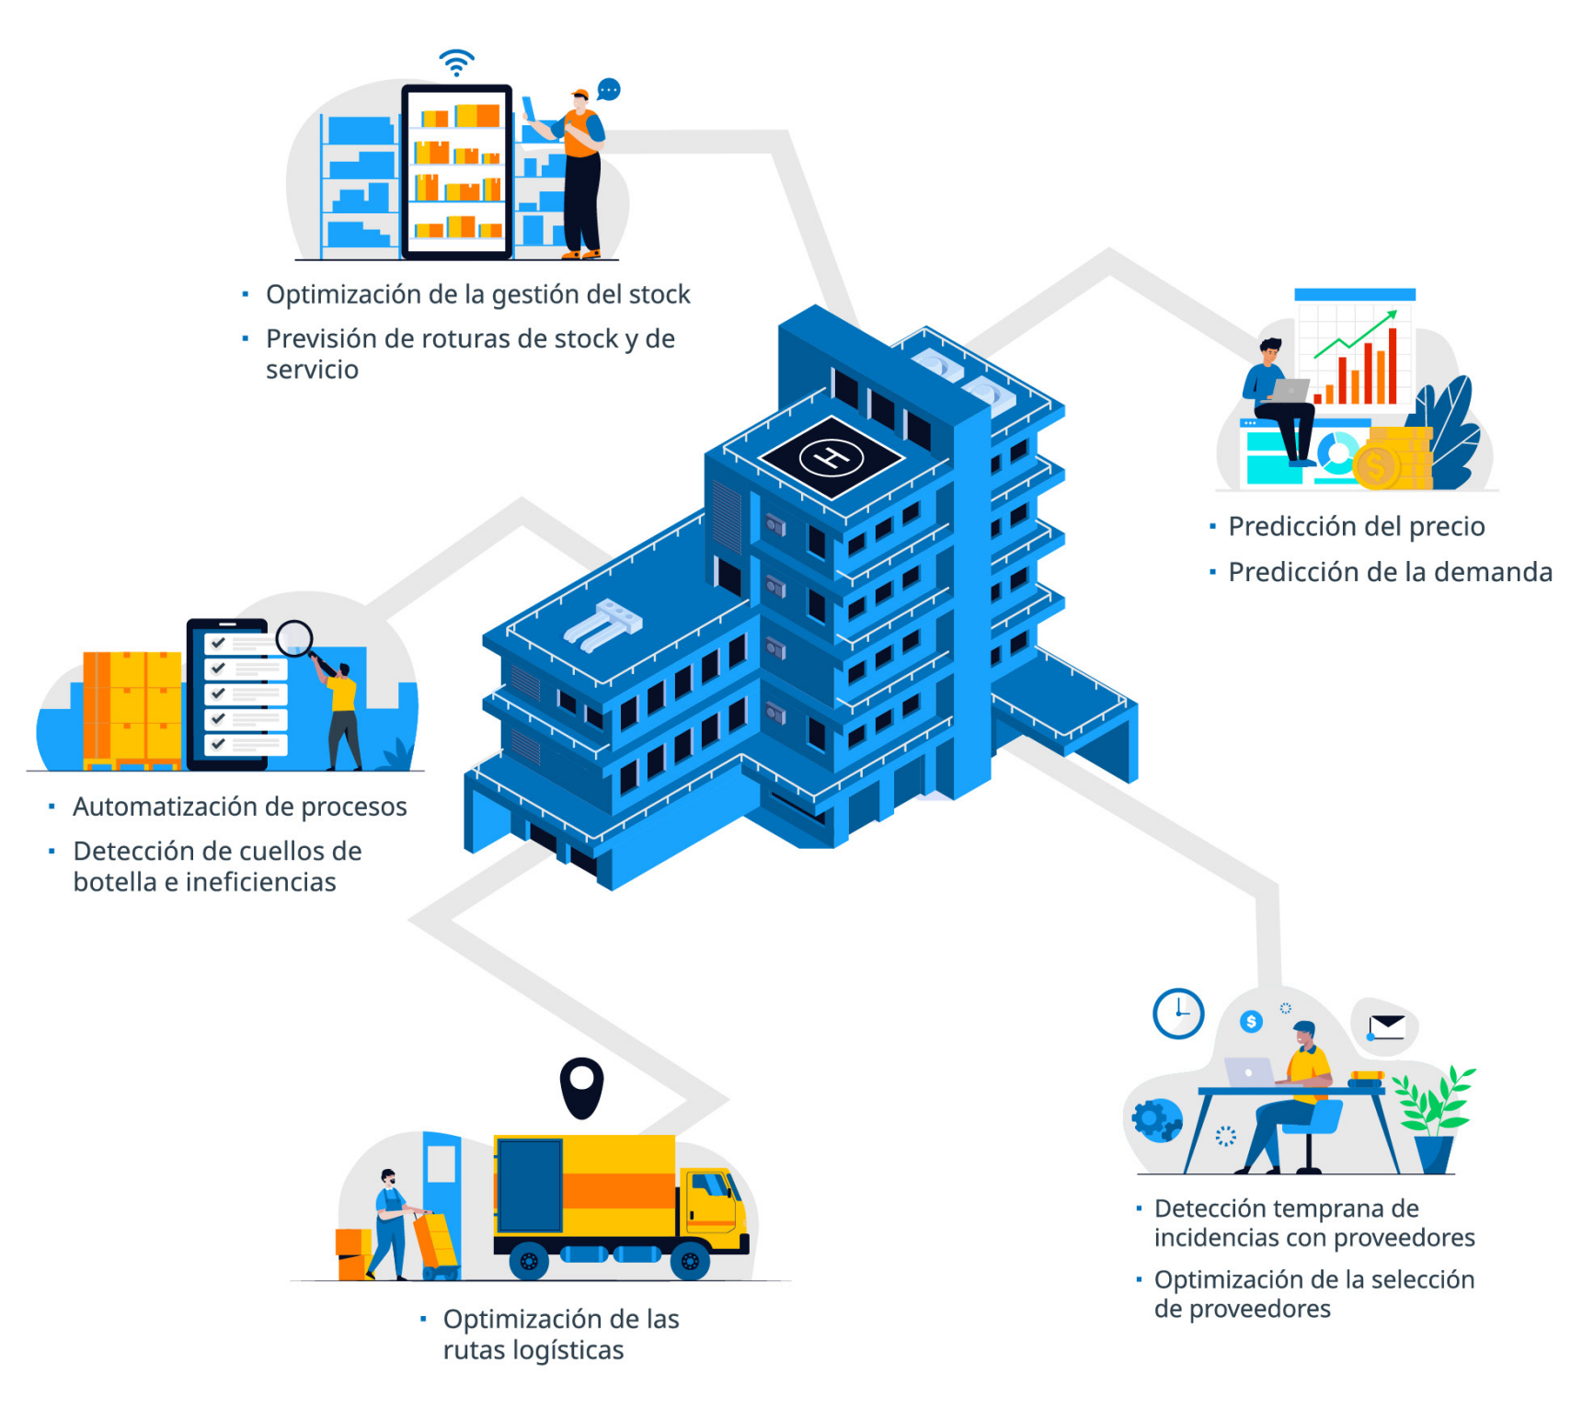



Healthcare Challenge
transformation will make it possible to:
Future vision
In the near future, this paradigm of logistics transformation will:
Optimization of stock management
Forecasting of out-of-stocks
Price prediction
Demand prediction
Improve patient safety
Reduce response times to emergency situations
Contribute significantly to the sustainability of the healthcare system
Process authorization
Bottleneck and inefficiencies detection
Early detection of providers incidences
Optimization of providers selection
Logistic routes optimization

Slide 4


Healthcare Challenge
CURRENT SITUATION
OBJECTIVES
Acquisition system working reactively. Acts based on demand whenever products are either required or out of stock
Advance towards a predictive system that ensures supplies on site preventing stockouts
Different units work independently, many of them buying general supplies on a frequent basis
Unified purchases for several months of supply and between several units leads to less CO2 emissions due to transportation

Slide 5

Healthcare Challenge
Ideas that can be part of the challenge
Main goal
Stablish a purchase plan for 2023
What else can we analyze?
Possible approaches
Forecasting
Segmentation
Visualization
Predict the expenses for the following year by product
Detect purchase patterns and combinations
Evaluate the environmental impact if purchase strategy changes

Slide 6
Healthcare Challenge
Dataset description
Purchase history since 2015 for of all the healthcare supplies of a group of hospitals
Variables
CODIGO
Product code (first letter relates to product classification)
PRODUCTO
Product description
O
Object
Purchase date (day/month/year)
N
Numeric
FECHAPEDIDO
D
Date
NUMERO
Order number/year
* Anonymized data
REFERENCIA
Reference number
CANTIDADCOMPRA
Number of products purchased
UNIDADESCONSUMOCONTENIDAS
Number of units that the product contains
PRECIO
Cost in €
IMPORTELINEA
Total cost of products purchase
TIPOCOMPRA
Type of public purchase (Compra menor: minor contract / Concurso : public tender)
ORIGEN*
Code corresponding to the purchasing region-hospital-department
TGL
Type of logistic distribution of products (transito: directly delivered at the hospital /almacenable: delivered at purchase center)

Slide 7
Evaluation criteria
Answer to the business case
Analytical skills
Storytelling & rationale
Innovation
Oral presentation skills

