Slide 1


Crash-Course in Contributing to Open Source Projects
Andreas Müller
(and contributions from: Reshama Shaikh)

Slide 2
Crash-Course in Contributing to Open Source Projects
(with some specific instructions to sklearn)
Gitter: https://gitter.im/scikit-learn/sprint

Slide 3
(Great!) Reasons to Contribute to Open Source
Giving back. Users of open source like to give back and participate in the community.
Contributing to open source is an excellent learning opportunity which advances one's data science and Python coding skills.
Fix bugs, add features & solve a problem that (we) developers faces in work.
OS is movement, projects flourish with various contributors (FB: Pytorch, Microsoft: VSC)

Slide 4
(Great!) Reasons to Contribute to Open Source
In DS more appealing to work with OS tools; the familiarity, allows job transition, increases value of tech skills because they are transferable, synergy of knowledge
Interact with core developers, who are experts
Job opportunities
Fun

Slide 5
Environment
If you don’t have a working python installation, install Anaconda.
If you don’t want to install the scikit-learn development version in your main environment, create a separate environment (with conda or virtualenv):
conda create -n sklearndev numpy scipy matplotlib pytest sphinx cython ipykernel
source activate sklearndev
conda install -c conda-forge sphinx-gallery

Slide 6
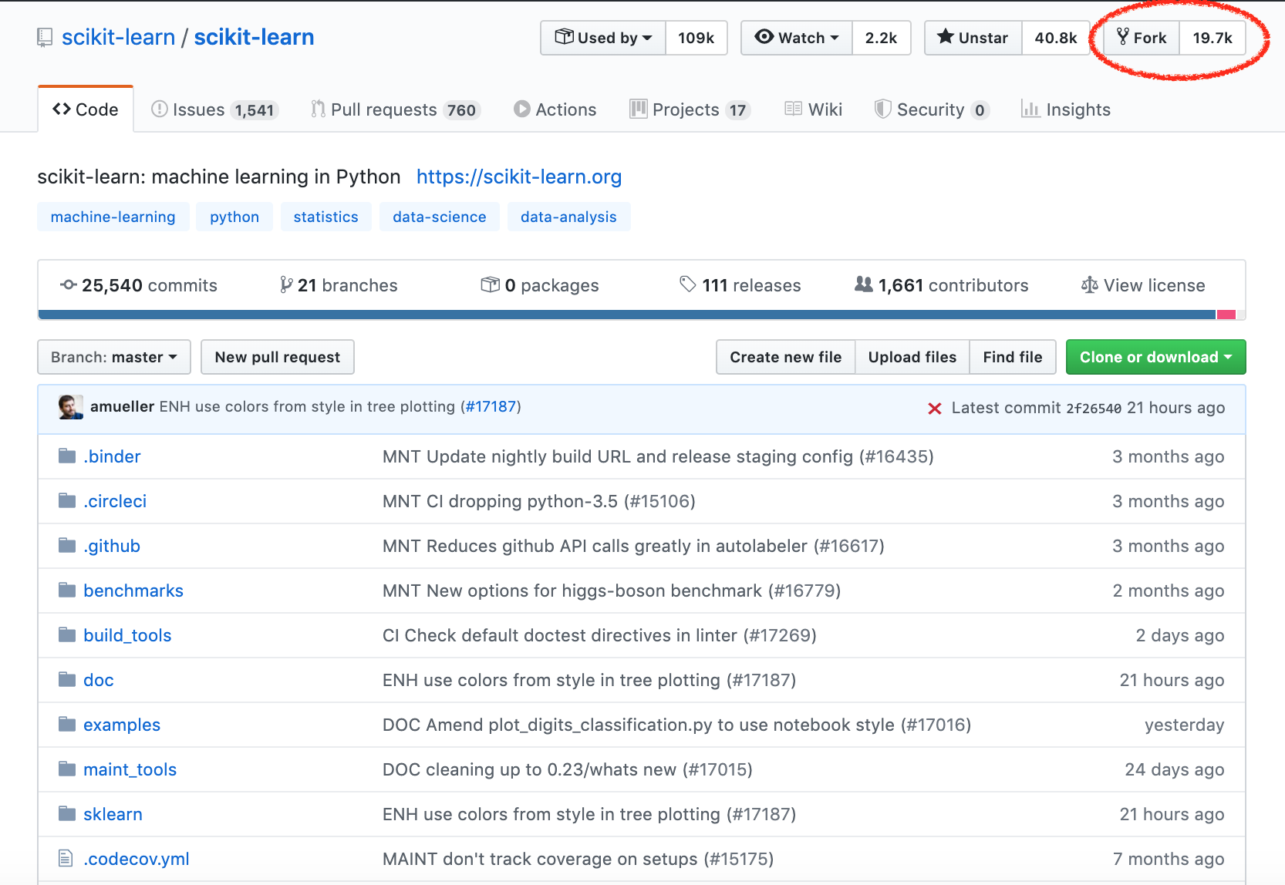
Fork sklearn on github
https://github.com/scikit-learn/scikit-learn

Slide 7
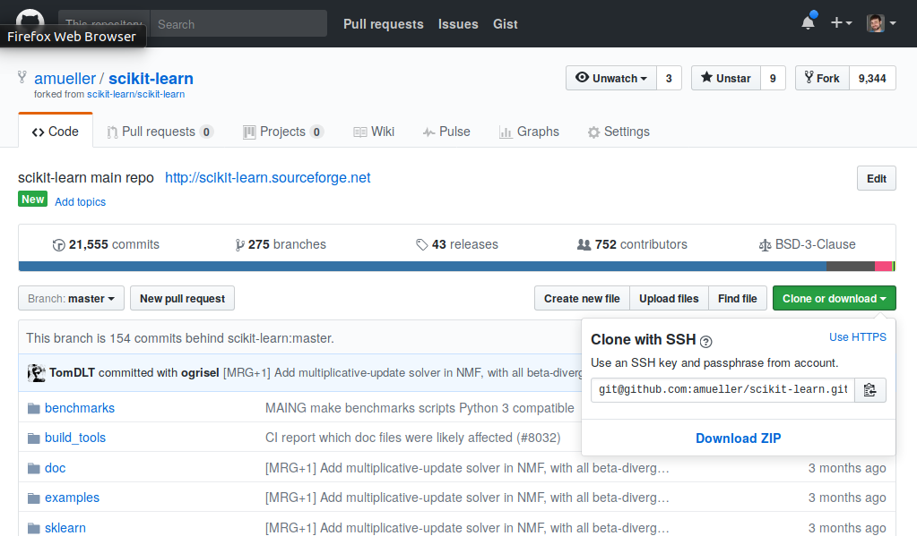
Clone the Fork
use https
If you don’t have ssh keys set up, use https!
Add main scikit-learn repo as remote called “upstream”:
git remote add upstream https://github.com/scikit-learn/scikit-learn.git

Slide 8
Build and run tests!
Easiest way:
cd scikit-learn
pip install -e .
Will overwrite existing installations!

Slide 9
Starting on Issues
Go to:
https://github.com/data-umbrella/2020-sklearn-sprint/projects/1
Comment on issue saying: “I'm working on this.”
Update local master branch from main sklearn repo
git pull upstream master
Fetching someone else’s PR:
git fetch https://github.com/theirusername/reponame.git theirbranch:ourbranch

Slide 10
Starting on Issues
Create feature branch
git checkout -b <branchname>
Commit changes to branch, run tests
pytest sklearn
(or individual test files)
Run flake8 on changed files

Slide 11
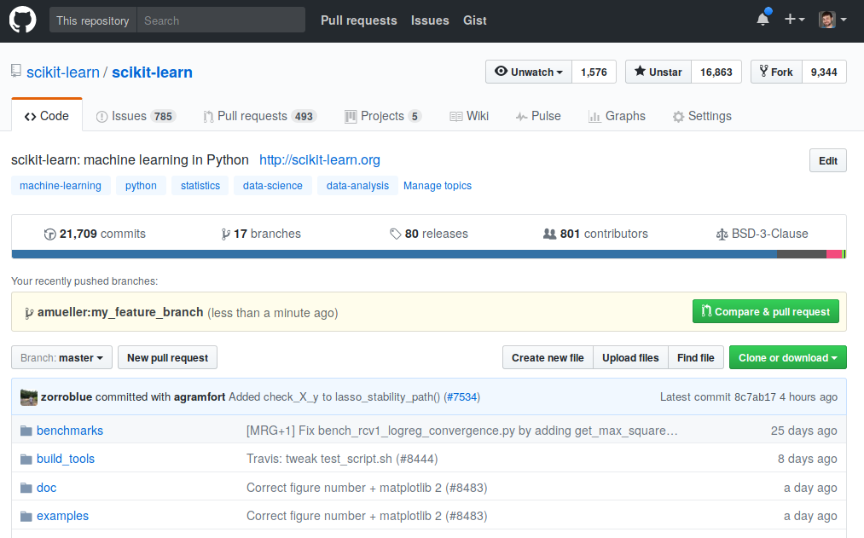
Creating a PR
Push changes to your fork
git push origin <branchname>
Create PR using GitHub UI:

Slide 12
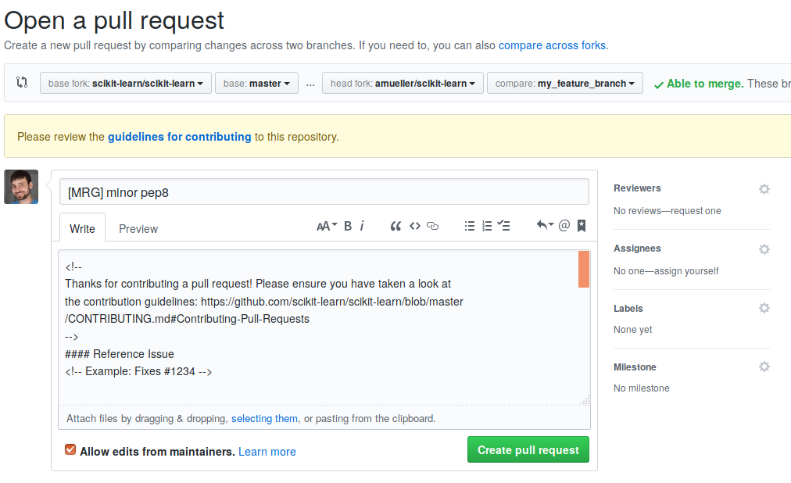
Describing PR
[WIP] = work in progress
[MRG] = ready to merge

Slide 13
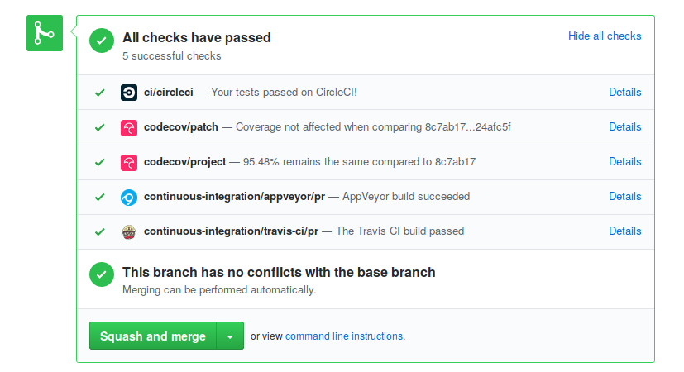
Regression tests
Are mandatory! For everything (except documentation changes)!
Make sure continuous integration passes:

Slide 14
What’s next?
Wait for reviews (be patient).
Address review comments in the same branch.
Pushing to your fork will update the PR.
Reviewers will “approve” PR or change title to [MRG + 1]
You need two approvals for a merge.

Slide 15
Finding Issues
Check “need contributor”, “easy” and “sprint” issues.
Something unclear in the docs? Fix it!
Can’t fix something that’s unclear? Open an issue!
Problem that you keep running into: Open an issue!
Find stalled PRs (the author didn’t address reviews for ~>1 month) and continue them!https://github.com/data-umbrella/2020-sklearn-sprint/projects/1

Slide 16
Reviewing
You can review PRs and issues!
Some bugs are not confirmed. See if you can confirm them and under what conditions?
You can review documentation PRs for language and whether they are clear to you.
You can review code changes on whether they address the issue (might be a bit tricky).
Don’t be afraid to ask clarifying questions!

Slide 17
Workflow Reminders
Why we do pair programming
Include @mention of other pair programmer in PR submission
Following up on work; expect a lot of back / forth, it's part of the process. It is worth the experience to see a PR through to the merge state!
Watch your GitHub notifications (especially for folks who use an alternative email address that is not checked often, or it gets filtered into a folder)
Policy of "abandoned / stalled PRs." Etiquette is to communicate status.

Slide 18
Final words
Pick something TRIVIALLY SIMPLE as the first contribution.
You can do the cool stuff afterwards!
There might be interesting issues that are not appropriately tagged.

Slide 19
Thank you for your help!
Enjoy!

