Slide 1


Data 422-19S2
Group Project
Neha Thakkar -51192498
Mrinal Jyoti Kumar - 96475046
Siddharth Rana – 45562544
Sudhanshu Kaushik - 75074054
https://github.com/data-wrangler19/myproject
Keybase

Slide 2

Abstract
In this project we are analyzing drug related deaths of US citizens.
There are different types of drugs that people are taking for many reasons such as:
Anxiety
Depression
Psychosis
Loneliness
The aim of the project is to show the death count of the drug addicted people.
Gender comparison for drug addiction.
Comparisons of the different age group of the people respect to drug addiction and their death.
We wrangle on the USA drug data set by using R and Julia programming language.

Slide 3
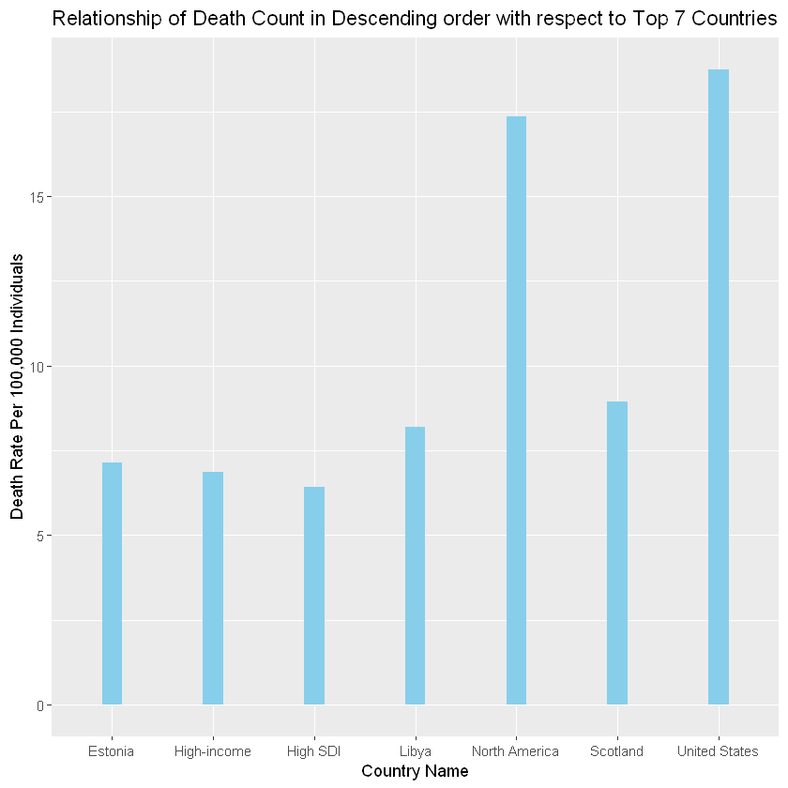

18.75 per 100,000 people
Drug deaths in USA in last decade
Highest drug consumption in USA

Slide 4

Packages used in the Project in different language (R and Julia)
R | Julia
tidyverse | queryverse
dplyr | VegaLite
ggplot2 | VegaDatasets
visdat | CSV, DataFrames, Query, Statistics, Dates

Slide 5

Cleaning of the data using R packages
At the first glance the data was untidy and it had missing values.
We have cleaned the data by using different libraries and packages.
We have deleted some of the unnecessary columns such as Injury city, injury country, injury state, manner of death, death city geo, residence city geo, injury city geo.
Some of the records were blank so we have deleted that particular columns to make it more feasible.

Slide 6

Reasons of Deleting the blank and other columns
Modeling the data with the goal of highlighting useful information.
For supporting the decision making power.
Reduction of misleading information.
Getting the meaningful output of the data.

Slide 7

Merging the dataset
It is useful to merge two datasets according to the value of one or more common (index) columns. This module allows you to merge two datasets, or, alternatively, update one dataset with the contents of another.
In this project we have merged the Zip code related data by using the common column which is Resident city in Parent dataset.
Merging the two dataset would be useful to analyse in the more discriptive way.

Slide 8

Pictorial View of the Data set using graphs
There are several graphs which contains the information about the drug related deaths in USA in last one decade. The list of graph we have used to represent the data which are as below.
Percentage of male and female death in US from 2012 till 2018
Different Age group and their death because of drug addiction
Various type of drugs and related deaths.
(4) Comparison between the residence state and death count.

Slide 9
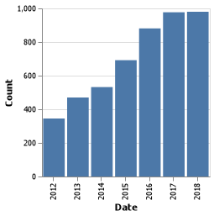
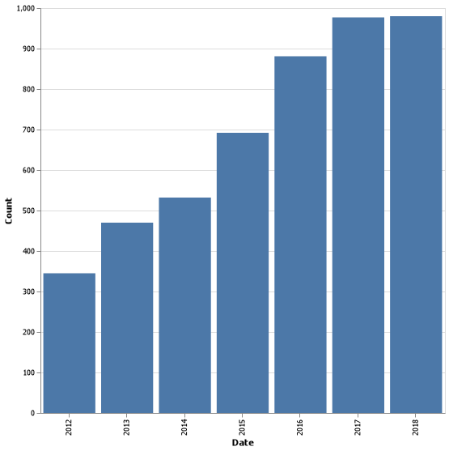
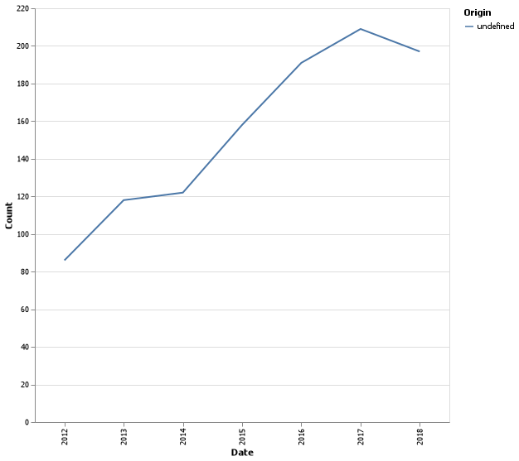
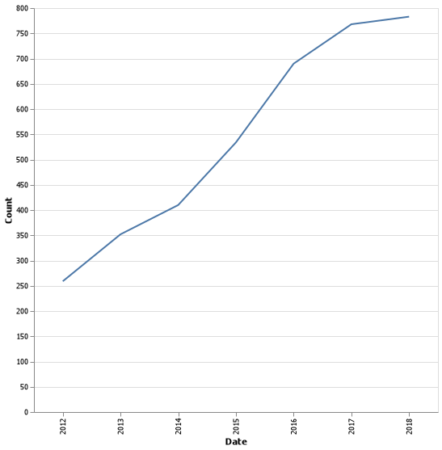
Different types of Graphs in Julia

Slide 10
Data Ethics

Slide 11
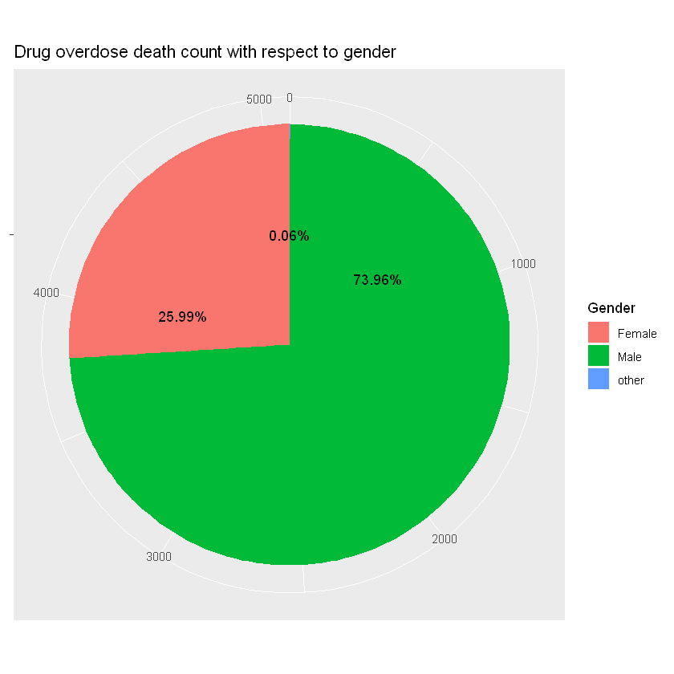
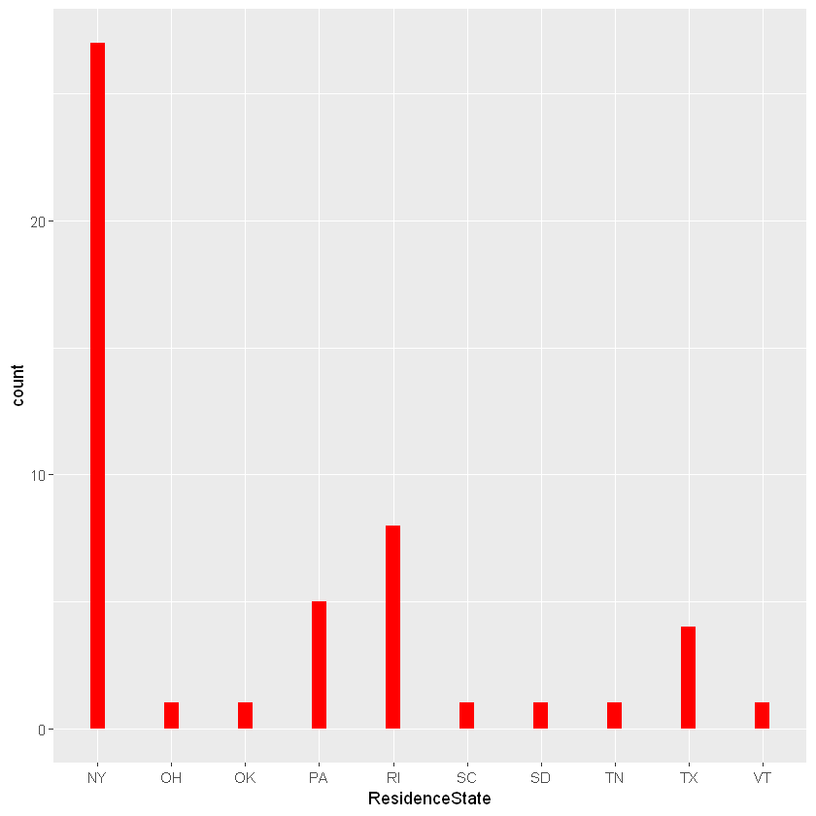

Slide 12
