Slide 1


Data 422 – Data Wrangling
Project Title:
DEATH RATE ANALYSIS IN USA DUE TO DRUG ADDICTION
Team Orion:
Neha Thakkar (51192498)
Mrinal Jyoti Kumar (96475046)
Siddharth Rana (45562544)
Sudhanshu Kaushik (75074054)
Repository Link:
https://github.com/data-wrangler19/myproject

Slide 2
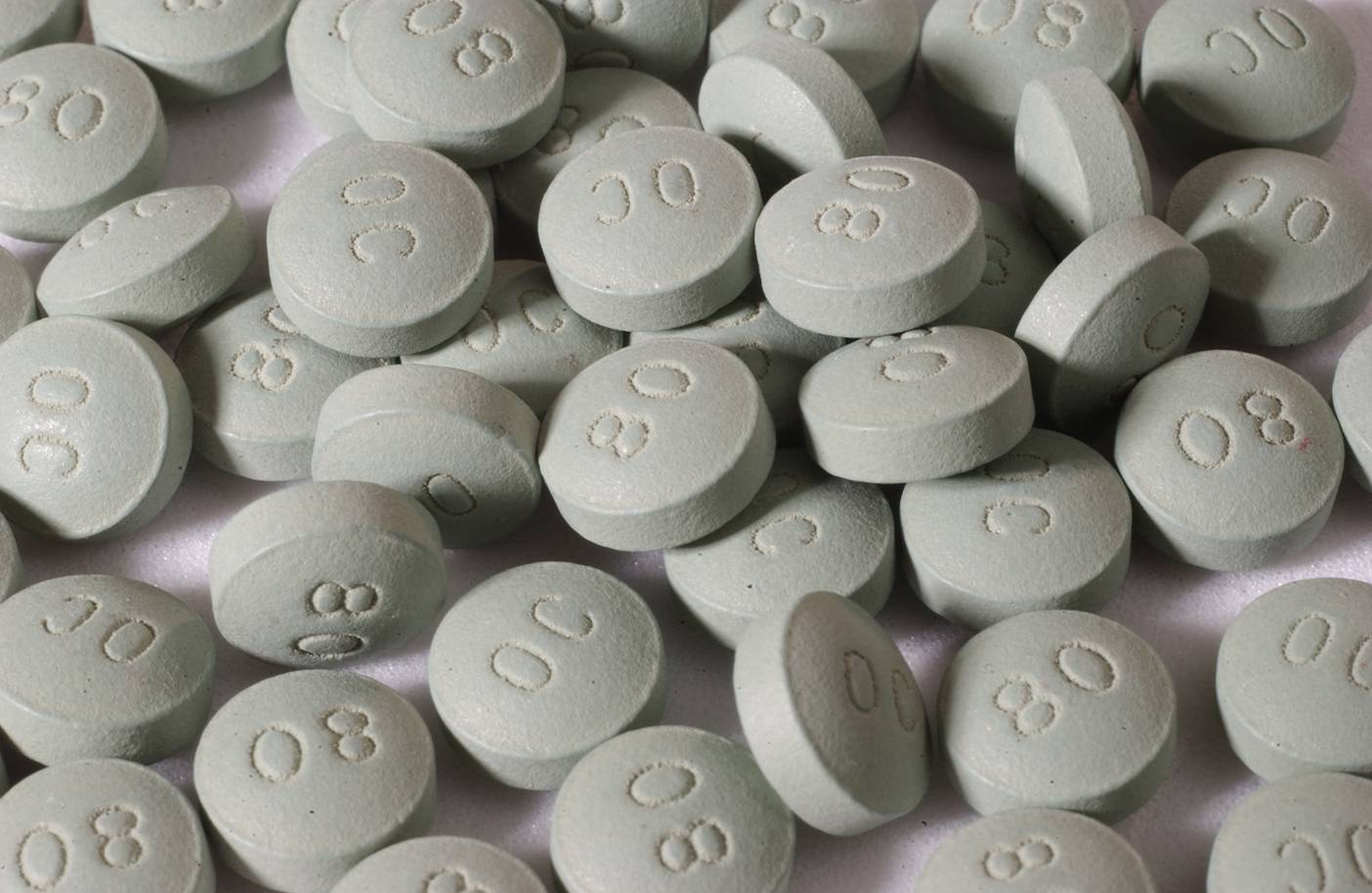
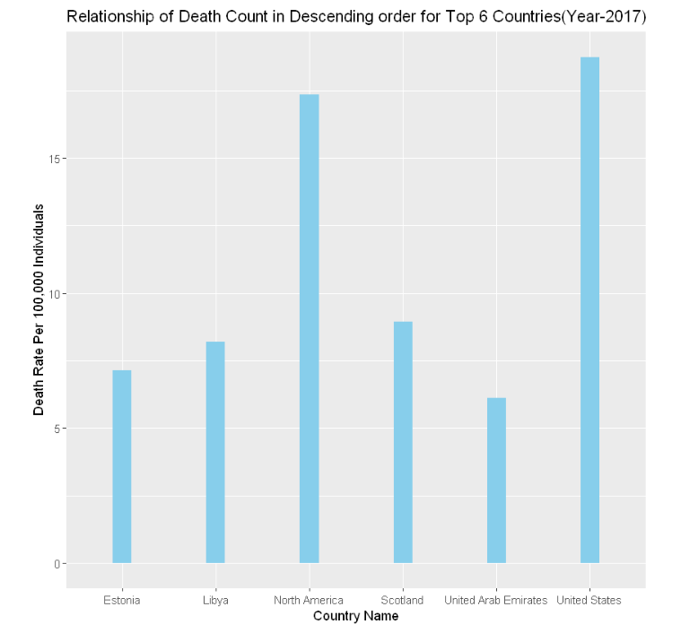
Death Rate In Descending Order Among All Countries
United States (USA)Tops the List
18.75 Death Per 100,000 Individuals(Death Rate)
Dataset Link: https://ourworldindata.org/drug-use

Slide 3

Project Abstract
Since USA tops the list in the highest death rate due to drug addiction as per the previous slide, hence in our project we are analyzing the death rate analysis in USA due to various types drug addiction.
The level of analysis has been performed on the basis of:
Gender
Age
Drug Type
Year
Place
We have two sections in our project:
Processing Section – Activities performed were Data Cleaning and Merging
Analysis Section – Activities performed were Data Visualization and Analyzed Comments
Dataset link: https://catalog.data.gov/dataset

Slide 4

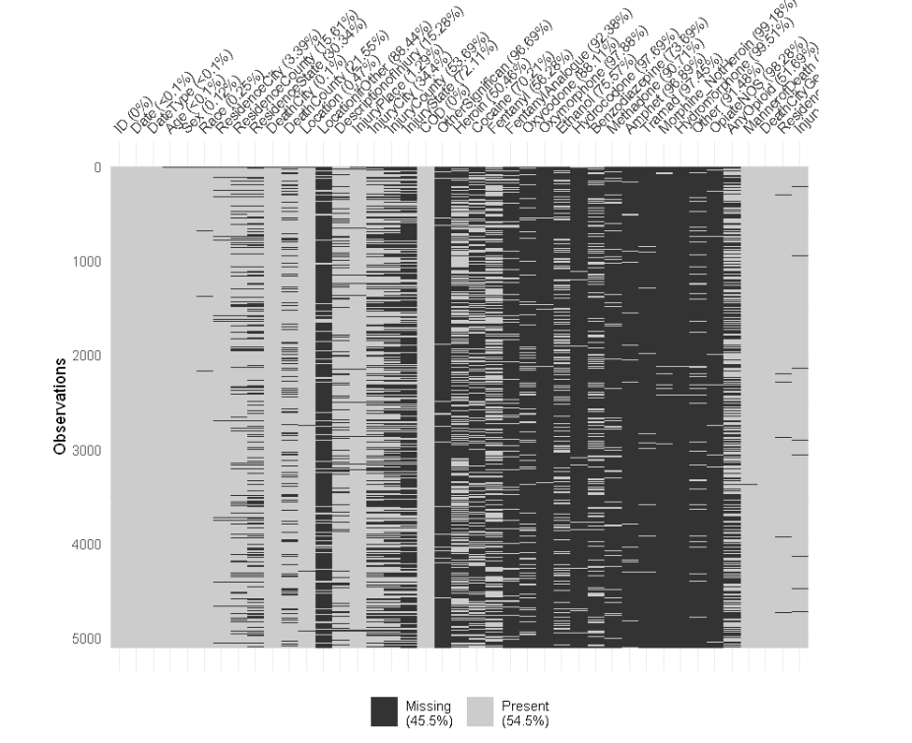

PROCESSING SECTION
A Glimpse Of Our Uncleaned Dataset…

Slide 5

PROCESSING SECTION
Strategies Implemented To Clean Our Uncleaned Dataset
Dropped few columns from our dataframe which are ‘ResidenceCounty’, ‘DeathCityGeo’, ‘ResidenceCityGeo’, ‘InjuryCityGeo’, ‘DeathCounty’, ‘InjuryCity’, ‘InjuryCounty’, ‘InjuryState’, ‘OtherSignifican’, ‘MannerofDeath’, ‘LocationifOther’. (These columns were not useful as part of our analysis).
Dropped some blank records for respective columns. (These records were very few in numbers, hence deleting those would not have impacted our analysis).
Replaced some records for respective columns with meaningful text. (These records were very few in numbers, hence modifying those would not have impacted our analysis).

Slide 6
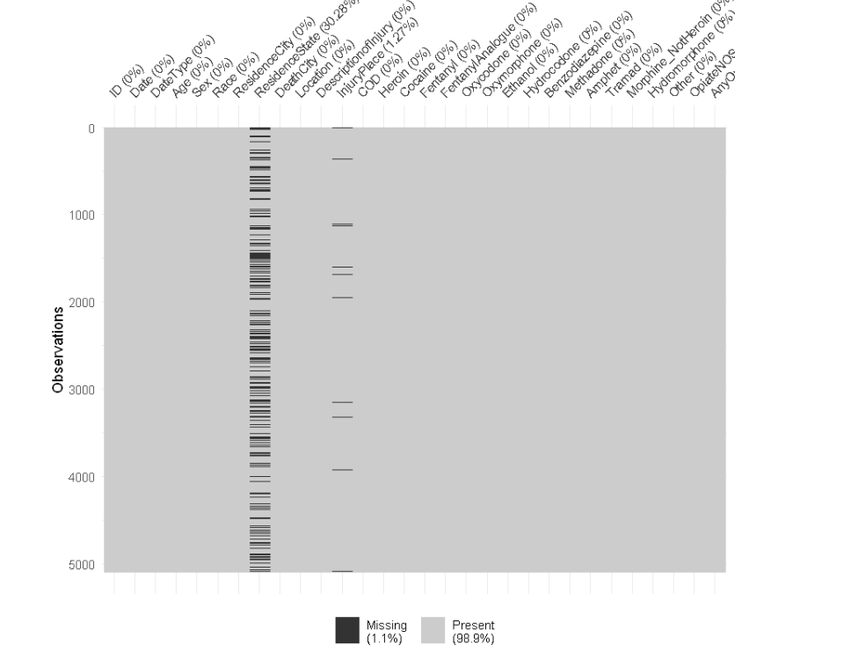

PROCESSING SECTION
A Glimpse Of Our Cleaned Dataset…
Rows: 5099; Columns: 36

Slide 7

PROCESSING SECTION
Merging The ZIPCode Dataset With The Cleaned Dataframe…
The zip code dataset consists of the zip codes details with respect to residence city names in USA. (The main intention was to show some relationship with respect to zipcodes in our dataframe object).
Merged the zip code dataset with the cleaned dataframe object using inner join to include a column with zip code for respective residence city names in USA.
Note: The “zipcode” .csv file is kind of a master data sheet file which was created manually
http://federalgovernmentzipcodes.us/download.html

Slide 8

ANALYSIS SECTION
The list of graph which we have used to analyze the data are:
Pie Chart – Death Count Percentage With Respect To Gender In USA
Bar Graph/Line Graph – Death Count With Respect To Different Age Groups In USA
Bar Graph - Death Count With Respect To Various Drugs Being Used In USA
Bar Graph – Death Count With Respect To Years
Bar Graph – Death Count With Respect To Residence State In USA
Bar Graph – Death Count With Respect To ZIPCode In USA For Highest Deaths

Slide 9
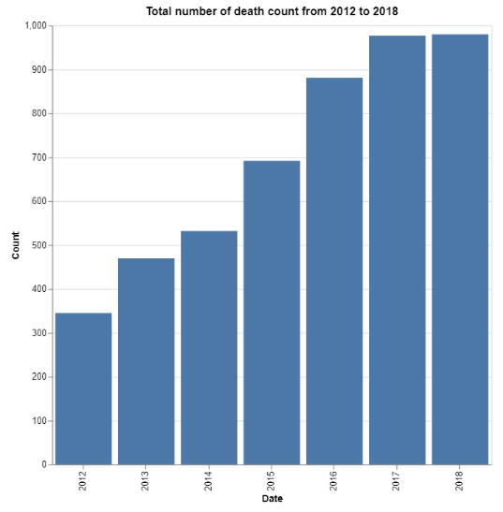
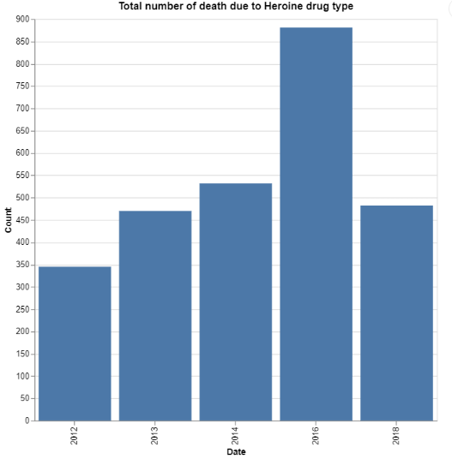
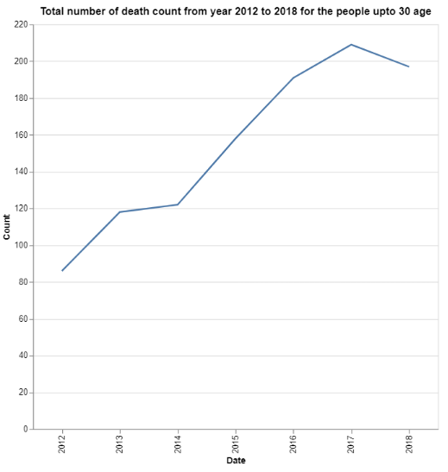
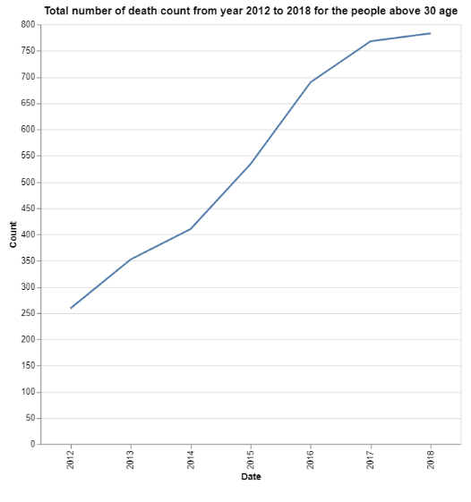
Data Visualization Using Julia…
ANALYSIS SECTION

Slide 10
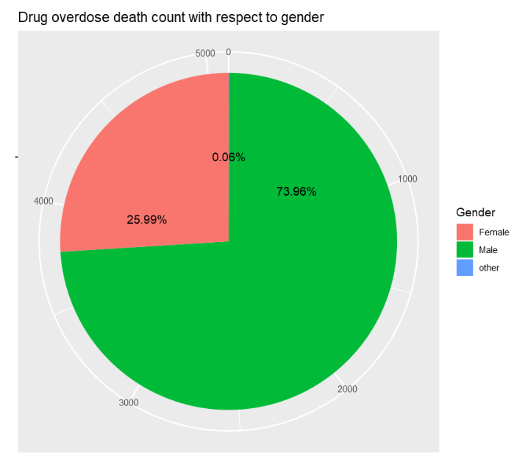
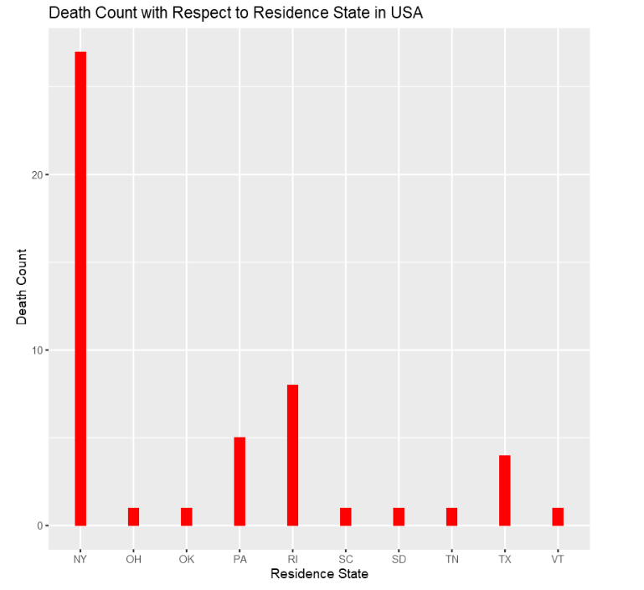
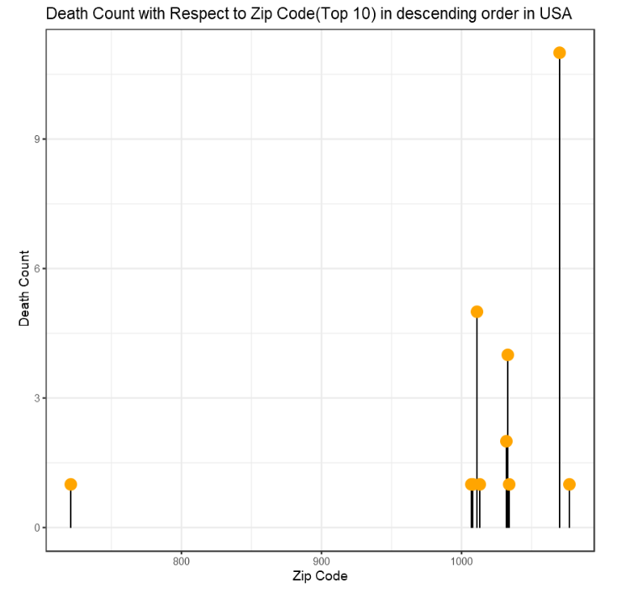
ANALYSIS SECTION
Data Visualization Using R…

Slide 11
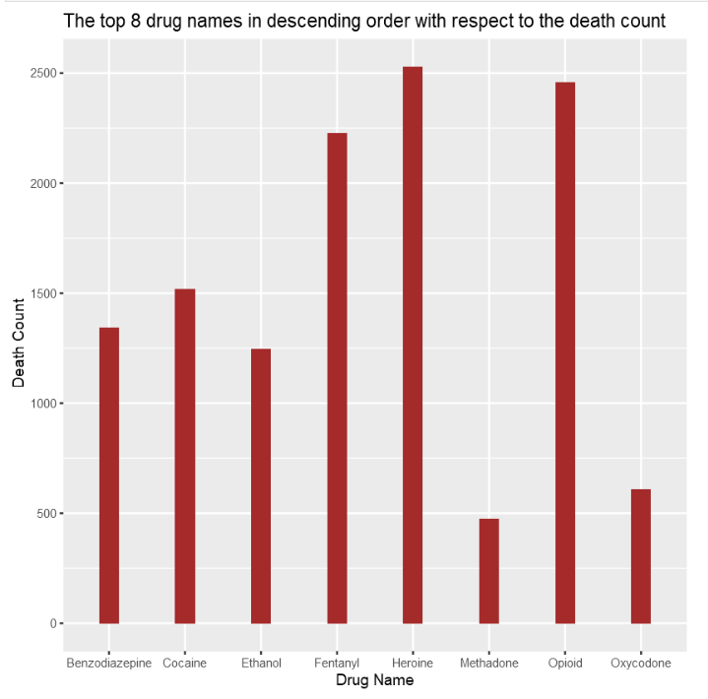
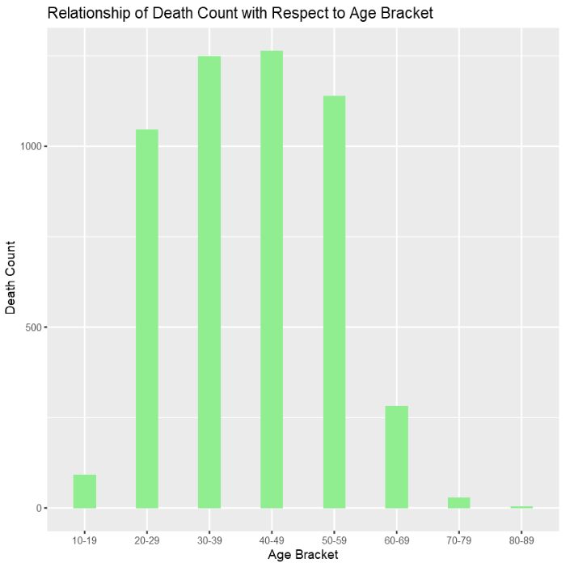

ANALYSIS SECTION
Some More Data Visualization Using R…

Slide 12
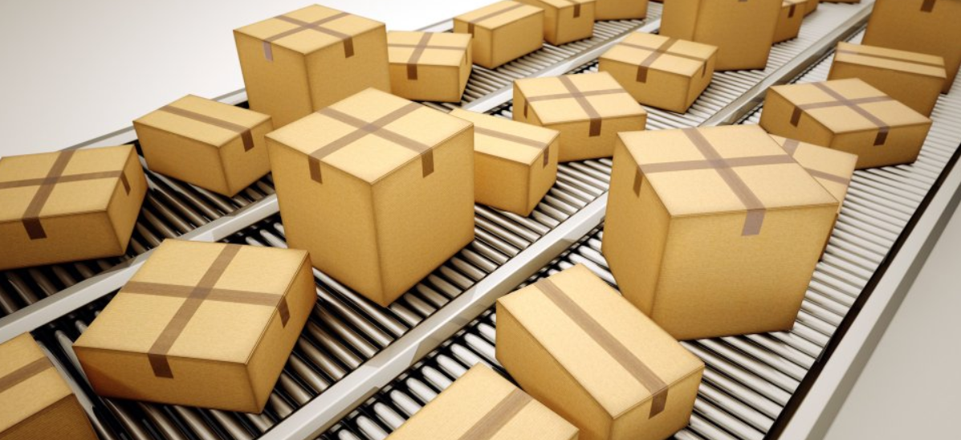
Libraries Used Throughout The Project
R | Julia
tidyverse | Queryverse
dplyr | VegaLite, VegaDatasets
ggplot2 | dataFrames, query
visdat, skimr, rvest | statistics, dates

Slide 13

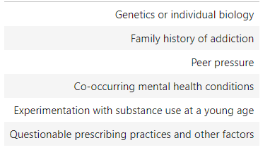
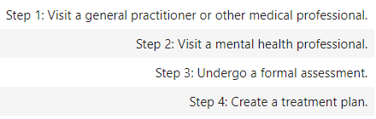
Summary Analysis
Male population have more death count compared to the females due to drug addiction in USA
People with age group greater than 30 years are more into drug addiction (40-49 age group is the most vulnerable)
‘Heroine’ is the most commonly used drug in USA
New York State has more cases of drug addiction compared to other states in USA
The usage of drugs have been increasing every year i.e. people are getting more addicted irrespective of the consequences
Most Common Reasons of Drug Addiction
Most Common Treatment for Drug Addiction

Slide 14


