Slide 1
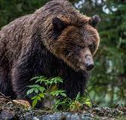
Grizzly Bear Mortality in BC
Ty Schultz and Adam Shippit
Data 301 Group 55

Slide 2
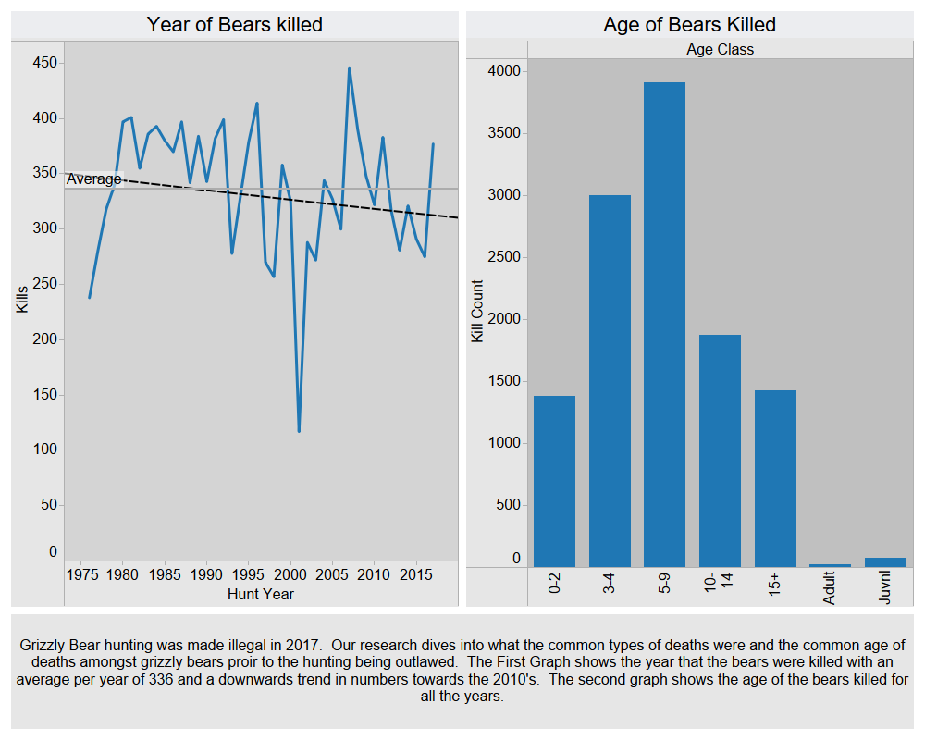

Slide 3
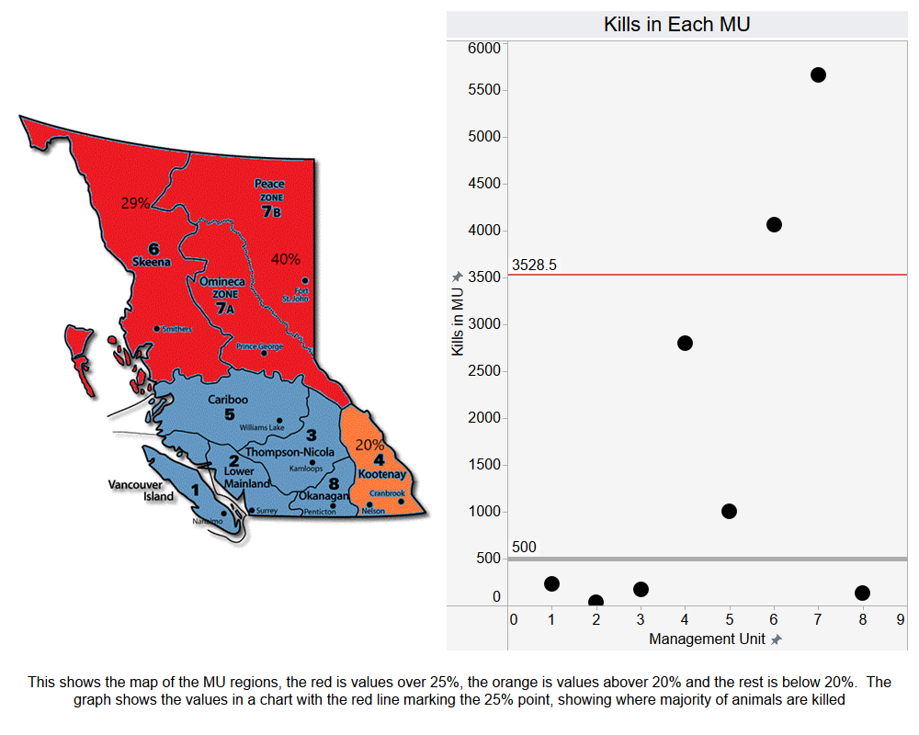

Slide 4
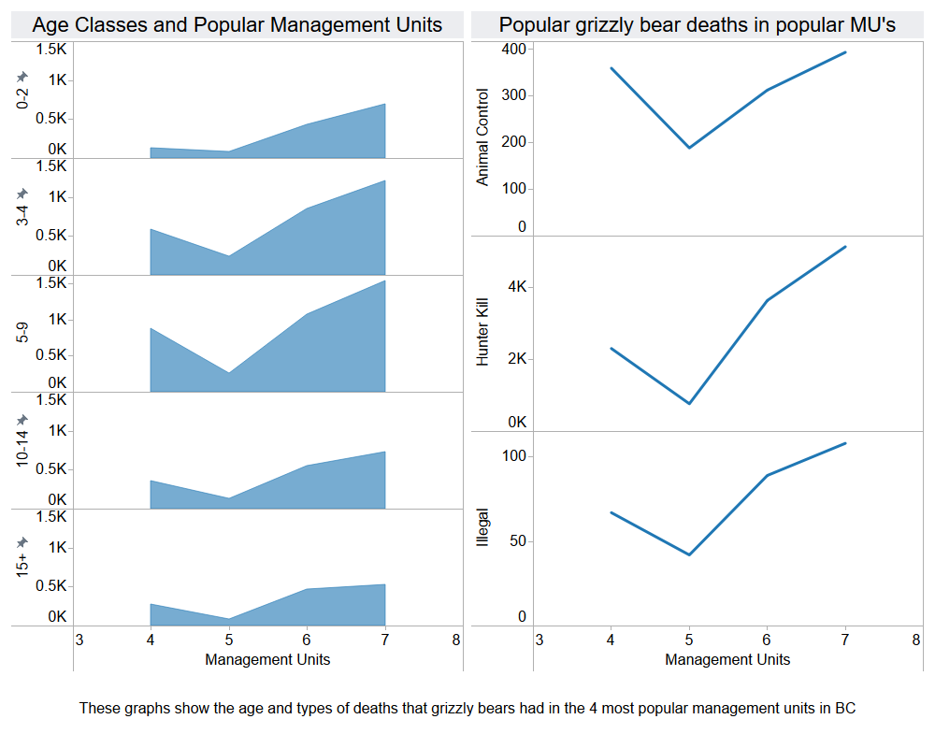

Slide 5
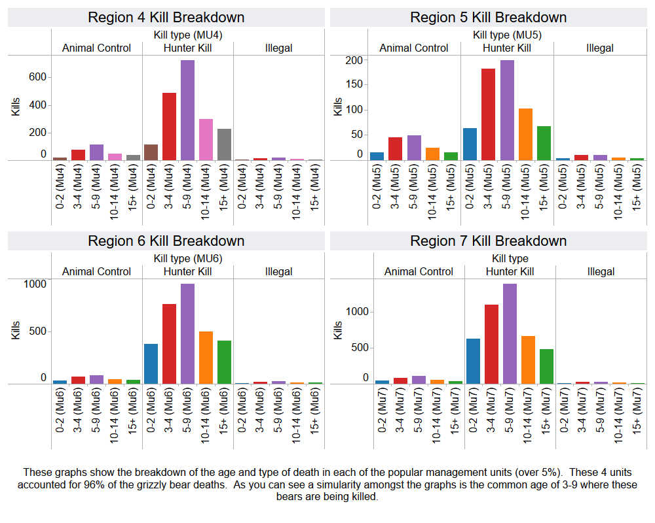

Slide 6
