Slide 1
d4k Microservice Architecture
Small steps, big effect
18th August 2022

Slide 2
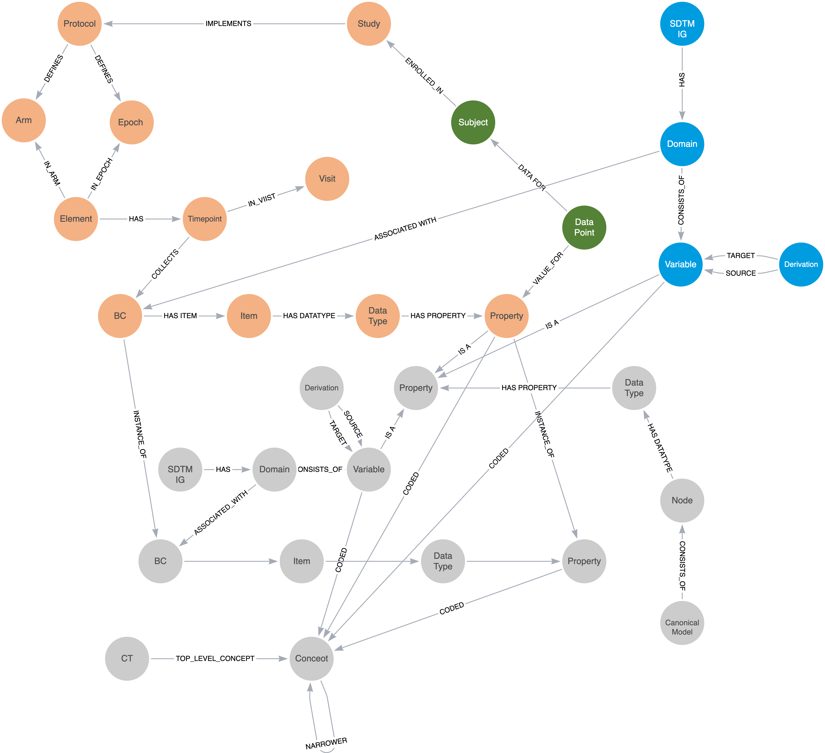

From Silos To Knowledge
2
Study Design & Configuration
Solid Foundation
A well defined set of definitions sourced from the CDISC library and elsewhere combined with a Biomedical Concept (BC) library. BCs are a unit of knowledge, pre-defined and bound to terminology that are ready to be linked into studies. The BCs provides reusable components that bring data consistency across study builds and data collection and thus subsequent processing. The BCs protect our study data against future capture technology change.
Study Build
Combining the power of a study design model, e.g. the TransCelerate Digital Data Flow (DDF) Study Design Model, and BCs allows for complete and well structured machine-readable study designs to be constructed. The combination provides for a precise study data contract that benefits the data collection process. It also allows for study artefacts such as define.xml and study annotated CRFs to be produced in an automated manner prior to a single data point being captured.
1
CDISC Library +
And We Gain …
Other desired outputs such as OMOP can be produced (queried) from the same graph. We achieve a repository of searchable “studies”, both the metadata and the data, all linked.
Old studies can be imported and brought back to life to prevent data decay and the model will allow for translations between SDTM versions. Multiple studies can be held together and thus searched and queried. We achieve our goal of better data: better data quality (from the BCs being more precise) and better data utility (from the linking into a single graph and access to the study design).
3
2
5
Data
Data Utility
Import Data
Data can be imported from a variety of sources in a range of formats including tabular (e.g. lab) formats and from other sources such as HL7 FHIR (RWE). The use of a ”translation” model (the canonical model) allows for a variety of input sources to be accommodated.
Automate SDTM
A precise and well structured study design linked to the subject data via BCs provides for a complete study graph from which SDTM can be queried and the datasets produced. Edge cases and supplemental qualifiers need consideration but the BC design allows for such flexibility.
4
1
SDTM Export

Slide 3

High Level Architecture
Micro Services Architecture
A series of cooperating micro services each task with a focused area of functionality. A set of services can be deployed to meet a given business need.
See the paper: Towards Collaboration, Dave Iberson-Hurst, 2021
SDTM Export
Study Data Recommendation Engine
Study
Definition & Data
Study
Data
Loader
OMOP Export
CT
BCs
Forms
SDTM
User Interface
DL
DL
DL
Data Loader
DL
CDISC API
DL

Slide 4
Key Areas
Study
The study, its design and its data, all linked providing the source of knowledge
Data Import
Ability to import data into a study using as much automation as possible allowing current and legacy data to be imported.
SDTM Export
Study Data Recommendation Engine
Study
Definition & Data
Study
Data
Loader
OMOP Export
Data Export
Take study data and transform into key business output
CT
BCs
Forms
SDTM
User Interface
DL
DL
Solid Foundation (Definitions)
Definition services that provide key definitions and the management thereof. Equivalent to what is seen currently as an “MDR”
DL
Data Loader
DL
CDISC API
DL

Slide 5
IDDO Use Case
SDTM Export
Study Data Recommendation Engine
Study
Definition & Data
Study
Data
Loader
OMOP Export
IDDO
The services needed to meet the business requirements of IDDO
CT
BCs
Forms
SDTM
User Interface
DL
DL
DL
Data Loader
DL
CDISC API
DL

Slide 6
Study Build Use Case
SDTM Export
Study Data Recommendation Engine
Study
Definition & Data
Study
Data
Loader
OMOP Export
Study Build
The services needed to build a study
CT
BCs
Forms
SDTM
User Interface
DL
DL
DL
Data Loader
DL
CDISC API
DL

Slide 7
Sponsor CT Use Case
SDTM Export
Study Data Recommendation Engine
Study
Definition & Data
Study
Data
Loader
OMOP Export
CT Management
Most basic need, the need to manage Controlled Terminology
CT
BCs
Forms
SDTM
User Interface
DL
DL
DL
Data Loader
DL
CDISC API
DL

Slide 8
Current Status
SDTM Export
Study Data Recommendation Engine
Study
Definition & Data
Study
Data
Loader
OMOP Export
BCs
Work starting
Forms
Work starting
CT
Basic version running
CT
BCs
Forms
SDTM
User Interface
DL
DL
DL
Data Loader
DL
CDISC API
DL

Slide 9

Technology Stack
Jupyter Notebook
R Shiny
Javascript
Simple UI
Simple UI that can be provided free
Complex UI
Paid for
Micro
Service
Python & FastAPI
Common micro service
Neo4j

