Slide 1
Final Presentation
Kathis Part

Slide 2
Agenda
Target & Organization
Semester 1
Semester 2
Projektmanagement
Technologies
Django Frontend
Mockup
View Implementation
Prediction Daily Base
Data presentation
Algorithms & evaluation
Additional Features

Slide 3
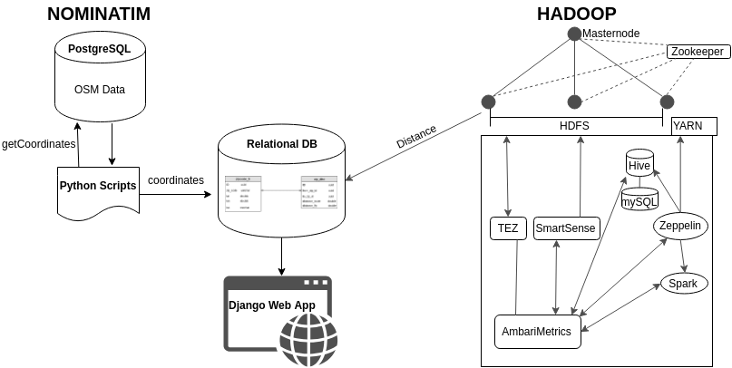
Target & Organisation Semester 1
Data Engineering
Virtual Infrastructure

Slide 4
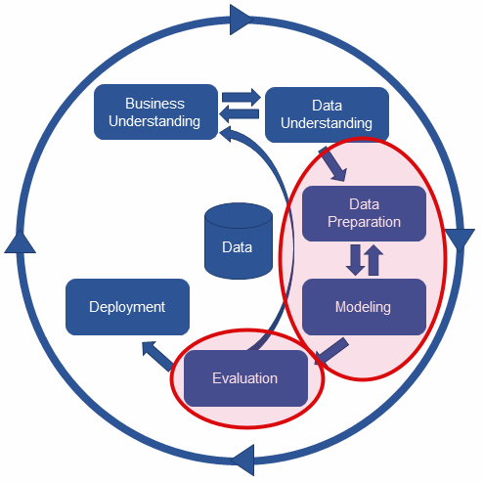
Target & Organisation Semester 2
Reference: https://www.kdnuggets.com/2017/01/four-problems-crisp-dm-fix.html

Slide 5
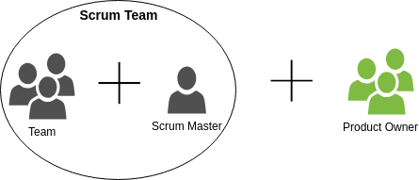
Target & Organisation Project Management
Release:
10 Sprints, Start: 02.11.2018 End: 04.07.2019

Slide 6




Target & Organisation Technologies
IceScrum: Project Management in an agile manner
Box: Share Documents (Dailies, working hours, documentation, …)
GitHub: Collaboration, Version Control
Skype: Daily Scrums

Slide 7
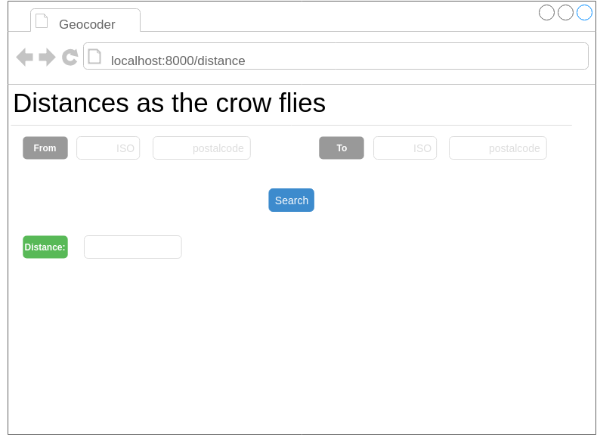
Django Frontend Mockup

Slide 8
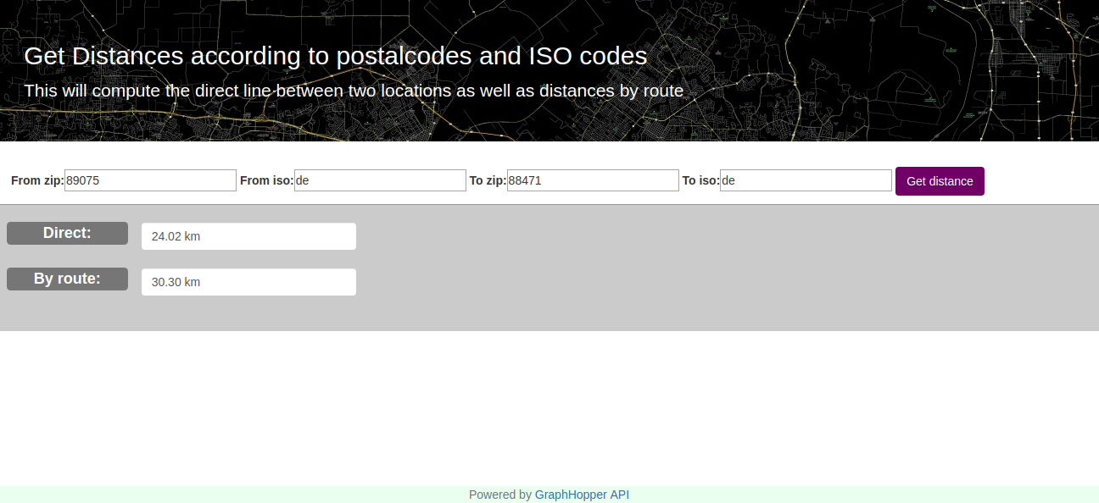
Django Frontend Implementation View

Slide 9
Presentation of data
MOST USED STATION: (name...)
Data on 1514 day
13 features + target
LEAST USED STATION: (name...)
Data on 145 day
13 features + target

Slide 10
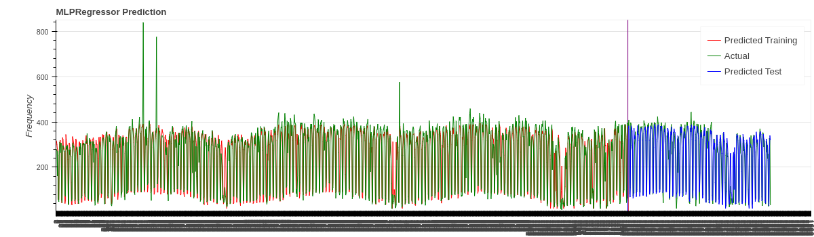
Prediction Daily Base MLPRegressor (Scikit-Learn)
13 Features -> Target Variable: Rented Bikes Future
Encoding of Data
Normalization

Slide 11
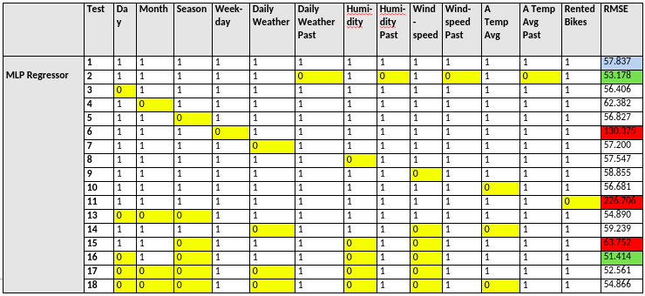
Prediction Daily Base Feature Evaluation
-> Weekday, Month, Past Data, Apparent Temperature (Avg), Daily Weather and Rented Bikes

Slide 12
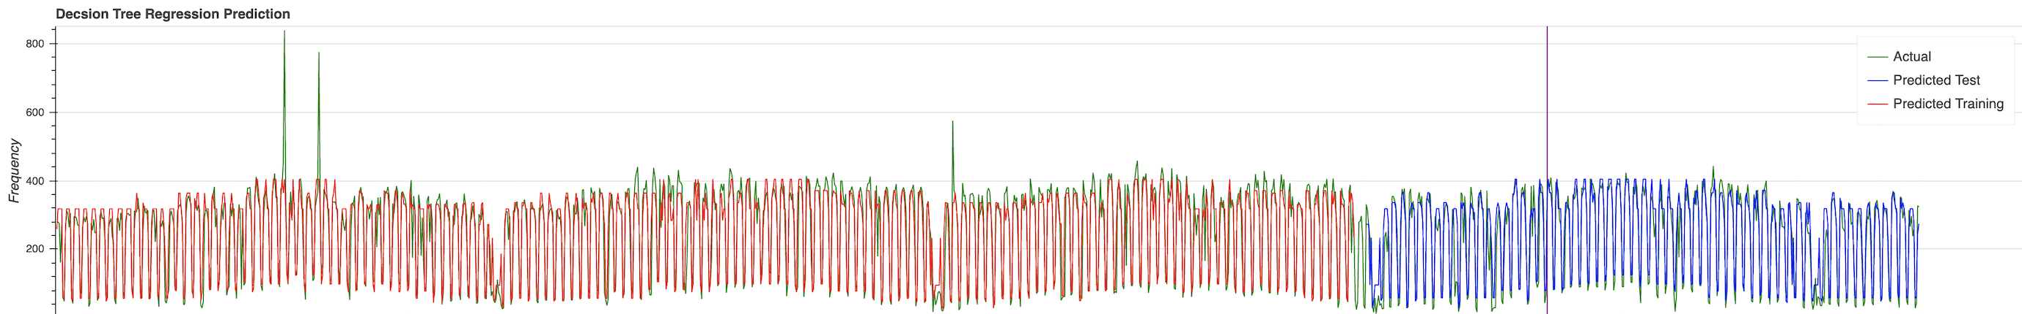
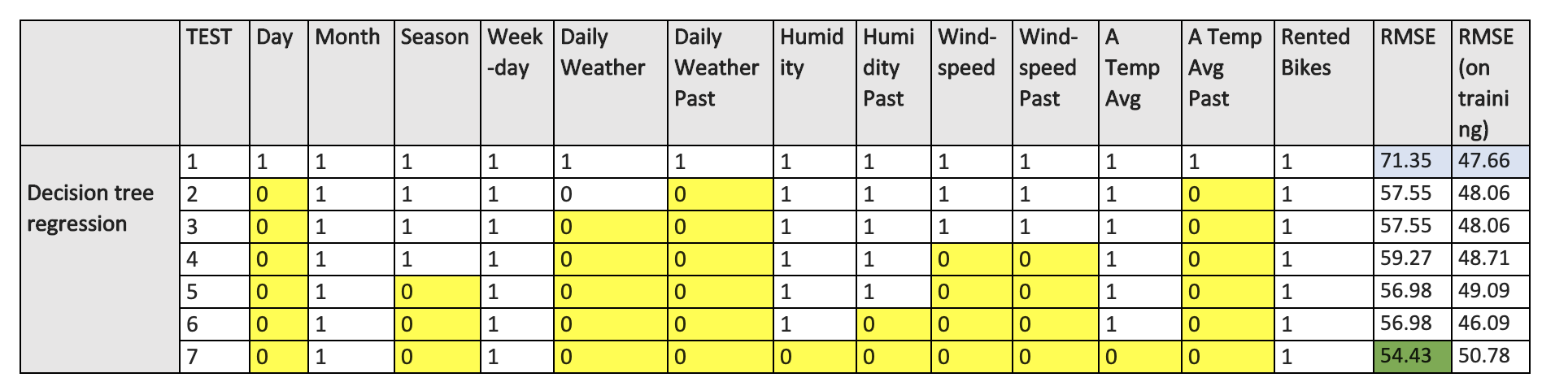
DECISION TREE REGRESSION

Slide 13
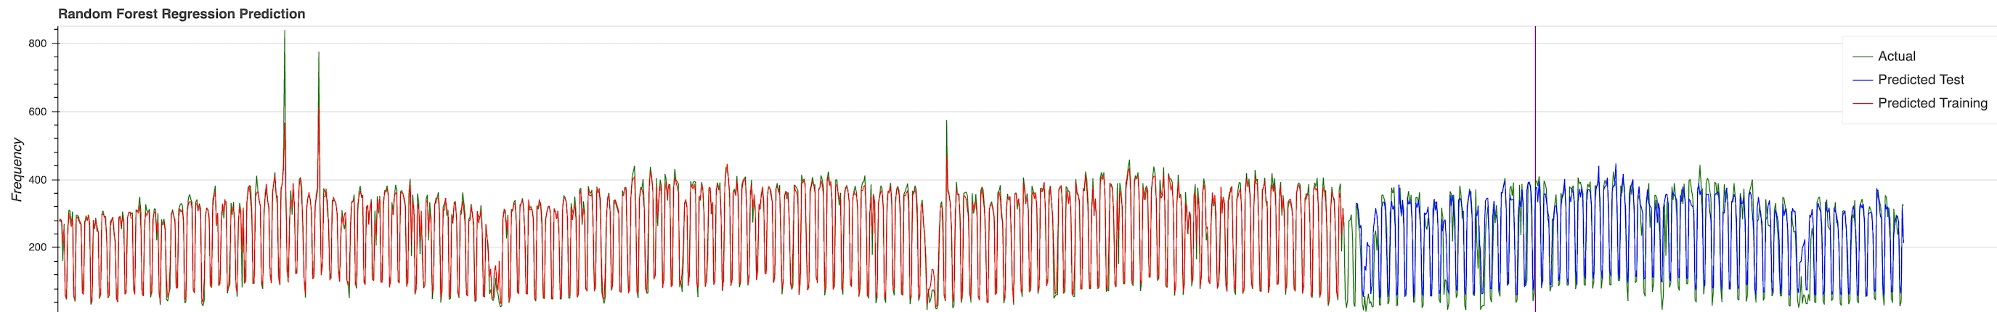
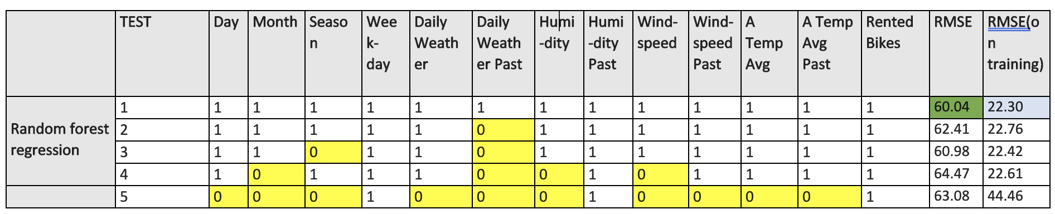
RANDOM FOREST REGRESSION

Slide 14
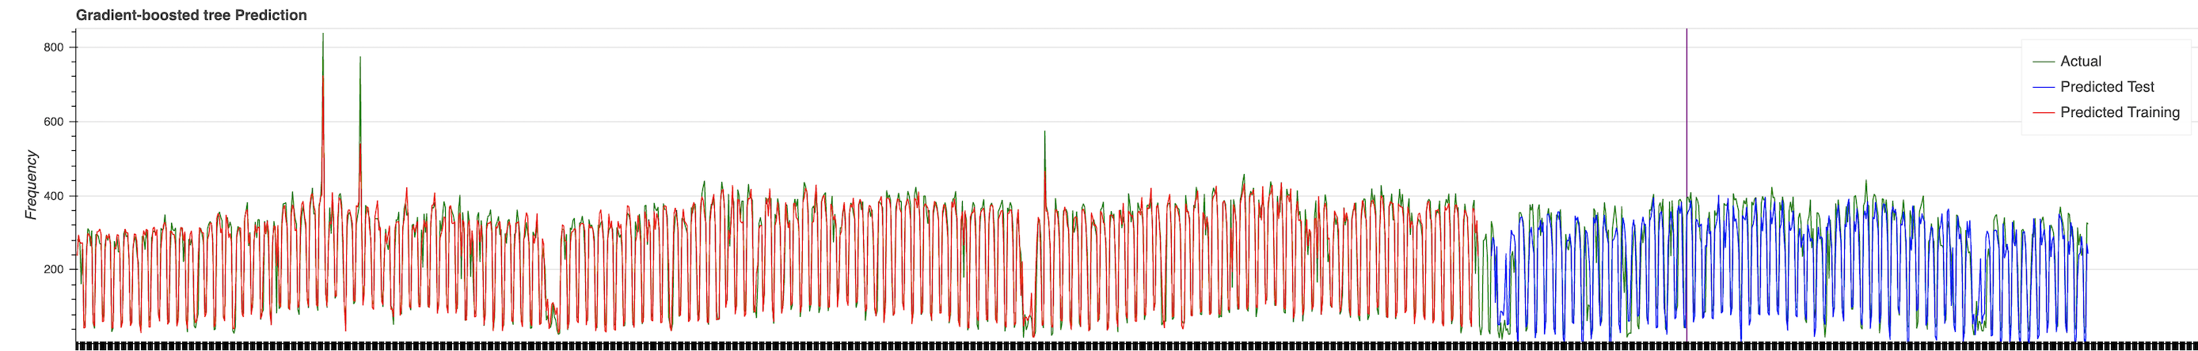
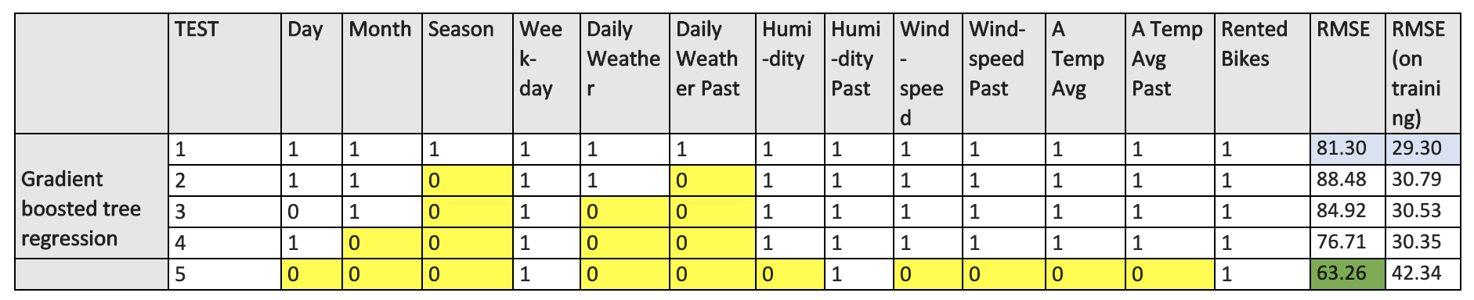
GRADIENT BOOSTED TREE REGRESSION ​

Slide 15
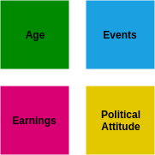
Additional Features
Office for National Statistics
London Datastore
LondonTown.com (Scraped Data)

