Slide 1
Final Presentation
Pascal Part

Slide 2
Agenda
Hadoop Evaluation & Setup
Data Profiling
Prediction Hourly Base

Slide 3
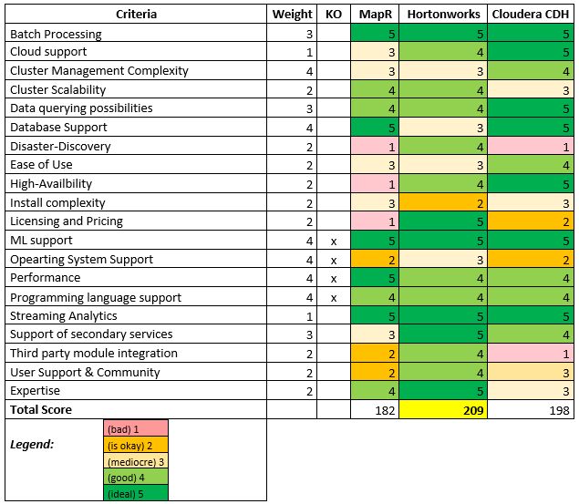
Hadoop Evaluation (Semester 1)
Table 1: Hadoop Comparison Matrix

Slide 4
Hadoop Evaluation (Semester 1)
Figure 1: Spider Chart Hadoop Comparison

Slide 5
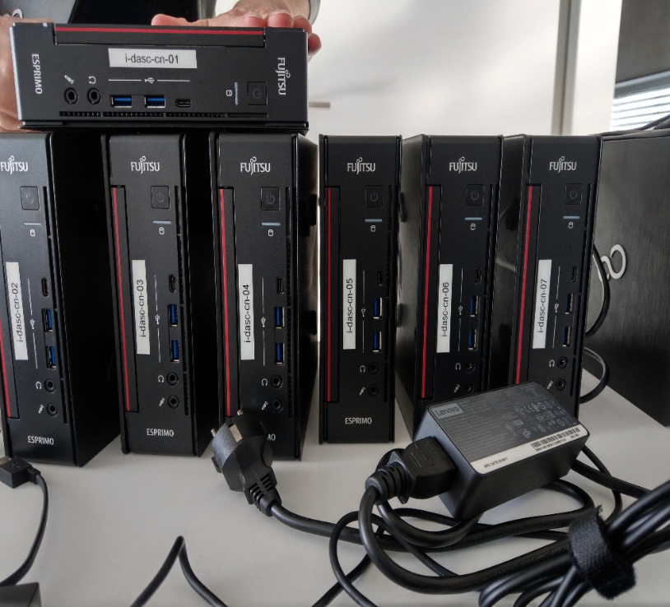
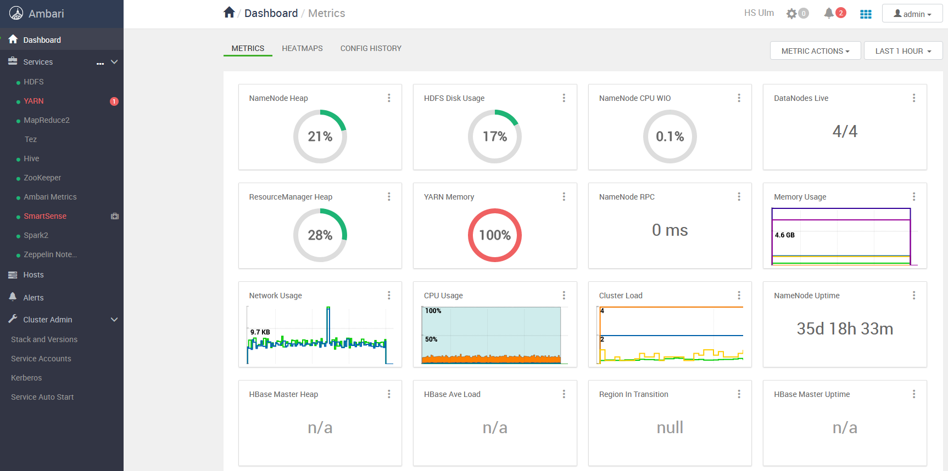
Hadoop Setup (Semester 2)
Semester 1: Test-setup of HDP + Ambari on VMs.
Semester 2: Rollout of Hadoop on physical cluster.
Figure 2: Ambari Surface
Figure 3: Physical Nodes

Slide 6
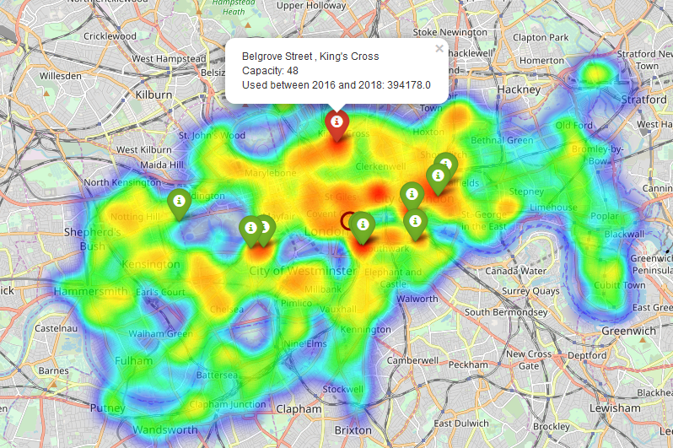
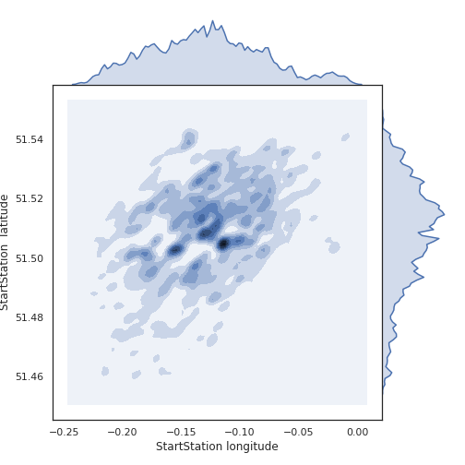
Data Profiling
Getting overview of TfL cycle data
Figure 4: Frequency of used StartStations and EndStations
Figure 5: Frequency of used StartStations and EndStations

Slide 7
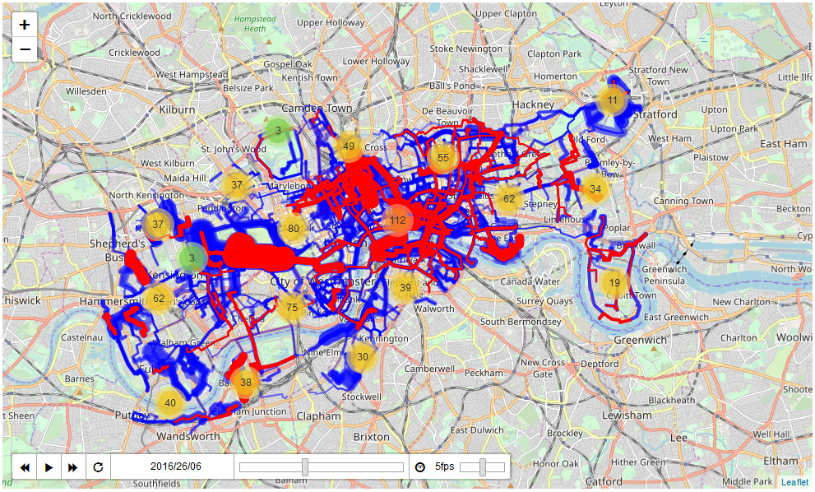
Data Profiling 2
Usage of cycling route between stations over time
Figure 6: Used bicycle routes over time plot

Slide 8
Prediction Hourly Base
Prediction of cycling usage on hourly base
Getting Weather Data (DarkSky API)
Prepare cycling and weather data on a hourly granularity
Apply MLPRegressor on prepared data
Data Preparation
Modelling

Slide 9
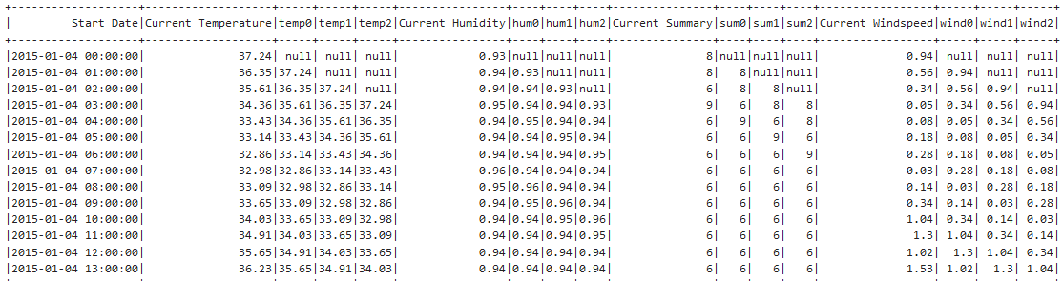
Prediction Hourly Base - Preparation
Prepare data on hourly base → sliding window.
Figure 7: Sliding window of weather data

Slide 10
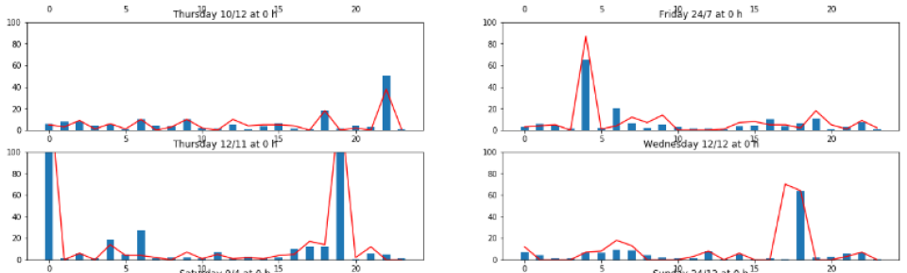
Prediction Hourly Base - Modeling
Apply the MLP Regressor
Figure 8: Prediction of usage next 24 hours

