Slide 1
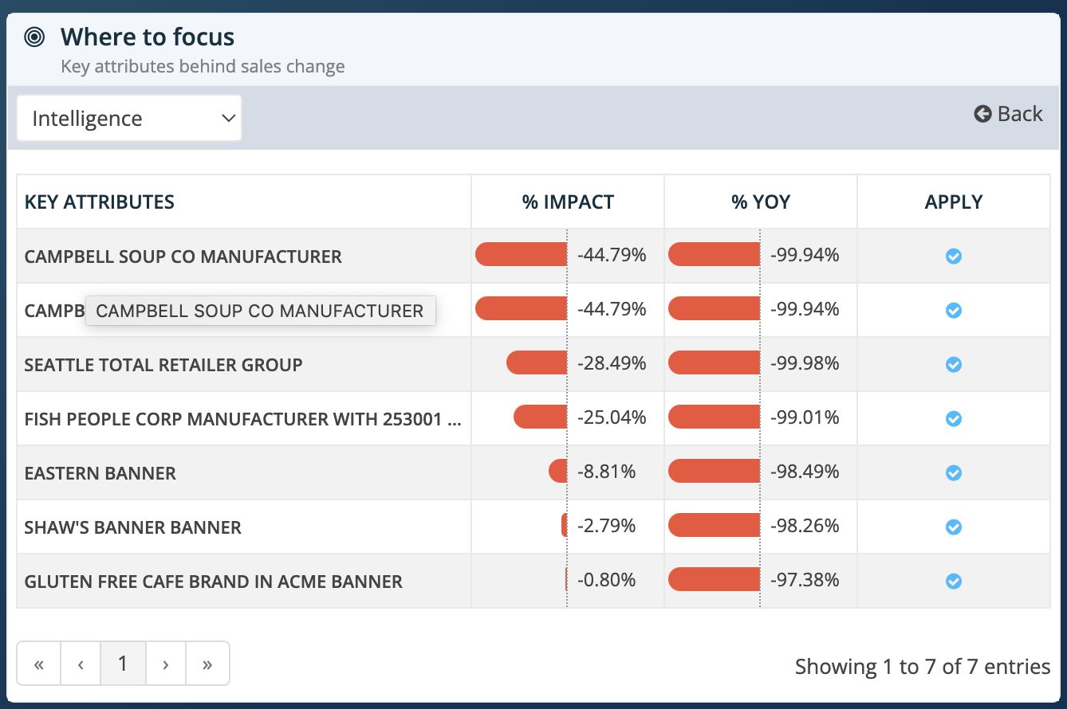
CURRENT

Slide 2
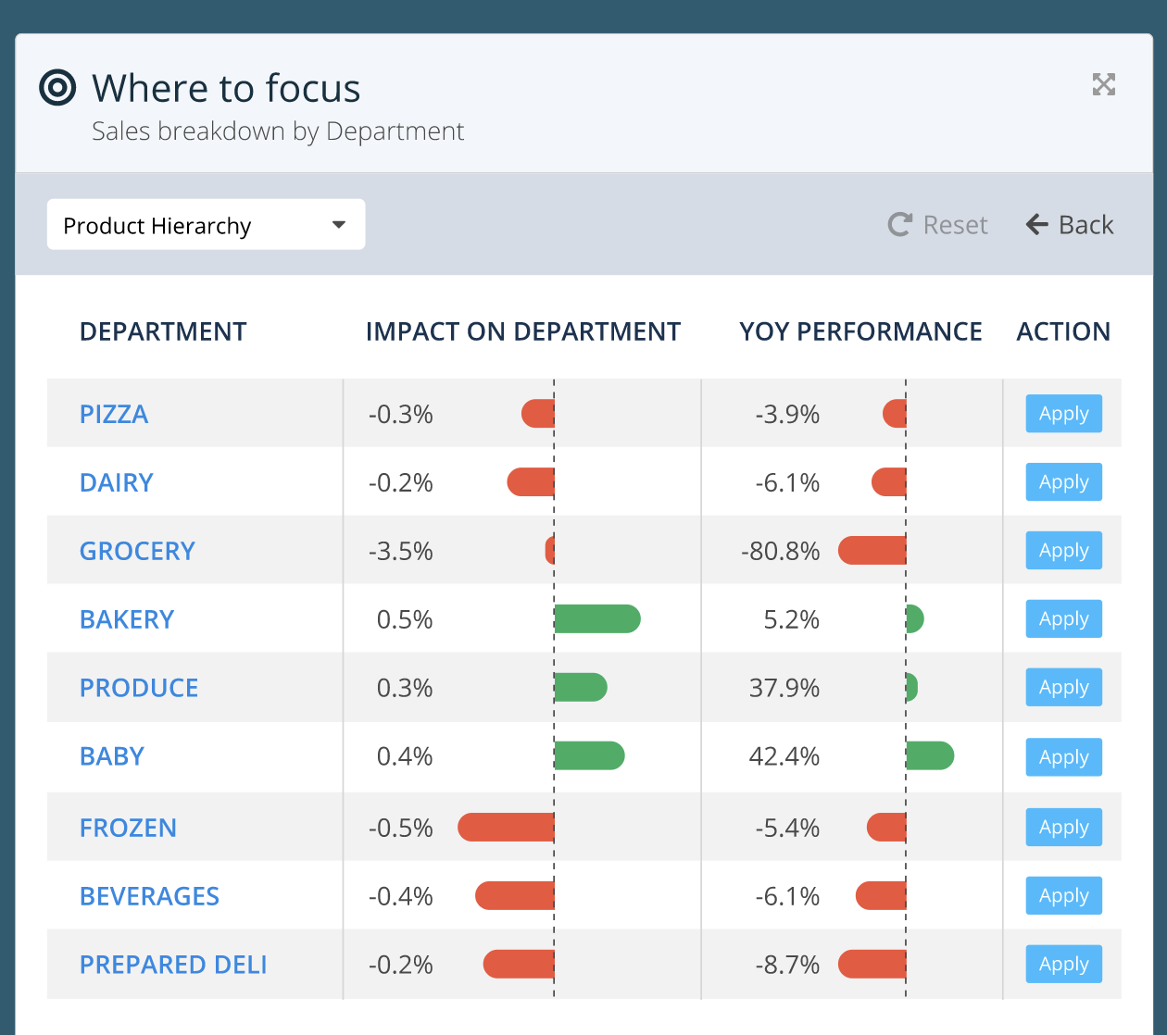
Suggested design

Slide 3
+ tooltip when hovering over Apply Button
Add to scope

Slide 4
Change column label to “REFINE SCOPE”
REFINE
SCOPE

Slide 5
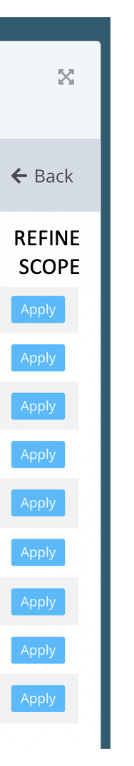


Change “Apply” to “Add to scope”
Add to scope
Add to scope
Add to scope
Add to scope
Add to scope
Add to scope
Add to scope
Add to scope
Add to scope

