Slide 1




Department of Information and Computer Science
KGE 2025 – Project Report
Knowledge Graph of
Mongolian Cinema
TEAM-1
© 2025 National University of Mongolia
Ulaanbaatar, Mongolia

Slide 2





TEAM-1 Member
Project manager and Doman expert
Sainbuyan L.
Knowledge engineer
Altangerel N.
Data sceintist
Munkhnaran B.

Slide 3




Contents
PHASE 1-PURPOSE DEFINITION
Personas
Scenarios
Concept identification
PHASE 2 - Information gathering
PHASE 3 - Language definition
PHASE 4 - Knowledge definition
PHASE 5 - Entity definition

Slide 4
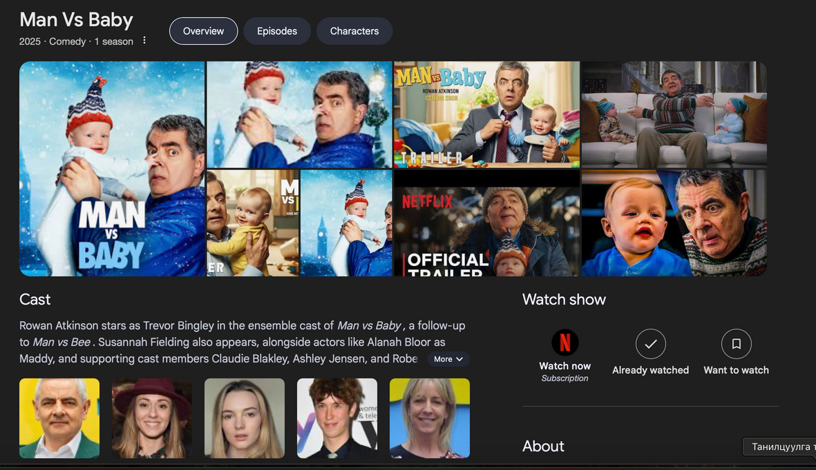
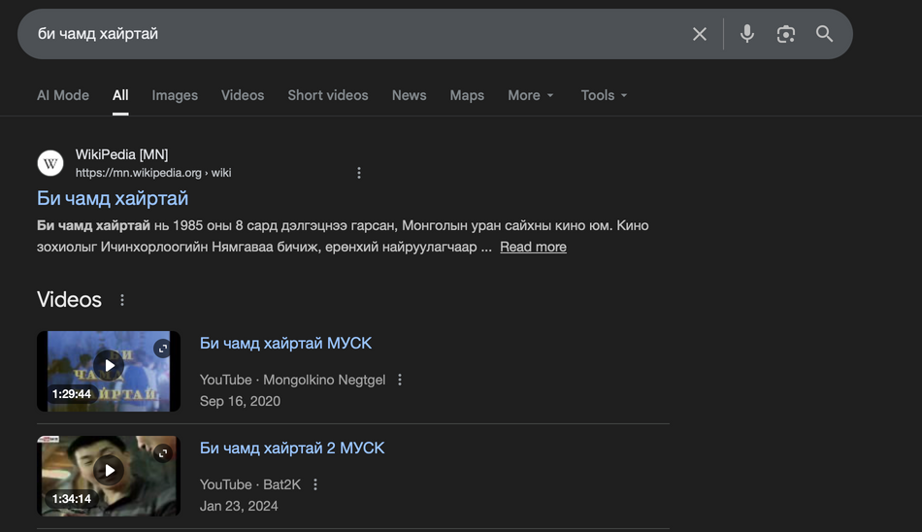
PHASE - 1
Informal Purpose
Consolidate dispersed and unstructured Mongolian cinema data
Build a connected data model using ontology and knowledge-graph methodology
Provide a comprehensive, searchable, analyzable Knowledge Graph of Mongolian Cinema.
Explore connections among Mongolian films,
Analyze relationships between filmmakers, actors, and studios,
Study genres, award trends, and historical developments,
Success all essential information about a film from a single query,

Slide 5



PHASE - 1
Personas and scenarios
Name | Non-Fan Viewer | Film Enthusiast | Business Owner
Goal | Has no film knowledge. Wants to pick a high-rated film by a director/actor his girlfriend likes for a movie date. | Find other works by a favorite actor or director. | Collaborate with filmmakers popular among target customers (e.g., children, women).
Needs | View linked information among director, film, actor Runtime and short summary High-rated films featuring a preferred artist | Similar-genre films, related works by the same creators, ability to discover underrated, lesser-known but high-rated films. Importance placed on rating and release year. | Networks of artist collaborations, film ratings and recent releases, identify current trending filmmakers with strong portfolios.
Scenarios | Selecting a good Mongolian film for a date. | Finding underrated films by a favorite director. | Collaborate with currently active, trending filmmakers.
KG-needs | Actor - list of other high-rated films; Movie - Genre, runtime; Director –genre connections to understand film type. | Director B – list of all directed films; Filter by high rating, Release year is before 2000. | Production company - list of produced films; Filter by 2020–2024 high-rated releases; Identify frequently collaborating actors and directors.

Slide 6
PHASE - 1
Competency Questions
Can Mongolian films be listed by release year?
What films has Director X made, and in which years?
Which actors starred in Movie Y?
Which Mongolian actors have the highest number of film appearances?
Which Mongolian films have won domestic or international awards?
What works has Production Company Z released?
What common features link films of a specific release year?
Can we generate an actor-actor or actor–director collaboration network?
Who are the trending filmmakers of the last five years?
Can we visualize the career timeline of an actor or director?

Slide 7
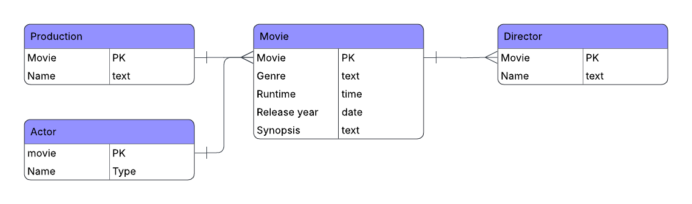
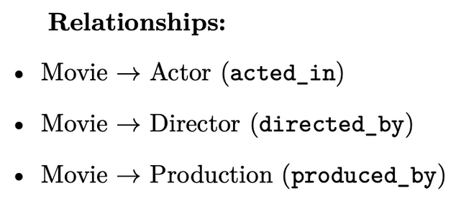
PHASE - 1
ERD

Slide 8



PHASE - 2
SOURCES
Provides semi-structured pages for individual Mongolian films, including titles, directors, actors, production companies, runtimes, summaries, and award information.
Type: Language + Data-value resource.
Diversity Awareness: Not diversity-aware; structure varies between pages.
A local Mongolian online movie portal listing films, posters, cast, genre tags, summaries, and sometimes ratings and release years.
Type: Data-value resource. Diversity Awareness: Not diversity-aware; heterogeneous formats.
Informal text resources describing film concepts (Movie, Person, Actor, Director, Genre, Rating).
Type: Language resource. Diversity Awareness: Yes; domain vocabulary structures are fully under project control.

Slide 9
PHASE - 2
DATA COLLECTING
WEB SCRAPING PIPELINE:
No. | Stage | Description | Implementation
1 | ID-based Crawling | Iterate through sequential movie pages | for movie_id in range(2500, 3000)
2 | Dynamic Loading | Fully load JavaScript-rendered content | Selenium + Headless Chrome
3 | Page Rendering | Retrieve complete page source | get_rendered_html()
4 | Text Extraction | Extract unified text from HTML | BeautifulSoup.get_text()
5 | Metadata Parsing | Parse title, type, year, age rating, runtime | extract_movie_header_and_genres()
6 | Rating Collection | Extract Kinosan rating using regex | extract_rating()
7 | Staff Collection | Extract director, writer, cast, production | extract_movie_staff()
8 | Validation & Filtering | Skip invalid or empty pages | Title check + empty field check
9 | Structured Storage | Organize collected data into tabular form | Pandas DataFrame
10 | Data Export | Generate cleaned Excel dataset | kinosan_movies5.xlsx

Slide 10
PHASE - 2
DATA CLEANING & STANDARDIZATION
No. | Step | Description | Output / Purpose
1 | Data Sources | Movies and Actors Excel files (heterogeneous schemas) | Raw input data
2 | Column Auto-Detection | Automatically match column names using pick_col() | Schema-independent processing
3 | Text Normalization | Remove extra spaces and special characters to create canonical text | Consistent entity names
4 | Name Canonicalization | Generate *_norm keys by lowercasing and removing punctuation | Entity matching
5 | Numerical Standardization | Year → Int64, Rating → Float, Runtime → minutes | Comparable numeric attributes
6 | Missing Value Handling | Empty / “NaN” values → pd.NA (nullable types) | KG-compatible NULL values
7 | Duplicate Removal | Movies: title_norm + release_yearActors: actor_name_norm | One entity = one node
8 | Clean Output | movies_clean.xlsx, actors_clean.xlsx | KG-ready datasets

Slide 11
PHASE - 2
Discussion of Choices, Strong and Weak Points
S
W
Strengths
Weaknesses
Local relevance: The data set reflects the actual Mongolian cinema landscape, allowing realistic KG use cases.
Rich metadata coverage: The combined sources provide: title, actors, directors, genre, release year, production company, ratings, summaries, and awards — enabling meaningful graph queries.
Compatibility with existing global models: The data set can be mapped to Schema.org and Wikidata film structures to ensure interoperability.
Heterogeneous formats: Wikipedia and Kinosan pages differ significantly in structure and require extensive cleanup.
Incomplete data: Many Mongolian films lack ratings, review counts, or award information.
Name inconsistency: Lack of standardized transliteration or naming conventions for actors and directors.

Slide 12
PHASE - 3
Language definition
 | Label | Description | notes/Range
Class | Movie | a cinematic work with descriptive and production metadata | Core entity
Class | Production | a production entity associated with a movie | Production company / uni
Class | Director | Person who directs a movie | Person role
Class | Actor | Person who performs in a movie | Person role
Object Property | Has Production | Links a movie to its production entity | Production
 | Has Director | Links a movie to its director | Director
 | Has Actor | Links a movie to its actor | Actor
Data Property | genre | Genre of the movie | xsd:string
 | runtime | Duration of the movie | xsd:time
 | releaseYear | Release year of the movie | xsd:gYear
 | rate | Short description of the movie | xsd:string
 | name | Name of a person or production | xsd:string

Slide 13
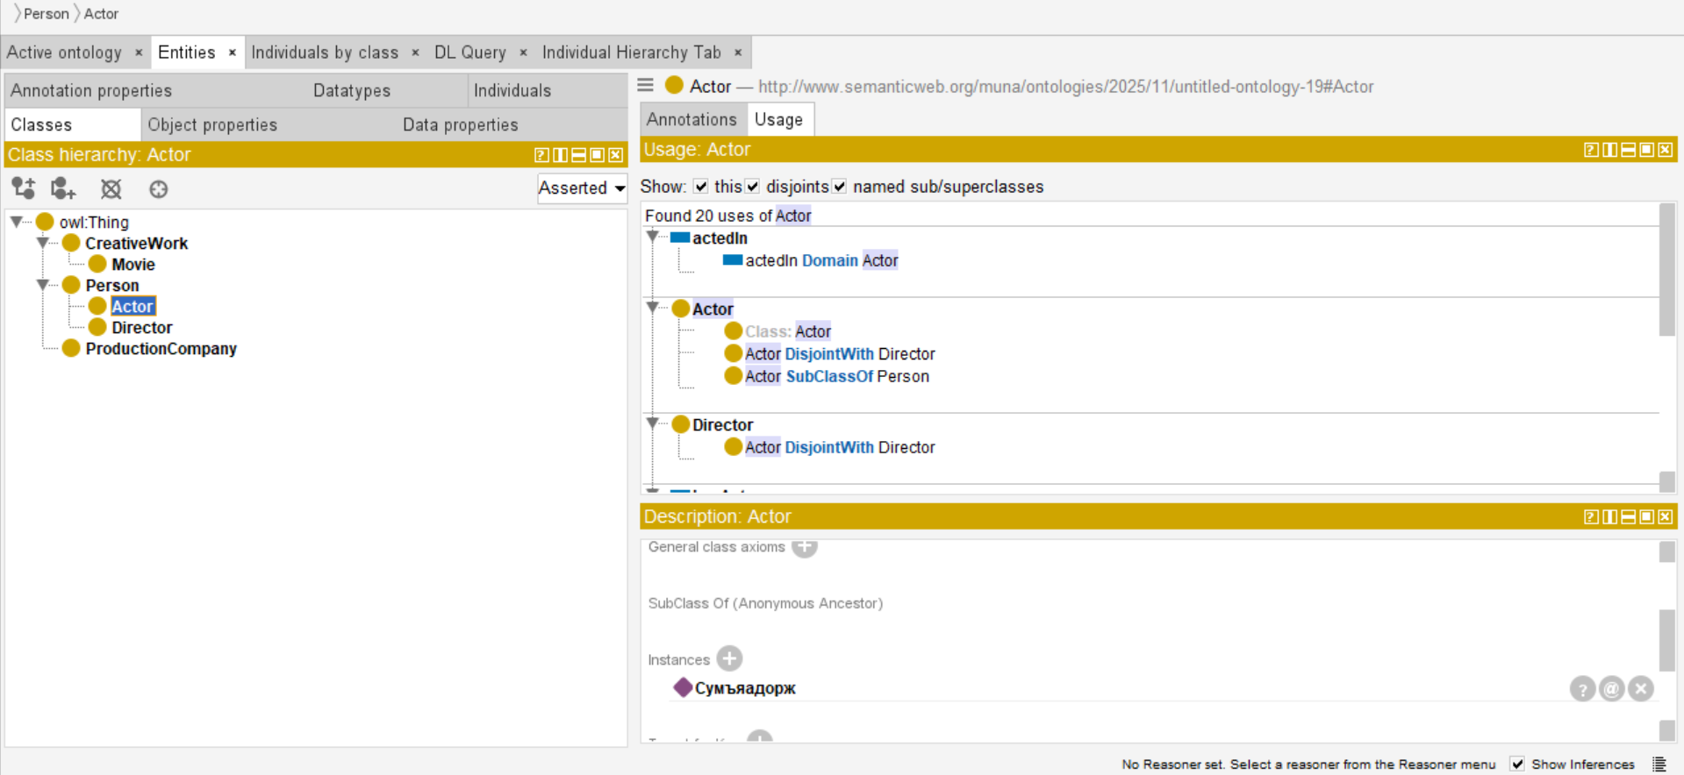
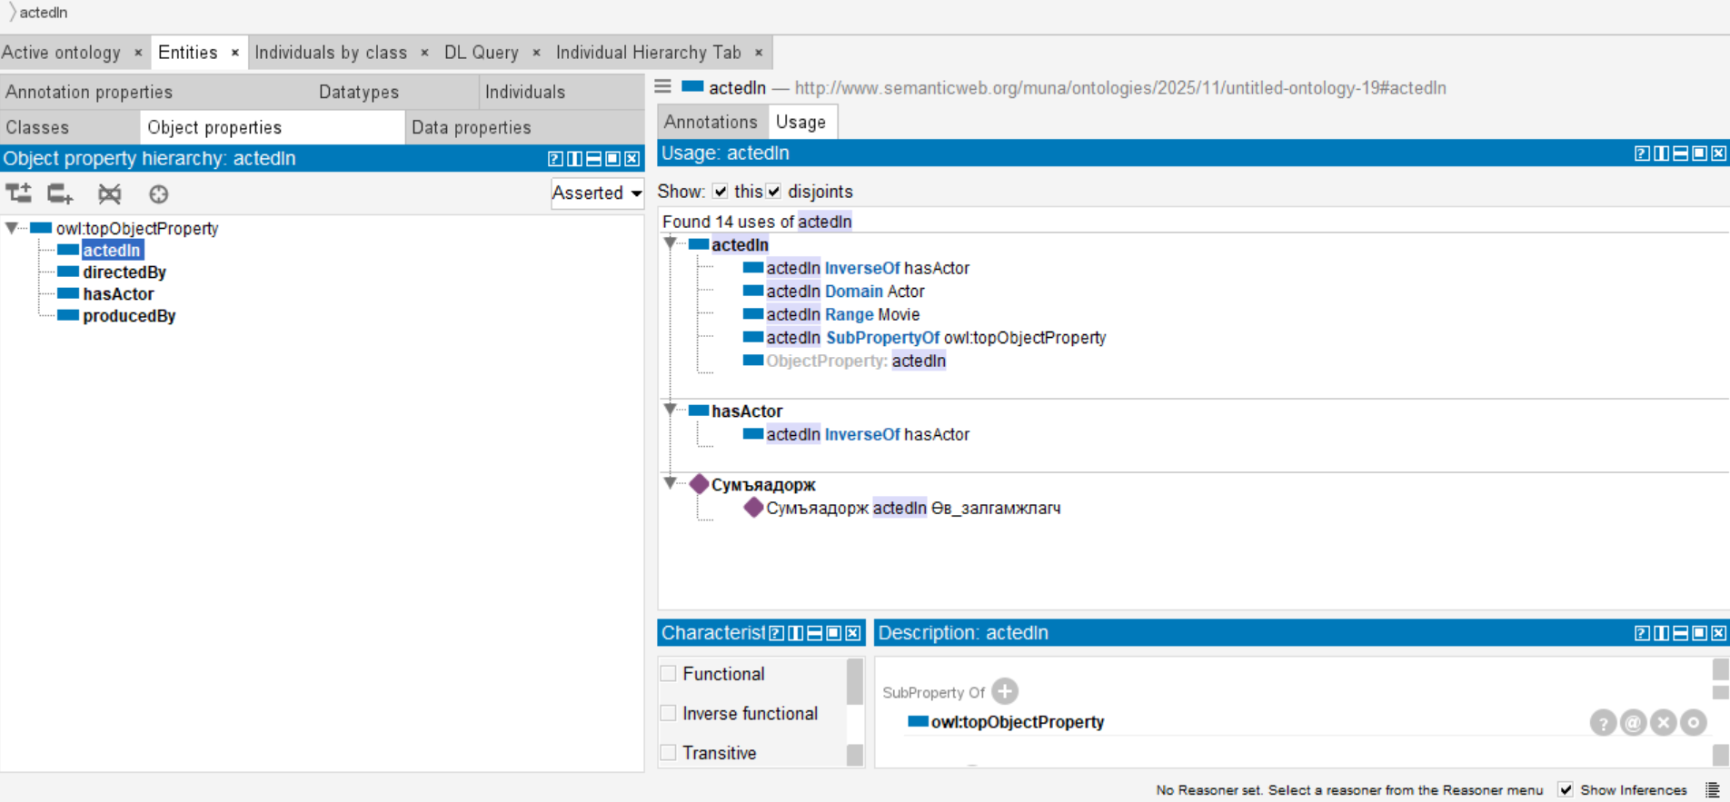
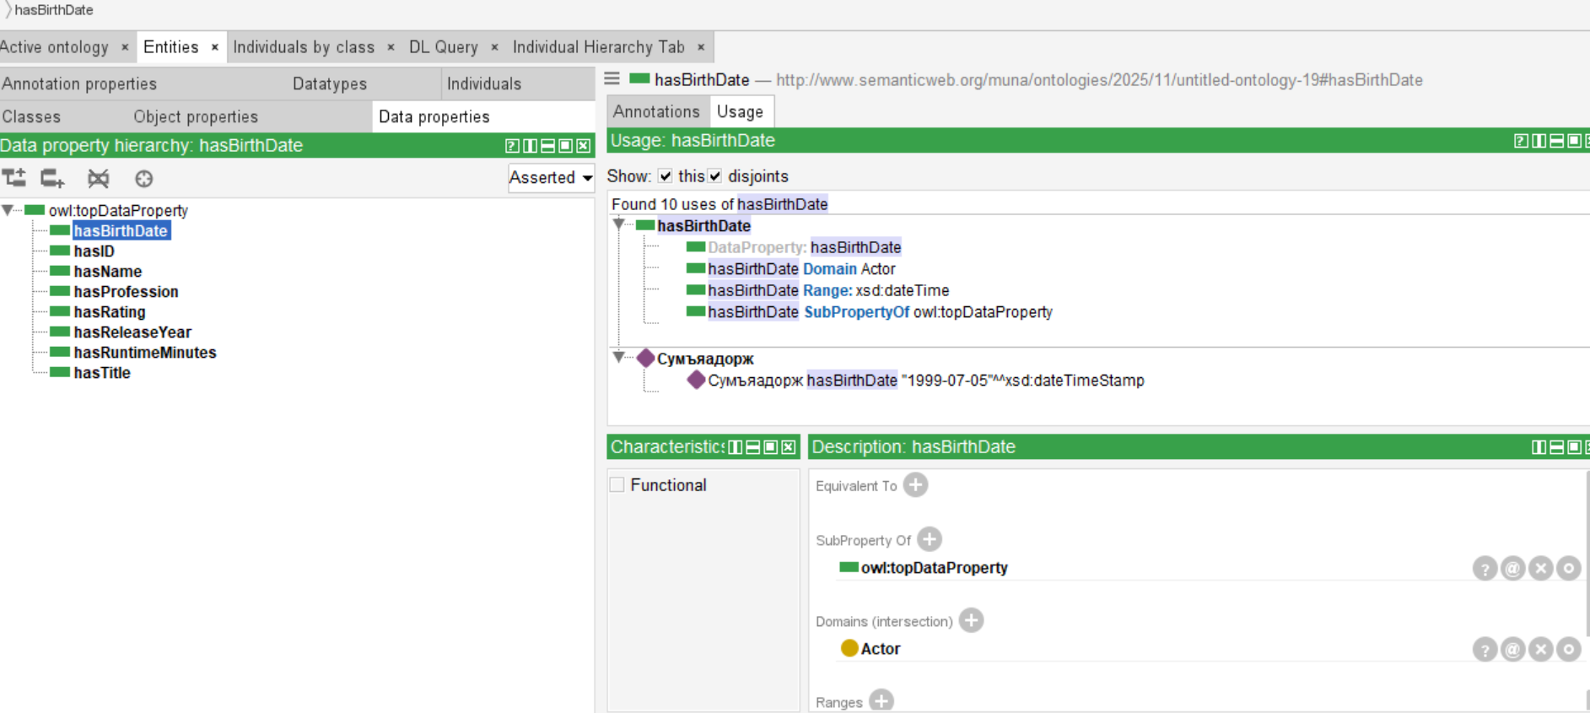
PHASE - 4
ONOTOLOGY

Slide 14
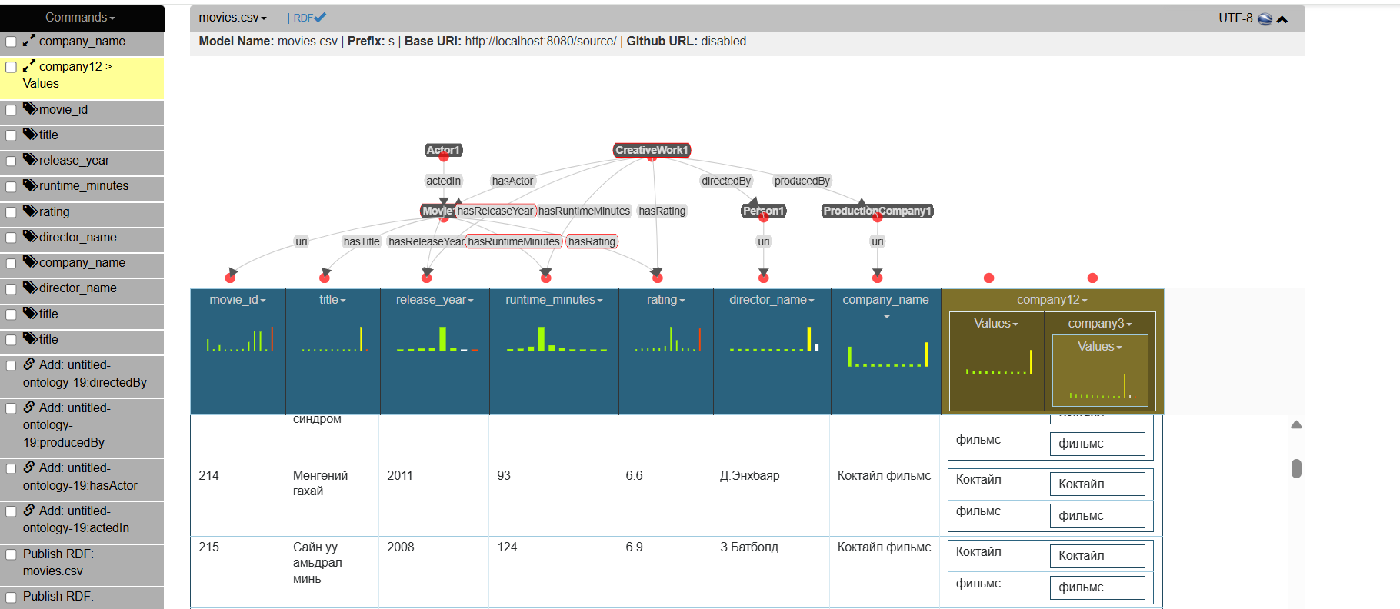
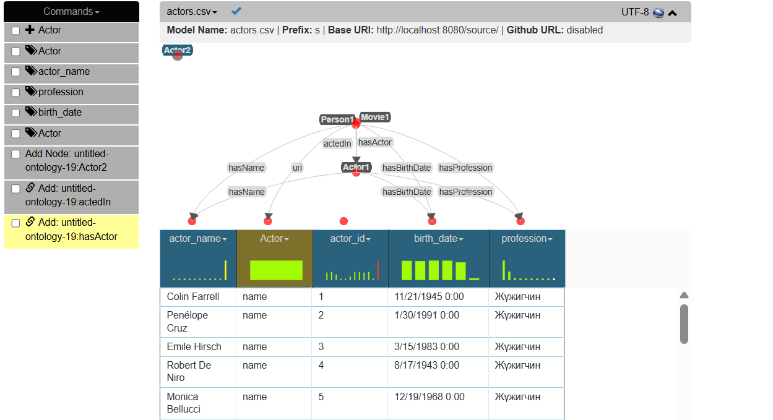
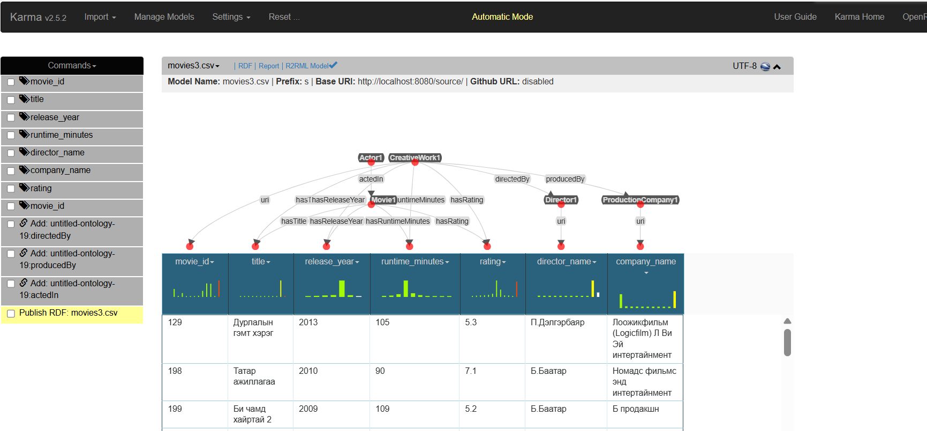
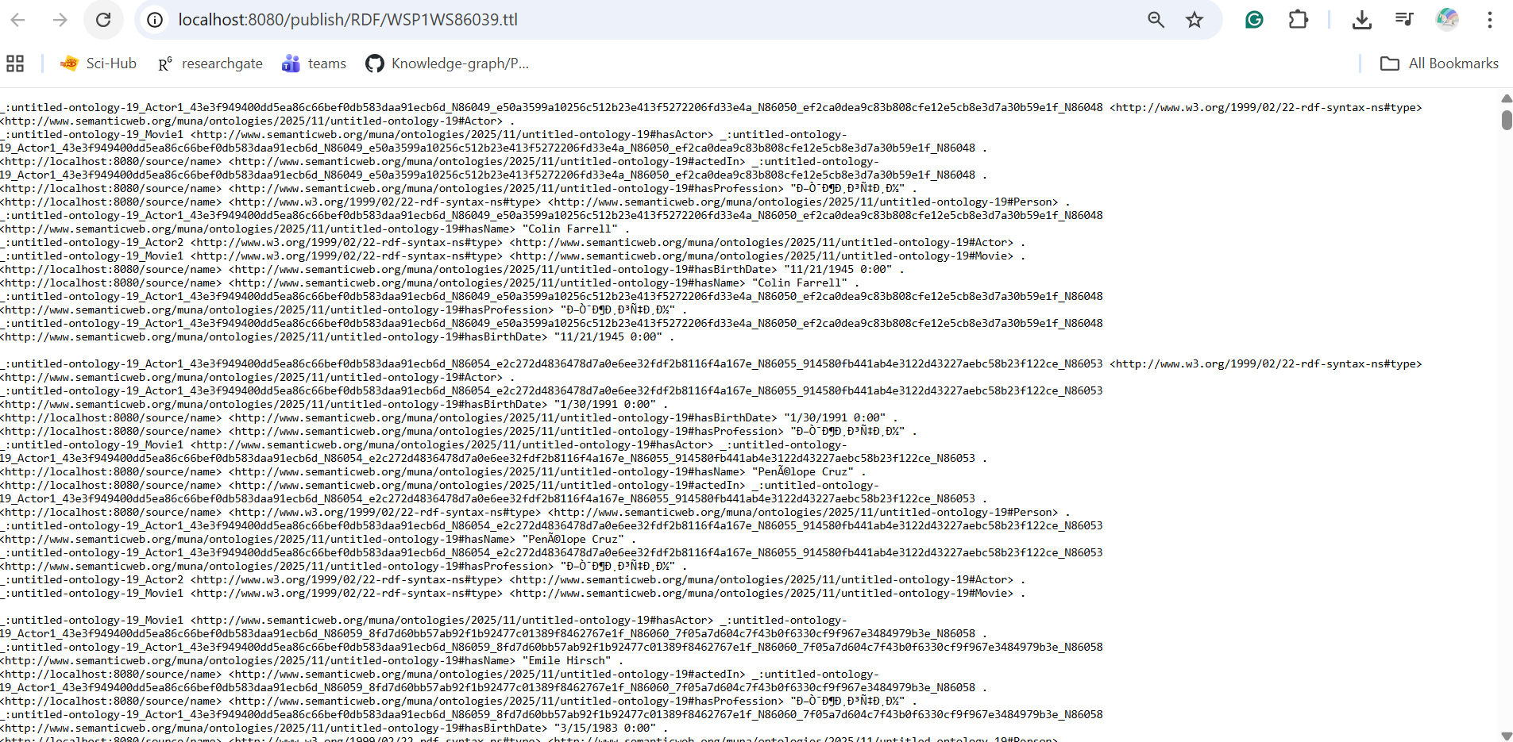
PHASE - 5
ENTITY

Slide 15
OPEN ISSUES
Heterogeneous data formats: Wikipedia and Kinosan.mn differ significantly in structure, requiring extensive data cleaning.
Incomplete data: Many Mongolian films lack ratings, review counts, or award information.
Name inconsistency: No standardized transliteration or naming conventions for actors and directors.
Limited coverage: Older and lesser-known films are not fully represented.
While the project establishes a solid foundation for a Mongolian film knowledge graph, addressing data heterogeneity, incompleteness, and naming inconsistencies remains essential for advanced analytics and comprehensive cultural insights.
Notes:
Open Issues
Heterogeneous data formats: Wikipedia ба Kinosan.mn нь бүтэц, шошгололт ялгаатай тул extensive data cleaning шаардсан.
Incomplete data: Олон Монгол кинонд үнэлгээ, review count, шагналын мэдээлэл дутуу.
Name inconsistency: Найруулагч, жүжигчдийн нэрсэд стандарт транслитераци, бичлэгийн нэгдсэн дүрэм байхгүй.
Limited coverage: Хуучин болон бага танигдсан кинонууд бүрэн хамрагдаагүй.

Slide 16
Conclusion
While the project establishes a solid foundation for a Mongolian film knowledge graph, addressing data heterogeneity, incompleteness, and naming inconsistencies remains essential for advanced analytics and comprehensive cultural insights.
Future work and opportunity:
Expand data sources to include archives, awards, and review platforms.
Improve name normalization and transliteration strategies.
Extend the ontology to support multiple directors and richer relationships.
Explore connections among films, filmmakers, actors, and studios.
Analyze genres, award trends, and historical developments.
Enable single-query access to all essential film information.
Notes:
Future Work
Нэмэлт өгөгдлийн эх сурвалжуудыг холбох (archives, awards, reviews).
Нэр нормчлох, транслитерацийг сайжруулах.
Ontology-г өргөтгөж олон найруулагч, нарийвчилсан харилцааг дэмжих.
Кино, уран бүтээлч, студи хоорондын холбоог судлах.
Genre, шагнал, түүхэн хөгжлийн аналитик хийх.
Нэг асуултаар киноны бүх үндсэн мэдээллийг авах боломж бүрдүүлэх.

Slide 17

Discussion

Slide 18

Thank you

