Slide 1

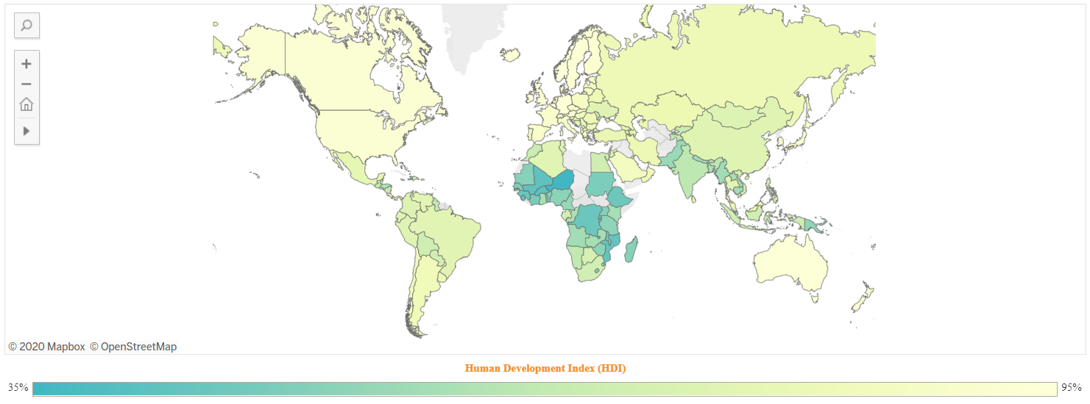
What Impacts Human Development the most?
A MACHINE LEARNING APPROACH TO SEE WHAT MATTERS

Slide 2
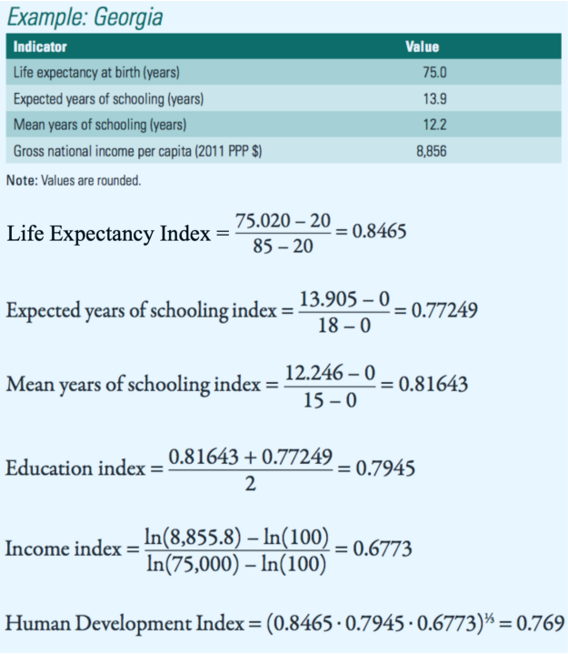
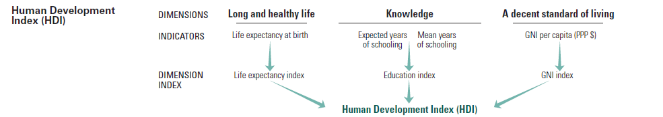
What is HDI

Slide 3
What is the problem?
Too Broad
0.33% weight is given only to GNI
Not easy to translate it into actions

Slide 4
The idea
The Idea
Collect as much micro factors as possible
For as many countries as possible
For as many years as possible
And isolate the most relevant factors

Slide 5
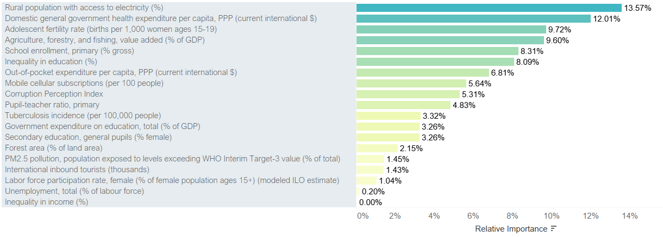
The idea
Results

Slide 6
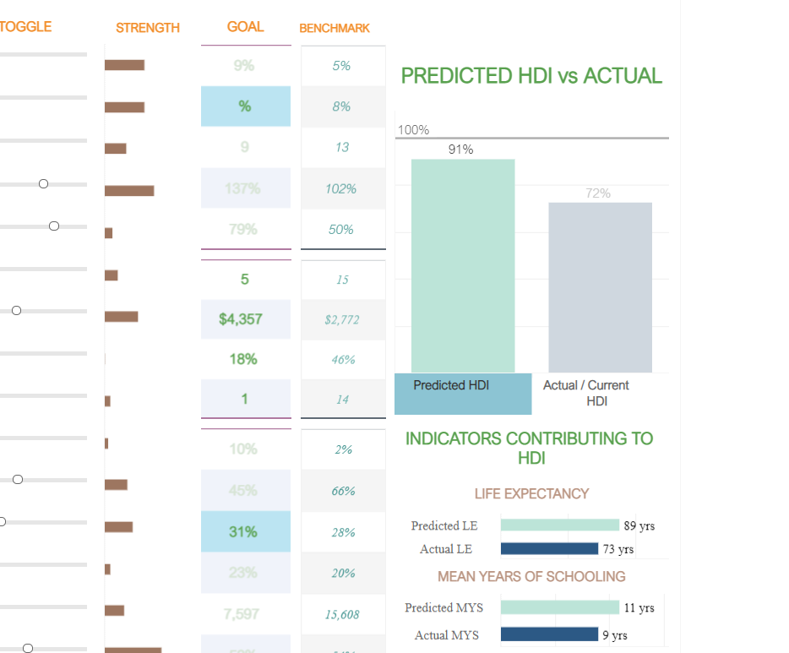

Tableau Dashboard

Slide 7
Limitations
HDI is subject to a lot of criticism
Some key factors show nil relevance in the model
Doesn’t factor in the environmental impacts
The core idea of the project was to explore my DA skills and not produce some ground breaking findings.

Slide 8

References / Inspirations
https://github.com/HDI-Project
https://github.com/HDI-Project/Trane
https://pypi.org/project/mlblocks/
https://www.datastuff.tech/machine-learning/xgboost-predicting-life-expectancy-with-supervised-learning/
https://medium.com/analytics-vidhya/using-scikit-learns-iterative-imputer-694c3cca34de
https://machinelearningmastery.com/iterative-imputation-for-missing-values-in-machine-learning/
https://towardsdatascience.com/human-development-national-eco-footprints-a-visual-orientation-9adf86618d4f

Slide 9

Thank You
Arasan MJ
arasanmj@live.com
linkedin.com/in/arasanmj/
https://github.com/dataaivu
+49 152 1800 3975

