Slide 1
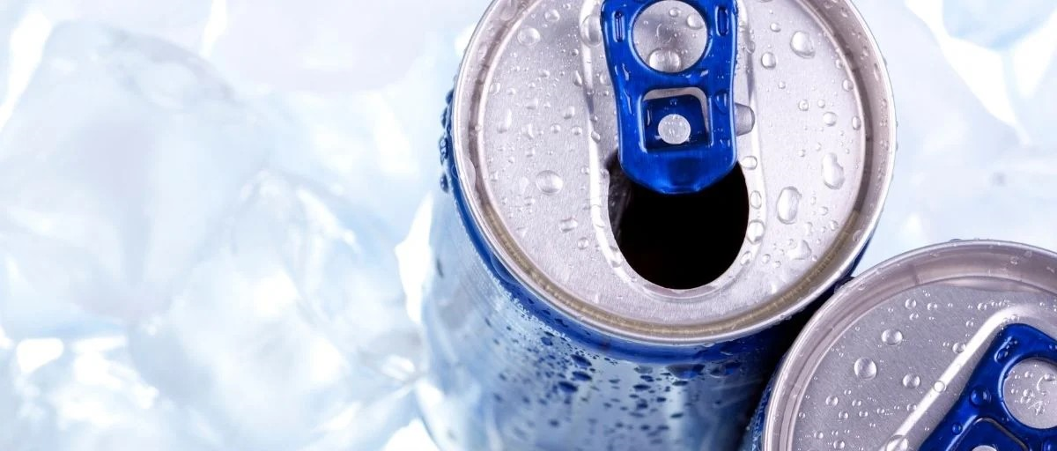
CODEX ENERGY DRINKS
Marketing Survey Analysis
By: Shardul S. Chavan

Slide 2
PROJECT GUIDE
Sr.No. | Particulars | Page No.
1 | Project Brief | 3
2 | Project Approach & RoadMap | 4
1 | Demographic Insights | 6-8
2 | Consumer Preference | 10-11
3 | Competition Analysis | 13-14
4 | Marketing Channels and Brand Awareness | 16-17
5 | Brand Penetration | 19-20
6 | Purchase Behaviour | 22-24
7 | Product Development | 26
8 | Secondary Insights | 28-33

Slide 3
PROJECT BRIEF
Codex Intro: Codex is a German beverage company that is aiming to make its mark in Indian Markets.
Survey Details: Codex launched their energy drinks in 10 different cities of India and conducted market survey in these 10 cities with a sample size of 10,000 respondents.
Survey Objective:
Product Details: The focus product for this entire analysis is “Energy Drinks”.
OBJECTIVE
Create Brand Awareness for Codex
Increase Market Share
Product Development

Slide 4
PROJECT APPROACH & ROADMAP
To Achieve Codex Objectives we have tried to explore the below mentioned segments with respect to Survey data:
Demographic Analysis: We are trying to understand the respondents characteristics based on certain attributes like Gender, Age, Consumption pattern etc.
Consumer Preference: We are looking at the respondents product preferences like Product packaging, Ingredients preference etc.
Competitor Analysis: In this segment, we are analysing the market in terms of the leading brands and competitors.
Marketing Channels & Brand Awareness: In this we will try to understand the different marketing approach used in market for reaching out to the customers.
Brand Penetration: Analysing Codex Brand Awareness and general perception in the market.
Purchase Behavior: Trying to understand what factors and elements a respondent might check before purchasing our product.
Product Development: Looking at the product factors which need to be improved.

Slide 5
DEMOGRAPHIC INSIGHTS

Slide 6
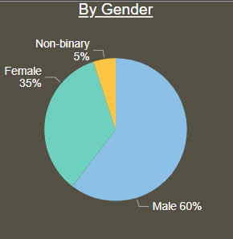
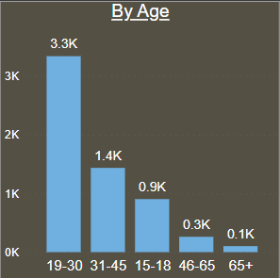
Who prefers energy drink more? (male/female/non-binary?)
The CODEX Energy drinks market survey is conducted for
10,000 respondents.
From the given pie, we can find that the major respondents are
males which constitute 60% of the total universe followed by
females with 35% and Non Binary with 5%.
The gender which prefers energy drinks more are the males with
a count of around 6,000. In male category, we find that the age
group of 15 to 45 years (92.7%) prefer energy drinks more.

Slide 7
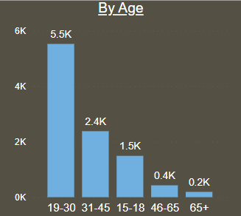
Which age group prefers energy drinks more?
We have respondents from different age groups ranging from
15 years to the age group of 65+ years.
We can observe that the age group of 19-30 years (55%) prefer
the energy drinks more followed by 31-45 years (24%) and
15-18 years (15%).
The probable reason for such observation could be the fact
the people in the age group of 15 to 45 years are more
engaged in gym or heavy physical activities where the need
for energy drinks is quite high.

Slide 8
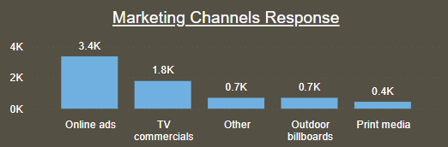
Which type of marketing reaches the most Youth (15-30)?
We find that the respondents in the age group of 15-30 years
are around 70% (7,000 respondents). This indicates major
chunk of the respondents are in the younger age groups.
With respect to the marketing channels which reaches most
in the age group of 15-30 years is online ads as 34% of the
respondents state that the product recall is more in online
ads.
The major reason for the stated fact could be high usage of
online and internet services, mobiles and gadgets by young
age group.

Slide 9
CONSUMER PREFERENCES

Slide 10
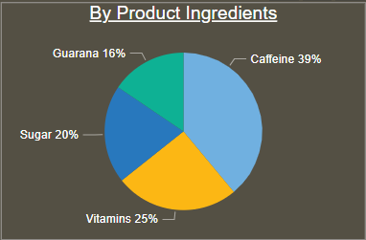
What are the preferred ingredients of energy drinks among respondents?
The mentioned pie gives us the basic idea with respect to the
consumer preference for the ingredients they look for in their
energy drinks.
We see that caffeine is the major ingredient been preferred by
the around 39% respondents, followed by vitamins (25%),
Sugar (20%) and Guarana (16%).
One of the reasons for most preference to Caffeine in the
energy drinks could be associated to its health beneficial
aspects. Also, Caffeine is a great source for energy and many
gym enthusiast recommend caffeine as a pre workout meal.

Slide 11
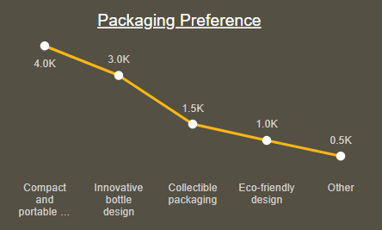
What packaging preferences do respondents have for energy drinks?
From the line chart, we can observe that 70% of
respondents prefer compact and portable cans and
innovative botte design as packaging preference.
In the 70% respondents mentioned above, 40% of the
respondents prefer compact and portable cans as the
packaging preference.
Considering the factor of space consumption (being -
handy) and ease of usage/mobility, the preference
for compact and portable cans can be considered to
be high.

Slide 12
COMPETITION ANALYSIS

Slide 13
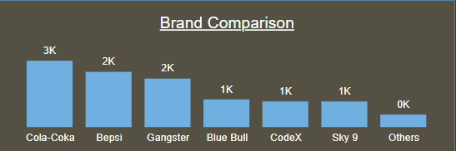
Who are the current market leaders?
We can clearly see that the Cola-Coka is the
current market leader as 1,889 (19%)
respondents use this energy drink brand.
Considering the market trend, we find that 49%
of the respondents prefer Cola-Coka, Bepsi &
Gangster as their energy drink.
With respect to the Codex brand’s usage, 762
respondents use codex energy drinks which
constitute around 8% of the total universe.

Slide 14
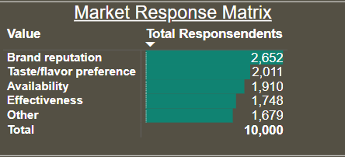
What are the primary reasons consumers prefer those brands over ours?
From the market response matrix been shown, we
find that 26.5% respondents prefer other brands
due to Brand Reputation.
If we look from product core dimension, factors like
Taste, Effectiveness etc. 40% of the respondents
prefer other brands over Codex.
Looking at the brand reputation and product avaibility,
44% of the respondents prefer other brands over
Codex.

Slide 15
MARKETING CHANNELS & BRAND AWARENESS

Slide 16
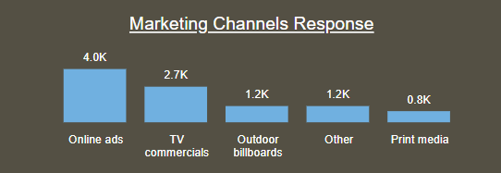
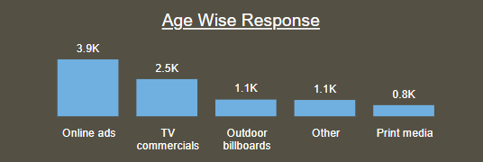
Which marketing channel can be used to reach more customers?
We have considered a general marketing channel
response and age group wise response.
Looking at both the aspects, we see that in general
focus should be primarily on Online ads, Outdoor
Billboards and TV commercials as 80% respondents
view energy drink advertisements.
Considering age group of 15 to 45 years (9,400 -
respondents), we find that out of these 75% of the
respondents view energy drinks advertisements on
Online ads, Outdoor Billboards & TV commercials.

Slide 17
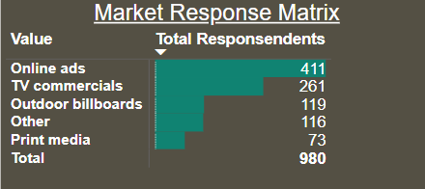
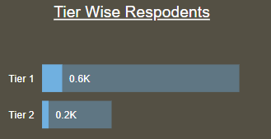
How effective are different marketing strategies and channels in reaching our customers?
In total Codex energy drinks consumers are 980, out
of which 80% customers do view our advertisements
on Online ads, Outdoor Billboards & TV commercials.
Around 42% customers view our product ads on
Online ads, followed by TV commercials (27%),
Outdoor billboards (12%), Other (12%) and print
media (7%).
Out of our 762 customers in Tier1 city, 78% customers
and out of 218 customers in Tier2 city, 89% customers
view our product add on Online ads, Outdoor
Billboards & TV commercials.

Slide 18
BRAND PENETRATION

Slide 19
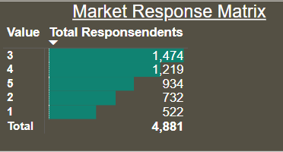
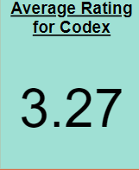
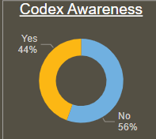
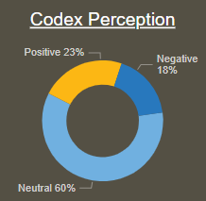
What do people think about our brand?
From the given charts we can see that Codex
awareness is around 45% of the total respondents.
In terms of brand perception for Codex, major chunk
(60%) are neutral followed by 23% positive and 1%
negative.
The average rating for Codex brand is around 3.27 if
across all the respondents which indicates that our
product is being rated mostly as average with respect to
various aspects like taste, overall experience etc.
Codex product has been tried by, 4,881 respondents
and out of that 74% of the overall ratings lie in the
range of Average to Excellent which is a good indicator.

Slide 20
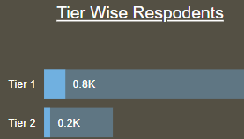
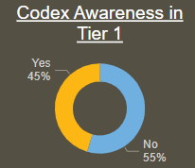
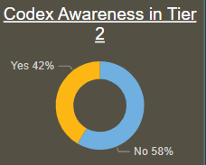
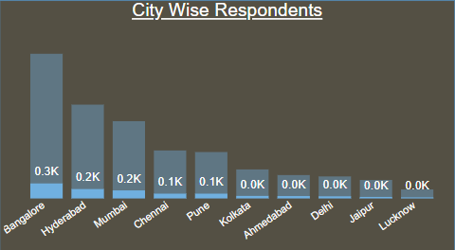
Which cities do we need to focus more on?
The people who use our product, in both the cities
i.e. Tier 1- 10% and Tier 2- 8.8% are quite low w.r.t
the total no. of respondents.
In Tier 1 cities, the ratio of Codex respondents to
total respondents is around 9% -10% whereas in
Tier 2, the ratio varies from 3% -10%.
Due to great variance in Tier 2 cities more focus
should be on Tier 2 cities considering specific cities
like Lucknow (3%), Jaipur (7%) and Kolkata (8%).
In terms of Codex brand’s awareness, the percent
of awareness is quite low in both the cities and that
too in Tier 2 cities.
Huge marketing initiative is required in Tier 2 cities.

Slide 21
PURCHASE BEHAVIOR

Slide 22
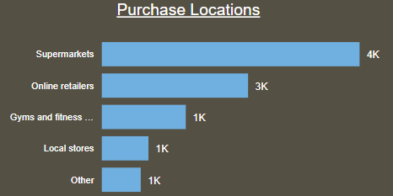
Where do respondents prefer to purchase energy drinks?
We can clearly see that Supermarkets is the major
preference (40% respondents) as purchase point
for energy drinks.
On a macro level, we find that 80% respondents prefer
to buy energy drinks from Supermarkets, Online retailers
& Gyms and Fitness centres.
With increasing brand reputation and use of certain
Supermarkets like D mart, Reliance Fresh and Online
retailers like Amazon in India, major preference is seen
for these locations as purchase points.
Also, these locations act as a one stop shop for all the major
products required in the household purpose hence we see
major preference for these locations.

Slide 23
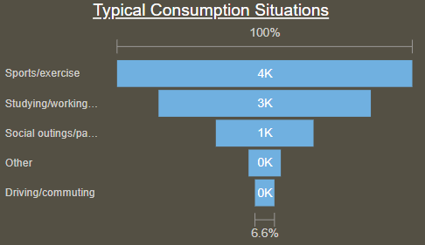
What are the typical consumption situations for energy drinks among respondents?
From the graph, we can find that the 70% of the total
respondents consume energy drinks in the situations
of Sports/Exercise or while Studying/Working till late
night.
This observation is self explanatory as major amount of
energy consumption in terms of physical as well as
mental energy can be seen in Sports or while working
till late nights.
Specifically in Sports/Exercises, energy drinks are used
to maintain energy levels such that it improves the
performance of an individual.

Slide 24
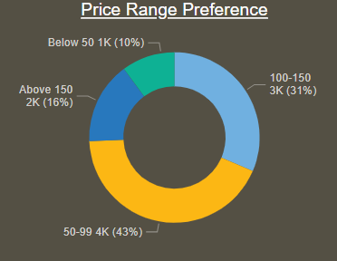
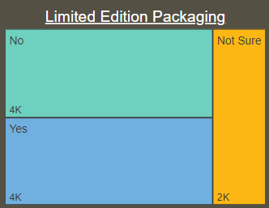
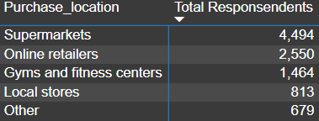
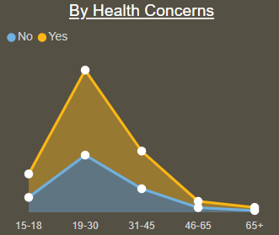
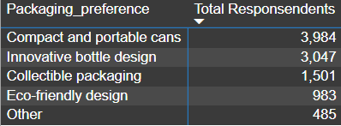
What factors influence respondents' purchase decisions, such as price range and limited edition packaging?
For Pricing, 74% respondents think that the ideal
purchase price should be in the range of INR 50 to
INR 150.
Limited Edition Packaging doesn’t seem to be very
crucial element as there is no clear indicator stating
the need for such packaging.
In terms of Purchase location, Packaging Preference
& Health Concerns, we find some clear indicators:
1. Purchase Locations: Supermarkets & Online
Retailers (74% preference).
2. Packaging: Compact and Portable cans
(40% preference).
3. Health Concerns: Should be Healthy
(60% preference).

Slide 25
PRODUCT DEVELOPMENT

Slide 26
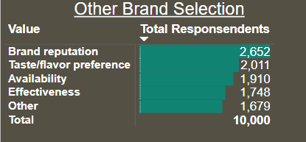
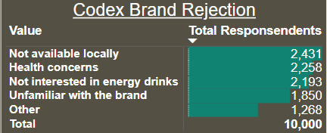
Which area of business should we focus more on our product development? (Branding/taste/availability)
As per the stats provided, we find that Brand Reputation,
Taste/Flavour, Health Concerns and Availability of Codex
product are the main areas of improvements.
66% respondents prefer other brands over Codex due to
their Brand Reputation, Taste and Availability.
65% respondents reject our energy drink due lack of
Availability, Heath Concerns and Brand Awareness.
First focus, at macro level should be on enhancing Brand
Reputation which can be achieved by providing customers
with energy drinks that are healthy & have good taste and
making these energy drinks available at right purchase
locations. E.g.: Supermarkets

Slide 27
SECONDARY INSIGHTS

Slide 28
What immediate improvements can we bring to the product?
Availability: Our product should be available at right time and right place. As per the analysis, we find most respondents prefer Supermarkets and Online Stores as their preferred purchase location.
Packaging: Our product should be packed in such a manner that it preserves the product as well as creates a greater ease of usage for customers. Most respondents prefer Compact and Portable cans as packaging element.
Health Concerns: Our product should be made in such a manner that it provides health benefits to the customer. 60% respondents prefer healthy energy drinks.
Product Ingredients: Right set of ingredients need to be added to our product like Caffeine, Vitamins. Along with this our product should have less Sugar content, Wide range of flavors and more natural ingredients.
Brand Reputation: Strong Marketing Efforts along with above mentioned 4 factors can lead to a good brand reputation of our company. Our brand awareness needs to be increased as only 44% respondents are aware about our brand.
General Rating: The average rating for our product is around 3.28, which needs to be improved.

Slide 29
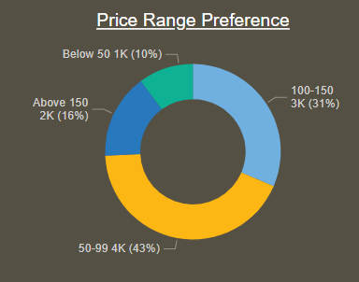
What should be the ideal price of our product?
As per the pie chart mentioned, the 74% respondents think that the
ideal purchase price should be in the range of INR 50 to INR 150.
10% respondents think that the ideal price of energy drinks should be
less than INR 50 and 16% respondents think that the ideal price should
be above INR 150.
In quadrangle cities of India like Mumbai, Chennai, Delhi and Kolkata
42% respondents are ready to pay in range of INR 50 to 99 and 32%
respondents prefer to pay in range of INR 100 to 150.
In rest of cities, 44% respondents are ready to pay in the range of INR
50 to 99 and 31% respondents are ready to pay in the range of INR 100
to 150.
Therefore the Ideal price range for our product is INR 50 to INR 150.

Slide 30
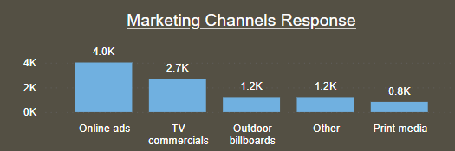
What kind of marketing campaigns, offers, and discounts we can run?
Push Marketing: Push Marketing is a concept where the product
need to be pushed in the market through certain marketing
activities. Since our brand is not so known in the market we need
to look out for some pull marketing activities like:
A. Field Marketing:
Participating in Health Exhibitions and Trade shows.
Setting up Point of Sales display on certain special events,
gym areas and Supermarkets and providing free samples to the customers to improve brand awareness.
B. Digital Marketing:
Social Media Marketing: Use of Social Media Marketing to be done by creating certain small videos or reels and sharing them on social media handles like YouTube, Instagram, Facebook etc.
Online Ads: As we can see from the chart, Online ads are the most useful medium to reach the customers as our majority respondents belong to younger age group.

Slide 31
What kind of marketing campaigns, offers, and discounts we can run?
TV Commercials: Use of TV Commercials is the most useful medium to reach the customers. Our suggestion would be to make TV Commercial with a well known Sports person like Virat Kohli, Neeraj Chopra, Hima Das etc. as these celebrities are quite health conscious and our promotion of product becomes quite logical.
Influencer Marketing: Use of Influencer Marketing can be done to increase our reach in the market as today’s youth is quite influenced by and do follow the influencers to a great extent. Therefore, some gym specialists or some emerging good sports players can be involved to promote our product who have a good number of followers and social media coverage.
DISCOUNTS & OFFERS:
Buy one Get one Free: Great source of discount to increase the reach of our product and provoke the customers to buy our product.
Bulk Purchase Discounts: This scheme can be used to attract certain supermarkets and online retail brands to purchase our product and display on their shelf space. Such discounts also sometimes provide an eye catching and appropriate shelf space for our product.

Slide 32
What kind of marketing campaigns, offers, and discounts we can run?
Seasonal/Special Discounts: Providing discounts on special occasions like National Sports Day, Indian Independence & Republic day and the same can be applied for some special festivals of the respective regions of India.
Referral Discounts: We can build a Referral program and the customer who refers our product will be provided special discounts and promotional gifts.
Percentage Sales Scheme: Use of such discounts can be of great help to promote our product. If a customer buys certain amount of sales value at one purchase time then he will be eligible for certain percentage of discount on that sales.
Loyalty Program: Loyalty programs have been a great way of promotion where we can work such discounts with customers, gym owners who will be credited with certain credit points based on their purchase and after reaching a particular milestone they will be rewarded with certain gifts.

Slide 33
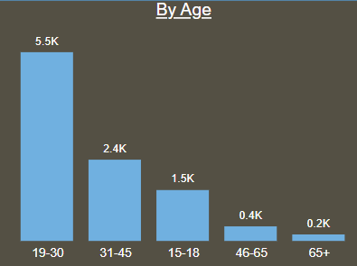
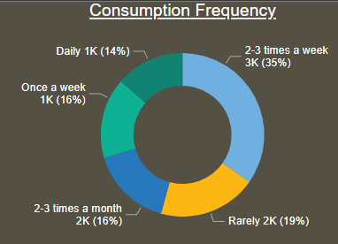
Who should be our target audience, and why?
As per the chart, we can clearly see that the 94% respondents
lie in the age group of 15 to 45 years.
Also, if we look by the parameter of Gender we find that 60%
males prefer energy drinks followed by females (35%) and
Non – binary (5%).
In terms of consumption frequency, 65% of the respondents in
the age group of 15 to 45 years consume energy drinks on a
weekly basis.
As per our suggestion, we should target the age group of
15 to 45 years as this is the major age group who show highly
prefer and consume energy drinks on an overall basis.

Slide 34
THANK YOU

