Slide 1
Vagrant

Slide 2
What is Vagrant?
Tool for building and distributing virtual development environments.
Provides framework to manage and create complete portable development environments.
Vagrant machines are provisioned on the top of VirtualBox, VMware, AWS, or any other provider supported by vagrant.

Slide 3
Benefits
Allows very easy spin up of a work environment.
Create own development/test environment which is very hard to create on a local machine.
Provisions Development/Testing/Production Environment.

Slide 4
Provisioning?
Provisioning is all tasks related to deployment and configurations of applications making them ready to use. In the past, this was done with many scripts or manual steps, which was quite unreliable and error-prone. There should be a proper way to do deployments as it eliminates the human error and speeds up deployment.

Slide 5
Provisioning mode
File Provisioning
Shell Provisoning
Ansible Provisioning

Slide 6
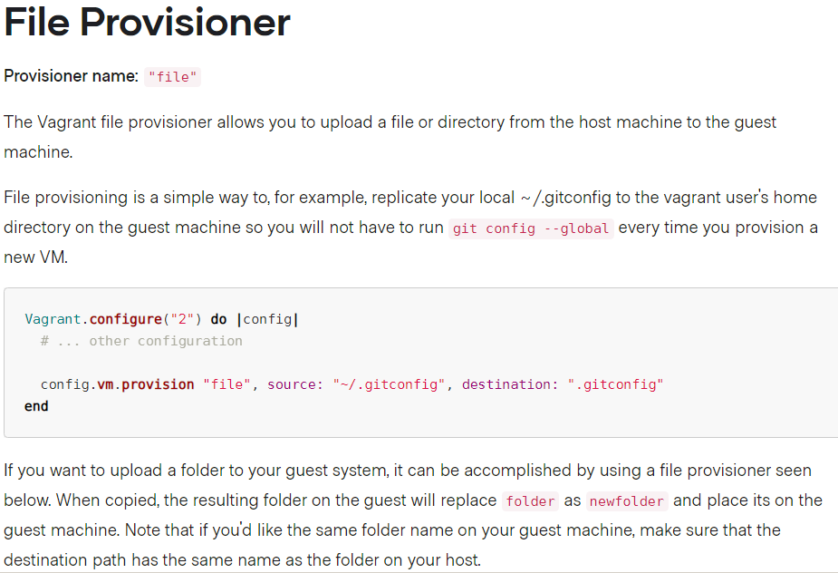

Slide 7
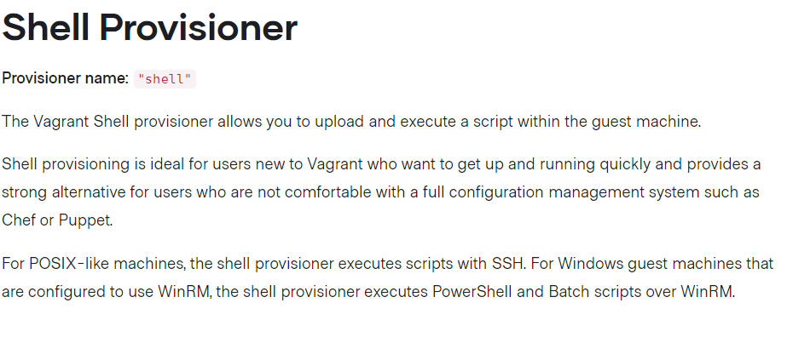
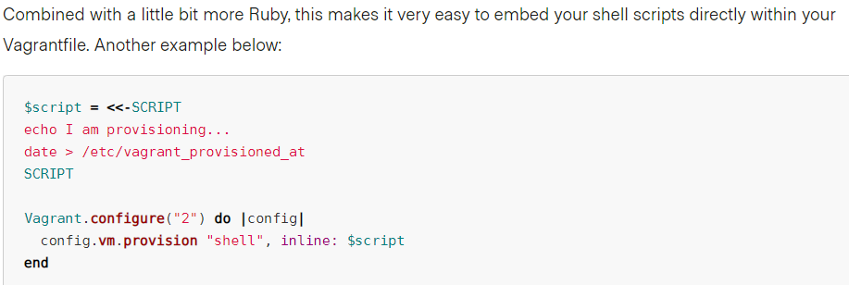

Slide 8
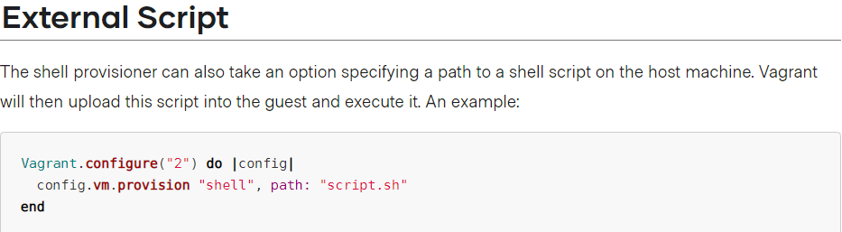
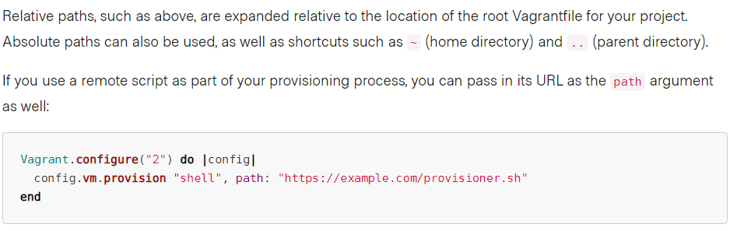

Slide 9
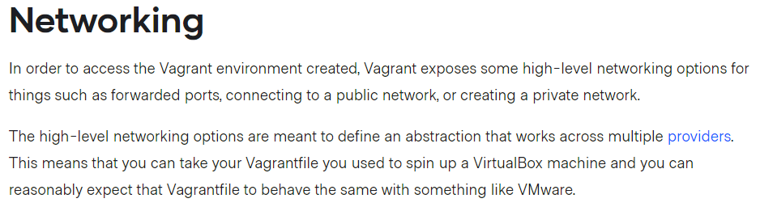
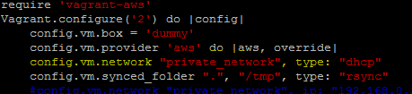

Slide 10
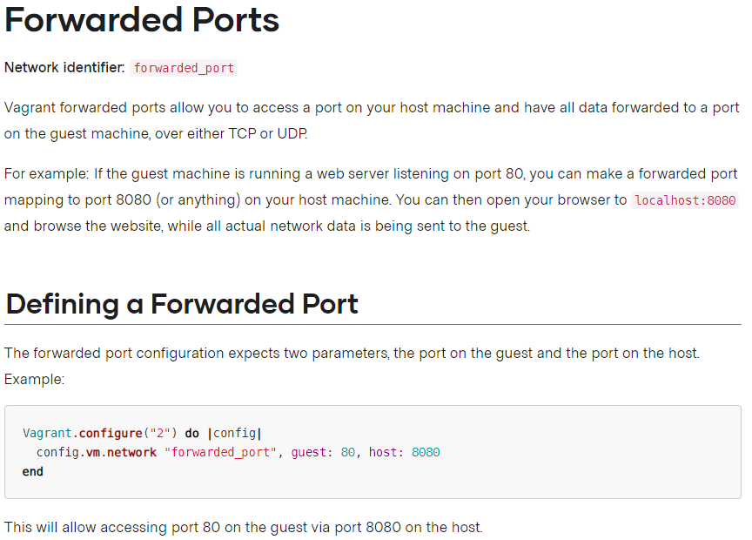

Slide 11
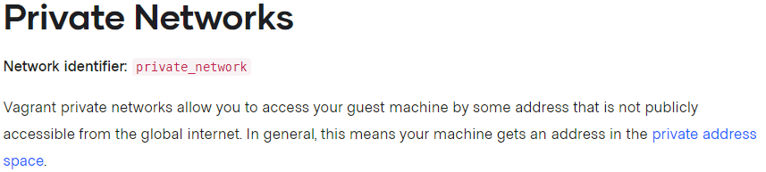
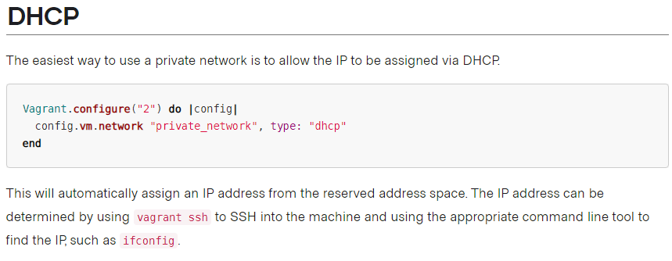

Slide 12
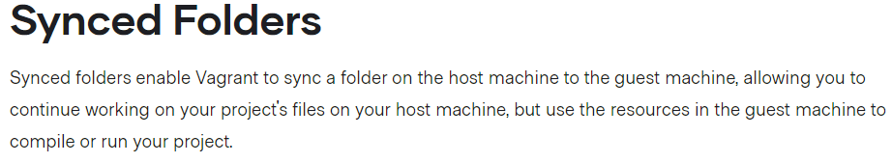
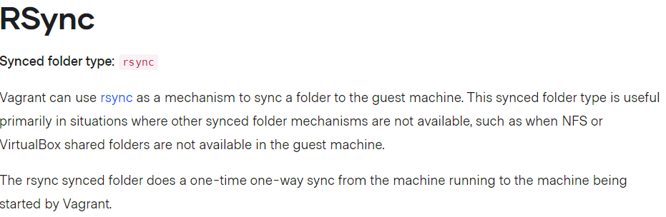


Slide 13
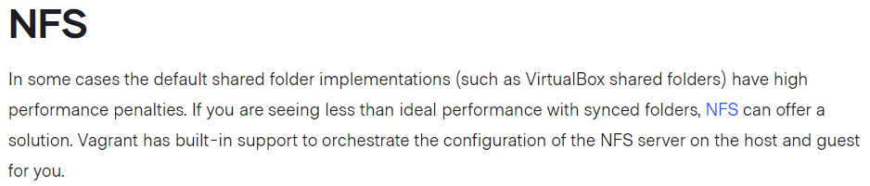
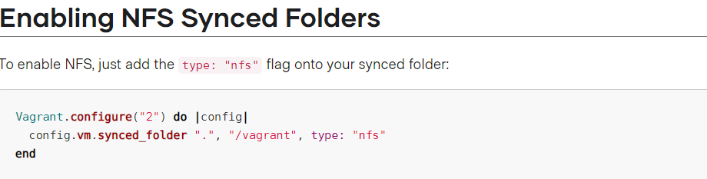

Slide 14
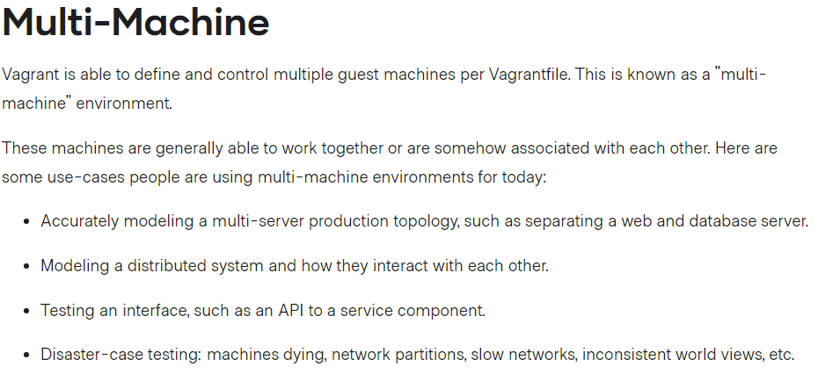
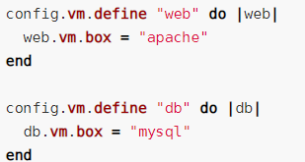

Slide 15
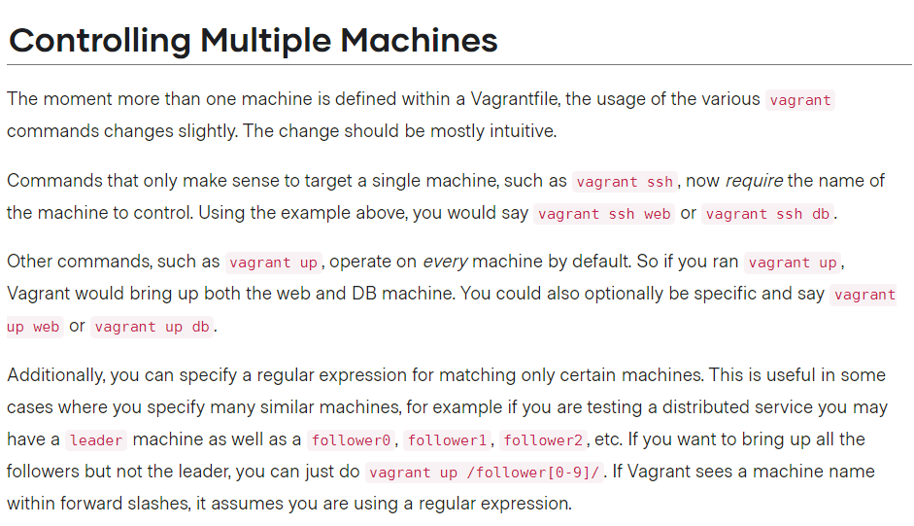

Slide 16
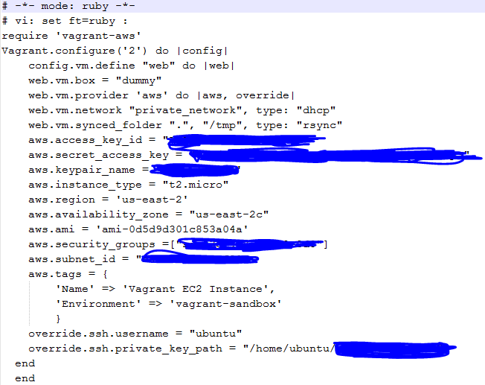

Slide 17
