Slide 1
ToU equity lab meeting
Who pays the fees?
Accessibility-based equity of congestion charging scenarios in Auckland
Hyesop Shin
University of Auckland
GTFS isochrone working group
May 2026

Slide 2
THE QUESTION
The research question
Who would face a Time of Use charge in Auckland without a viable public transport alternative under each of the six shortlisted scenarios, and how would that burden be distributed against area-level deprivation?
Burden
Alternative
Distribution
Who would pay the charge under each scenario?
Does that population have a viable 45-minute public transport alternative?
How does the burden sit against area-level deprivation?
ToU equity, lab meeting
2

Slide 3
AUCKLAND, 2029
Congestion pricing is no longer a hypothetical.
The Land Transport (Time of Use Charging) Amendment Act 2025 sets the legal frame. Auckland Transport has six shortlisted scenarios. We do not adjudicate whether pricing should happen, but which option carries which equity cost.
84.7%
NZ$6
6
of Aucklanders travel by car (Census 2023)
peak cordon charge under consideration
shortlisted scenarios, three families
ToU equity, lab meeting
3

Slide 4
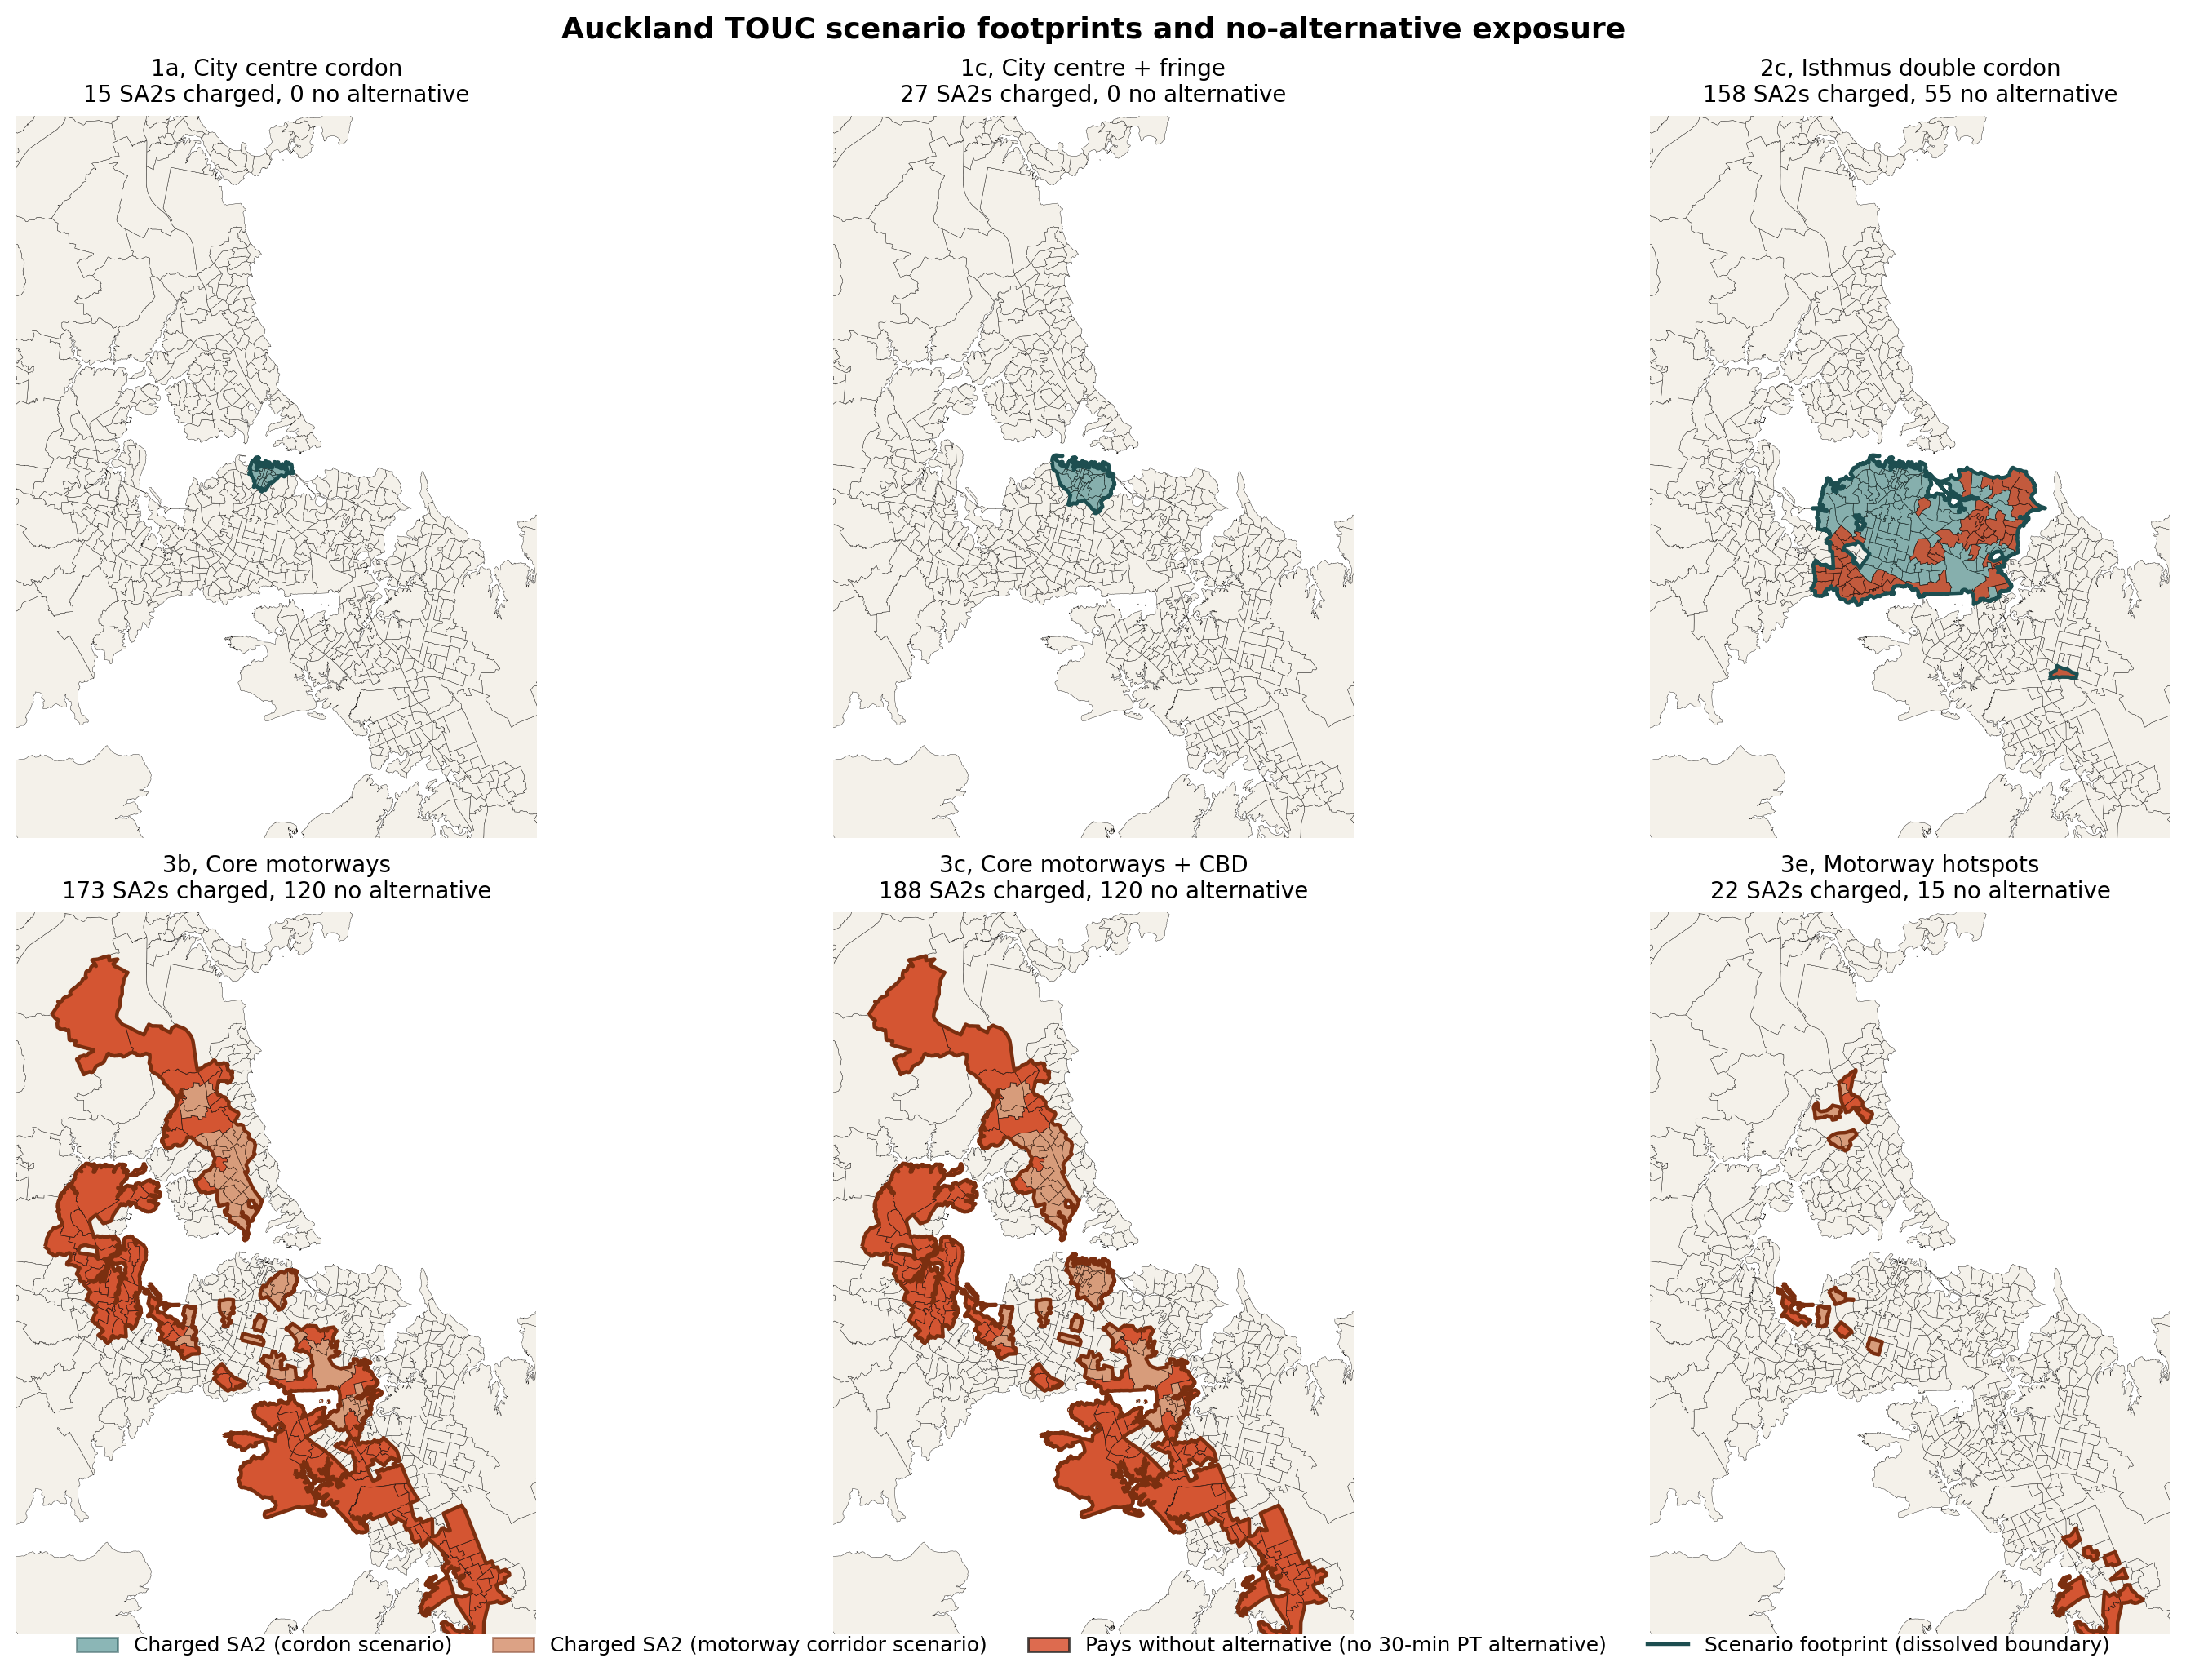
THE SIX SCENARIOS
Three families, six footprints.
1
City centre cordons
1a, CBD only (15)
1c, CBD + fringe (27)
2
Isthmus double cordon
2c, expanded inner isthmus (158)
3
Motorway corridors
3b, core motorways (173)
3c, core motorways + CBD (188)
3e, motorway hotspots (22)
ToU equity, lab meeting
4
Charged SA2s shaded by family; pays without alternative overlaid in deeper colour.

Slide 5
METHODS
Five steps from raw GTFS to a scenario equity index.
1
2
3
4
5
Routing
Accessibility
Q75 cut-point
Burden class
Equity index
r5py over the Auckland Transport GTFS feed (22 April 2026) and OpenStreetMap walking network. Origins are SA2 population-weighted centroids.
Jobs reachable within a 45-minute weekday peak window, 07:00 to 09:00, combined walk and PT. 45 min chosen because Auckland's mean commute is 32 min.
Pre-specified within-Auckland Q75 of access_45min, 104,812 jobs. The top quartile is a conservative test for what counts as a viable alternative.
Each SA2 coded pays_with_alternative, pays_without_alternative, or does_not_pay. Cross-tabulated against NZDep2023 decile.
Wagstaff Concentration Index of access_45min against NZDep2023, both baseline (619 SA2s) and per-scenario on the charged subset. SA1-population-weighted.
ToU equity, lab meeting
5

Slide 6
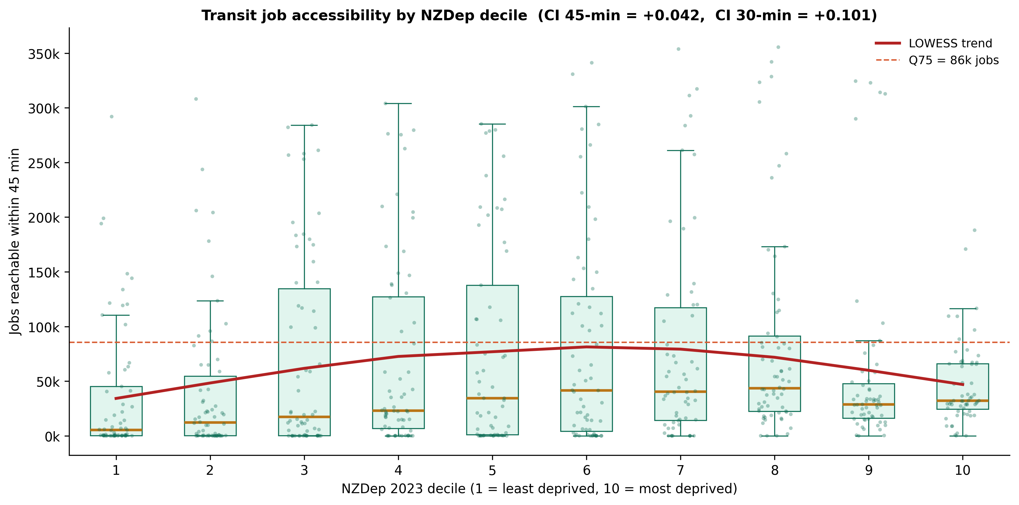
BASELINE
Auckland's access surface is non-monotonic.
Two low-access tails.
Decile 1 is affluent rural fringe (Coatesville, Riverhead, Kumeu, Maraetai). Low access by choice, not constraint.
Decile 10 is the outer south and outer west (Manurewa, Papakura, Henderson, Ranui). Low access as a binding constraint.
Peak at D6-7 averages around 82,000 reachable jobs.
Box plots of access_45min by NZDep decile, with LOWESS trend. Q75 line at 86k jobs (this older run uses an earlier weighting; current table uses 104,812).
Overall CI sits near zero (+0.031) because the two low tails average out. The right answer is the D8-10 subgroup CI of -0.083.
ToU equity, lab meeting
6

Slide 7
HEADLINE
One in five Aucklanders.
20.7%
of Auckland's 1.65 million people would face the charge under 3b or 3c with no viable 45-minute public transport alternative
340,908 residents | 120 SA2s | mostly outer south and outer west
ToU equity, lab meeting
7

Slide 8
TABLE 1, BURDEN INCIDENCE
How many residents pay without an alternative?
45-minute Q75 cut-point = 104,812 reachable jobs. Residents column = SA1-summed Census 2023 usually resident count in 'pays without alternative' SA2s.
Scenario | Charged SA2 | Pays without alt SA2 | Residents affected | % of Auckland (1.65M)
1a, City centre cordon | 15 | 0 | 0 | 0.0%
1c, City centre + fringe | 27 | 0 | 0 | 0.0%
2c, Isthmus double cordon | 158 | 57 | 151,050 | 9.2%
3b, Core motorways | 173 | 120 | 340,908 | 20.7%
3c, Core motorways + CBD | 188 | 120 | 340,908 | 20.7%
3e, Motorway hotspots | 22 | 15 | 28,614 | 1.7%
ToU equity, lab meeting
8

Slide 9
TABLE 2, SCENARIO CI
Same six scenarios, different question.
Among the SA2s that would pay, do the more deprived ones have lower 45-minute accessibility? Wagstaff CI restricted to the charged subset, population-weighted by SA1 usually resident count. Baseline (all 619 SA2s) CI(access_45min) = +0.031, D8-10 = -0.083.
Scenario | Charged SA2 | Residents in charged SA2 | CI(access_45min | charged) | Equity reading
1a, City centre cordon | 15 | 31,107 | -0.005 | not equity-active
1c, City centre + fringe | 27 | 57,420 | +0.029 | not equity-active
2c, Isthmus double cordon | 158 | 414,066 | +0.010 | near-zero
3b, Core motorways | 173 | 476,415 | -0.166 | strongly regressive
3c, Core motorways + CBD | 188 | 507,522 | -0.120 | regressive
3e, Motorway hotspots | 22 | 51,588 | +0.046 | near-zero
ToU equity, lab meeting
9

Slide 10
THE 3b vs 3c PUZZLE
Adding the CBD compresses the CI but leaves the burden unchanged.
3b
CI -0.166
3c
CI -0.120
Core motorways
Core motorways + CBD
340,908 residents | 120 no-alt SA2s
340,908 residents | 120 no-alt SA2s
The same 340,908 residents would pay without a viable 45-minute alternative under both 3b and 3c. The CBD SA2s 3c adds sit well above the Q75 cut-point and span the deprivation gradient, so the regressive gradient is diluted. A measurement effect, not a real improvement in distributional outcomes.
ToU equity, lab meeting
10

Slide 11
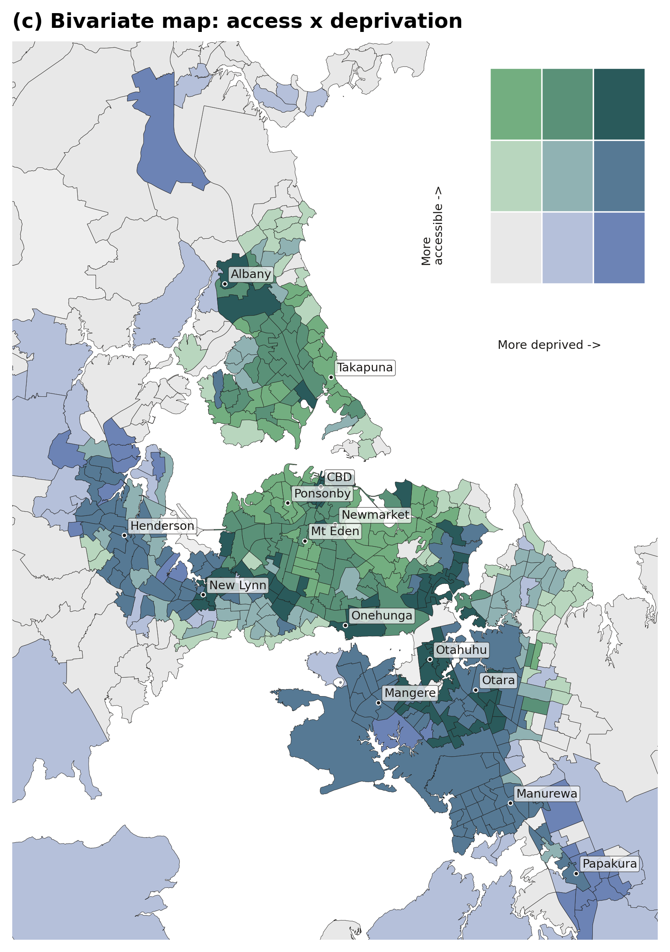
SPATIAL SIGNATURE
Four local clusters tell the policy story.
Bivariate Local Moran's I, access_45min focal, NZDep2023 spatial lag, queen weights, 999 permutations, p < 0.05.
HH
34 SA2s
High access, high deprivation
Rail-served deprived band of the inner-south, including Point England, Glen Innes, Otahuhu, Mangere Central, parts of Onehunga. The data-driven reason H2 does not classify the deprived inner-south as paying without an alternative.
HL
26 SA2s
High access, low deprivation
Inner-isthmus elite belt, Remuera, Mt Eden, Newmarket, the inner CBD ring.
LH
76 SA2s
Low access, high deprivation
The H2 burden cluster proper, outer Manurewa, Papakura, Takanini, outer Henderson, Massey, and Ranui.
LL
81 SA2s
Low access, low deprivation
Affluent rural and coastal fringe, Coatesville, Riverhead, Whangaparaoa, Kumeu, Maraetai, which produces the decile 1 tail of the inverted-U.
ToU equity, lab meeting
11

Slide 12
POLICY
No charge without an alternative.
We take no position on whether Auckland should introduce ToU charging. Given the policy decision has been made under the Land Transport (Time of Use Charging) Amendment Act 2025, three implications follow from the data.
1
Inner cordon options 1a and 1c can proceed
The population paying the charge under those scenarios has a clearly above-average public transport alternative. No distributional preconditions.
2
Motorway options 3b and 3c require a preceding PT step
Credible public transport investment in the affected outer SA2s is needed before the charge takes effect. Otherwise the scheme would charge 340,908 residents for a journey it has not yet given them a way to make.
3
Expanded isthmus 2c is a different question
Non-trivial cost on a sizeable share of Auckland without a clear distributional sign. The policy frame for that scenario is total cost-benefit, not equity.
ToU equity, lab meeting
12

Slide 13
WHAT NEXT
Three extensions, in priority order.
01
Per-corridor PT audit
Map each of the 120 no-alt SA2s to the specific bus, rail, or active travel intervention that would lift it above Q75 before the charge.
02
SA1-resolution accessibility
Routing from 10,207 SA1 centroids directly, rather than inheriting SA2 access. Reveals within-SA2 heterogeneity.
03
HOP patronage validation
Test the alternative classification against observed HOP growth on recently service-uplifted AT corridors since 2023.
Thanks. Questions welcome.
13

