Slide 1
Pay, Oscillate, or Learn?
Three Agent Decision Rules under Congestion Pricing
Social Simulation Conference 2026
Hyesop Shin | University of Auckland
Agent-Based Modelling
Q-Learning
El Farol
Auckland CBD
ToU Pricing

Slide 2
Why Does the Behavioural Assumption Matter?
🏙️
❓
🔬
Auckland's Context
The Gap
Our Approach
Congestion costs NZ$2.6B/yr. Time-of-Use (ToU) charging legislation passed Nov 2025. CBD cordon launch expected alongside City Rail Link.
Most models ask 'how much will traffic fall?' — but behavioural assumptions drive whether congestion shifts in time, in space, or not at all.
ABM with 2,500 heterogeneous agents (1 agent = 160 vehicles, calibrated to observed daily counts), Auckland CBD road network. Three decision rules, same pricing environment, same LoS measurement.
Research questions: (1) How does decision rule choice affect V/C outcomes? (2) Where does congestion shift spatially under ToU?

Slide 3
Three Agent Decision Rules: A Rationality Spectrum
← Static Rationality
Bounded Rationality with Learning →
01
02
03
Exponential Decay
El Farol Bar Model
Q-Learning
Static Rationality
Bounded Rationality (No Learning)
Bounded Rationality with Learning
P(entry) = e^(–α · fee / VoT)
Enter if best predictor: E[congestion] < θ
Q(s,a) ← Q(s,a) + α[r + γ·max Q(s',a') – Q(s,a)]
Entry probability declines with fee/VoT ratio
No memory, no adaptation
Standard equilibrium assumption
Result: −19% (fixed hour) to −24% (may retime); ≈0 if rerouting backfills
Portfolio of predictors based on recent history
Reads yesterday's congestion, not today's fee
Near-universal entry (92%), so little left to deter
Result: 0% in every arm — the charge never binds
State = time band x congestion band; action = enter or not
Fee is absent from the decision — it enters only via the reward
So the response is learned over days, not applied at once
Result: −24% if staying home is the only option, −9 to −16% if not

Slide 4
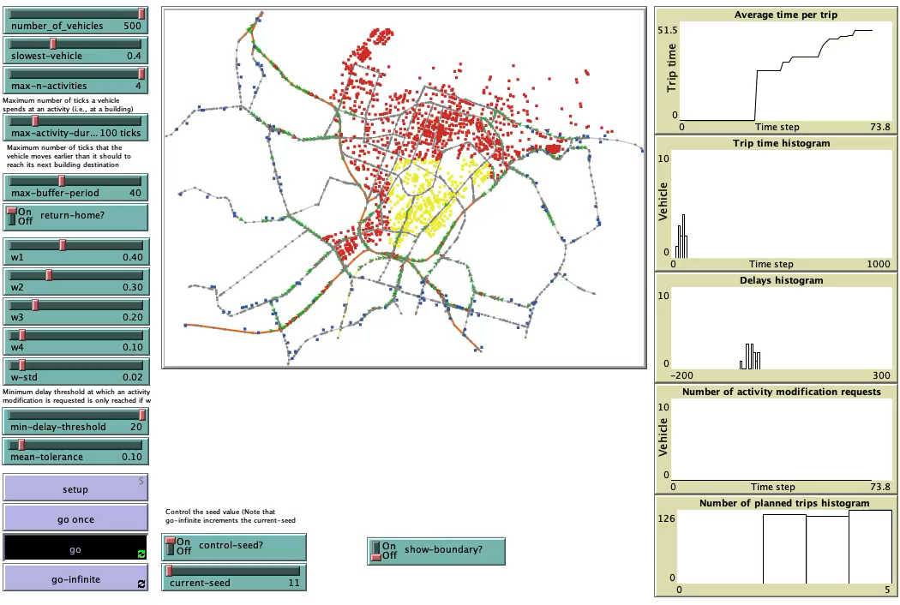

Slide 5
What Happens When You Charge Drivers?
Same road. Same price. Three very different outcomes — depending on how drivers think.
😐
Baseline Driver
😵
Herd Driver
🧠
Learning Driver
"I check the price and decide."
"Everyone avoided it yesterday, so I'll go today."
"The fee stung last time — I'll skip the trip today."
Fewer drivers enter at the peak: entry falls from 52% to 40% and peak V/C by 19%, steadily from day 1. Give them an hour of flexibility and the cut deepens to 24%.
Drivers read yesterday's congestion, not today's price. Almost everyone still enters (92%), so the charge has nothing left to deter — in every arm we tried.
Drivers learn day by day until only exploration noise is left: a −24% cut, the largest here. But it assumes staying home is the only alternative — give them options and it falls to −9 to −16%.
Peak V/C (inner cordon)
Peak V/C (inner cordon)
Peak V/C (inner cordon)
No charge 0.120
No charge 0.166
No charge 0.116
ToU 0.097
ToU 0.163
ToU 0.088
↓ Steady reduction
→ No response
↓ Largest cut in entries
Key insight: the right behavioural assumption changes not just how much congestion falls — but whether the policy works at all.

Slide 6
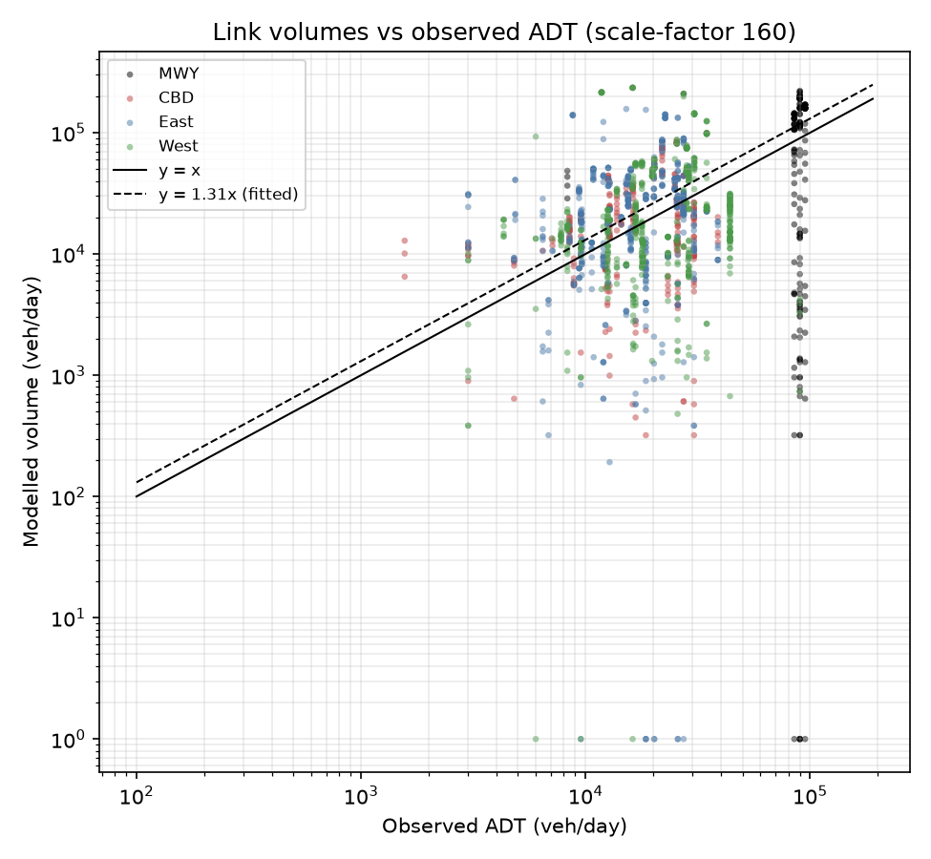
Calibrated Pre-Fix — Volume Now Reads 31% High
Volume: fitted pre-fix, kept at 160
The 1.013 fit was made while declined trips vanished. Restoring them puts the ratio at 1.308 across all 1,634 links — we keep sf 160 and report differences, not levels.
Space: 1,400 suburban trip ends added
Every non-home destination used to sit inside the cordon; adding suburban trip ends removed the CBD concentration. Post-fix overshoot sits on suburban arterials (East 1.57, West 1.40); motorways are near parity (1.04).
Time: assumed, never fitted
Departure hours come from a fixed weight profile (~20% of trips at 08:00), not from observed data. Implied design-hour factor 0.143 vs the 0.10 assumed, so absolute LoS reads pessimistically.
OD matrix: synthetic, not estimated
Origins follow 2023 Census sector shares; destinations are drawn uniformly from the building stock. No gravity model, no observed trip ends. k = 0.08/0.10/0.12 leaves direction and ordering unchanged.
So: absolute volumes and congestion levels read ~30% high against observed counts; every comparison — charged vs uncharged, rule vs rule, arm vs arm — faces the identical demand, which is what the study reports. Re-fitting (sf ≈ 122) would rescale levels only; deterrence decisions never see the vehicle weight.

Slide 7
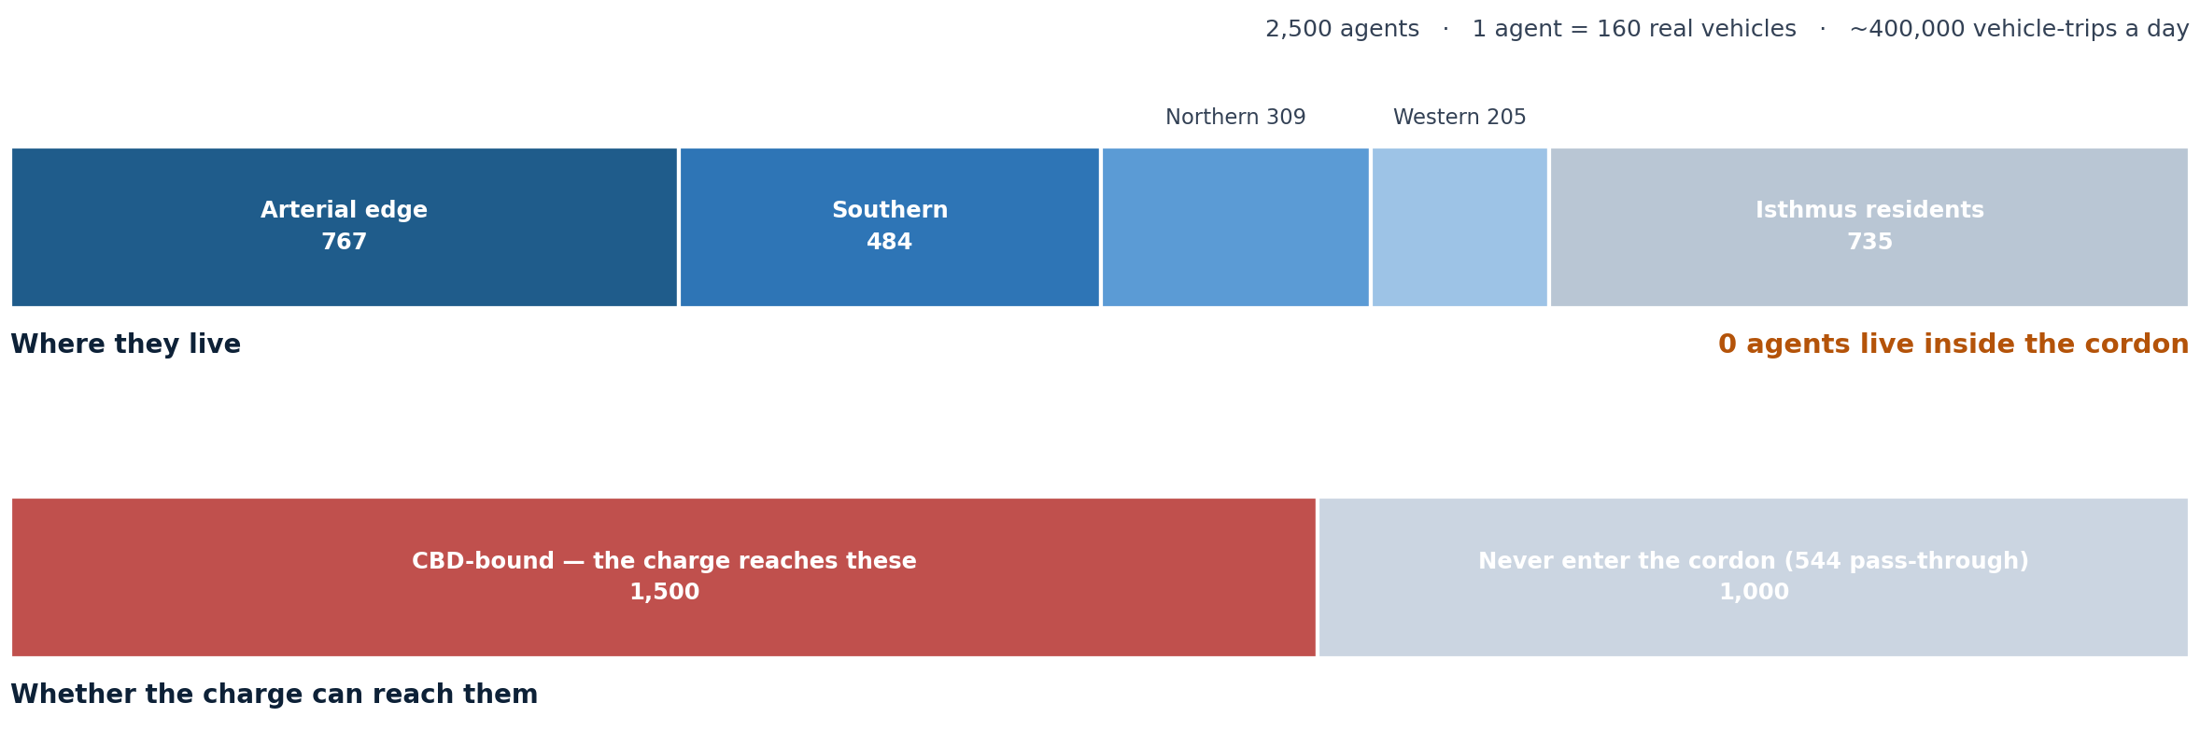
Who Are the 2,500 Agents?
Measured at setup, seed 11. Every agent lives outside the cordon, so the charge is always a decision to cross a boundary — never a resident’s parking decision.
The 1,000 agents that never enter are an unpriced comparison group inside the same run.
Notes:
Measured at setup on seed 11 by the agent-census experiment, not the expected values the sliders imply.
Where they live: 1,765 of 2,500 (70.6 %) enter from the network boundary — 767 arterial edges, 484 southern corridor, 309 northern, 205 western. The corridor split follows 2023 Census sector populations, not metered flow. The remaining 735 (29.4 %) are isthmus residents drawn uniformly from the local housing stock.
Nobody lives inside the cordon: 0 agents have a CBD home. So every charged trip is an inbound trip. The charge is never a resident's parking decision — always a decision to cross a boundary.
Exposure: 1,500 agents have at least one CBD destination and are the only ones the charge can reach. The other 1,000 never enter, so they act as an unpriced comparison group inside the same run. 544 of them are pass-through traffic crossing boundary-to-boundary, never charged, loading the ring roads whatever the fee.
Itineraries average 2.98 destinations (1-4 activity stops plus home). That multi-stop structure is why deactivating a declining agent for the whole day was such a consequential bug.
Scale: 1 agent = 160 real vehicles, so the population stands for roughly 400,000 vehicle-trips a day. That factor is what the volume calibration tunes, and every V/C and capacity number is proportional to it.

Slide 8
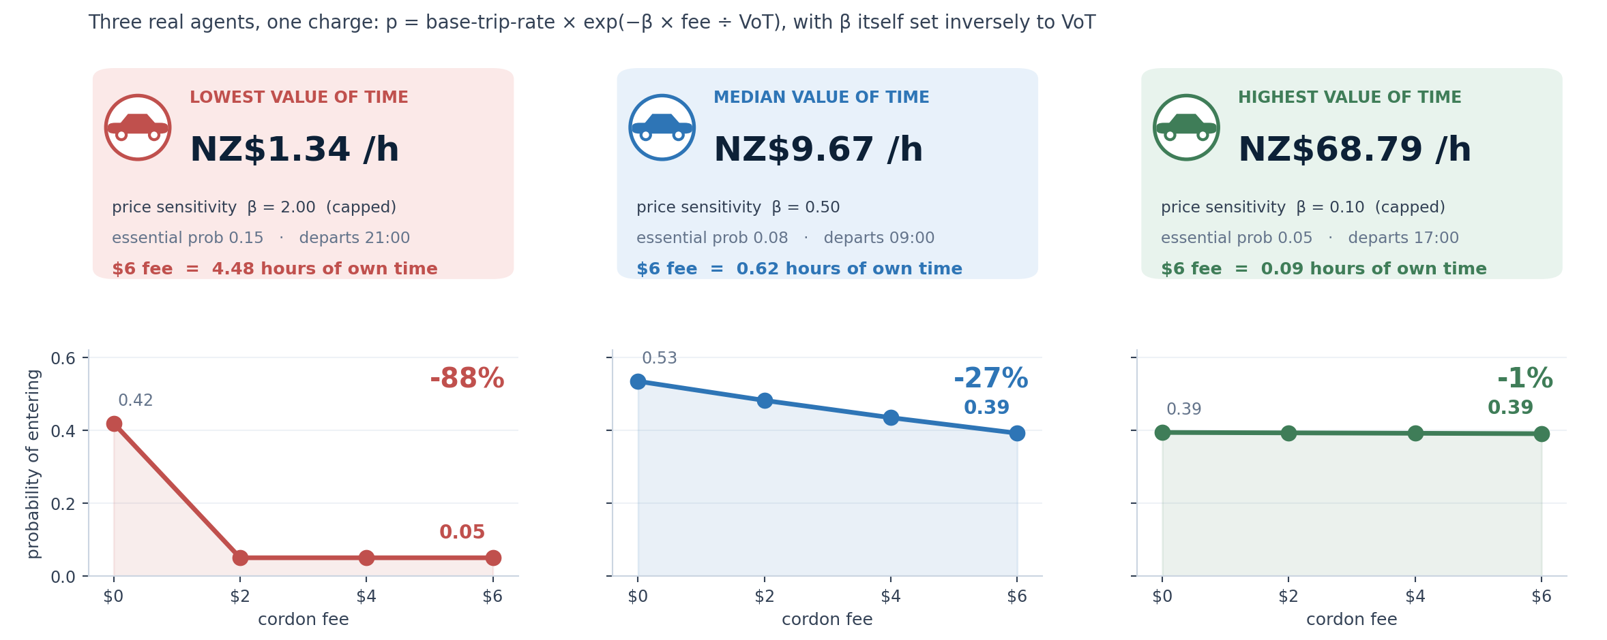
What Each Agent Carries — Three Real Examples
Every agent carries a value of time, a price sensitivity set inversely to it, a baseline trip rate and an essential-trip probability. Because β scales as 1/VoT, the deterrent behaves like fee ÷ VoT² — halving income roughly quadruples it. That is the whole equity result, visible in three individuals.
Notes:
Every agent carries four kinds of attribute. This slide shows the first kind, because it is the one that decides the response to a charge.
ECONOMIC. Value of time is drawn lognormal, exp(N(2.3, 0.6)): median NZ$9.67 an hour, mean 11.61, range 1.34 to 68.79. Price sensitivity beta is then set inversely, clip(0.5 x median VoT / own VoT, 0.1, 2.0) — so the two agents at the extremes here are both pinned at the clip. Baseline trip rate is uniform 0.3 to 0.7. Essential-trip probability is 0.15 for the bottom VoT quintile, 0.08 in the middle, 0.05 for the top.
LEARNING STATE. El Farol agents carry five predictors with weights and scores; Q-learning agents carry a 24-state by 4-action table initialised uniform on plus or minus 0.1, plus an exploration rate starting at 0.4. Each rule only uses its own.
ITINERARY. Home, a list of destinations averaging 2.98 stops, departure and return ticks, the charged hour, and today's retiming shift of minus one, zero or plus one.
PHYSICAL. Location, speed, current route, active flag, delay tolerance — inherited from the Glasgow base model and unchanged.
The mechanism to say out loud: entry probability is base-trip-rate times exp(minus beta times fee divided by VoT). Because beta is itself one over VoT, the exponent behaves like fee divided by VoT squared. Halve someone's income and the deterrent roughly quadruples. That is why the same six-dollar charge removes 88 per cent of the poorest agent's trips and 1 per cent of the richest's.
Note the last line on each card: six dollars is 4.48 hours of the lowest agent's own valuation and 5 minutes of the highest agent's. Same charge, two different prices in the currency that matters to them.
Caveat, if asked: these three are real agents from seed 11, but the entry probabilities are the decision rule evaluated directly, not counted from a run — the same derived-not-measured status as the equity slide.

Slide 9
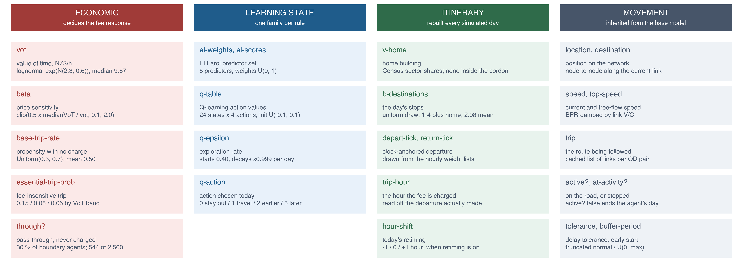
Every Attribute an Agent Carries
Only the first column decides the response to a charge. The learning state is per rule — an agent uses one family and ignores the others. Distributions are measured at setup, seed 11.

Slide 10
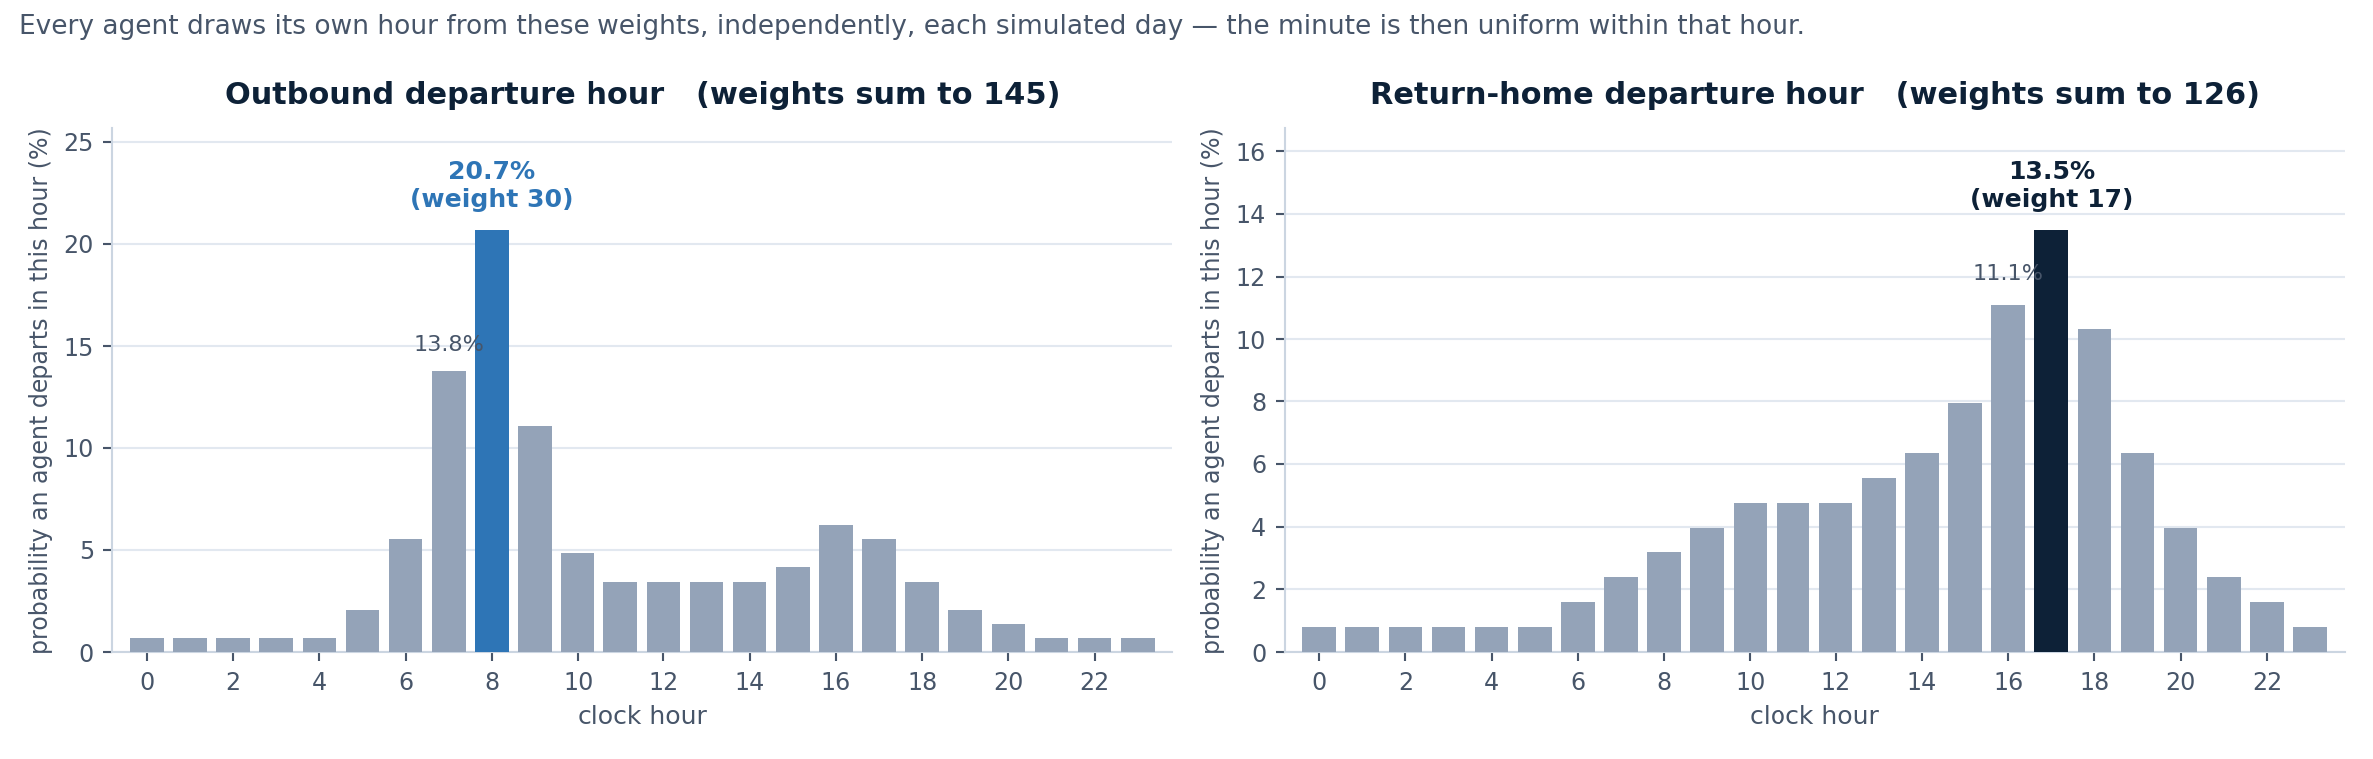
How Departure Hours Are Drawn — Not an OD Matrix
Two axes, drawn independently. The OD matrix answers where a trip goes; these weights answer when it leaves. The weights do not stand in for an OD matrix — they act after the origin and destination are already fixed.
Hourly volume is never assigned. Each of the 2,500 agents spins its own roulette every simulated day, so "how many depart at 08:00" emerges from 2,500 independent draws and differs from day to day. The 20.7 % spike at 08:00 is the direct cause of the too-sharp morning peak (implied k = 0.157 against the 0.10 assumed).

Slide 11
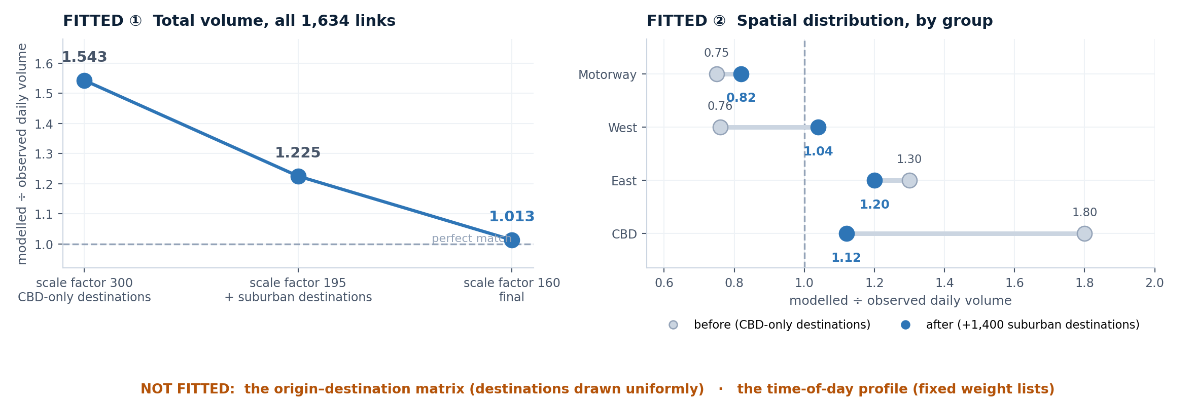
What Was Fitted, and What Was Assumed
Two knobs, and only two. The agent scale factor fixes total volume; suburban destinations fix the spatial spread. Both converge on the observed counts.
Nothing fits the temporal axis, which is why the implied design-hour factor sits at 0.157 against the 0.10 assumed — a missing fit, not a poor one.
Notes:
Only two knobs were turned in calibration; everything else about demand is a modelling choice.
FITTED 1, total volume. The agent scale factor went 300 to 195 to 160, matched against Auckland Transport observed ADT on all 1,634 links. Flow-weighted modelled-over-observed ratio fell 1.543 to 1.225 to 1.013, median per link 1.010. One division sufficed because routes are fixed and every trip completes, so link volumes are exactly proportional to the scale factor — the fit is arithmetic, not an iterative search.
FITTED 2, spatial distribution. All 1,484 non-home buildings originally sat inside the cordon, so uniform sampling sent every trip to the city centre. Adding 1,400 suburban destinations moved group ratios from a 0.75-1.80 spread to 0.82-1.20, and the CBD from 1.80 to 1.12. Note this changed the pool the draw samples from — the uniform drawing rule itself was never changed.
ASSUMED 1, the origin-destination matrix. Origins follow Census sector shares; destinations are drawn uniformly from the non-home building stock. No gravity term, no size or attraction weighting, no observed trip ends.
ASSUMED 2, the time-of-day profile — the two weight lists on the previous slide. No observed departure distribution enters the model at any point.
So the temporal residual is not a shortfall. Implied design-hour factor 0.157 against the 0.10 assumed in the capacity conversion. That gap is not a profile fitted badly; it is what happens when no profile is fitted at all. Fitting it to observed data is the obvious next calibration step.
If asked: the earlier draft credited TomTom Move data with the profile and NZTA screenline counts with corridor inflow. Neither is implemented — no TomTom file exists in the repository, and the screenline reporters are never called by any procedure. The write-up has been corrected.
The honest framing: the model reproduces observed traffic volume and its spatial spread, not observed travel patterns. Every rule and fee regime faces the identical demand realisation, so this bounds how the absolute levels may be read without weakening the comparison between rules, which is what the study is for.

Slide 12
How Much to Trust Each Number
Evidence status: what is measured, what is only derived, and what is superseded
MEASURED in the runs
DERIVED — not yet measured
Peak V/C, entry trajectories, hourly profiles, LoS shares, the map. Seed 11, 14 days. Levels read ~30% high vs counts; quote differences.
The equity result, the OD matrix and the time-of-day profile.
SUPERSEDED — not quoted
RANGES, not point estimates
All pre-calibration numbers, El Farol’s ‘oscillation’, Learn’s −39 %.
Pay 0–24 % (rerouting moves the benefit to the boundary), Learn 9–24 %, Oscillate 0 % — width set by the action space.
Controlled comparison
Direction robust to capacity assumption
One network, one population, one seed across every rule and arm.
k = 0.08 / 0.10 / 0.12 never changes the sign or ordering.
KNOWN BIAS, repaired: a declined CBD entry cancelled the agent’s whole day
~100,000 suburban vehicle-trips a day vanished with the declining agents, flattering every result outside the cordon. Fixed 30 Jul 2026; all four arms re-run on the fixed model, 6 Aug.
Notes:
This slide exists so nobody has to guess which numbers carry weight.
MEASURED: peak V/C by rule and arm, entry trajectories, hourly profiles, LoS shares and the redistribution map. Seed 11, 14 simulated days, with day-to-day standard deviation quoted alongside every mean.
DERIVED, not measured: the income-quintile burden and the learner's reward diagnosis come from applying the model's own decision and reward equations to the calibrated value-of-time distribution. No run has recorded entries by income band, and the reporter that would have done so is defective. The OD matrix and the time-of-day profile are likewise assumed inputs rather than estimated ones.
SUPERSEDED, do not quote: every pre-calibration number; El Farol's apparent oscillation, which was an artefact of an overloaded network; and the learner's minus 39 per cent base-arm headline, which is an artefact of an action space where staying home is the only alternative.
RANGES rather than point estimates: the ToU cut in peak inner-cordon V/C is 12 to 26 per cent for Pay, 14 to 39 per cent for Learn, and zero for Oscillate. The width comes from what agents are permitted to do, with rule, network, demand and fee schedule all held fixed.
Controlled comparison: one network, one population, one fee schedule and one seed across all rules and arms, so differences between cells are attributable rather than sampling noise. The flip side is that all spreads are within-seed.
Capacity assumption: k at 0.08, 0.10 and 0.12 changes how congestion is graded but never the sign or ordering of any pricing effect, which is why we report differences rather than absolute Level of Service.
Known bias: a declined CBD entry used to deactivate the agent for the whole day, cancelling its suburban stops too — of the order of 100,000 vehicle-trips a day off roads outside the cordon for no behavioural reason. That flattered the peripheral reductions and the no-displacement result. Fixed in the model on 29 July 2026; every number in this talk predates the fix and the re-run is pending.

Slide 13
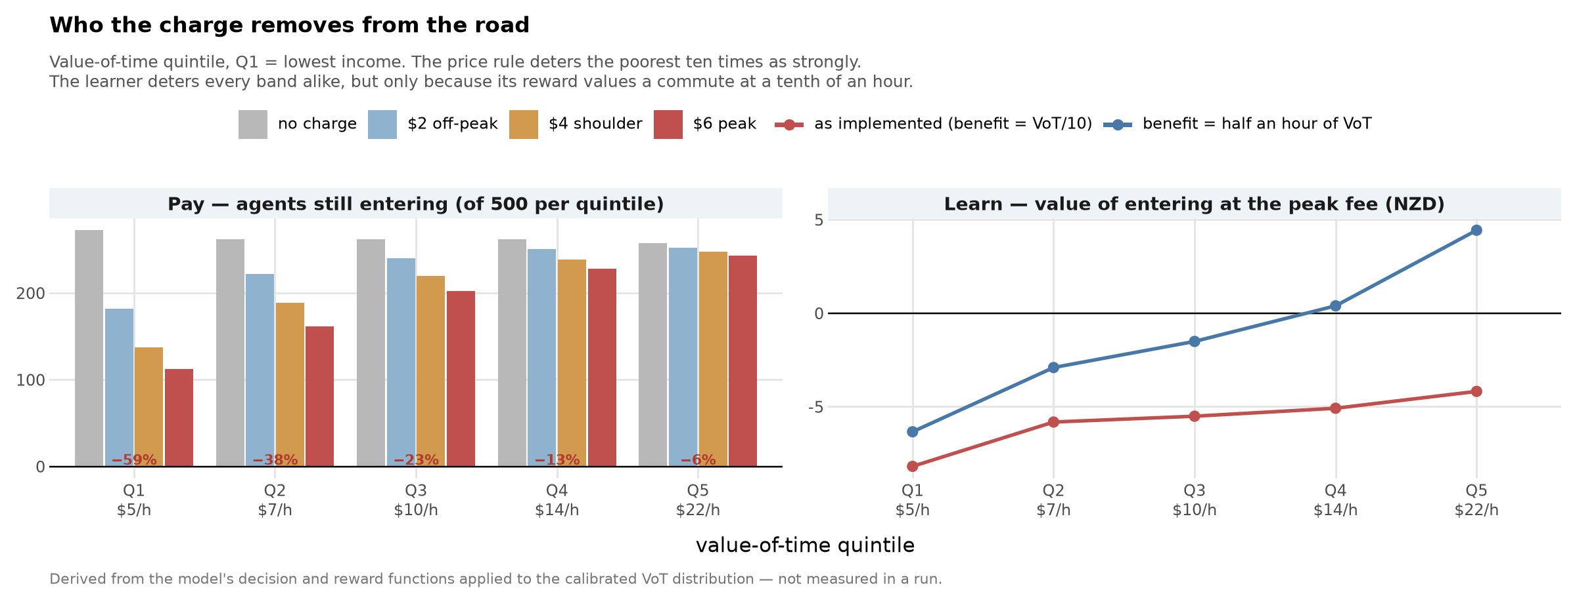
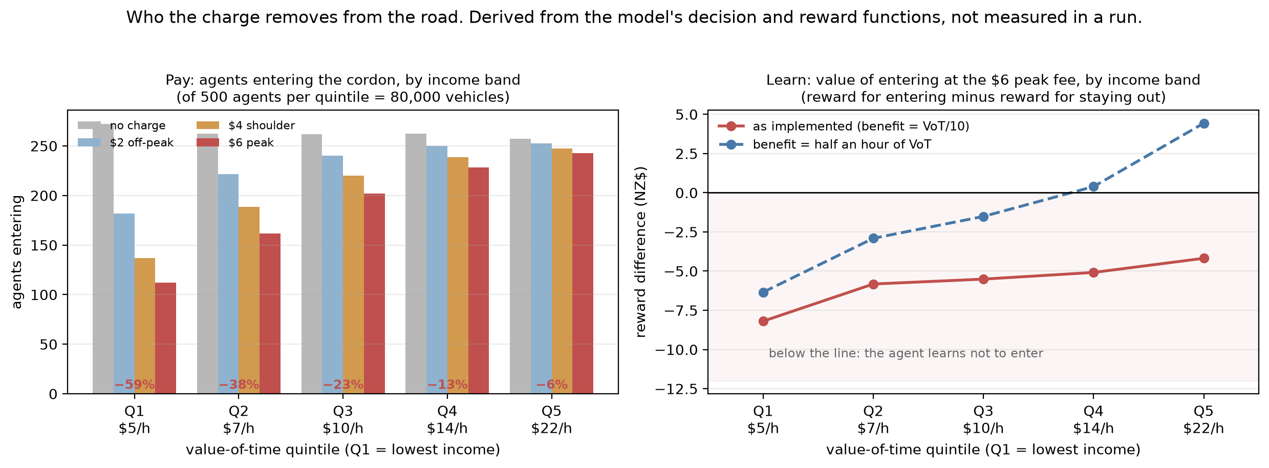
Who Would Pay? Derived, Not Yet Measured
DERIVED — NOT MEASURED
Left (price rule): projected entries per value-of-time quintile as the fee rises. IF the decision rule holds, the $6 peak fee removes 59% of Q1’s trips against 6% of Q5’s — the same charge costs Q1 1.30 hours of its own time and Q5 0.28 hours.
Implication, conditional on the rule: most of the congestion relief would be bought by low-income drivers giving up trips.
Right (learner): a diagnosis, not a result — its flat income gradient exists only because the reward prices a commute at VoT/10. Valued at half an hour of VoT, the regressive pattern returns. The learner’s equity story is a scaling choice.
How these numbers were obtained: the model’s decision and reward equations applied to the calibrated VoT distribution (median NZ$10/h). No run has recorded entries by income band, so regressivity is a projection of the assumed rule, not a confirmed simulation outcome. A recording re-run is planned.

Slide 14
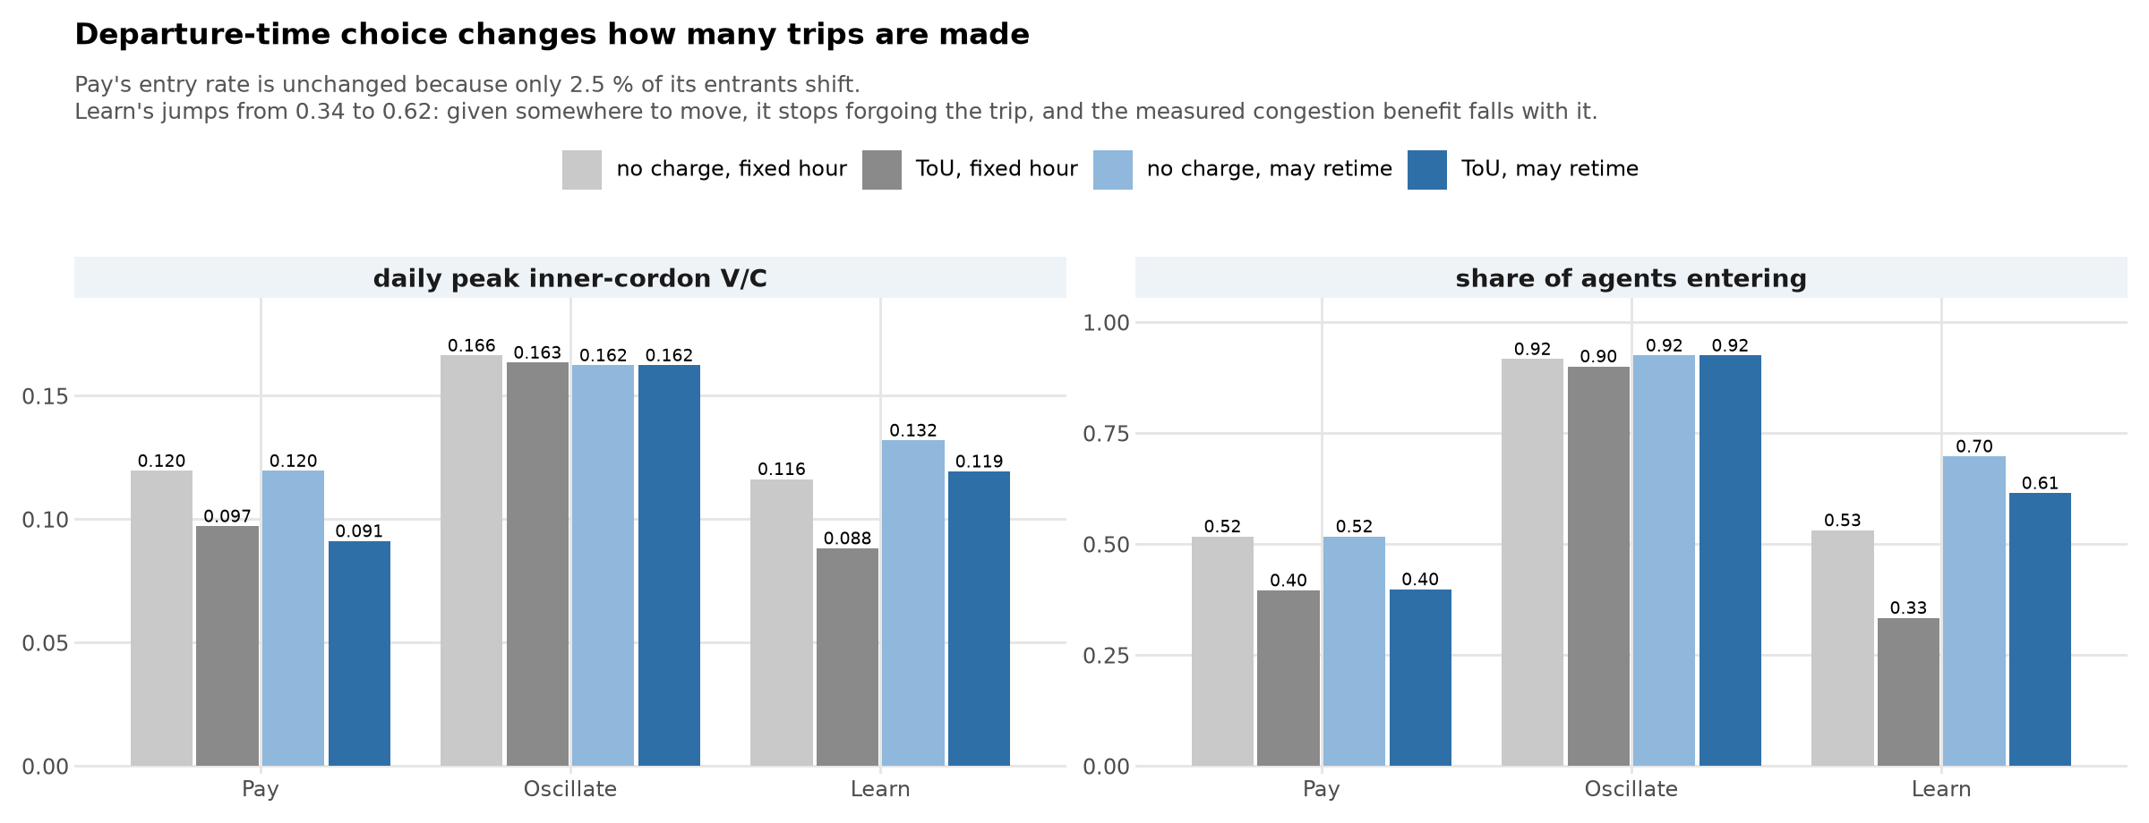
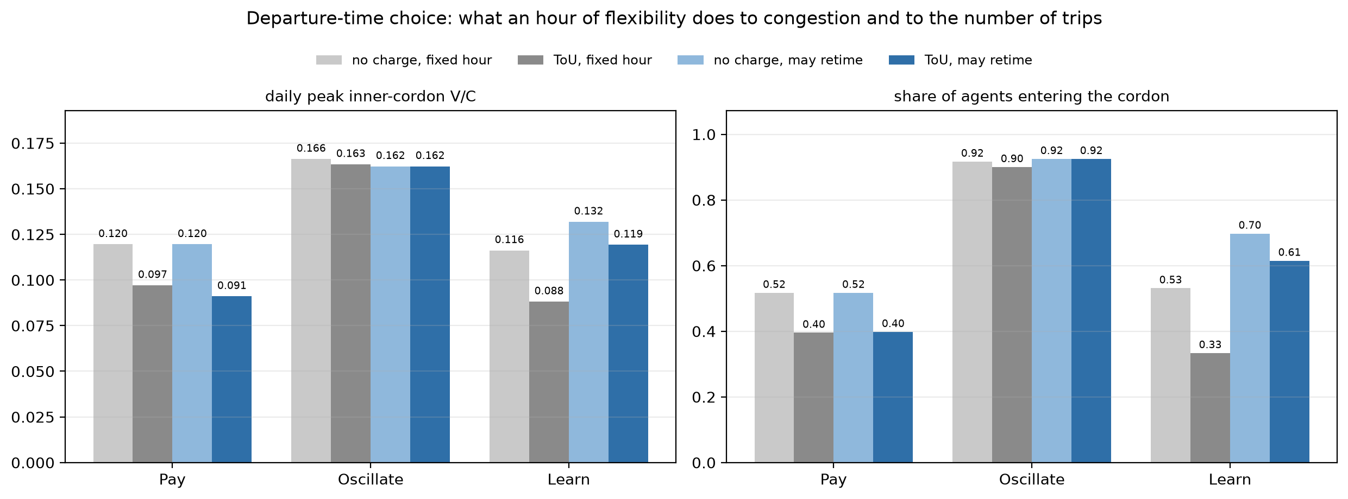
Let Them Shift an Hour: Fewer Trips Forgone
Retiming is the only option that changes HOW MANY trips are made. Pay's entry rate is unchanged (0.40) because only 2.5% of its entrants shift — 13 of 15 earlier, all of them low-income, since an hour of schedule delay costs 0.6 x VoT against a $2 saving.
Learn is the opposite: given somewhere to move, 64% shift and entry jumps 0.33 → 0.62, so the measured congestion benefit falls from 24% to 9%.
A model where the only response is 'stay home' overstates what the charge achieves.

Slide 15
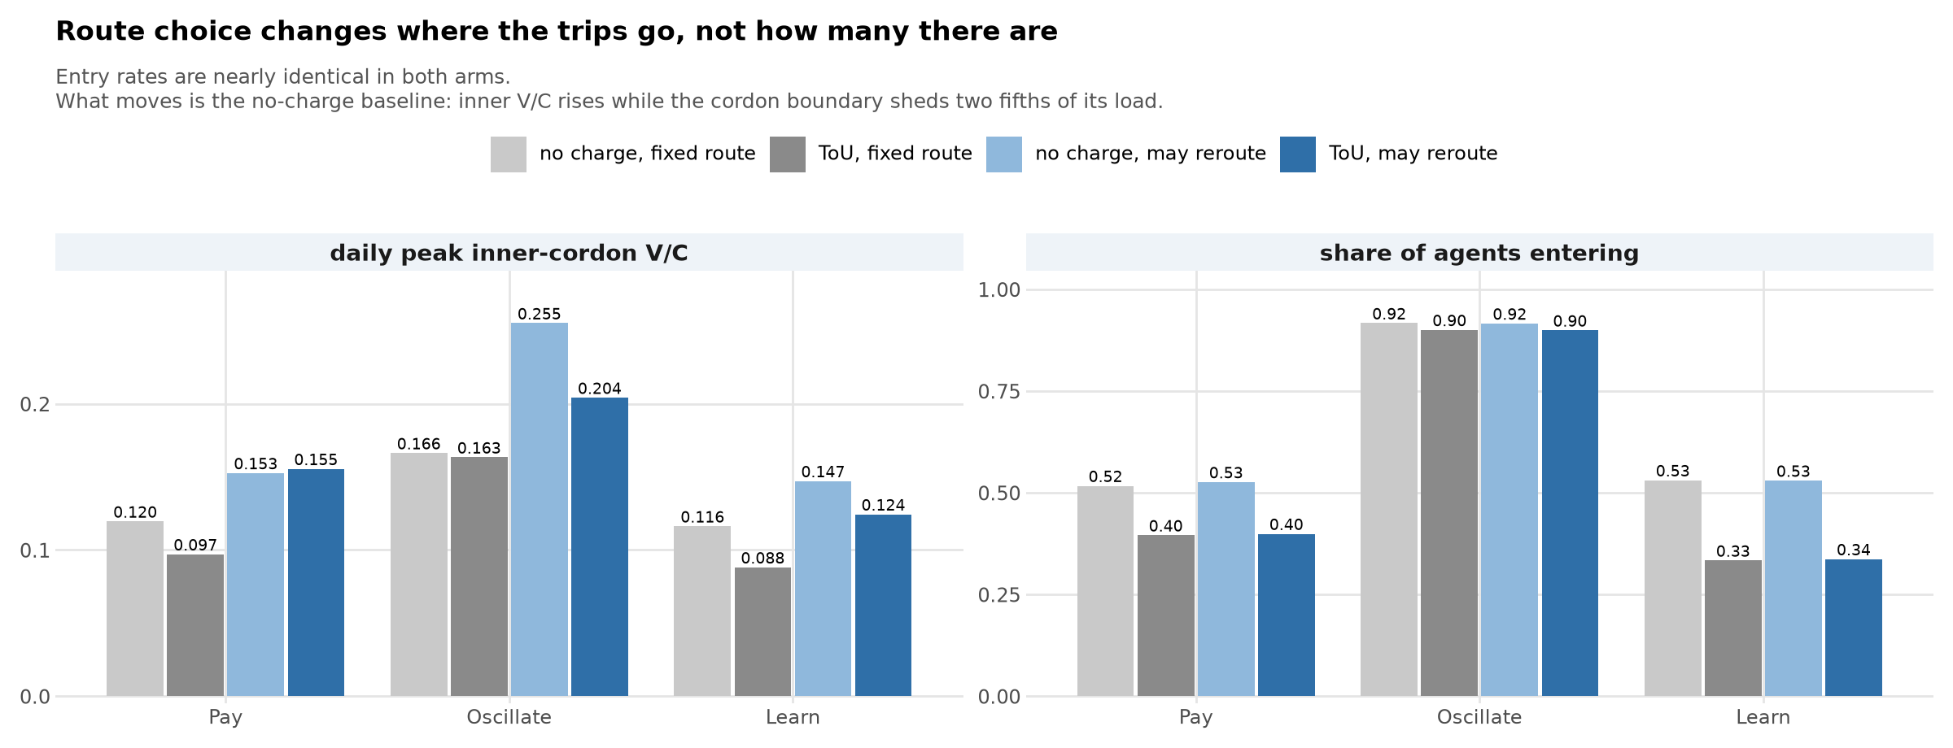
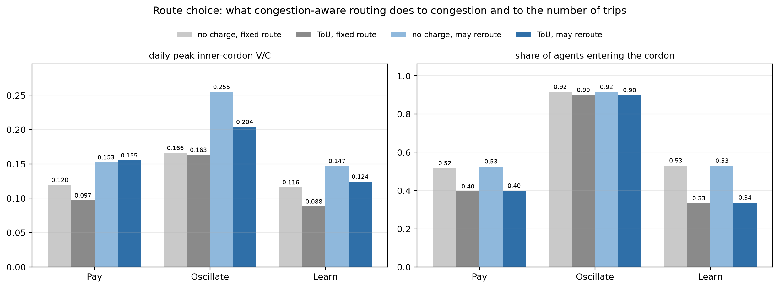
Let Them Take Another Road: Same Trips, New Places
Route choice leaves the number of trips untouched — entry rates are nearly identical (Pay 0.40, Learn 0.34) — and changes only where those trips go.
The no-charge baseline moves a lot: inner V/C rises (0.120 → 0.153 for Pay) while the cordon boundary falls by two fifths, because fixed shortest paths were funnelling traffic onto a few approach arterials.
This is the arm that makes displacement testable: the traffic still exists and can move. It still does not pile up outside the cordon — instead it partly refills the interior the charge empties, so Pay's inner benefit vanishes (within noise) and shows up on the boundary (−20%).

Slide 16
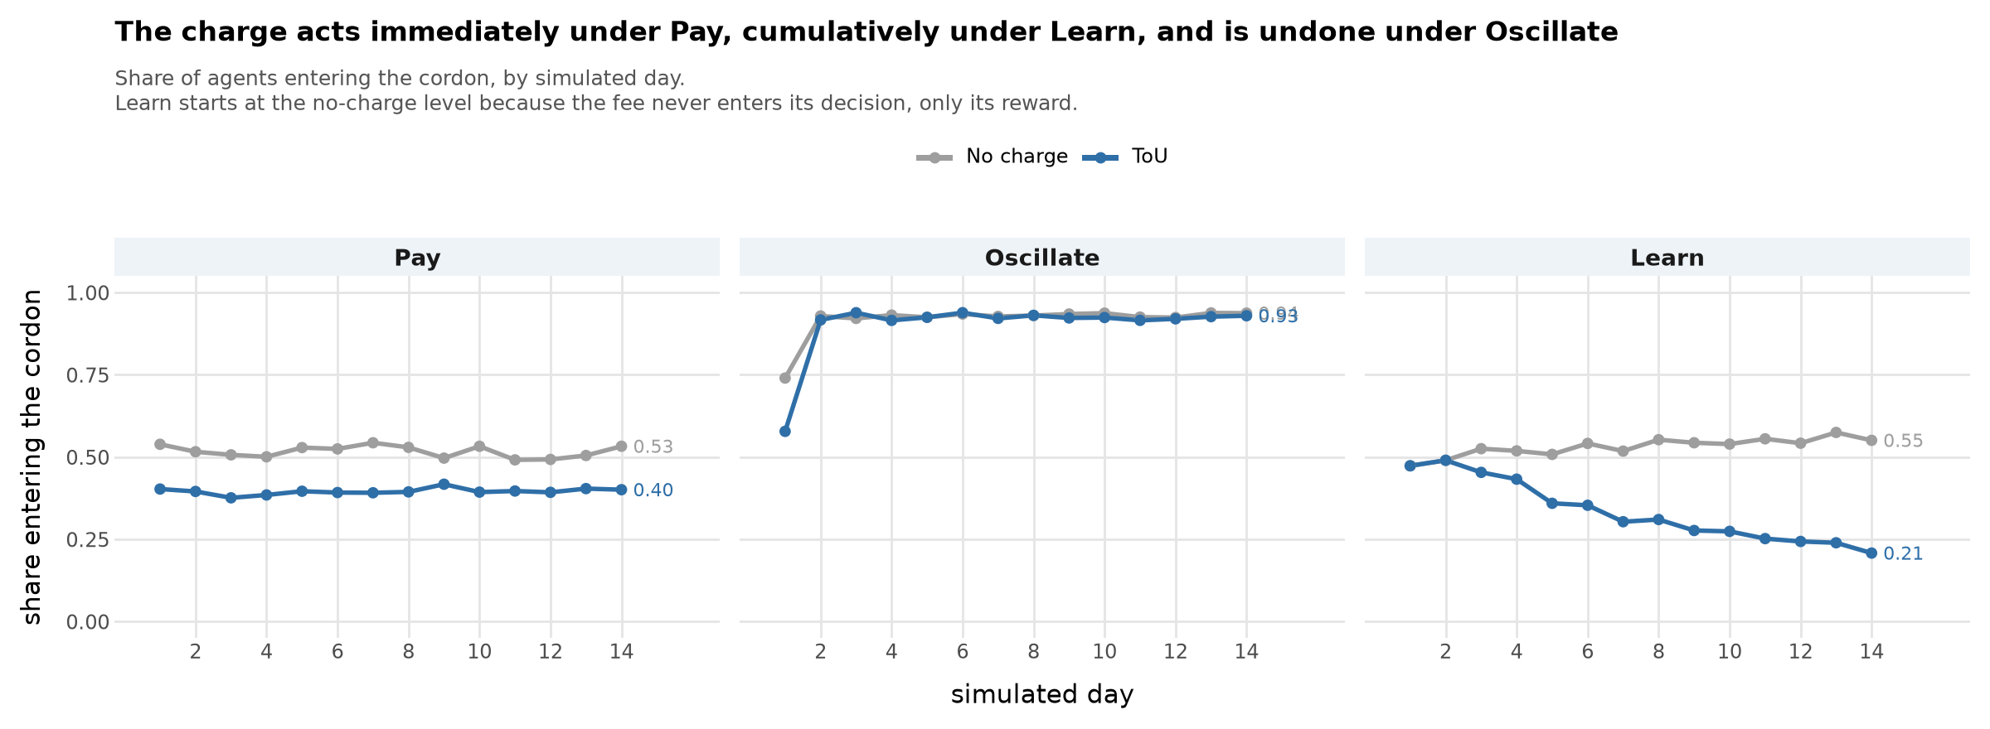
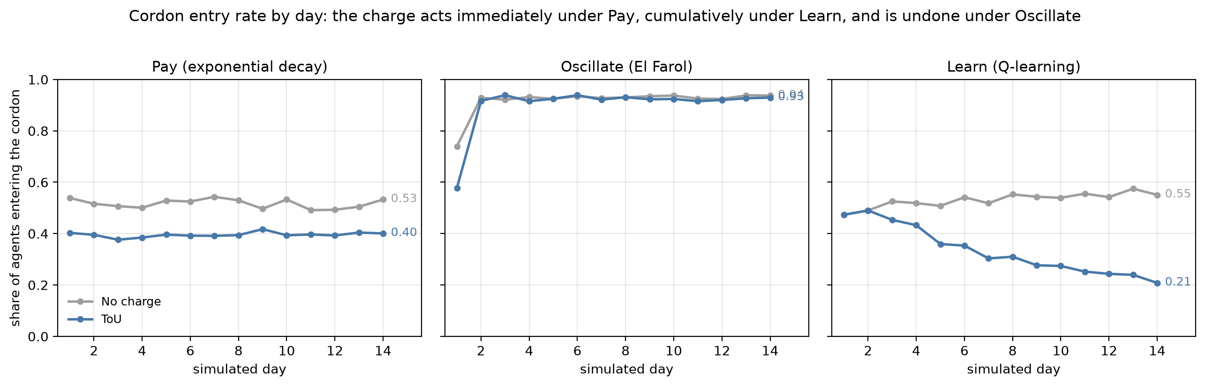
Learning Hits Its Floor — Herding Bounces Back
Pay reads the fee inside the decision, so its response is complete on day 1 and then flat.
Learn never sees the fee when it decides — it only feels it in the reward. Entry starts at the no-charge level (0.47, identical for two days) and slides to 0.21 by day 14: the fee ($2–6) outweighs the congestion it could avoid (~0.3 in reward units), so nothing pulls entry back up. And 0.21 is the floor, not a pause — agents still explore at ε ≈ 0.39 and an explorer enters half the time, so ε/2 ≈ 0.19 of entries are dice. The learned policy is ‘do not enter’ for essentially everyone: learning has finished. Fee per entrant is flat (2.83 → 2.74): deterrence, not retiming.
Oscillate is deterred on day 1 (0.58 vs 0.74) but its own feedback erases that within a day — by day 2 both regimes sit at 0.92.

Slide 17
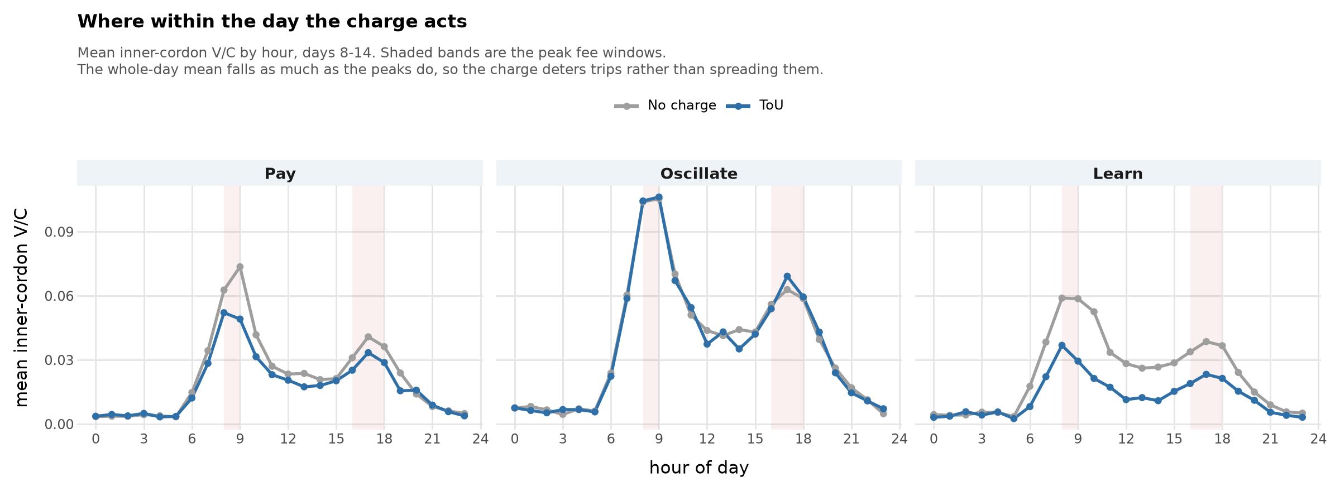
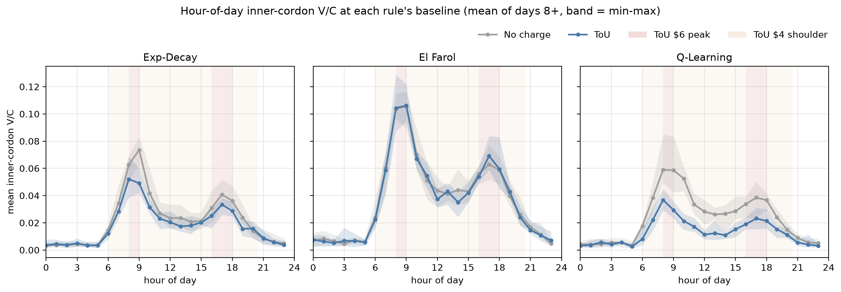
Where the Charge Acts Within the Day
Hour-of-day inner-cordon V/C, days 8–14, no charge (grey) vs ToU (blue); shaded bands are the $6 peak and $4 shoulder fee windows. Pay −17% at the morning peak, Learn −39%, Oscillate −1%. The whole-day mean falls by as much as the peaks do, so the charge deters trips rather than spreading them.

Slide 18
Midday Is Where the Charge Actually Bites
% of each group's traffic at LoS E or worse, no charge → ToU. Mean of days 8–14.
Road group / time band | Pay | Oscillate | Learn
MWY · AM 07–09 | 53 → 54 (+3%) | 62 → 58 (-6%) | 53 → 49 (-7%)
MWY · Midday 12–15 | 46 → 39 (-16%) | 62 → 58 (-6%) | 48 → 18 (-63%)
MWY · PM 16–18 | 63 → 60 (-4%) | 81 → 82 (+1%) | 68 → 58 (-14%)
CBD · AM 07–09 | 61 → 59 (-4%) | 75 → 74 (-2%) | 62 → 54 (-14%)
CBD · Midday 12–15 | 65 → 60 (-7%) | 80 → 79 (-1%) | 69 → 49 (-30%)
CBD · PM 16–18 | 70 → 68 (-3%) | 83 → 83 (+1%) | 72 → 62 (-14%)
East · AM 07–09 | 69 → 67 (-3%) | 77 → 77 (+0%) | 70 → 67 (-4%)
East · Midday 12–15 | 64 → 62 (-3%) | 79 → 77 (-3%) | 68 → 54 (-20%)
East · PM 16–18 | 75 → 73 (-2%) | 84 → 84 (+0%) | 77 → 70 (-9%)
West · AM 07–09 | 68 → 67 (-0%) | 70 → 69 (-1%) | 68 → 66 (-3%)
West · Midday 12–15 | 68 → 64 (-5%) | 71 → 68 (-4%) | 68 → 61 (-10%)
West · PM 16–18 | 74 → 75 (+0%) | 79 → 79 (-0%) | 77 → 76 (-2%)
Green = a fall of 10 % or more, red = the charge made it worse. The peaks barely move because what is left in them is essential travel; the midday shoulder is where discretionary trips sit, and Learn cuts motorway E/F traffic there by 63 %. Oscillate moves nothing anywhere.

Slide 19
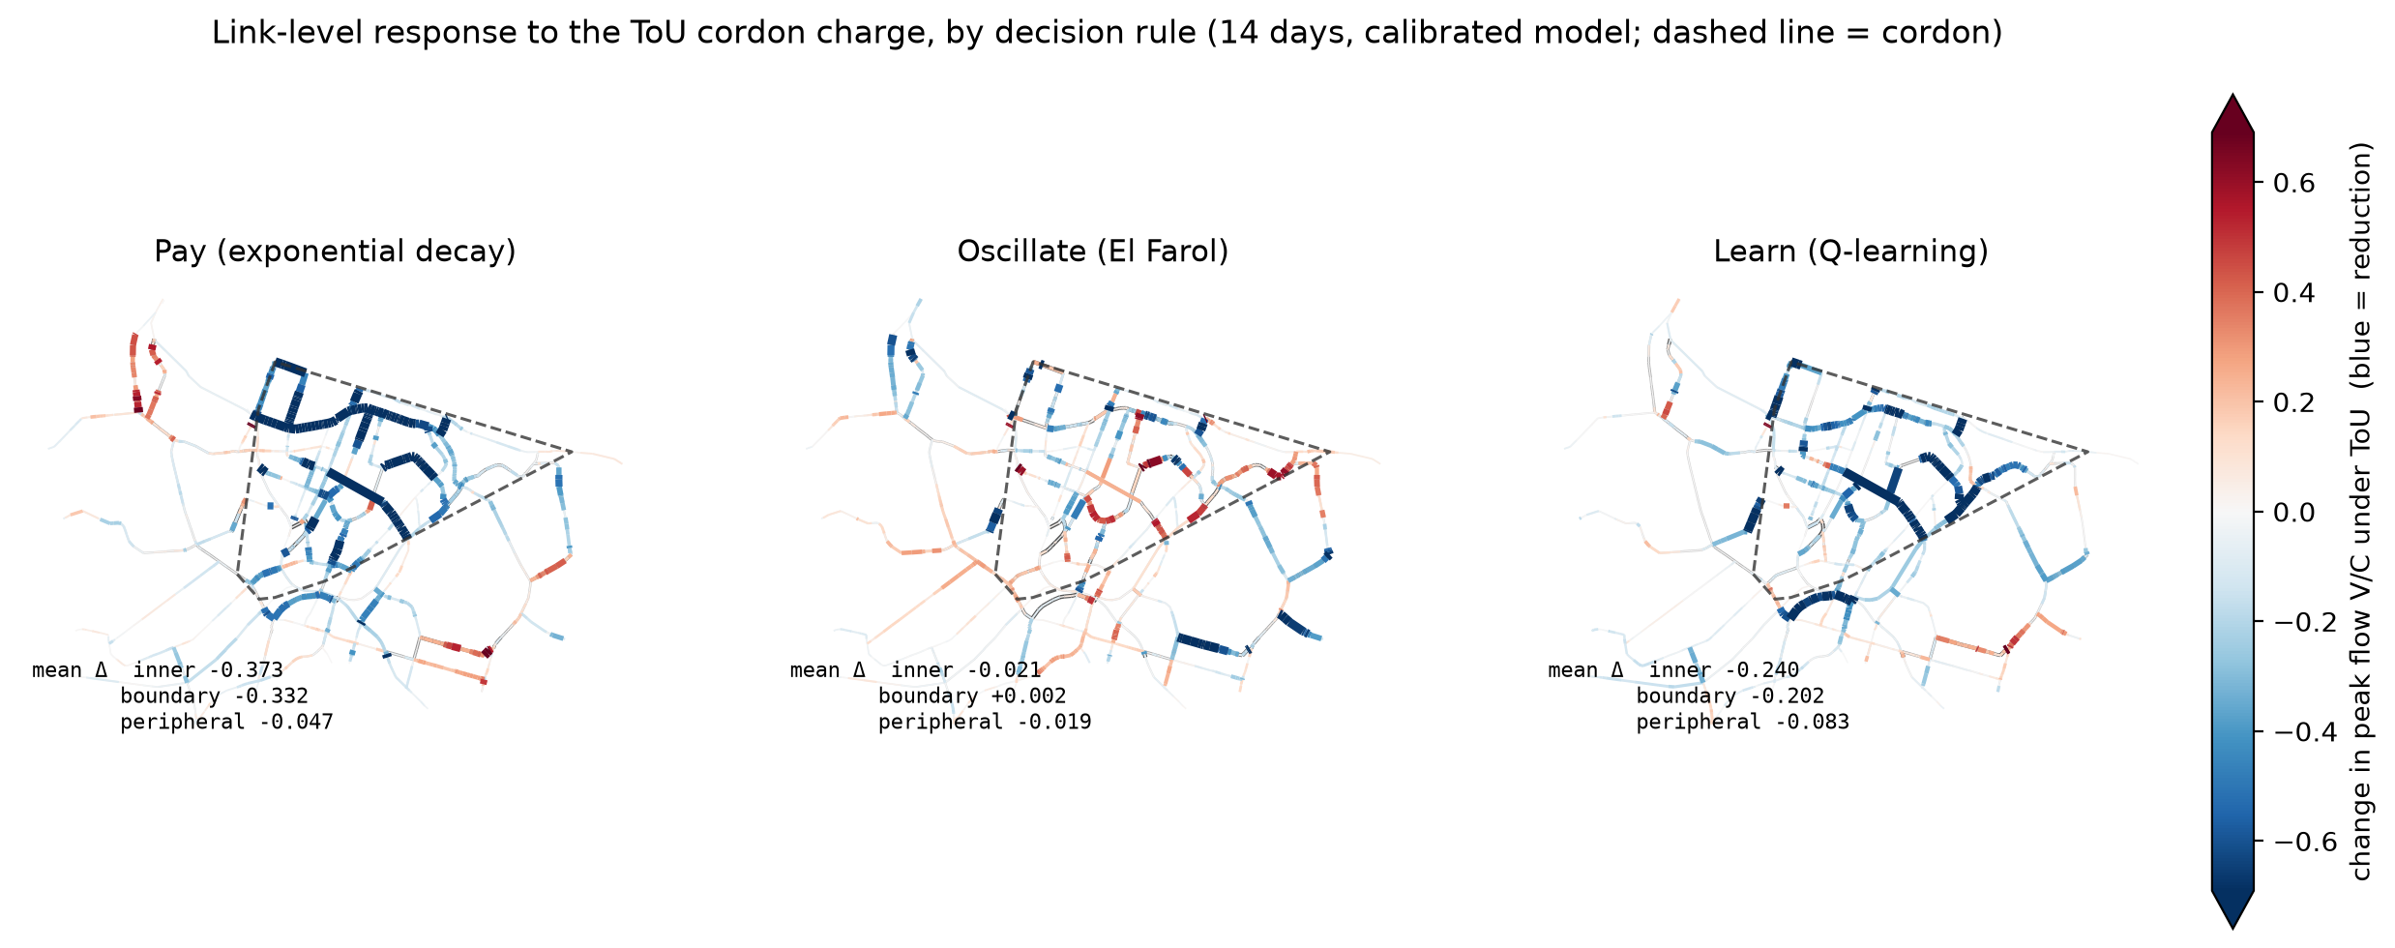
No Displacement onto the Ring Roads — So Far
Change in per-link peak V/C under ToU: blue is a reduction, red an increase, dashed outline is the cordon. Under Pay and Learn the boundary and approach roads fall together with the interior (−12% and −23% at the boundary). Under Oscillate the map is mottled and the net change is zero.
Post-fix: these runs include the trip-suppression fix, so a declining agent keeps its suburban trips and the roads outside the cordon carry the traffic they should. The outer-zone falls are smaller than pre-fix — and more defensible — and still negative everywhere: no ring of increases.

Slide 20
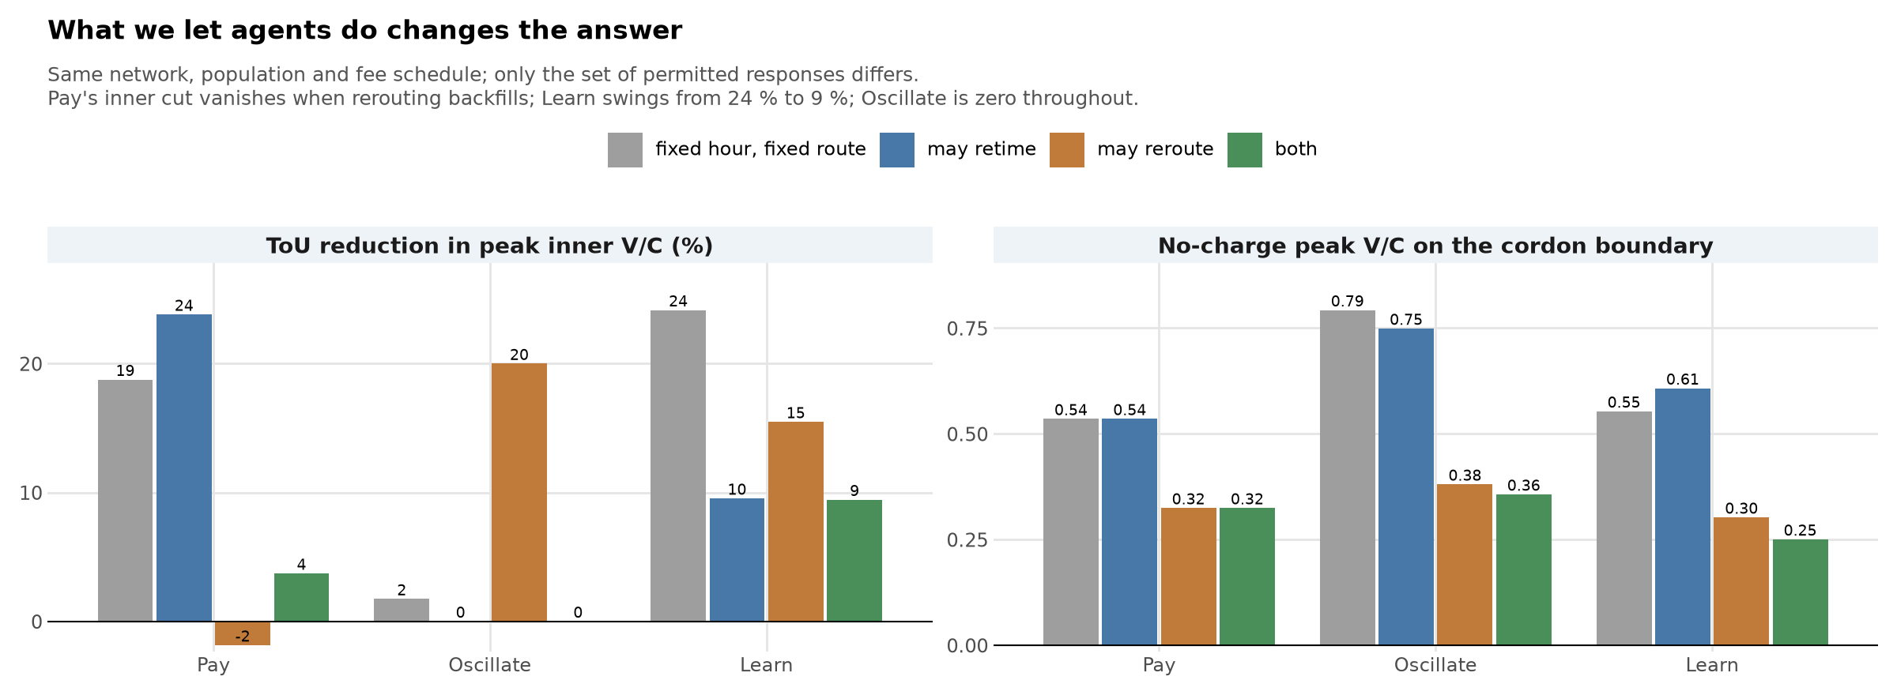
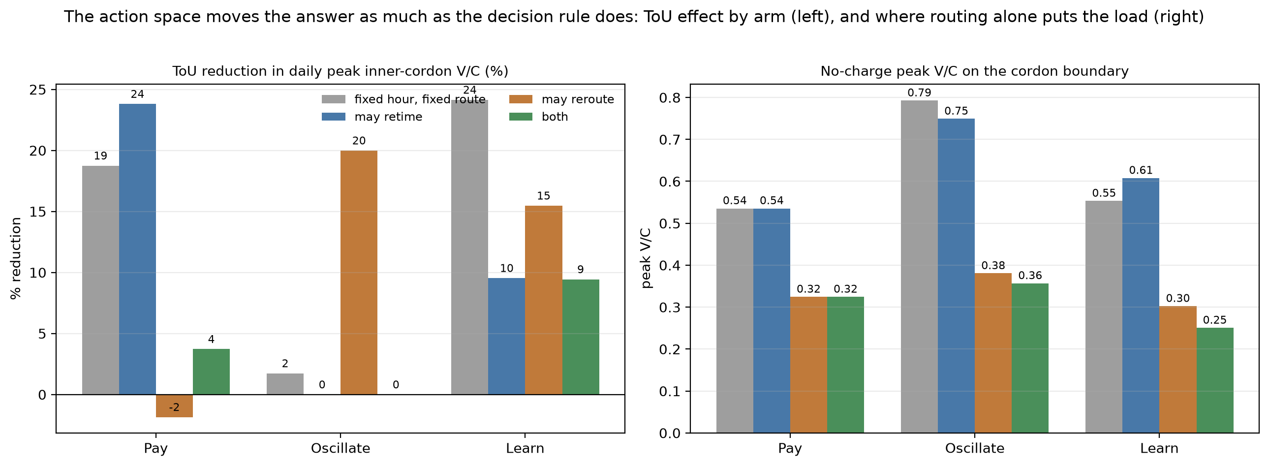
What We Let Agents Do Changes the Answer
Same network, same population, same fee schedule. The only difference is the set of responses an agent is allowed: forgo the trip only (grey), or also shift an hour (blue), reroute (orange), or both (green).
Pay deters ~24% of entries in every arm, but its inner-cordon cut (−19 to −24% with fixed routes) vanishes under rerouting — the benefit moves to the boundary (−20%). Learn swings 24% → 9%. Oscillate is zero in every arm.
Right: routing alone cuts the no-charge boundary load by two fifths to half — the biggest single effect here is a modelling assumption, not a policy.

Slide 21
What This Model Cannot Say
Seven limits that bound every number in this talk
Single seed
Fee level untested
Spreads are within-seed. Only El Farol has a five-seed replication.
No fee-level sweep. The beta sweep varies sensitivity, not price.
Equity is derived, not measured
Learn rests on two arbitrary settings
From the equations, not the runs. No entries recorded by income band.
Reward scale and action space between them decide the headline.
Routing answers to congestion, not the fee
Demand is synthetic, not observed
A CBD-bound agent pays whichever road it takes.
No observed OD or time profile; post-fix, volume runs 31% above counts — differences reported, not levels.
A declined trip cancelled the agent’s whole day — fixed, base arm re-run 6 Aug
Declining deactivated the whole multi-stop agent, so ~100,000 suburban vehicle-trips a day vanished. Fixed 30 Jul 2026; base-arm numbers are post-fix (6 Aug re-run), extension arms re-running.
Notes:
Seven limits that bound every number in this talk.
Single seed: day-to-day spreads describe variation within one seed, not run-to-run uncertainty. Only the El Farol case has a five-seed replication, which confirmed its null result at minus 1.7 per cent, range minus 5.8 to plus 1.1.
Fee level untested: no fee-level sweep has been run on the calibrated model. The beta sensitivity varies price sensitivity, not price, so this study says nothing about how much to charge.
Equity is derived: the quintile figures come from the decision and reward equations, not from any run. No experiment recorded entries by income band.
The learner rests on two arbitrary settings: its reward values a commute at one tenth of the agent's hourly value of time, against fees of two to six dollars, and its action space decides the headline — 39 per cent versus 14 per cent.
Routing answers to congestion, not the fee: a CBD-bound agent pays whichever road it takes, so cordon-dodging proper is still untested.
Demand is synthetic: no observed OD matrix and no observed time-of-day profile. Destinations are drawn uniformly from the building stock and departure hours from a fixed weight list. Volume and spatial spread are fitted to observed counts; travel patterns are not.
The structural one: all 1,500 CBD-bound agents are multi-stop, 3.76 destinations each, and declining the charge used to deactivate the whole agent. Fixed on 29 July 2026, but every number here predates the fix. The k-factor sweep re-grades identical traffic, so it never tested this.

Slide 22
Conclusions & Next Steps
Key Findings
Next Steps
1
Behavioural assumption shapes both magnitude and temporal redistribution of congestion — not just the quantity
Model Extension
Mode choice, household VoT calibration from NZ travel survey data
2
Q-learning's headline depends on what agents may do: −39% when the only option is to stay home, −14% when they can shift an hour
LLM-ABM Hybrid
3-layer cognitive architecture: reactive (classical), deliberate (lightweight LLM), reflective (daily/weekly reasoning)
3
El Farol shows what happens when agents track each other rather than the fee — entry stays at 91% and the charge does nothing
Fee-Level Sweep
Vary the ToU schedule itself: the one experiment that would let us say how much to charge, not just whether
4
ABM places competing theories side-by-side within a common environment — revealing structural differences invisible to aggregate models
Scale Up
Scale beyond 2,500 agents (≈400k vehicles today); dynamic OD matrix replacing the fixed assumption
github.com/dataandcrowd/SSC2026 | h.shin@auckland.ac.nz

