Slide 1
The Impacts of Biases in Crowdsourced Data on the Output of Machine Learning
Dr Ana Basiri, Professor Muki Haklay, Dr Zoe Gardner
Lecturer in Spatial Data Science and Visualisation
Centre for Advanced Spatial Analysis (CASA), University College London (UCL)
A.Basiri@ucl.ac.uk

Slide 2

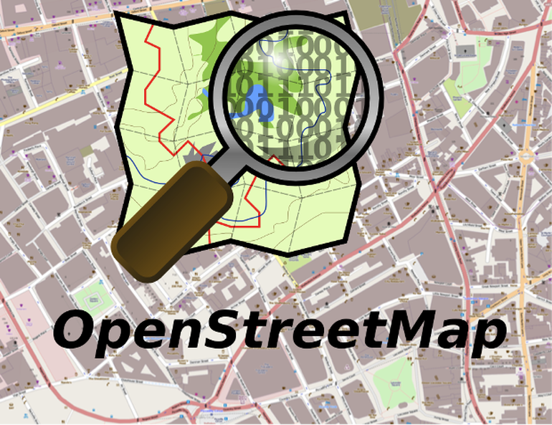


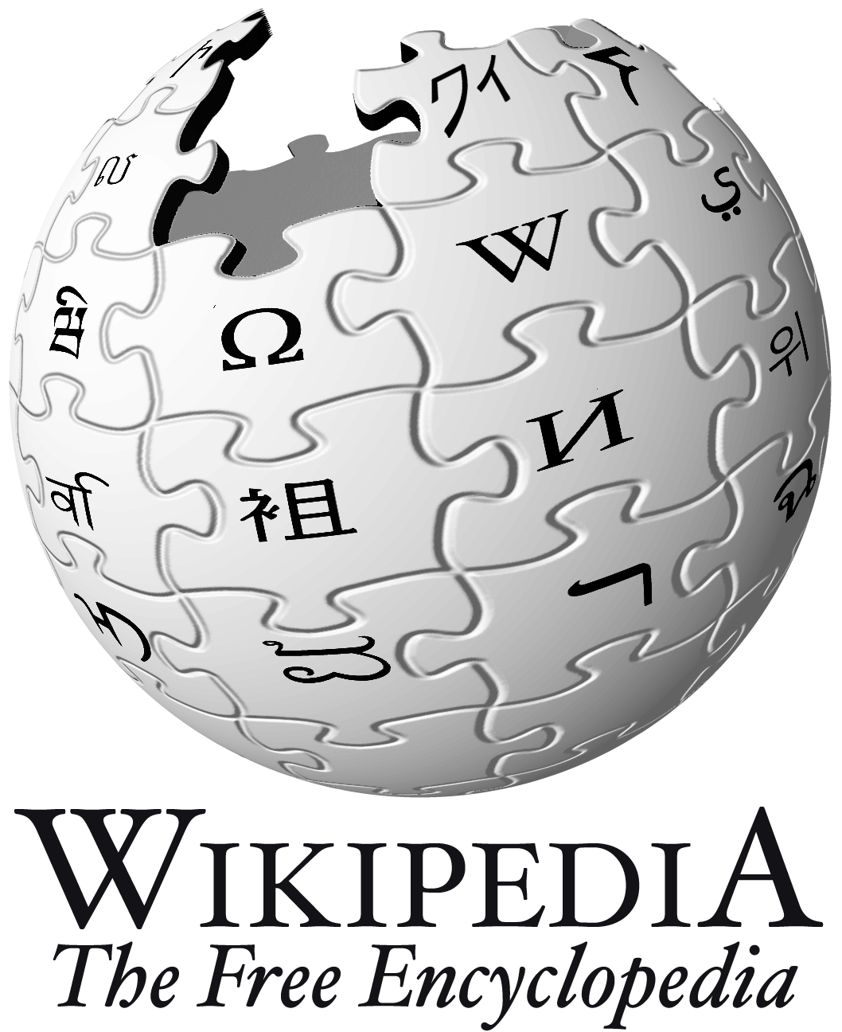



Importance: Popularity of Crowdsourcing faster, cheaper, better (?)
Notes:
1955: The Sydney Opera House
In 1955 the Premier of NSW state of Australia, Joseph Cahill, ran a contest offering £5,000 to design a building for part of Sydney's Harbour. The contest received 233 entries from 32 countries around the world. The winning design is one of the most innovative landmarks. Architectural contests continues to be a popular model for getting buildings designed.

Slide 3
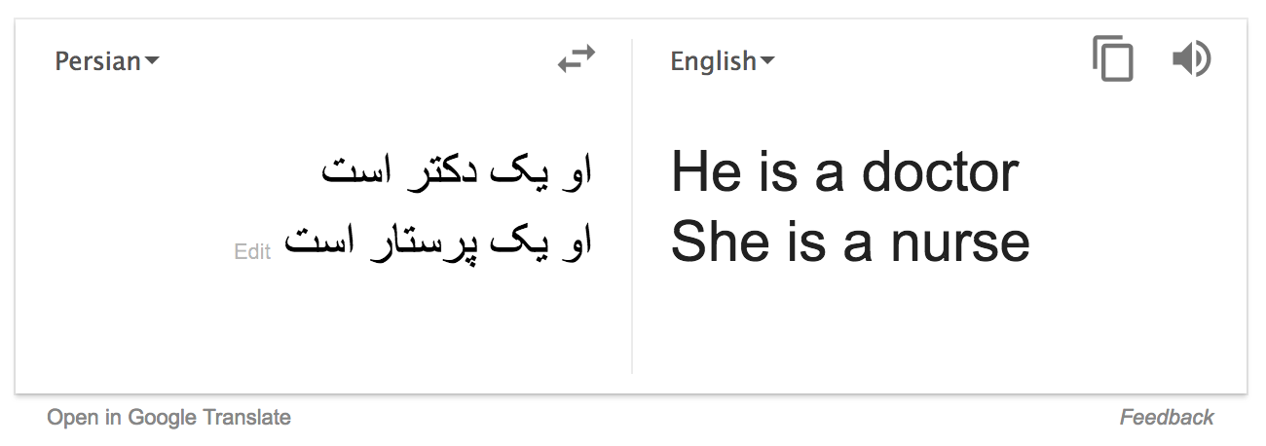

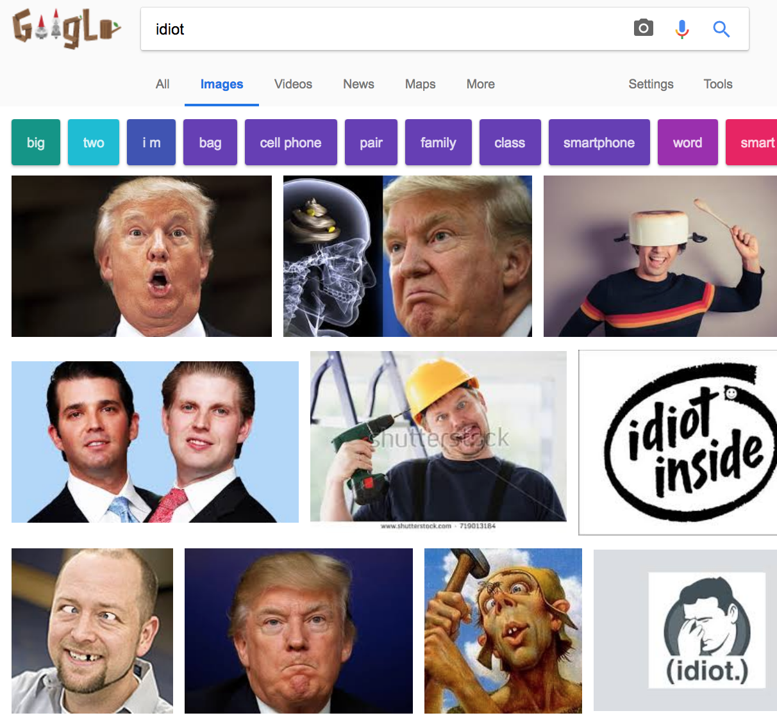
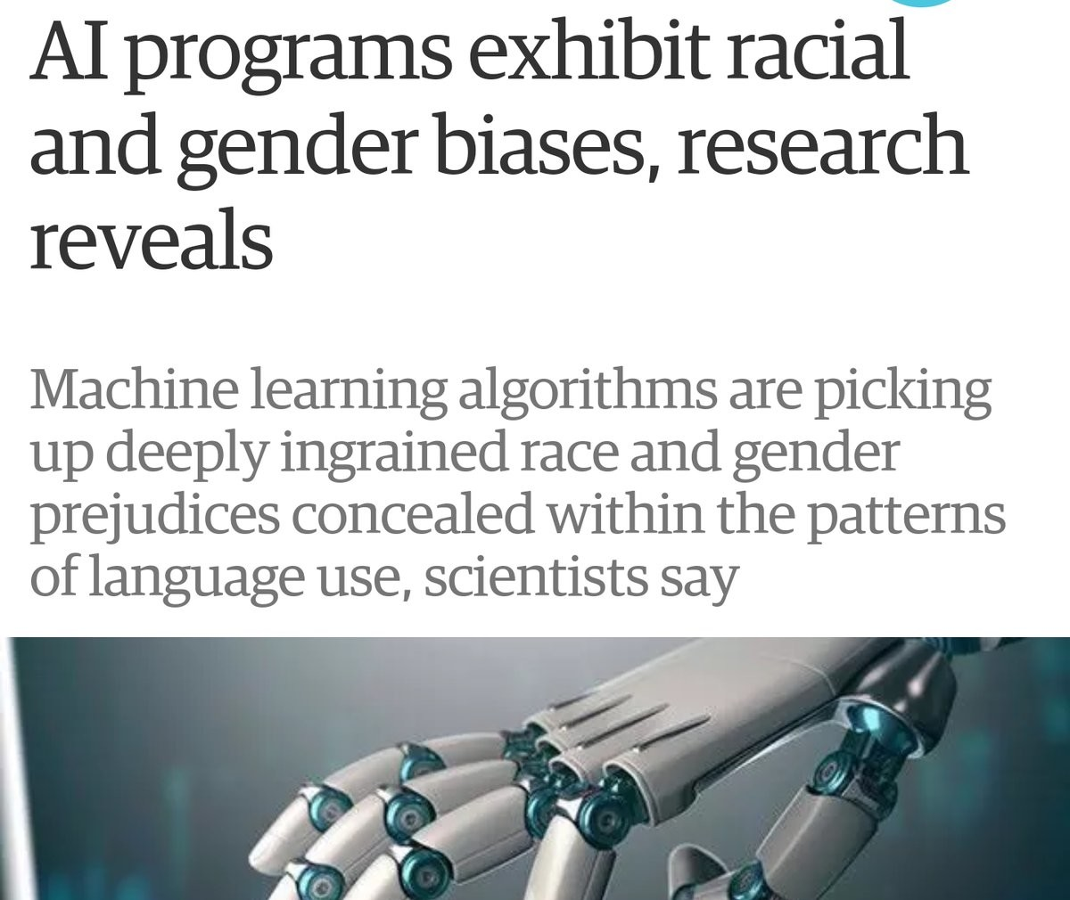
Importance: GIGO(garbage in, garbage out)
Most algorithms are only as good as the quality and accuracy of the training data. If the data is biased or skewed in any way, the resulting algorithm will be, as well.
Notes:
RoboCup aims, by the year 2050, to develop a team of fully autonomous robots that can win against the human world soccer champion team.

Slide 4
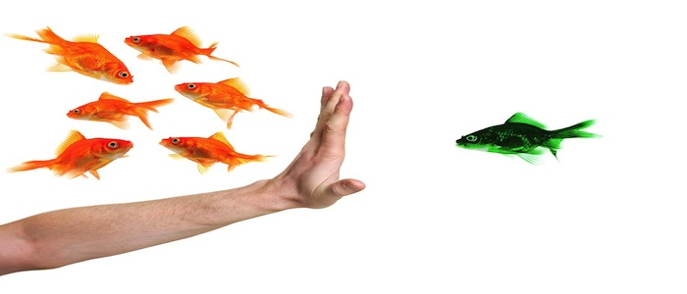
OK, bias is not great, then where is the problem?
Biases in Data
Biases in algorithm
In an ML technical sense, bias refers to systematic differences between sample data and the target population.

Slide 5
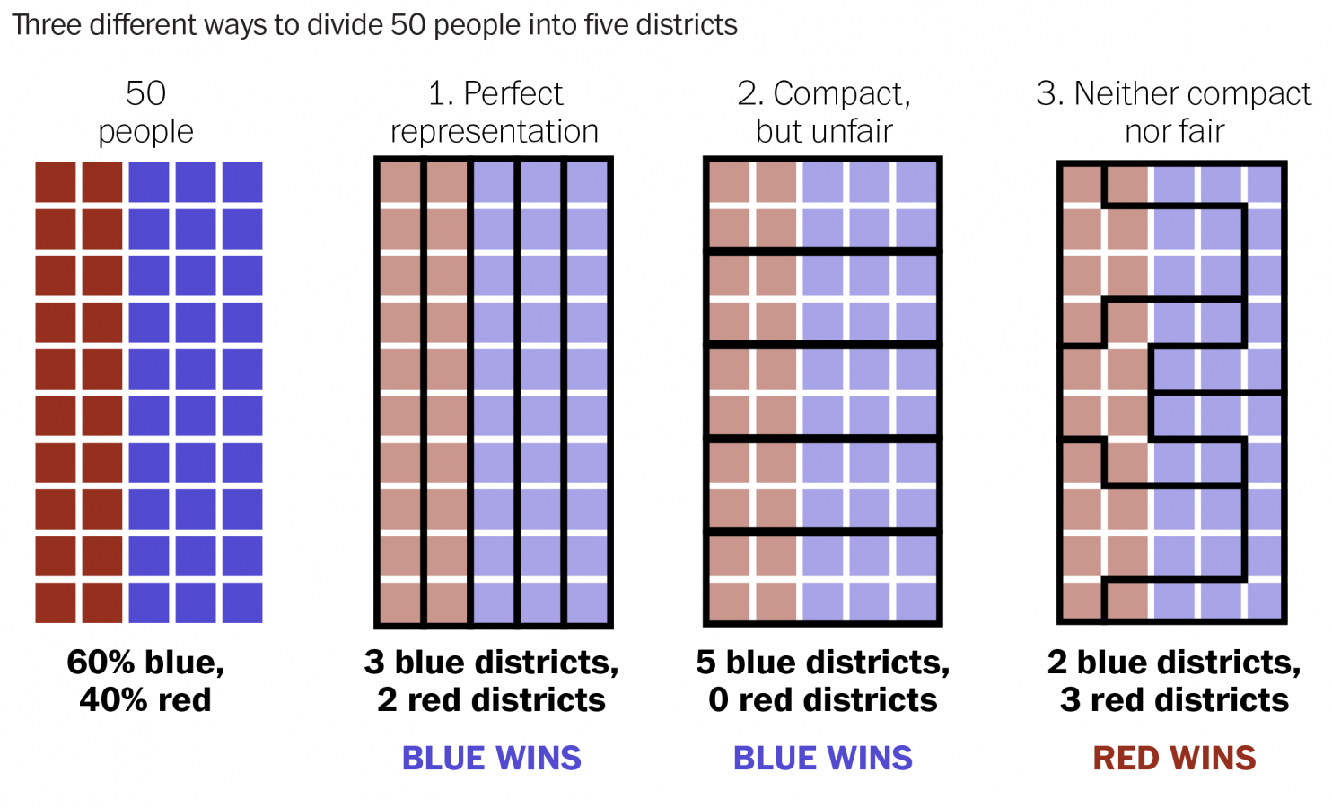
OK, bias is not great, where is the problem?
Bias in Data
Bias in Algorithm (Gerrymandering, not polylines are lines, etc.)
In an ML technical sense, bias refers to systematic differences between sample data and the target population.

Slide 6
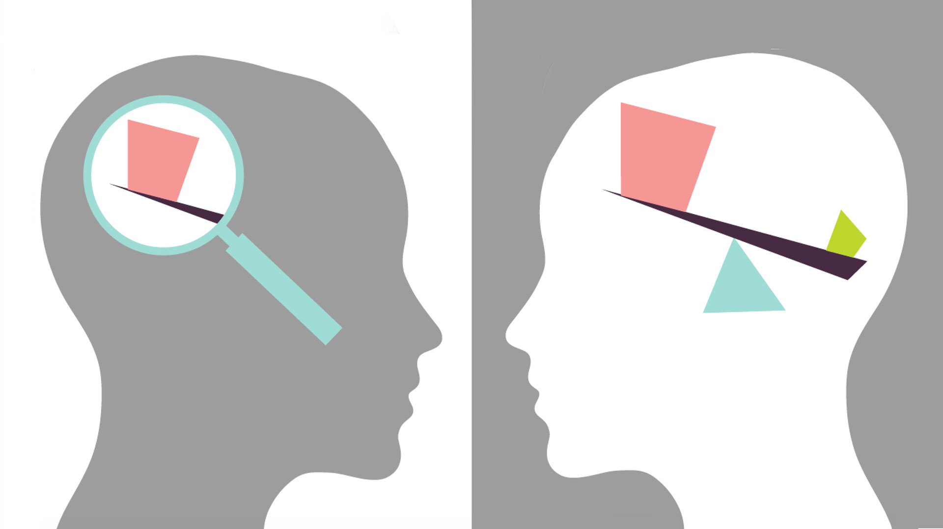
Types and Sources of Biases in Data
Selection Bias (participants)
Information Bias (error remaining in a variable)

Slide 7



Volunteer Sampling Vs Random Sampling

Slide 8


VGI, Crowdsourcing
90-9-1 rule in “crowd”-sourcing projects
Vs.
Notes:
(Mullen et al., 2015; Gardner et. al. 2018; Zhu et al., 2017) have shown that even the most popular crowdsourced projects, such as OSM, are biased by the contribution patterns of its contributors, i.e. that a small percentage of the community contribute the greatest proportion of activity (the ‘long tail effect’ or 90-9-1 rule). This therefore questions the use of the terms “crowd” and “public” used in many crowdsourcing and public participatory projects by virtue of this skewed pattern of participation. This excludes the projects which may require a relatively higher experience level, access to some resources, or may limit participation to a specific geography or particular time interval due to the nature of the project.

Slide 9
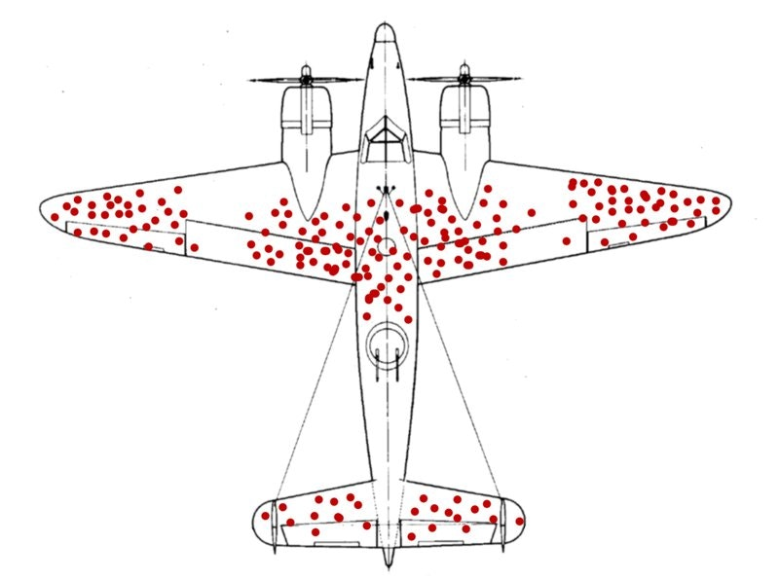
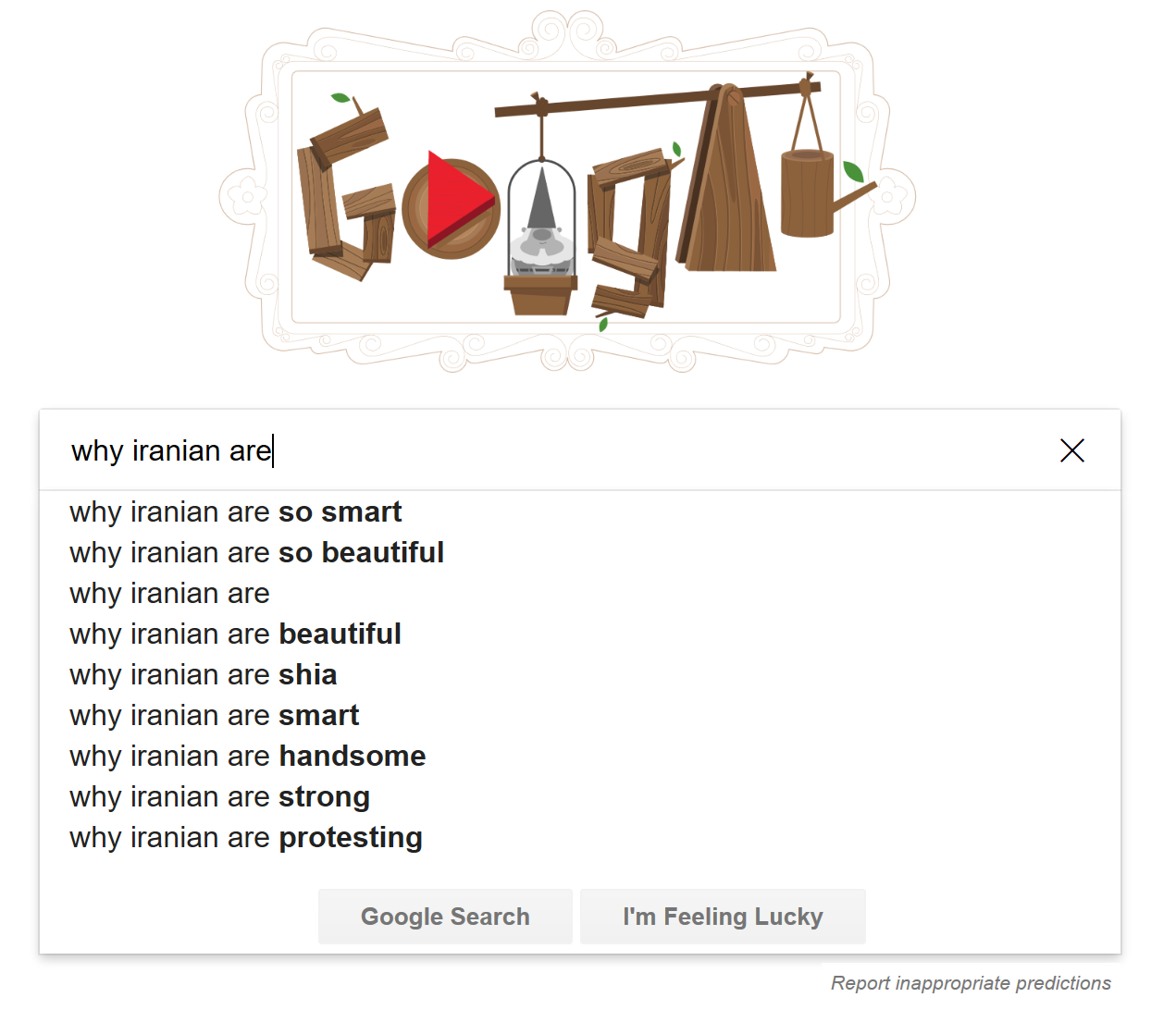
Survival Bias

Slide 10
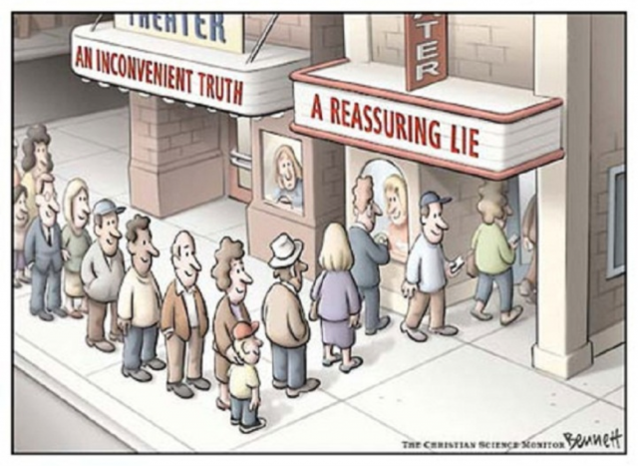
Confirmation and congruence biases
Notes:
Confirmation bias and congruence bias which can occur when a contributor looks for confirmatory patterns or interprets information in a way that confirms their assumptions and passes the hypothesis (Nickerson, 1998).

Slide 11
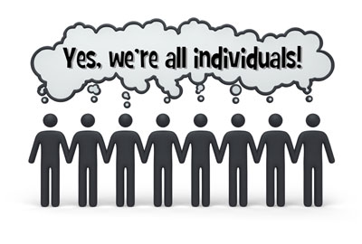
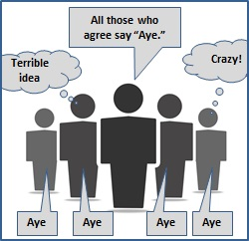
Bandwagon, groupthink and herd behaviour biases
Notes:
Bandwagon bias (also referred to or related to groupthink bias and herd behavior) refers to the tendency of contributors to change their own opinion in favor or due to of an existing group pattern/behaviour to look they believe in the same way (Bikhchandani et al., 1992). This project can see this bias in the geography of the participants’ movements. As shown in figure 1, participants tend to follow the same area/route even though they are allowed to go anywhere within the campus. Although this may be due to common Points of Interest (PoIs) to visit, such as restaurants and lecture theatres, it may also be influenced by bandwagon bias.

Slide 12
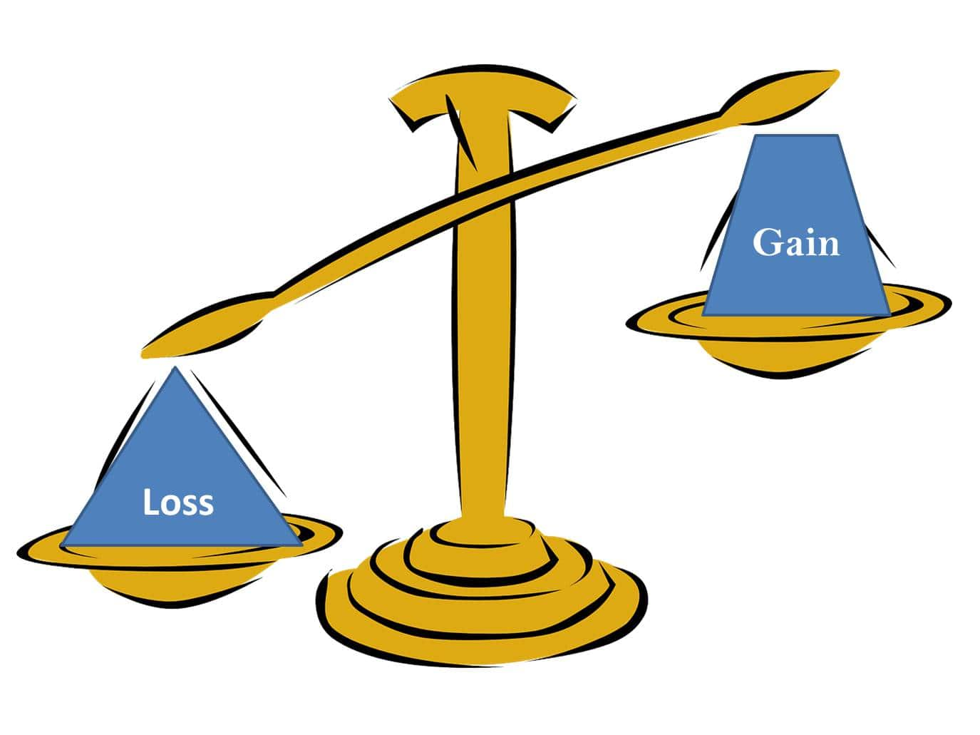
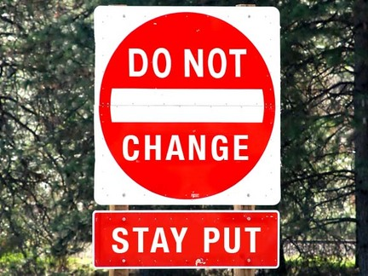
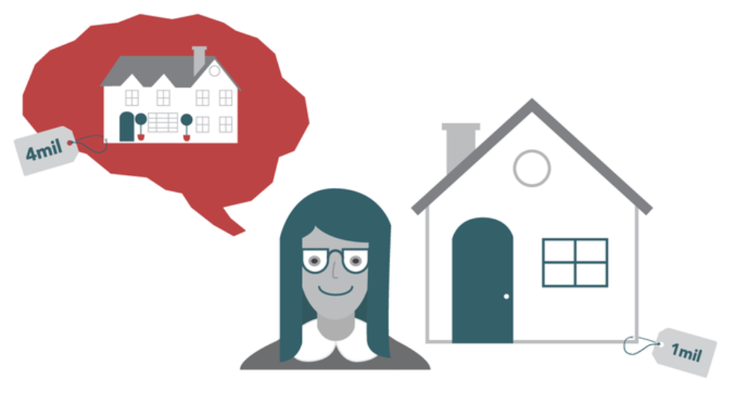


Status quo, loss aversion and endowment biases
Lake Wobegon, self-serving and overconfidence bias

Slide 13
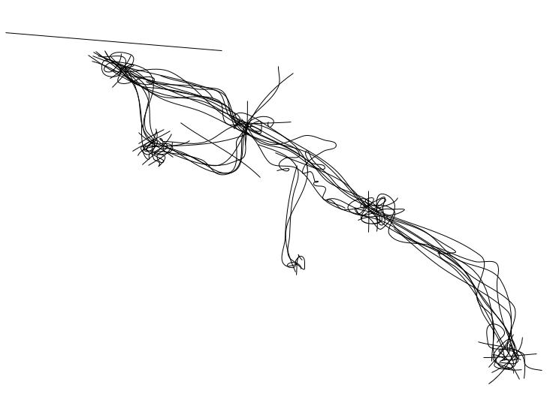
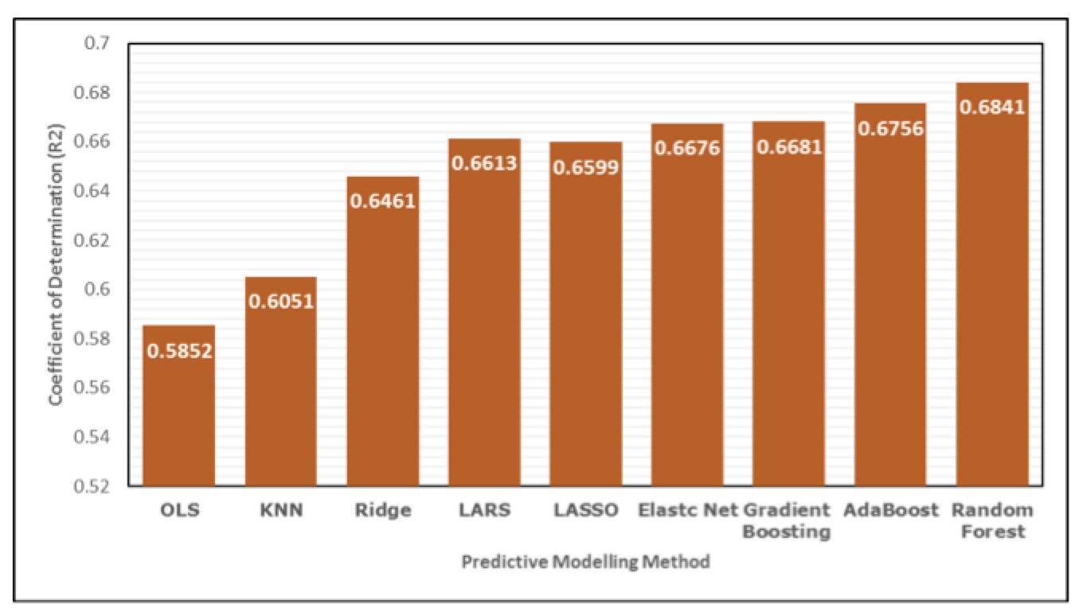
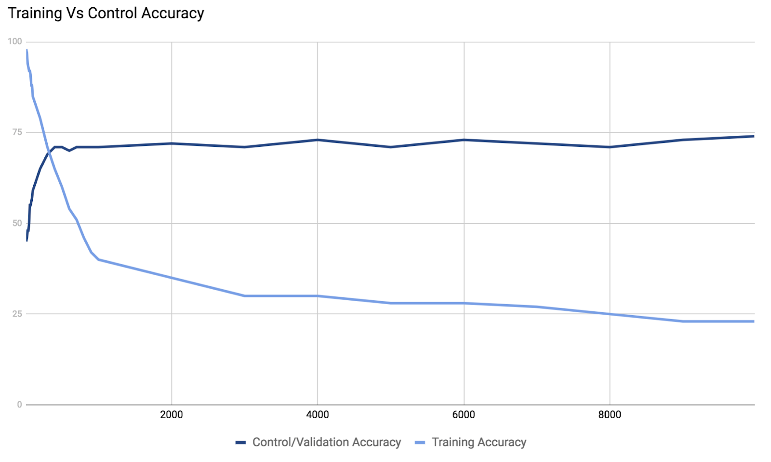
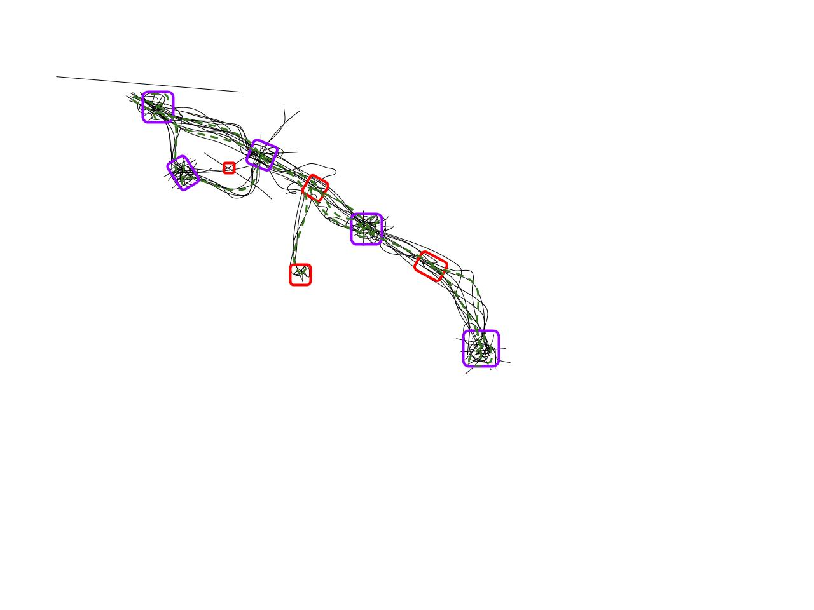
Random vs. Biased selection of Training Data

Slide 14
Final Notes (no, it is NOT a conclusion)
Values of fairness and equality (if matters)
Transparency (but doesn’t necessarily means fairness)
Benchmark training data against established standards of statistical or legal bias.
Once deployed, continue to validate the algorithms periodically, adjust if needed. It is the early days for these technologies, and we must actively “train and supervise” them.
Invite, make it open to a diverse contributors
To get a stratified random sample, start by classifying the population into groups of similar individuals, called strata.
Then choose a separate SRS in each stratum and combine these SRSs to form the sample.

Slide 15
Any question/comment from the crowd?
(oh wait, from whom?!)

Slide 17
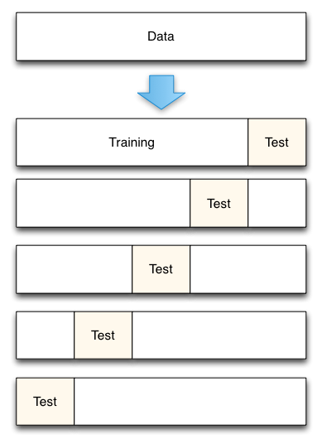
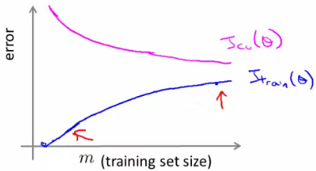
Stepwise fold (5-fold) cross validation

Slide 18
Stratified Random Sample
The basic idea of sampling is straightforward: take an SRS from the population and use your sample results to gain information about the population.
Sometimes there are statistical advantages to using more complex sampling methods.
To get a stratified random sample, start by classifying the population into groups of similar individuals, called strata.
Then choose a separate SRS in each stratum and combine these SRSs to form the sample.
Notes:
One common alternative to an SRS involves sampling important groups (called strata) within the population separately. These “sub-samples” are combined to form one stratified random sample.

Slide 19
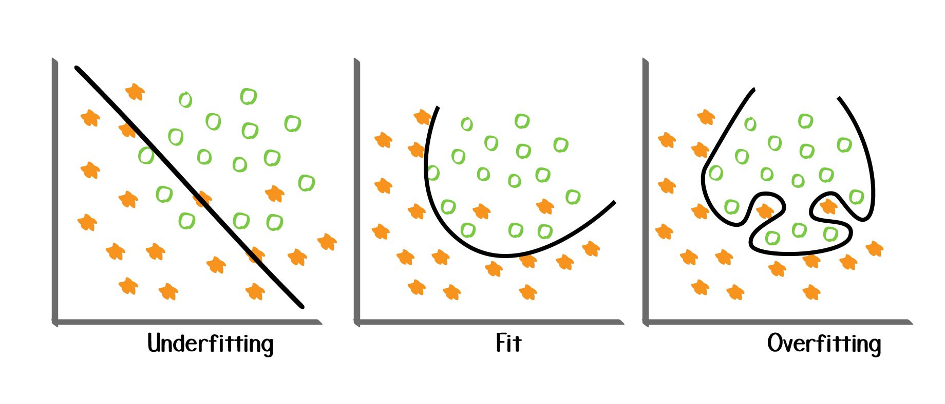

Slide 20


